Slide 1


Slide 2
CHAPTER 27
Introduction to Information Retrieval and Web Search

Slide 3
27.1 Information Retrieval (IR) Concepts
Information retrieval
  Process of retrieving documents from a collection in response to a query (search request)
  Deals mainly with unstructured data
    Example: homebuying contract documents
Unstructured information
  Does not have a well-defined formal model
  Based on an understanding of natural language
  Stored in a wide variety of standard formats

Slide 4
Information Retrieval (IR) Concepts (cont’d.)
Information retrieval field predates database field
  Academic programs in Library and Information Science
RDBMS vendors providing new capabilities to support various data types
  Extended RDBMSs or object-relational database management systems
User’s information need expressed as free-form search request
  Keyword search query

Slide 5
Information Retrieval (IR) Concepts (cont’d.)
Characterizing an IR system
  Types of users
    Expert
    Layperson
  Types of data
    Domain-specific
  Types of information needs
    Navigational search
    Informational search
    Transactional search

Slide 6
Information Retrieval (IR) Concepts (cont’d.)
Enterprise search systems
  Limited to an intranet
Desktop search engines
  Searches an individual computer system
Databases have fixed schemas
  IR system has no fixed data model

Slide 7
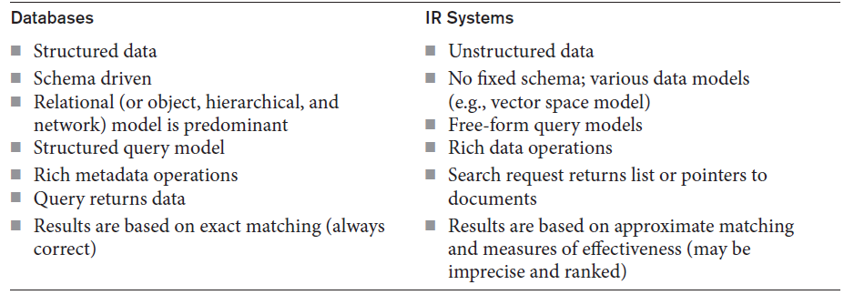
Comparing Databases and IR Systems
Table 27.1 A comparison of databases and IR systems

Slide 8
A Brief History of IR
Stone tablets and papyrus scrolls
Printing press
Public libraries
Computers and automated storage systems
  Inverted file organization based on keywords and their weights as indexing method
Search engine
Crawler
Challenge: provide high quality, pertinent, timely information

Slide 9
Modes of Interactions in IR Systems
Primary modes of interaction
  Retrieval
    Extract relevant information from document repository
  Browsing
    Exploratory activity based on user’s assessment of relevance
Web search combines both interaction modes
  Rank of a web page measures its relevance to query that generated the result set

Slide 10
Generic IR Pipeline
Statistical approach
  Documents analyzed and broken down into chunks of text
  Each word or phrase is counted, weighted, and measured for relevance or importance
Types of statistical approaches
  Boolean
  Vector space
  Probabilistic

Slide 11
Generic IR Pipeline (cont’d.)
Semantic approaches
  Use knowledge-based retrieval techniques
  Rely on syntactic, lexical, sentential, discourse-based, and pragmatic levels of knowledge understanding
  Also apply some form of statistical analysis

Slide 12
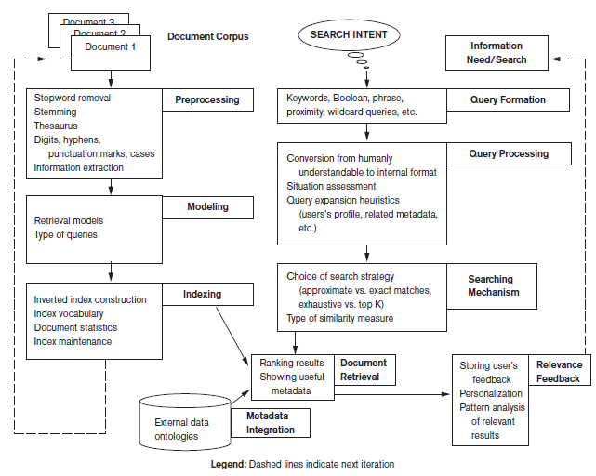
Figure 27.1 Generic IR framework

Slide 13
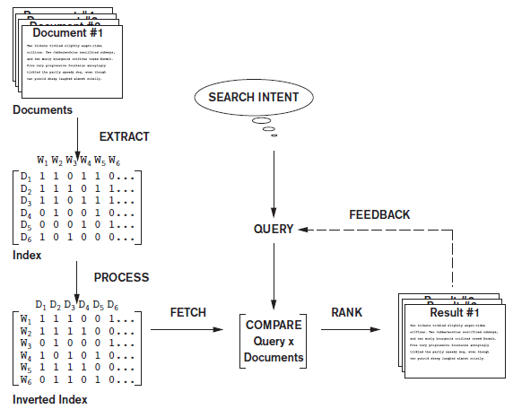
Figure 27.2 Simplified IR process pipeline

Slide 14
27.2 Retrieval Models
Boolean model
  One of earliest and simplest IR models
  Documents represented as a set of terms
  Queries formulated using AND, OR, and NOT
  Retrieved documents are an exact match
    No notion of ranking of documents
  Easy to associate metadata information and write queries that match contents of documents

Slide 15
Retrieval Models (cont’d.)
Vector space model
  Weighting, ranking, and determining relevance are possible
  Uses individual terms as dimensions
  Each document represented by an n-dimensional vector of values
  Features
    Subset of terms in a document set that are deemed most relevant to an IR search for the document set

Slide 16
Retrieval Models (cont’d.)
Vector space model (cont’d.)
  Different similarity assessment functions can be used
Term frequency-inverse document frequency (TF-IDF)
  Statistical weight measure used to evaluate the importance of a document word in a collection of documents
  A discriminating term must occur in only a few documents in the general population

Slide 17
Retrieval Models (cont’d.)
Probabilistic model
  Involves ranking documents by their estimated probability of relevance with respect to the query and the document
  IR system must decide whether a document belongs to the relevant set or nonrelevant set for a query
    Calculate probability that document belongs to the relevant set
  BM25: a popular ranking algorithm

Slide 18
Retrieval Models (cont’d.)
Semantic model
  Morphological analysis
    Analyze roots and affixes to determine parts of speech of search words
  Syntactic analysis
    Parse and analyze complete phrases in documents
  Semantic analysis
    Resolve word ambiguities and generate relevant synonyms based on semantic relationships
  Uses techniques from artificial intelligence and expert systems

Slide 19
27.3 Types of Queries in IR Systems
Keyword queries
  Simplest and most commonly used
  Keyword terms implicitly connected by logical AND
Boolean queries
  Allow use of AND, OR, NOT, and other operators
  Exact matches returned
    No ranking possible

Slide 20
Types of Queries in IR Systems (cont’d.)
Phrase queries
  Sequence of words that make up a phrase
  Phrase enclosed in double quotes
  Each retrieved document must contain at least one instance of the exact phrase
Proximity queries
  How close within a record multiple search terms are to each other
  Phrase search is most commonly used proximity query

Slide 21
Types of Queries in IR Systems (cont’d.)
Proximity queries (cont’d.)
  Specify order of search terms
  NEAR, ADJ (adjacent), or AFTER operators
  Sequence of words with maximum allowed distance between them
  Computationally expensive
    Suitable for smaller document collections rather than the Web

Slide 22
Types of Queries in IR Systems (cont’d.)
Wildcard queries
  Supports regular expressions and pattern-based matching
    Example ‘data*’ would retrieve data, database, dataset, etc.
  Not generally implemented by Web search engines
Natural language queries
  Definitions of textual terms or common facts
  Semantic models can support

Slide 23
27.4 Text Preprocessing
Stopword removal must be performed before indexing
Stopwords
  Words that are expected to occur in 80% or more of the documents of a collection
    Examples: the, of, to, a, and, said, for, that
  Do not contribute much to relevance
Queries preprocessed for stopword removal before retrieval process
  Many search engines do not remove stopwords

Slide 24
Text Preprocessing (cont’d.)
Stemming
  Trims suffix and prefix
  Reduces the different forms of the word to a common stem
  Martin Porter’s stemming algorithm
Utilizing a thesaurus
  Important concepts and main words that describe each concept for a particular knowledge domain
  Collection of synonyms
  UMLS

Slide 25
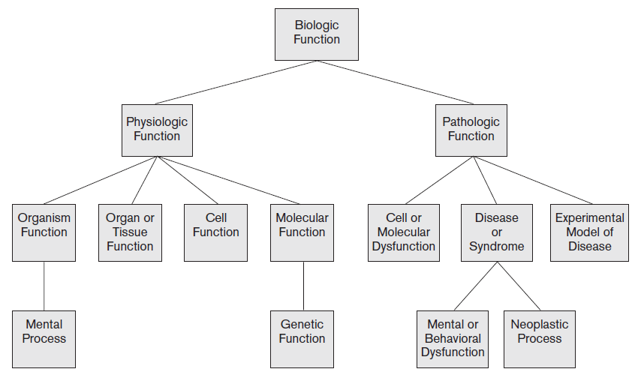
Figure 27.3 A portion of the UMLS Semantic Network: “Biologic Function” Hierarchy
Source: UMLS Reference Manual, National Library of Medicine

Slide 26
Text Preprocessing (cont’d.)
Other preprocessing steps
  Digits
    May or may not be removed during preprocessing
  Hyphens and punctuation marks
    Handled in different ways
  Cases
    Most search engines use case-insensitive search
Information extraction tasks
  Identifying noun phrases, facts, events, people, places, and relationships

Slide 27
27.5 Inverted Indexing
Inverted index structure
  Vocabulary information
    Set of distinct query terms in the document set
  Document information
  Data structure that attaches distinct terms with a list of all documents that contain the term

Slide 28
Inverted Indexing (cont’d.)
Construction of an inverted index
  Break documents into vocabulary terms
    Tokenizing, cleansing, removing stopwords, stemming, and/or using a thesaurus
  Collect document statistics
    Store statistics in document lookup table
  Invert the document-term stream into a term-document stream
    Add additional information such as term frequencies, term positions, and term weights

Slide 29
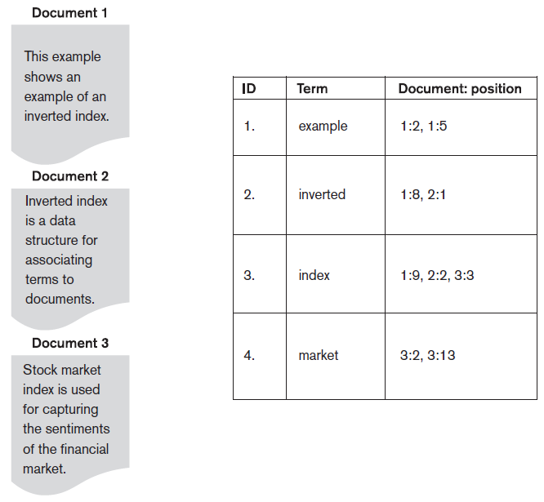
Figure 27.4 Example of an inverted index

Slide 30
Inverted Indexing (cont’d.)
Searching for relevant documents from an inverted index
  Vocabulary search
  Document information retrieval
  Manipulation of retrieved information

Slide 31
Introduction to Lucene
Lucene: open source indexing/search engine
  Indexing is primary focus
Document composed of set of fields
  Chunks of untokenized text
  Series of processed lexical units called token streams
    Created by tokenization and filtering algorithms
Highly-configurable search API
Ease of indexing large, unstructured document collections

Slide 32
27.6 Evaluation Measures of Search Relevance
Topical relevance
  Measures result topic match to query topic
User relevance
  Describes ‘goodness’ of retrieved result with regard to user’s information need
Web information retrieval
  No binary classification made for relevance or nonrelevance
  Ranking of documents

Slide 33
Evaluation Measures of Search Relevance (cont’d.)
Recall
  Number of relevant documents retrieved by a search divided by the total number of actually relevant documents existing in the database
Precision
  Number of relevant documents retrieved by a search divided by total number of documents retrieved by that search

Slide 34
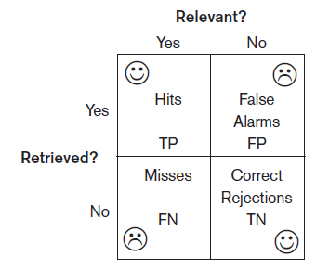
Retrieved Versus Relevant Search Results
TP: true positive
FP: false positive
TN: true negative
FN: false negative
Figure 27.5 Retrieved versus relevant search results

Slide 35
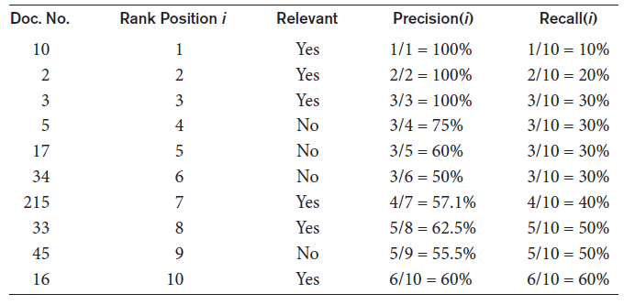
Evaluation Measures of Search Relevance (cont’d.)
Recall can be increased by presenting more results to the user
  May decrease the precision
Table 27.2 Precision and recall for ranked retrieval

Slide 36
Evaluation Measures of Search Relevance (cont’d.)
Average precision
  Computed based on the precision at each relevant document in the ranking
Recall/precision curve
  Based on the recall and precision values at each rank position
    x-axis is recall and y-axis is precision
F-score
  Harmonic mean of the precision (p) and recall (r) values

Slide 37
27.7 Web Search and Analysis
Search engines must crawl and index Web sites and document collections
  Regularly update indexes
  Link analysis used to identify page importance
Vertical search engines
  Customized topic-specific search engines that crawl and index a specific collection of documents on the Web

Slide 38
Web Search and Analysis (cont’d.)
Metasearch engines
  Query different search engines simultaneously and aggregate information
Digital libraries
  Collections of electronic resources and services for the delivery of materials in a variety of formats
Web analysis
  Applies data analysis techniques to discover and analyze useful information from the Web

Slide 39
Web Search and Analysis (cont’d.)
Goals of Web analysis
  Finding relevant information
  Personalization of the information
  Finding information of social value
Categories of Web analysis
  Web structure analysis
  Web content analysis
  Web usage analysis

Slide 40
Web Search and Analysis (cont’d.)
Web structure analysis
  Hyperlink
  Destination page
  Anchor text
  Hub
  Authority
PageRank ranking algorithm
  Used by Google
  Analyzes forward links and backlinks
    Highly linked pages are more important

Slide 41
Web Search and Analysis (cont’d.)
Web content analysis tasks
  Structured data extraction
    Wrapper
  Web information integration
    Web query interface integration
    Schema matching
    Ontology-based information integration
  Building concept hierarchies
  Segmenting web pages and detecting noise

Slide 42
Web Search and Analysis (cont’d.)
Approaches to Web content analysis
  Agent-based
    Intelligent Web agents
    Personalized Web agents
    Information filtering/categorization
  Database-based
    Attempts to organize a Web site as a database
    Object Exchange Model
    Multilevel database
    Web query system

Slide 43
Web Search and Analysis (cont’d.)
Web usage analysis attempts to discover usage patterns from Web data
  Preprocessing
    Usage, content, structure
  Pattern discovery
    Statistical analysis, association rules, clustering, classification, sequential patterns, dependency modeling
  Pattern analysis
    Filter out patterns not of interest

Slide 44
Web Search and Analysis (cont’d.)
Practical applications of Web analysis
  Web analytics
    Understand and optimize the performance of Web usage
  Web spamming
    Deliberate activity to promote a page by manipulating search engine results
  Web security
    Allow design of more robust Web sites
  Web crawlers

Slide 45
27.8 Trends in Information Retrieval
Faceted search
  Classifying content
Social search
  Collaborative social search
Conversational information access
  Intelligent agents perform intent extraction to provide information relevant to a conversation
Probabilistic topic modeling
  Automatically organize large collections of documents into relevant themes

Slide 46
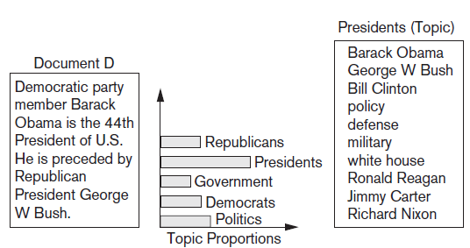
Trends in Information Retrieval (cont’d.)
Figure 27.6 A document D and its topic proportions

Slide 47
Trends in Information Retrieval (cont’d.)
Question-answering systems
  Factoid questions
  List questions
  Definition questions
  Opinion questions
  Composed of question analysis, query generation, search, candidate answer generation, and answer scoring

Slide 48
27.9 Summary
Information retrieval mainly targeted at unstructured data
Query and browsing modes of interaction
Retrieval models
  Boolean, vector space, probabilistic, and semantic
Text preprocessing
Web search
Web ranking
Trends

