Slide 1
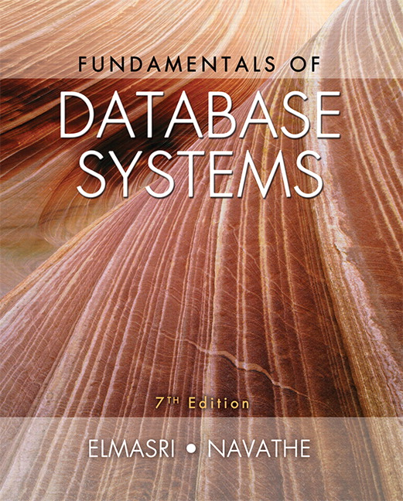

Slide 2
CHAPTER 26
Enhanced Data Models:
Introduction to Active,
Temporal, Spatial, Multimedia,
and Deductive Databases

Slide 3
26.1 Active Database Concepts and Triggers
Database systems implement rules that specify actions automatically triggered by certain events
Triggers
  Technique for specifying certain types of active rules
Commercial relational DBMSs have various versions of triggers available
  Oracle syntax used to illustrate concepts

Slide 4
Generalized Model for Active Databases and Oracle Triggers
Event-condition-action (ECA) model
  Event triggers a rule
    Usually database update operations
  Condition determines whether rule action should be completed
    Optional
    Action will complete only if condition evaluates to true
  Action to be taken
    Sequence of SQL statements, transaction, or external program

Slide 5
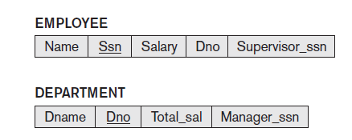
Example
Events that may cause a change in value of Total_sal attribute
  Inserting new employee
  Changing salary
  Reassigning or deleting employees
Figure 26.1 A simplified COMPANY database used for active rule examples

Slide 6
Example (cont’d.)
Condition to be evaluated
  Check that value of Dno attribute is not NULL
Action to be taken
  Automatically update the value of Total_sal

Slide 7
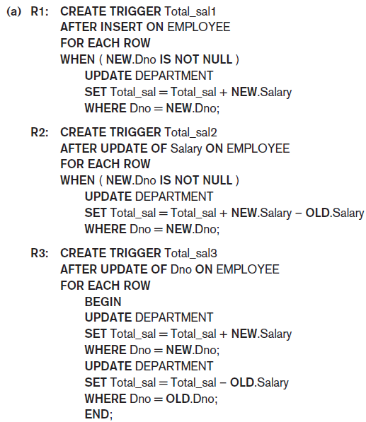
Figure 26.2 Specifying active rules as triggers in Oracle notation (a) Triggers for automatically maintaining the consistency of Total_sal of DEPARTMENT

Slide 8
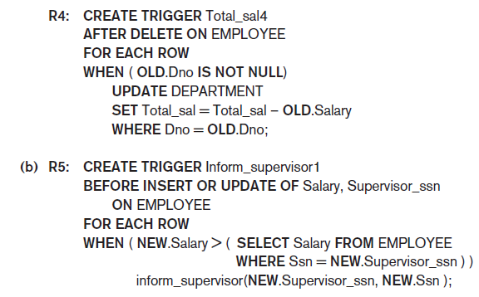
Figure 26.2 (cont’d.) Specifying active rules as triggers in Oracle notation (b) Trigger for comparing an employee’s salary with that of his or her supervisor

Slide 9
Design and Implementation Issues for Active Databases
Deactivated rule
  Will not be triggered by the triggering event
Activate command
  Makes the rule active again
Drop command
  Deletes the rule from the system
Approach: group rules into rule sets
  Entire rule set can be activated, deactivated, or dropped

Slide 10
Design and Implementation Issues for Active Databases (cont’d.)
Timing of action
  Before trigger executes trigger before executing event that caused the trigger
  After trigger executes trigger after executing the event
  Instead of trigger executes trigger instead of executing the event
Action can be considered separate transaction
  Or part of same transaction that triggered the rule

Slide 11
Design and Implementation Issues for Active Databases (cont’d.)
Rule consideration
  Immediate consideration
    Condition evaluated as part of same transaction
    Evaluate condition either before, after, or instead of executing the triggering event
  Deferred consideration
    Condition evaluated at the end of the transaction
  Detached consideration
    Condition evaluated as a separate transaction

Slide 12
Design and Implementation Issues for Active Databases (cont’d.)
Row-level rule
  Rule considered separately for each row
Statement-level rule
  Rule considered once for entire statement
Difficult to guarantee consistency and termination of rules

Slide 13
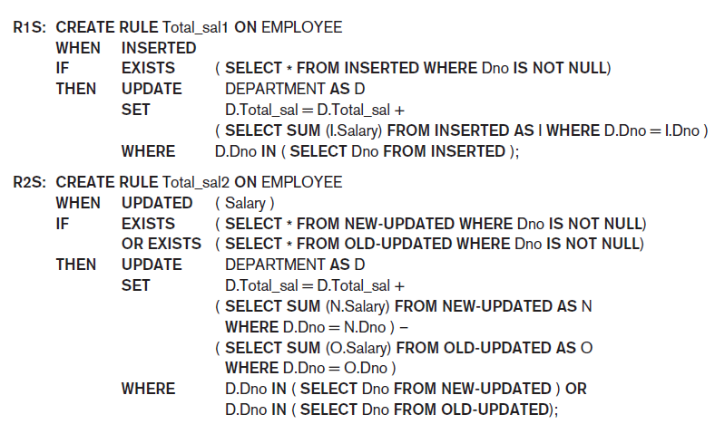
Examples of Statement-Level Active Rules in STARBURST
Figure 26.5 (continues) Active rules using statement-level semantics in STARBURST notation

Slide 14
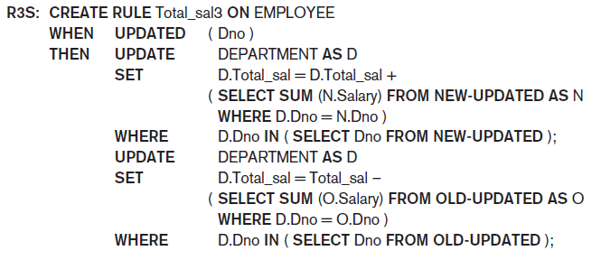
Examples of Statement-Level Active Rules in STARBURST (cont’d.)
Figure 26.5 (cont’d.) Active rules using statement-level semantics in STARBURST notation

Slide 15
Potential Applications for Active Databases
Allow notification of certain conditions that occur
Enforce integrity constraints
Automatically maintain derived data
Maintain consistency of materialized views
Enable consistency of replicated tables

Slide 16
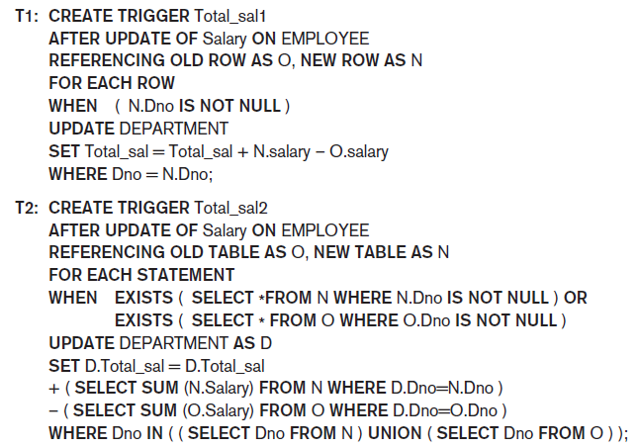
Triggers in SQL-99
Figure 26.6 Trigger T1 illustrating the syntax for defining triggers in SQL-99

Slide 17
26.2 Temporal Database Concepts
Temporal databases require some aspect of time when organizing information
  Healthcare
  Insurance
  Reservation systems
  Scientific databases
Time considered as ordered sequence of points
  Granularity determined by the application

Slide 18
Temporal Database Concepts (cont’d.)
Chronon
  Term used to describe minimal granularity of a particular application
Reference point for measuring specific time events
  Various calendars
SQL2 temporal data types
  DATE, TIME, TIMESTAMP, INTERVAL, PERIOD

Slide 19
Temporal Database Concepts (cont’d.)
Point events or facts
  Typically associated with a single time point
  Time series data
Duration events or facts
  Associated with specific time period
  Time period represented by start and end points
Valid time
  True in the real world

Slide 20
Temporal Database Concepts (cont’d.)
Transaction time
  Value of the system clock when information is valid in the system
User-defined time
Bitemporal database
  Uses valid time and transaction time
Valid time relations
  Used to represent history of changes

Slide 21
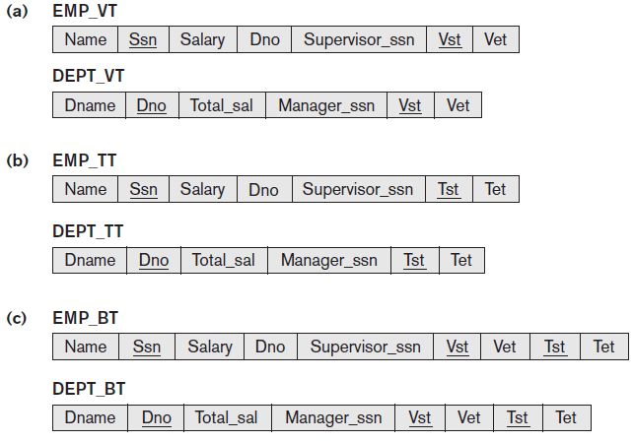
Temporal Database Concepts (cont’d.)
Figure 26.7 Different types of temporal relational databases (a) Valid time database schema (b) Transaction time database schema (c) Bitemporal database schema

Slide 22
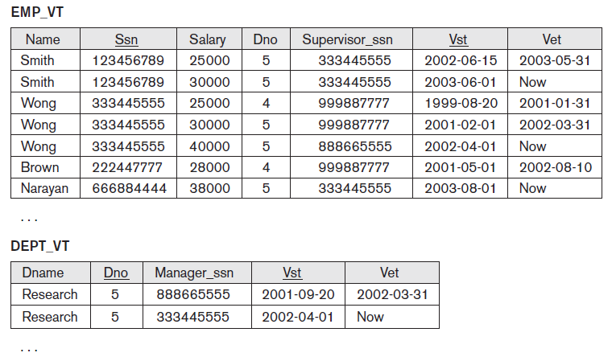
Temporal Database Concepts (cont’d.)
Figure 26.8 Some tuple versions in the valid time relations EMP_VT and DEPT_VT

Slide 23
Temporal Database Concepts (cont’d.)
Types of updates
  Proactive
  Retroactive
  Simultaneous
Timestamp recorded whenever change is applied to database
Bitemporal relations
  Application requires both valid time and transaction time

Slide 24
Temporal Database Concepts (cont’d.)
Implementation considerations
  Store all tuples in the same table
  Create two tables: one for currently valid information and one for the rest
  Vertically partition temporal relation attributes into separate relations
    New tuple created whenever any attribute updated
Append-only database
  Keeps complete record of changes and corrections

Slide 25
Temporal Database Concepts (cont’d.)
Attribute versioning
  Simple complex object used to store all temporal changes of the object
  Time-varying attribute
    Values versioned over time by adding temporal periods to the attribute
  Non-time-varying attribute
    Values do not change over time

Slide 26
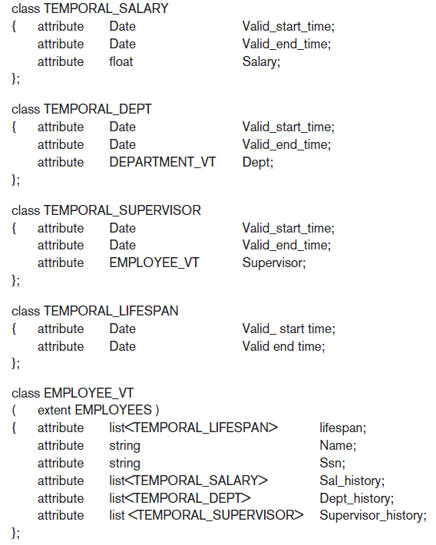
Figure 26.10 Possible ODL schema for a temporal valid time EMPLOYEE_VT object class using attribute versioning

Slide 27
Temporal Database Concepts (cont’d.)
TSQL2 language
  Extends SQL for querying valid time and transaction time tables
  Used to specify whether a relation is temporal or nontemporal
Temporal database query conditions may involve time and attributes
  Pure time condition involves only time
  Attribute and time conditions

Slide 28
Temporal Database Concepts (cont’d.)
CREATE TABLE statement
  Extended with optional AS clause
  Allows users to declare different temporal options
  Examples:
    AS VALID STATE<GRANULARITY> (valid time relation with valid time period)
    AS TRANSACTION (transaction time relation with transaction time period)
Keywords STATE and EVENT
  Specify whether a time period or point is associated with valid time dimension

Slide 29
Temporal Database Concepts (cont’d.)
Time series data
  Often used in financial, sales, and economics applications
  Special type of valid event data
  Event’s time points predetermined according to fixed calendar
  Managed using specialized time series management systems
  Supported by some commercial DBMS packages

Slide 30
26.3 Spatial Database Concepts
Spatial databases support information about objects in multidimensional space
  Examples: cartographic databases, geographic information systems, weather information databases
Spatial relationships among the objects are important
Optimized to query data such as points, lines, and polygons
  Spatial queries

Slide 31
Spatial Database Concepts (cont’d.)
Measurement operations
  Used to measure global properties of single objects
Spatial analysis operations
  Uncover spatial relationships within and among mapped data layers
Flow analysis operations
  Help determine shortest path between two points

Slide 32
Spatial Database Concepts (cont’d.)
Location analysis
  Determine whether given set of points and lines lie within a given polygon
Digital terrain analysis
  Used to build three-dimensional models

Slide 33
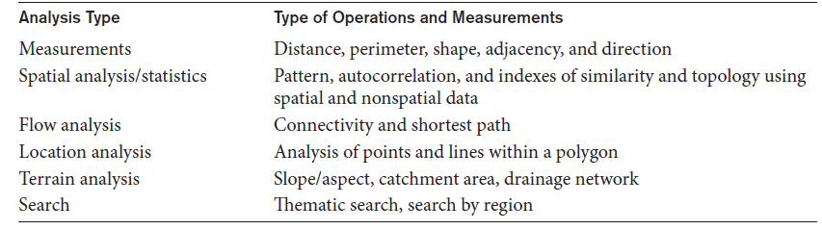
Spatial Database Concepts (cont’d.)
Table 26.1 Common types of analysis for spatial data

Slide 34
Spatial Database Concepts (cont’d.)
Spatial data types
  Map data
    Geographic or spatial features of objects in a map
  Attribute data
    Descriptive data associated with map features
  Image data
    Satellite images
Models of spatial information
  Field models
  Object models

Slide 35
Spatial Database Concepts (cont’d.)
Spatial operator categories
  Topological operators
    Properties do not change when topological transformations applied
  Projective operators
    Express concavity/convexity of objects
  Metric operators
    Specifically describe object’s geometry
  Dynamic spatial operators
    Create, destroy, and update

Slide 36
Spatial Database Concepts (cont’d.)
Spatial queries
  Range queries
    Example: find all hospitals with the Metropolitan Atlanta city area
  Nearest neighbor queries
    Example: find police car nearest location of a crime
  Spatial joins or overlays
    Example: find all homes within two miles of a lake

Slide 37
Spatial Database Concepts (cont’d.)
Spatial data indexing
  Grid files
  R-trees
  Spatial join index
Spatial data mining techniques
  Spatial classification
  Spatial association
  Spatial clustering

Slide 38
26.4 Multimedia Database Concepts
Multimedia databases allow users to store and query images, video, audio, and documents
Content-based retrieval
  Automatic analysis
  Manual identification
  Color often used in content-based image retrieval
  Texture and shape
Object recognition
  Scale-invariant feature transform (SIFT) approach

Slide 39
Multimedia Database Concepts (cont’d.)
Semantic tagging of images
  User-supplied tags
  Automated generation of image tags
  Web Ontology Language (OWL) provides concept hierarchy
Analysis of audio data sources
  Text-based indexing
  Content-based indexing

Slide 40
26.5 Introduction to Deductive Databases
Deductive database uses facts and rules
  Inference engine can deduce new facts using rules
Prolog/Datalog notation
  Based on providing predicates with unique names
  Predicate has an implicit meaning and a fixed number of arguments
    If arguments are all constant values, predicate states that a certain fact is true
    If arguments are variables, considered as a query or part of a rule or constraint

Slide 41
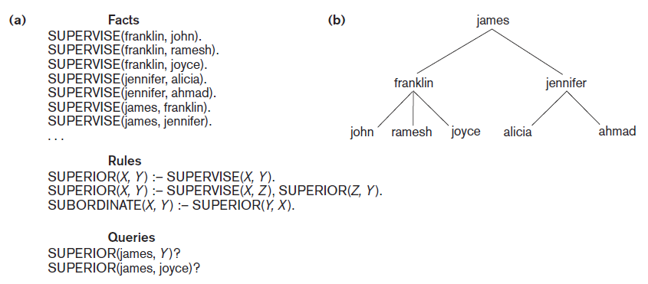
Prolog Notation and The Supervisory Tree
Figure 26.11 (a) Prolog notation (b) The supervisory tree

Slide 42
Introduction to Deductive Databases (cont’d.)
Datalog notation
  Program built from basic objects called atomic formulas
  Literals of the form p(a₁,a₂,…a_{n})
    p is the predicate name
    n is the number of arguments for predicate p
Interpretations of rules
  Proof-theoretic versus model-theoretic
  Deductive axioms
  Ground axioms

Slide 43
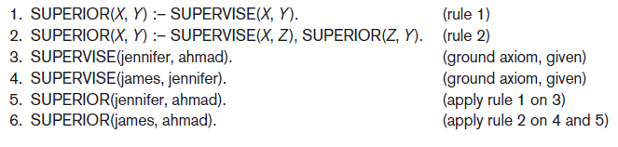
Introduction to Deductive Databases (cont’d.)
Figure 26.12 Proving a new fact

Slide 44
Introduction to Deductive Databases (cont’d.)
Safe program or rule
  Generates a finite set of facts
Nonrecursive query
  Includes only nonrecursive predicates

Slide 45
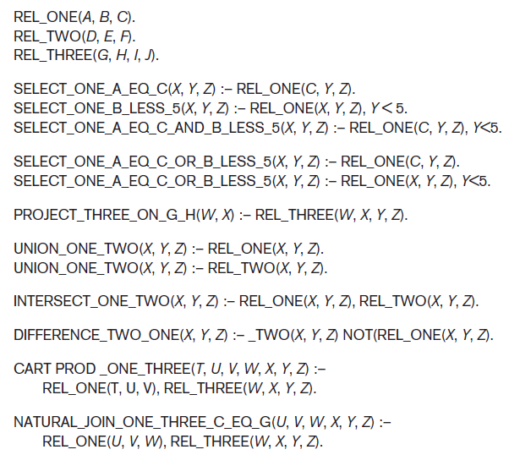
Use of Relational Operations
Figure 26.16 Predicates for illustrating
relational operations

Slide 46
26.6 Summary
Active databases
  Specify active rules
Temporal databases
  Involve time concepts
Spatial databases
  Involve spatial characteristics
Multimedia databases
  Store images, audio, video, documents, and more
Deductive databases
  Prolog and Datalog notation

