Slide 1
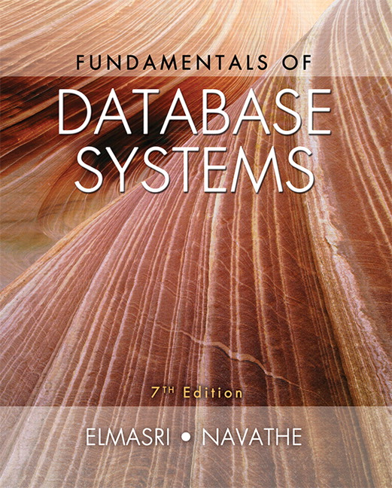

Slide 2
CHAPTER 25
Big Data Technologies Based
on MapReduce and Hadoop

Slide 3
Introduction
Phenomenal growth in data generation
  Social media
  Sensors
  Communications networks and satellite imagery
  User-specific business data
“Big data” refers to massive amounts of data
  Exceeds the typical reach of a DBMS
Big data analytics

Slide 4
25.1 What is Big Data?
Big data ranges from terabytes (10¹² bytes) or petabytes (10¹⁵ bytes) to exobytes (10¹⁸ bytes)
Volume
  Refers to size of data managed by the system
Velocity
  Speed of data creation, ingestion, and processing
Variety
  Refers to type of data source
  Structured, unstructured

Slide 5
What is Big Data? (cont’d.)
Veracity
  Credibility of the source
  Suitability of data for the target audience
  Evaluated through quality testing or credibility analysis

Slide 6
25.2 Introduction to MapReduce and Hadoop
Core components of Hadoop
  MapReduce programming paradigm
  Hadoop Distributed File System (HDFS)
Hadoop originated from quest for open source search engine
  Developed by Cutting and Carafella in 2004
  Cutting joined Yahoo in 2006
  Yahoo spun off Hadoop-centered company in 2011
  Tremendous growth

Slide 7
Introduction to MapReduce and Hadoop (cont’d.)
MapReduce
  Fault-tolerant implementation and runtime environment
  Developed by Dean and Ghemawat at Google in 2004
  Programming style: map and reduce tasks
    Automatically parallelized and executed on large clusters of commodity hardware
  Allows programmers to analyze very large datasets
  Underlying data model assumed: key-value pair

Slide 8
The MapReduce Programming Model
Map
  Generic function that takes a key of type K1 and value of type V1
  Returns a list of key-value pairs of type K2 and V2
Reduce
  Generic function that takes a key of type K2 and a list of values V2 and returns pairs of type (K3, V3)
Outputs from the map function must match the input type of the reduce function

Slide 9
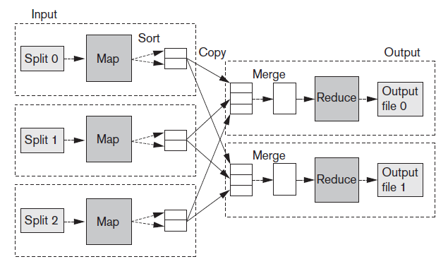
The MapReduce Programming Model (cont’d.)
Figure 25.1 Overview of MapReduce execution (Adapted from T. White, 2012)

Slide 10

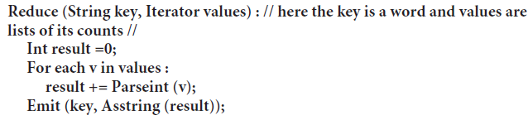
The MapReduce Programming Model (cont’d.)
MapReduce example
  Make a list of frequencies of words in a document
  Pseudocode

Slide 11
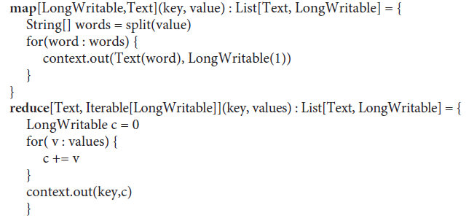
The MapReduce Programming Model (cont’d.)
MapReduce example (cont’d.)
  Actual MapReduce code

Slide 12
The MapReduce Programming Model (cont’d.)
Distributed grep
  Looks for a given pattern in a file
  Map function emits a line if it matches a supplied pattern
  Reduce function is an identity function
Reverse Web-link graph
  Outputs (target URL, source URL) pairs for each link to a target page found in a source page

Slide 13
The MapReduce Programming Model (cont’d.)
Inverted index
  Builds an inverted index based on all words present in a document repository
  Map function parses each document
    Emits a sequence of (word, document_id) pairs
  Reduce function takes all pairs for a given word and sorts them by document_id
Job
  Code for Map and Reduce phases, a set of artifacts, and properties

Slide 14
The MapReduce Programming Model (cont’d.)
Hadoop releases
  1.x features
    Continuation of the original code base
    Additions include security, additional HDFS and MapReduce improvements
  2.x features
    YARN (Yet Another Resource Navigator)
    A new MR runtime that runs on top of YARN
    Improved HDFS that supports federation and increased availability

Slide 15
25.3 Hadoop Distributed File System (HDFS)
HDFS
  File system component of Hadoop
  Designed to run on a cluster of commodity hardware
  Patterned after UNIX file system
  Provides high-throughput access to large datasets
  Stores metadata on NameNode server
  Stores application data on DataNode servers
    File content replicated on multiple DataNodes

Slide 16
Hadoop Distributed File System (cont’d.)
HDFS design assumptions and goals
  Hardware failure is the norm
  Batch processing
  Large datasets
  Simple coherency model
HDFS architecture
  Master-slave
  Decouples metadata from data operations
  Replication provides reliability and high availability
  Network traffic minimized

Slide 17
Hadoop Distributed File System (cont’d.)
NameNode
  Maintains image of the file system
    i-nodes and corresponding block locations
  Changes maintained in write-ahead commit log called Journal
Secondary NameNodes
  Checkpointing role or backup role
DataNodes
  Stores blocks in node’s native file system
  Periodically reports state to the NameNode

Slide 18
Hadoop Distributed File System (cont’d.)
File I/O operations
  Single-writer, multiple-reader model
  Files cannot be updated, only appended
  Write pipeline set up to minimize network utilization
Block placement
  Nodes of Hadoop cluster typically spread across many racks
    Nodes on a rack share a switch

Slide 19
Hadoop Distributed File System (cont’d.)
Replica management
  NameNode tracks number of replicas and block location
    Based on block reports
  Replication priority queue contains blocks that need to be replicated
HDFS scalability
  Yahoo cluster achieved 14 petabytes, 4000 nodes, 15k clients, and 600 million files

Slide 20
The Hadoop Ecosystem
Related projects with additional functionality
  Pig and hive
    Provides higher-level interface for working with Hadoop framework
  Oozie
    Service for scheduling and running workflows of jobs
  Sqoop
    Library and runtime environment for efficiently moving data between relational databases and HDFS

Slide 21
The Hadoop Ecosystem (cont’d.)
Related projects with additional functionality (cont’d.)
  HBase
    Column-oriented key-value store that uses HDFS

Slide 22
25.4 MapReduce: Additional Details
MapReduce runtime environment
  JobTracker
    Master process
    Responsible for managing the life cycle of Jobs and scheduling Tasks on the cluster
  TaskTracker
    Slave process
    Runs on all Worker nodes of the cluster

Slide 23
MapReduce: Additional Details (cont’d.)
Overall flow of a MapReduce job
  Job submission
  Job initialization
  Task assignment
  Task execution
  Job completion

Slide 24
MapReduce: Additional Details (cont’d.)
Fault tolerance in MapReduce
  Task failure
    Runtime exception
    Java virtual machine crash
    No timely updates from the task process
  TaskTracker failure
    Crash or disconnection from JobTracker
    Failed Tasks are rescheduled
  JobTracker failure
    Not a recoverable failure in Hadoop v1

Slide 25
MapReduce: Additional Details (cont’d.)
The shuffle procedure
  Reducers get all the rows for a given key together
  Map phase
    Background thread partitions buffered rows based on the number of Reducers in the job and the Partitioner
    Rows sorted on key values
    Comparator or Combiner may be used
  Copy phase
  Reduce phase

Slide 26
MapReduce: Additional Details (cont’d.)
Job scheduling
  JobTracker schedules work on cluster nodes
  Fair Scheduler
    Provides fast response time to small jobs in a Hadoop shared cluster
  Capacity Scheduler
    Geared to meet needs of large enterprise customers

Slide 27
MapReduce: Additional Details (cont’d.)
Strategies for equi-joins in MapReduce environment
  Sort-merge join
  Map-side hash join
  Partition join
  Bucket joins
  N-way map-side joins
  Simple N-way joins

Slide 28
MapReduce: Additional Details (cont’d.)
Apache Pig
  Bridges the gap between declarative-style interfaces such as SQL, and rigid style required by MapReduce
  Designed to solve problems such as ad hoc analyses of Web logs and clickstreams
  Accommodates user-defined functions

Slide 29
MapReduce: Additional Details (cont’d.)
Apache Hive
  Provides a higher-level interface to Hadoop using SQL-like queries
  Supports processing of aggregate analytical queries typical of data warehouses
  Developed at Facebook

Slide 30
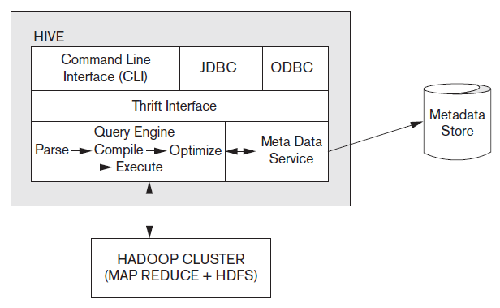
Hive System Architecture and Components
Figure 25.2 Hive system architecture and components

Slide 31
Advantages of the Hadoop/MapReduce Technology
Disk seek rate a limiting factor when dealing with very large data sets
  Limited by disk mechanical structure
Transfer speed is an electronic feature and increasing steadily
MapReduce processes large datasets in parallel
MapReduce handles semistructured data and key-value datasets more easily
Linear scalability

Slide 32
25.5 Hadoop v2 (Alias YARN)
Reasons for developing Hadoop v2
  JobTracker became a bottleneck
  Cluster utilization less than desirable
  Different types of applications did not fit into the MR model
  Difficult to keep up with new open source versions of Hadoop

Slide 33
YARN Architecture
Separates cluster resource management from Jobs management
ResourceManager and NodeManager together form a platform for hosting any application on YARN
ApplicationMasters send ResourceRequests to the ResourceManager which then responds with cluster Container leases
NodeManager responsible for managing Containers on their nodes

Slide 34
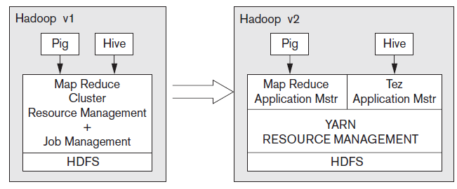
Hadoop Version Schematics
Figure 25.3 The Hadoop v1 vs. Hadoop v2 schematic

Slide 35
Other Frameworks on YARN
Apache Tez
  Extensible framework being developed at Hortonworks for building high-performance applications in YARN
Apache Giraph
  Open-source implementation of Google’s Pregel system, a large-scale graph processing system used to calculate Page-Rank
Hoya: HBase on YARN
  More flexibility and improved cluster utilization

Slide 36
25.6 General Discussion
Hadoop/MapReduce versus parallel RDBMS
  2009: performance of two approaches measured
    Parallel database took longer to tune compared to MR
    Performance of parallel database 3-6 times faster than MR
    MR improvements since 2009
  Hadoop has upfront cost advantage
    Open source platform

Slide 37
General Discussion (cont’d.)
MR able to handle semistructured datasets
Support for unstructured data on the rise in RDBMSs
Higher level language support
  SQL for RDBMSs
  Hive has incorporated SQL features in HiveQL
Fault-tolerance: advantage of MR-based systems

Slide 38
General Discussion (cont’d.)
Big data somewhat dependent on cloud technology
Cloud model offers flexibility
  Scaling out and scaling up
  Distributed software and interchangeable resources
  Unpredictable computing needs not uncommon in big data projects
  High availability and durability

Slide 39
General Discussion (cont’d.)
Data locality issues
  Network load a concern
  Self-configurable, locality-based data and virtual machine management framework proposed
    Enables access of data locally
  Caching techniques also improve performance
Resource optimization
  Challenge: optimize globally across all jobs in the cloud rather than per-job resource optimizations

Slide 40
General Discussion (cont’d.)
YARN as a data service platform
  Emerging trend: Hadoop as a data lake
    Contains significant portion of enterprise data
    Processing happens
  Support for SQL in Hadoop is improving
Apache Storm
  Distributed scalable streaming engine
  Allows users to process real-time data feeds
Storm on YARN and SAS on YARN

Slide 41
General Discussion (cont’d.)
Challenges faced by big data technologies
  Heterogeneity of information
  Privacy and confidentiality
  Need for visualization and better human interfaces
  Inconsistent and incomplete information

Slide 42
General Discussion (cont’d.)
Building data solutions on Hadoop
  May involve assembling ETL (extract, transform, load) processing, machine learning, graph processing, and/or report creation
  Programming models and metadata not unified
    Analytics application developers must try to integrate services into coherent solution
Cluster a vast resource of main memory and flash storage
  In-memory data engines
  Spark platform from Databricks

Slide 43
25.7 Summary
Big data technologies at the center of data analytics and machine learning applications
MapReduce
Hadoop Distributed File System
Hadoop v2 or YARN
  Generic data services platform
MapReduce/Hadoop versus parallel DBMSs

