Slide 1
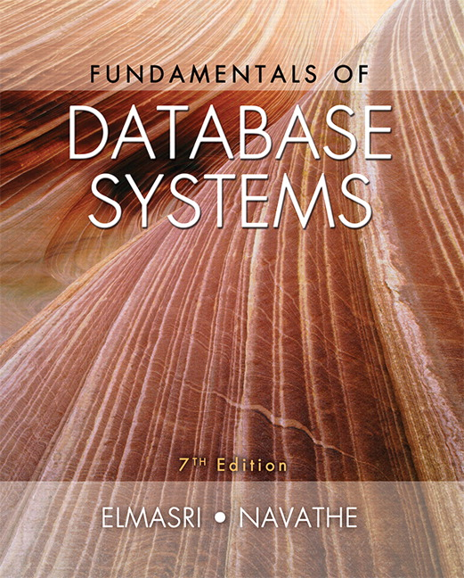

Slide 2
CHAPTER 23
Distributed Database Concepts

Slide 3
Introduction
Distributed computing system
  Consists of several processing sites or nodes interconnected by a computer network
  Nodes cooperate in performing certain tasks
  Partitions large task into smaller tasks for efficient solving
Big data technologies
  Combine distributed and database technologies
  Deal with mining vast amounts of data

Slide 4
23.1 Distributed Database Concepts
What constitutes a distributed database?
  Connection of database nodes over computer network
  Logical interrelation of the connected databases
  Possible absence of homogeneity among connected nodes
Distributed database management system (DDBMS)
  Software system that manages a distributed database

Slide 5
Distributed Database Concepts (cont’d.)
Local area network
  Hubs or cables connect sites
Long-haul or wide area network
  Telephone lines, cables, wireless, or satellite connections
Network topology defines communication path
Transparency
  Hiding implementation details from the end user

Slide 6
Transparency
Types of transparency
  Data organization transparency
    Location transparency
    Naming transparency
  Replication transparency
  Fragmentation transparency
    Horizontal fragmentation
    Vertical fragmentation
  Design transparency
  Execution transparency

Slide 7
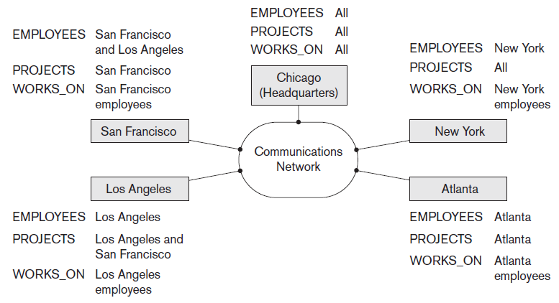
Distributed Databases
Figure 23.1 Data distribution and replication among distributed databases

Slide 8
Availability and Reliability
Availability
  Probability that the system is continuously available during a time interval
Reliability
  Probability that the system is running (not down) at a certain time point
Both directly related to faults, errors, and failures
Fault-tolerant approaches

Slide 9
Scalability and Partition Tolerance
Horizontal scalability
  Expanding the number of nodes in a distributed system
Vertical scalability
  Expanding capacity of the individual nodes
Partition tolerance
  System should have the capacity to continue operating while the network is partitioned

Slide 10
Autonomy
Determines extent to which individual nodes can operate independently
Design autonomy
  Independence of data model usage and transaction management techniques among nodes
Communication autonomy
  Determines the extent to which each node can decide on sharing information with other nodes
Execution autonomy
  Independence of users to act as they please

Slide 11
Advantages of Distributed Databases
Improved ease and flexibility of application development
  Development at geographically dispersed sites
Increased availability
  Isolate faults to their site of origin
Improved performance
  Data localization
Easier expansion via scalability
  Easier than in non-distributed systems

Slide 12
23.2 Data Fragmentation, Replication, and Allocation Techniques for Distributed Database Design
Fragments
  Logical units of the database
Horizontal fragmentation (sharding)
  Horizontal fragment or shard of a relation is a subset of the tuples in that relation
  Can be specified by condition on one or more attributes or by some other method
  Groups rows to create subsets of tuples
    Each subset has a certain logical meaning

Slide 13
Data Fragmentation (cont’d.)
Vertical fragmentation
  Divides a relation vertically by columns
  Keeps only certain attributes of the relation
Complete horizontal fragmentation
  Apply UNION operation to the fragments to reconstruct relation
Complete vertical fragmentation
  Apply OUTER UNION or FULL OUTER JOIN operation to reconstruct relation

Slide 14
Data Fragmentation (cont’d.)
Mixed (hybrid) fragmentation
  Combination of horizontal and vertical fragmentations
Fragmentation schema
  Defines a set of fragments that includes all attributes and tuples in the database
Allocation schema
  Describes the allocation of fragments to nodes of the DDBS

Slide 15
Data Replication and Allocation
Fully replicated distributed database
  Replication of whole database at every site in distributed system
  Improves availability remarkably
  Update operations can be slow
Nonredundant allocation (no replication)
  Each fragment is stored at exactly one site

Slide 16
Data Replication and Allocation (cont’d.)
Partial replication
  Some fragments are replicated and others are not
  Defined by replication schema
Data allocation (data distribution)
  Each fragment assigned to a particular site in the distributed system
  Choices depend on performance and availability goals of the system

Slide 17
Example of Fragmentation, Allocation, and Replication
Company with three computer sites
  One for each department
  Expect frequent access by employees working in the department and projects controlled by that department
See Figures 23.2 and 23.3 in the text for example fragmentation among the three sites

Slide 18
23.3 Overview of Concurrency Control and Recovery in Distributed Databases
Problems specific to distributed DBMS environment
  Multiple copies of the data items
  Failure of individual sites
  Failure of communication links
  Distributed commit
  Distributed deadlock

Slide 19
Distributed Concurrency Control Based on a Distinguished Copy of a Data Item
Particular copy of each data item designated as distinguished copy
  Locks are associated with the distinguished copy
Primary site technique
  All distinguished copies kept at the same site
Primary site with backup site
  Locking information maintained at both sites
Primary copy method
  Distributes the load of lock coordination among various sites

Slide 20
Distributed Concurrency Control Based on Voting
Voting method
  No distinguished copy
  Lock requests sent to all sites that contain a copy
  Each copy maintains its own lock
  If transaction that requests a lock is granted that lock by a majority of the copies, it holds the lock on all copies
  Time-out period applies
  Results in higher message traffic among sites

Slide 21
Distributed Recovery
Difficult to determine whether a site is down without exchanging numerous messages with other sites
Distributed commit
  When a transaction is updating data at several sties, it cannot commit until certain its effect on every site cannot be lost
  Two-phase commit protocol often used to ensure correctness

Slide 22
23.4 Overview of Transaction Management in Distributed Databases
Global transaction manager
  Supports distributed transactions
  Role temporarily assumed by site at which transaction originated
    Coordinates execution with transaction managers at multiple sites
  Passes database operations and associated information to the concurrency controller
    Controller responsible for acquisition and release of locks

Slide 23
Commit Protocols
Two-phase
  Coordinator maintains information needed for recovery
    In addition to local recovery managers
Three-phase
  Divides second commit phase into two subphases
    Prepare-to-commit phase communicates result of the vote phase
    Commit subphase same as two-phase commit counterpart

Slide 24
23.5 Query Processing and Optimization in Distributed Databases
Stages of a distributed database query
  Query mapping
    Refers to global conceptual schema
  Localization
    Maps the distributed query to separate queries on individual fragments
  Global query optimization
    Strategy selected from list of candidates
  Local query optimization
    Common to all sites in the DDB

Slide 25
Query Processing and Optimization in Distributed Databases (cont’d.)
Data transfer costs of distributed query processing
  Cost of transferring intermediate and final result files
Optimization criterion: reducing amount of data transfer

Slide 26
Query Processing and Optimization in Distributed Databases (cont’d.)
Distributed query processing using semijoin
  Reduces the number of tuples in a relation before transferring it to another site
  Send the joining column of one relation R to one site where the other relation S is located
  Join attributes and result attributes shipped back to original site
  Efficient solution to minimizing data transfer

Slide 27
Query Processing and Optimization in Distributed Databases (cont’d.)
Query and update decomposition
  User can specify a query as if the DBMS were centralized
    If full distribution, fragmentation, and replication transparency are supported
  Query decomposition module
    Breaks up a query into subqueries that can be executed at the individual sites
    Strategy for combining results must be generated
  Catalog stores attribute list and/or guard condition

Slide 28
23.6 Types of Distributed Database Systems
Factors that influence types of DDBMSs
  Degree of homogeneity of DDBMS software
    Homogeneous
    Heterogeneous
  Degree of local autonomy
    No local autonomy
    Multidatabase system has full local autonomy
Federated database system (FDBS)
  Global view or schema of the federation of databases is shared by the applications

Slide 29
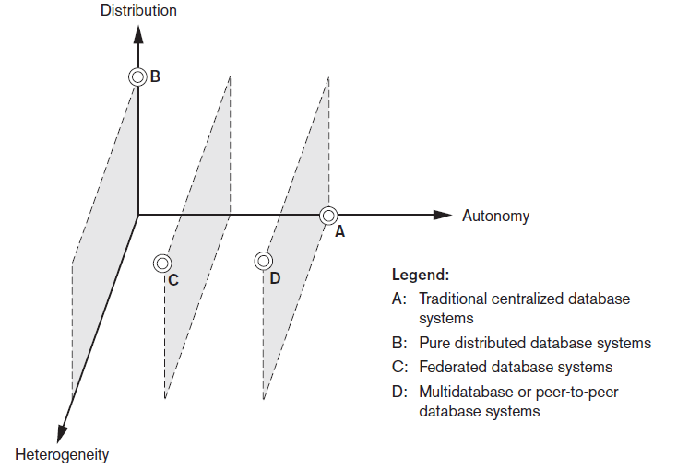
Classification of Distributed Databases
Figure 23.6 Classification of distributed databases

Slide 30
Types of Distributed Database Systems (cont’d.)
Federated database management systems issues
  Differences in data models
  Differences in constraints
  Differences in query languages
Semantic heterogeneity
  Differences in meaning, interpretation, and intended use of the same or related data

Slide 31
Types of Distributed Database Systems (cont’d.)
Design autonomy allows definition of the following parameters
  The universe of discourse from which the data is drawn
  Representation and naming
  Understanding, meaning, and subjective interpretation of data
  Transaction and policy constraints
  Derivation of summaries

Slide 32
Types of Distributed Database Systems (cont’d.)
Communication autonomy
  Decide whether to communicate with another component DBS
Execution autonomy
  Execute local operations without interference from external operations by other component DBSs
  Ability to decide order of execution
Association autonomy
  Decide whether and how much to share its functionality and resources

Slide 33
23.7 Distributed Database Architectures
Parallel versus distributed architectures
Types of multiprocessor system architectures
  Shared memory (tightly coupled)
  Shared disk (loosely coupled)
  Shared-nothing

Slide 34
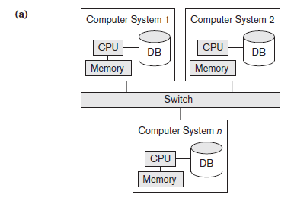
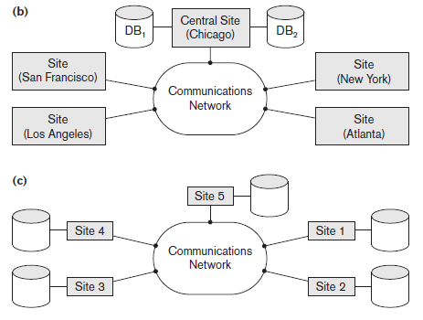
Database System Architectures
Figure 23.7 Some different database system architectures (a) Shared-nothing architecture (b) A networked architecture with a centralized database at one of the sites (c) A truly distributed database architecture

Slide 35
General Architecture of Pure Distributed Databases
Global query compiler
  References global conceptual schema from the global system catalog to verify and impose defined constraints
Global query optimizer
  Generates optimized local queries from global queries
Global transaction manager
  Coordinates the execution across multiple sites with the local transaction managers

Slide 36
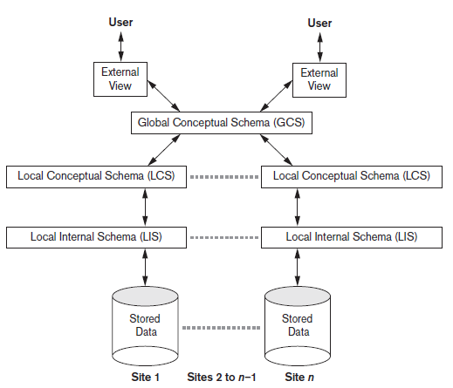
Schema Architecture of Distributed Databases
Figure 23.8 Schema architecture of distributed databases

Slide 37
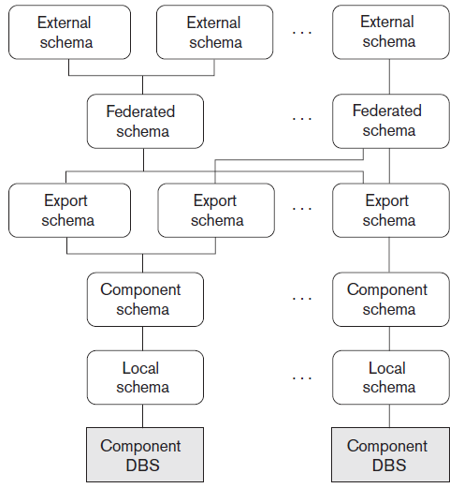
Federated Database Schema Architecture
Figure 23.9 The five-level schema architecture in a federated database system (FDBS)

Slide 38
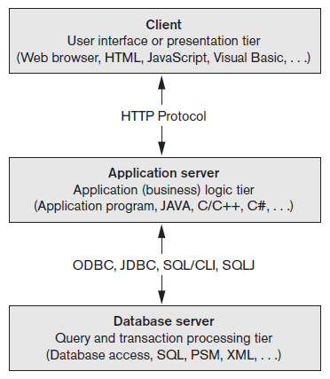
An Overview of Three-Tier Client/Server Architecture
Division of DBMS functionality among the three tiers can vary
Figure 23.10 The three-tier client/server architecture

Slide 39
23.8 Distributed Catalog Management
Centralized catalogs
  Entire catalog is stored at one single site
  Easy to implement
Fully replicated catalogs
  Identical copies of the complete catalog are present at each site
  Results in faster reads
Partially replicated catalogs
  Each site maintains complete catalog information on data stored locally at that site

Slide 40
23.9 Summary
Distributed database concept
Distribution transparency
Fragmentation transparency
Replication transparency
Design issues
  Horizontal and vertical fragmentation
Concurrency control and recovery techniques
Query processing
Categorization of DDBMSs

