Slide 1


Slide 2
CHAPTER 22
Database Recovery Techniques

Slide 3
Introduction
Recovery algorithms
Recovery concepts
  Write-ahead logging
  In-place versus shadow updates
  Rollback
  Deferred update
  Immediate update
Certain recovery techniques best used with specific concurrency control methods

Slide 4
22.1 Recovery Concepts
Recovery process restores database to most recent consistent state before time of failure
Information kept in system log
Typical recovery strategies
  Restore backed-up copy of database
    Best in cases of extensive damage
  Identify any changes that may cause inconsistency
    Best in cases of noncatastrophic failure
    Some operations may require redo

Slide 5
Recovery Concepts (cont’d.)
Deferred update techniques
  Do not physically update the database until after transaction commits
  Undo is not needed; redo may be needed
Immediate update techniques
  Database may be updated by some operations of a transaction before it reaches commit point
  Operations also recorded in log
  Recovery still possible

Slide 6
Recovery Concepts (cont’d.)
Undo and redo operations required to be idempotent
  Executing operations multiple times equivalent to executing just once
  Entire recovery process should be idempotent
Caching (buffering) of disk blocks
  DBMS cache: a collection of in-memory buffers
  Cache directory keeps track of which database items are in the buffers

Slide 7
Recovery Concepts (cont’d.)
Cache buffers replaced (flushed) to make space for new items
Dirty bit associated with each buffer in the cache
  Indicates whether the buffer has been modified
Contents written back to disk before flush if dirty bit equals one
Pin-unpin bit
  Page is pinned if it cannot be written back to disk yet

Slide 8
Recovery Concepts (cont’d.)
Main strategies
  In-place updating
    Writes the buffer to the same original disk location
    Overwrites old values of any changed data items
  Shadowing
    Writes an updated buffer at a different disk location, to maintain multiple versions of data items
    Not typically used in practice
Before-image: old value of data item
After-image: new value of data item

Slide 9
Recovery Concepts (cont’d.)
Write-ahead logging
  Ensure the before-image (BFIM) is recorded
  Appropriate log entry flushed to disk
  Necessary for UNDO operation if needed
UNDO-type log entries
REDO-type log entries

Slide 10
Recovery Concepts (cont’d.)
Steal/no-steal and force/no-force
  Specify rules that govern when a page from the database cache can be written to disk
No-steal approach
  Cache buffer page updated by a transaction cannot be written to disk before the transaction commits
Steal approach
  Recovery protocol allows writing an updated buffer before the transaction commits

Slide 11
Recovery Concepts (cont’d.)
Force approach
  All pages updated by a transaction are immediately written to disk before the transaction commits
  Otherwise, no-force
Typical database systems employ a steal/no-force strategy
  Avoids need for very large buffer space
  Reduces disk I/O operations for heavily updated pages

Slide 12
Recovery Concepts (cont’d.)
Write-ahead logging protocol for recovery algorithm requiring both UNDO and REDO
  BFIM of an item cannot be overwritten by its after image until all UNDO-type log entries have been force-written to disk
  Commit operation of a transaction cannot be completed until all REDO-type and UNDO-type log records for that transaction have been force-written to disk

Slide 13
Checkpoints in the System Log and Fuzzy Checkpointing
Taking a checkpoint
  Suspend execution of all transactions temporarily
  Force-write all main memory buffers that have been modified to disk
  Write a checkpoint record to the log, and force-write the log to the disk
  Resume executing transactions
DBMS recovery manager decides on checkpoint interval

Slide 14
Checkpoints in the System Log and Fuzzy Checkpointing (cont’d.)
Fuzzy checkpointing
  System can resume transaction processing after a begin_checkpoint record is written to the log
  Previous checkpoint record maintained until end_checkpoint record is written

Slide 15
Transaction Rollback
Transaction failure after update but before commit
  Necessary to roll back the transaction
  Old data values restored using undo-type log entries
Cascading rollback
  If transaction T is rolled back, any transaction S that has read value of item written by T must also be rolled back
  Almost all recovery mechanisms designed to avoid this

Slide 16
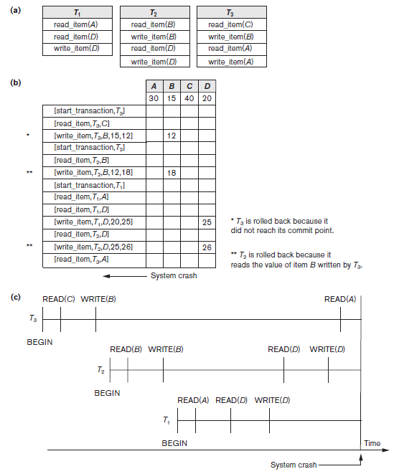
Figure 22.1 Illustrating cascading rollback (a process that never occurs
in strict or cascadeless
schedules) (a) The read and write operations of three transactions (b) System log at point of crash (c) Operations before the crash

Slide 17
Transactions that Do Not Affect the Database
Example actions: generating and printing messages and reports
If transaction fails before completion, may not want user to get these reports
  Reports should be generated only after transaction reaches commit point
Commands that generate reports issued as batch jobs executed only after transaction reaches commit point
  Batch jobs canceled if transaction fails

Slide 18
22.2 NO-UNDO/REDO Recovery Based on Deferred Update
Deferred update concept
  Postpone updates to the database on disk until the transaction completes successfully and reaches its commit point
  Redo-type log entries are needed
  Undo-type log entries not necessary
  Can only be used for short transactions and transactions that change few items
    Buffer space an issue with longer transactions

Slide 19
NO-UNDO/REDO Recovery Based on Deferred Update (cont’d.)
Deferred update protocol
  Transaction cannot change the database on disk until it reaches its commit point
    All buffers changed by the transaction must be pinned until the transaction commits (no-steal policy)
  Transaction does not reach its commit point until all its REDO-type log entries are recorded in log and log buffer is force-written to disk

Slide 20
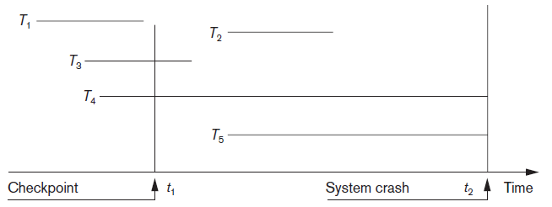
NO-UNDO/REDO Recovery Based on Deferred Update (cont’d.)
Figure 22.2 An example of a recovery timeline to illustrate the effect of checkpointing

Slide 21
22.3 Recovery Techniques Based on Immediate Update
Database can be updated immediately
  No need to wait for transaction to reach commit point
  Not a requirement that every update be immediate
UNDO-type log entries must be stored
Recovery algorithms
  UNDO/NO-REDO (steal/force strategy)
  UNDO/REDO (steal/no-force strategy)

Slide 22
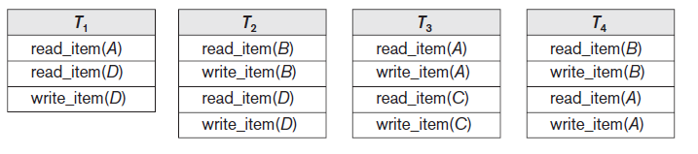
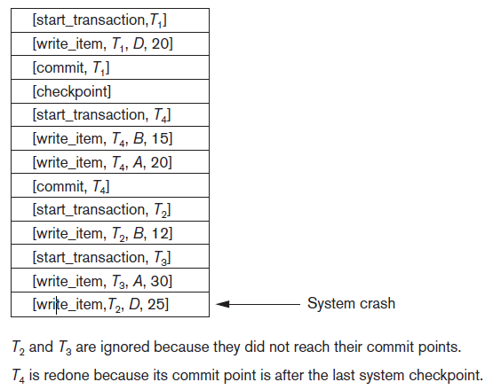
Figure 22.3 An example of recovery using deferred update with concurrent transactions (a) The READ and WRITE operations of four transactions (b) System log at the point of crash

Slide 23
22.4 Shadow Paging
No log required in a single-user environment
  Log may be needed in a multiuser environment for the concurrency control method
Shadow paging considers disk to be made of n fixed-size disk pages
  Directory with n entries is constructed
  When transaction begins executing, directory copied into shadow directory to save while current directory is being used
  Shadow directory is never modified

Slide 24
Shadow Paging (cont’d.)
New copy of the modified page created and stored elsewhere
  Current directory modified to point to new disk block
  Shadow directory still points to old disk block
Failure recovery
  Discard current directory
  Free modified database pages
  NO-UNDO/NO-REDO technique

Slide 25
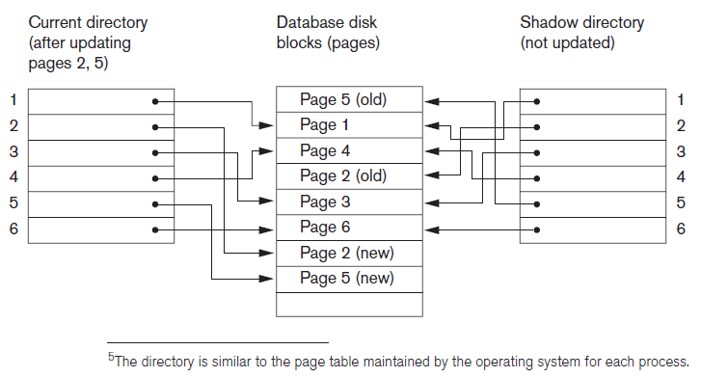
Shadow Paging (cont’d.)
Figure 22.4 An example of shadow paging

Slide 26
22.5 The ARIES Recovery Algorithm
Used in many IBM relational database products
Uses a steal/no-force approach for writing
Concepts
  Write-ahead logging
  Repeating history during redo
    Retrace all database system actions prior to crash to reconstruct database state when crash occurred
  Logging changes during undo
    Prevents ARIES from repeating completed undo operations if failure occurs during recovery

Slide 27
The ARIES Recovery Algorithm (cont’d.)
Analysis step
  Identifies dirty (updated) pages in the buffer and set of transactions active at the time of crash
  Determines appropriate start point in the log for the REDO operation
REDO
  Reapplies updates from the log to the database
  Only necessary REDO operations are applied

Slide 28
The ARIES Recovery Algorithm (cont’d.)
UNDO
  Log is scanned backward
  Operations of transactions that were active at the time of the crash are undone in reverse order
Every log record has associated log sequence number (LSN)
  Indicates address of log record on disk
  Corresponds to a specific change of some transaction

Slide 29
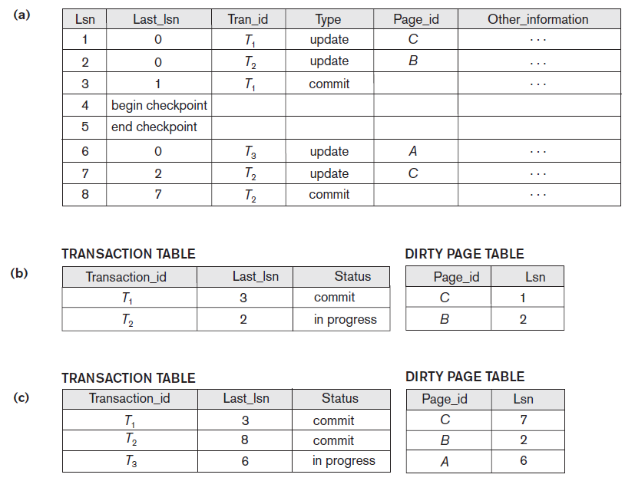
ARIES Recovery Example
Figure 22.5 An example of recovery in ARIES (a) The log at point of crash (b) The Transaction and Dirty Page Tables at time of checkpoint (c) The Transaction and Dirty Page Tables after the analysis phase

Slide 30
22.6 Recovery in Multidatabase Systems
Two-level recovery mechanism
Global recovery manager (coordinator) needed to maintain recovery information
Coordinator follows two-phase commit protocol
  Phase 1: Prepare for commit message
    Ready to commit or cannot commit signal returned
  Phase 2: Issue commit signal
Either all participating databases commit the effect of the transaction or none of them do

Slide 31
Recovery in Multidatabase Systems (cont’d.)
Always possible to recover to a state where either the transaction is committed or it is rolled back
Failure during phase 1 requires rollback
Failure during phase 2 means successful transaction can recover and commit

Slide 32
22.7 Database Backup and Recovery from Catastrophic Failures
Database backup
  Entire database and log periodically copied onto inexpensive storage medium
  Latest backup copy can be reloaded from disk in case of catastrophic failure
Backups often moved to physically separate locations
  Subterranean storage vaults

Slide 33
Database Backup and Recovery from Catastrophic Failures (cont’d.)
Backup system log at more frequent intervals and copy to magnetic tape
  System log smaller than database
    Can be backed up more frequently
  Benefit: users do not lose all transactions since last database backup

Slide 34
22.8 Summary
Main goal of recovery
  Ensure atomicity property of a transaction
Caching
In-place updating versus shadowing
Before and after images of data items
UNDO and REDO operations
Deferred versus immediate update
Shadow paging
Catastrophic failure recovery

