Slide 1
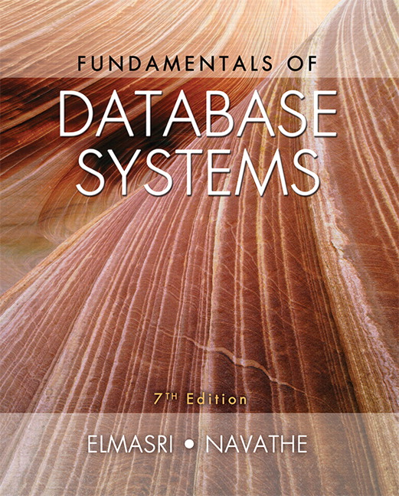

Slide 2
CHAPTER 21
Concurrency Control Techniques

Slide 3
Introduction
Concurrency control protocols
  Set of rules to guarantee serializability
Two-phase locking protocols
  Lock data items to prevent concurrent access
Timestamp
  Unique identifier for each transaction
Multiversion currency control protocols
  Use multiple versions of a data item
Validation or certification of a transaction

Slide 4
21.1 Two-Phase Locking Techniques for Concurrency Control
Lock
  Variable associated with a data item describing status for operations that can be applied
  One lock for each item in the database
Binary locks
  Two states (values)
    Locked (1)
      Item cannot be accessed
    Unlocked (0)
      Item can be accessed when requested

Slide 5
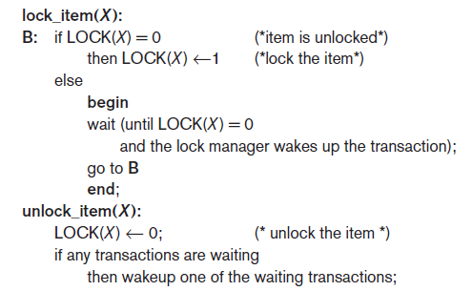
Two-Phase Locking Techniques for Concurrency Control (cont’d.)
Transaction requests access by issuing a lock_item(X) operation
Figure 21.1 Lock and unlock operations for binary locks

Slide 6
Two-Phase Locking Techniques for Concurrency Control (cont’d.)
Lock table specifies items that have locks
Lock manager subsystem
  Keeps track of and controls access to locks
  Rules enforced by lock manager module
At most one transaction can hold the lock on an item at a given time
Binary locking too restrictive for database items

Slide 7
Two-Phase Locking Techniques for Concurrency Control (cont’d.)
Shared/exclusive or read/write locks
  Read operations on the same item are not conflicting
  Must have exclusive lock to write
  Three locking operations
    read_lock(X)
    write_lock(X)
    unlock(X)

Slide 8
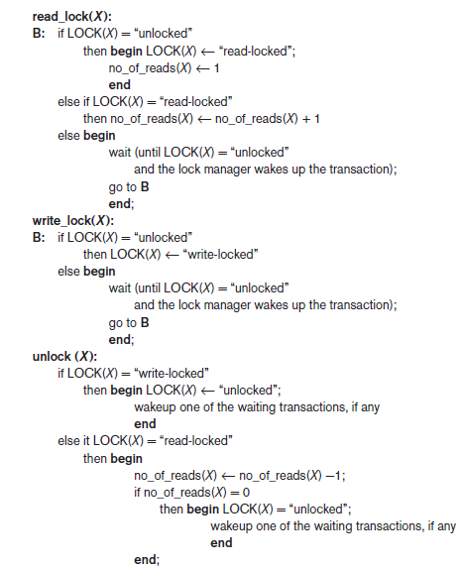
Figure 21.2 Locking and unlocking operations for two-mode (read/write, or shared/exclusive) locks

Slide 9
Two-Phase Locking Techniques for Concurrency Control (cont’d.)
Lock conversion
  Transaction that already holds a lock allowed to convert the lock from one state to another
Upgrading
  Issue a read_lock operation then a write_lock operation
Downgrading
  Issue a read_lock operation after a write_lock operation

Slide 10
Guaranteeing Serializability by Two-Phase Locking
Two-phase locking protocol
  All locking operations precede the first unlock operation in the transaction
  Phases
    Expanding (growing) phase
      New locks can be acquired but none can be released
      Lock conversion upgrades must be done during this phase
    Shrinking phase
      Existing locks can be released but none can be acquired
      Downgrades must be done during this phase

Slide 11
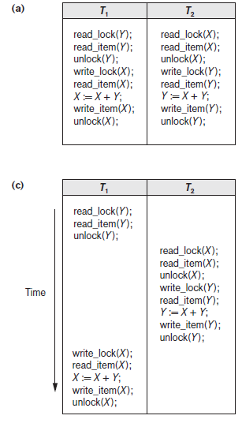
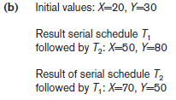
Figure 21.3 Transactions that do not obey two-phase locking (a) Two transactions T1 and T2 (b) Results of possible serial schedules of T1 and T2 (c) A nonserializable schedule S that uses locks

Slide 12
Guaranteeing Serializability by Two-Phase Locking
If every transaction in a schedule follows the two-phase locking protocol, schedule guaranteed to be serializable
Two-phase locking may limit the amount of concurrency that can occur in a schedule
Some serializable schedules will be prohibited by two-phase locking protocol

Slide 13
Variations of Two-Phase Locking
Basic 2PL
  Technique described on previous slides
Conservative (static) 2PL
  Requires a transaction to lock all the items it accesses before the transaction begins
    Predeclare read-set and write-set
  Deadlock-free protocol
Strict 2PL
  Transaction does not release exclusive locks until after it commits or aborts

Slide 14
Variations of Two-Phase Locking (cont’d.)
Rigorous 2PL
  Transaction does not release any locks until after it commits or aborts
Concurrency control subsystem responsible for generating read_lock and write_lock requests
Locking generally considered to have high overhead

Slide 15
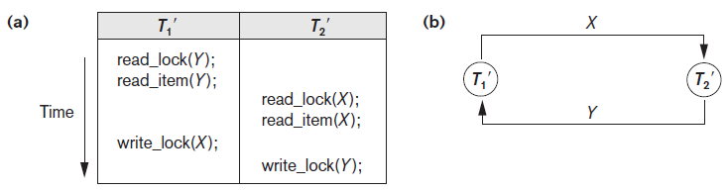
Dealing with Deadlock and Starvation
Deadlock
  Occurs when each transaction T in a set is waiting for some item locked by some other transaction T’
  Both transactions stuck in a waiting queue
Figure 21.5 Illustrating the deadlock problem (a) A partial schedule of T1′ and T2′ that is
in a state of deadlock (b) A wait-for graph for the partial schedule in (a)

Slide 16
Dealing with Deadlock and Starvation (cont’d.)
Deadlock prevention protocols
  Every transaction locks all items it needs in advance
  Ordering all items in the database
    Transaction that needs several items will lock them in that order
  Both approaches impractical
Protocols based on a timestamp
  Wait-die
  Wound-wait

Slide 17
Dealing with Deadlock and Starvation (cont’d.)
No waiting algorithm
  If transaction unable to obtain a lock, immediately aborted and restarted later
Cautious waiting algorithm
  Deadlock-free
Deadlock detection
  System checks to see if a state of deadlock exists
  Wait-for graph

Slide 18
Dealing with Deadlock and Starvation (cont’d.)
Victim selection
  Deciding which transaction to abort in case of deadlock
Timeouts
  If system waits longer than a predefined time, it aborts the transaction
Starvation
  Occurs if a transaction cannot proceed for an indefinite period of time while other transactions continue normally
  Solution: first-come-first-served queue

Slide 19
21.2 Concurrency Control Based on Timestamp Ordering
Timestamp
  Unique identifier assigned by the DBMS to identify a transaction
  Assigned in the order submitted
  Transaction start time
Concurrency control techniques based on timestamps do not use locks
  Deadlocks cannot occur

Slide 20
Concurrency Control Based on Timestamp Ordering (cont’d.)
Generating timestamps
  Counter incremented each time its value is assigned to a transaction
  Current date/time value of the system clock
    Ensure no two timestamps are generated during the same tick of the clock
General approach
  Enforce equivalent serial order on the transactions based on their timestamps

Slide 21
Concurrency Control Based on Timestamp Ordering (cont’d.)
Timestamp ordering (TO)
  Allows interleaving of transaction operations
  Must ensure timestamp order is followed for each pair of conflicting operations
Each database item assigned two timestamp values
  read_TS(X)
  write_TS(X)

Slide 22
Concurrency Control Based on Timestamp Ordering (cont’d.)
Basic TO algorithm
  If conflicting operations detected, later operation rejected by aborting transaction that issued it
  Schedules produced guaranteed to be conflict serializable
  Starvation may occur
Strict TO algorithm
  Ensures schedules are both strict and conflict serializable

Slide 23
Concurrency Control Based on Timestamp Ordering (cont’d.)
Thomas’s write rule
  Modification of basic TO algorithm
  Does not enforce conflict serializability
  Rejects fewer write operations by modifying checks for write_item(X) operation

Slide 24
21.3 Multiversion Concurrency
Control Techniques
Several versions of an item are kept by a system
Some read operations that would be rejected in other techniques can be accepted by reading an older version of the item
  Maintains serializability
More storage is needed
Multiversion currency control scheme types
  Based on timestamp ordering
  Based on two-phase locking
  Validation and snapshot isolation techniques

Slide 25
Multiversion Concurrency
Control Techniques (cont’d.)
Multiversion technique based on timestamp ordering
  Two timestamps associated with each version are kept
    read_TS(X_{i})
    write_TS(X_{i})

Slide 26
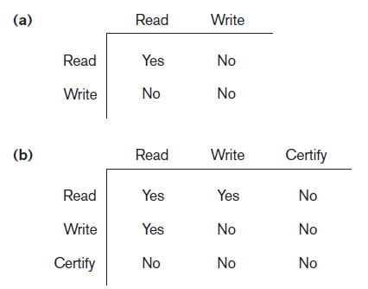
Multiversion Concurrency
Control Techniques (cont’d.)
  Multiversion two-phase locking using certify locks
    Three locking modes: read, write, and certify
Figure 21.6 Lock compatibility tables (a) Lock compatibility table for read/write locking scheme (b) Lock compatibility table for read/write/certify locking scheme

Slide 27
21.4 Validation (Optimistic) Techniques and Snapshot Isolation Concurrency Control
Optimistic techniques
  Also called validation or certification techniques
  No checking is done while the transaction is executing
  Updates not applied directly to the database until finished transaction is validated
    All updates applied to local copies of data items
  Validation phase checks whether any of transaction’s updates violate serializability
    Transaction committed or aborted based on result

Slide 28
Concurrency Control Based on Snapshot Isolation
Transaction sees data items based on committed values of the items in the database snapshot
  Does not see updates that occur after transaction starts
Read operations do not require read locks
  Write operations require write locks
Temporary version store keeps track of older versions of updated items
Variation: serializable snapshot isolation (SSI)

Slide 29
21.5 Granularity of Data Items and
Multiple Granularity Locking
Size of data items known as granularity
  Fine (small)
  Coarse (large)
Larger the data item size, lower the degree of concurrency permitted
  Example: entire disk block locked
Smaller the data item size, more locks required
  Higher overhead
Best item size depends on transaction type

Slide 30
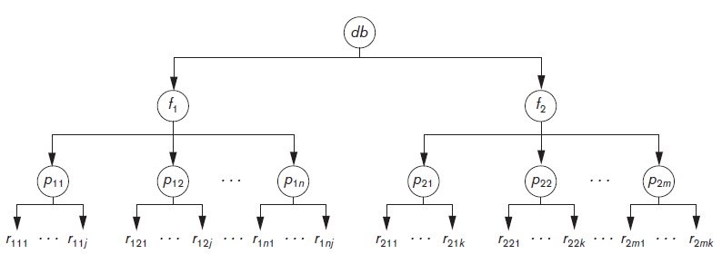
Multiple Granularity Level Locking
Lock can be requested at any level
Figure 21.7 A granularity hierarchy for illustrating multiple granularity level locking

Slide 31
Multiple Granularity Level Locking (cont’d.)
Intention locks are needed
  Transaction indicates along the path from the root to the desired node, what type of lock (shared or exclusive) it will require from one of the node’s descendants
Intention lock types
  Intention-shared (IS)
    Shared locks will be requested on a descendant node
  Intention-exclusive (IX)
    Exclusive locks will be requested

Slide 32
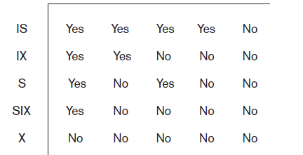
Multiple Granularity Level Locking (cont’d.)
Intention lock types (cont’d.)
  Shared-intension-exclusive (SIX)
    Current node is locked in shared mode but one or more exclusive locks will be requested on a descendant node
Figure 21.8 Lock compatibility matrix for multiple granularity locking

Slide 33
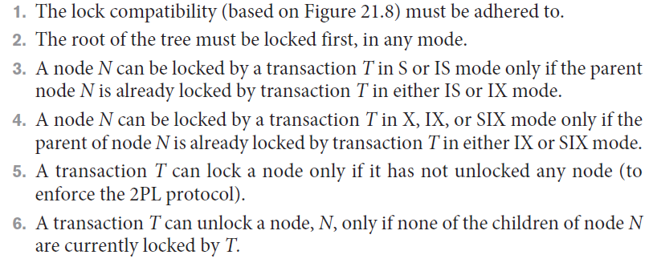
Multiple Granularity Level Locking (cont’d.)
Multiple granularity locking (MGL) protocol rules

Slide 34
21.6 Using Locks for Concurrency
Control in Indexes
Two-phase locking can be applied to B-tree and B+ -tree indexes
  Nodes of an index correspond to disk pages
Holding locks on index pages could cause transaction blocking
  Other approaches must be used
Conservative approach
  Lock the root node in exclusive mode and then access the appropriate child node of the root

Slide 35
Using Locks for Concurrency
Control in Indexes (cont’d.)
Optimistic approach
  Request and hold shared locks on nodes leading to the leaf node, with exclusive lock on the leaf
B-link tree approach
  Sibling nodes on the same level are linked at every level
  Allows shared locks when requesting a page
  Requires lock be released before accessing the child node

Slide 36
21.7 Other Concurrency Control Issues
Insertion
  When new data item is inserted, it cannot be accessed until after operation is completed
Deletion operation on the existing data item
  Write lock must be obtained before deletion
Phantom problem
  Can occur when a new record being inserted satisfies a condition that a set of records accessed by another transaction must satisfy
  Record causing conflict not recognized by concurrency control protocol

Slide 37
Other Concurrency Control Issues (cont’d.)
Interactive transactions
  User can input a value of a data item to a transaction T based on some value written to the screen by transaction T′, which may not have committed
  Solution approach: postpone output of transactions to the screen until committed
Latches
  Locks held for a short duration
  Do not follow usual concurrency control protocol

Slide 38
21.8 Summary
Concurrency control techniques
  Two-phase locking
  Timestamp-based ordering
  Multiversion protocols
  Snapshot isolation
Data item granularity
Locking protocols for indexes
Phantom problem and interactive transaction issues

