Slide 1
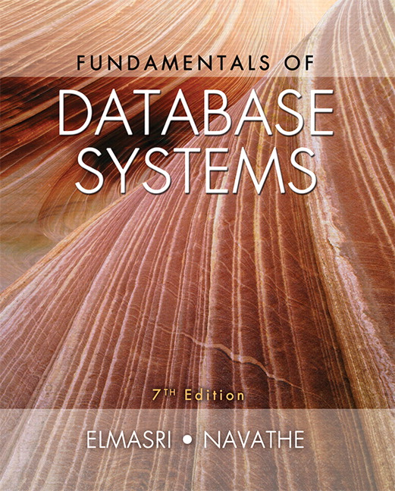

Slide 2
CHAPTER 20
Introduction to Transaction Processing Concepts and Theory

Slide 3
Introduction
Transaction
  Describes local unit of database processing
Transaction processing systems
  Systems with large databases and hundreds of concurrent users
  Require high availability and fast response time

Slide 4
20.1 Introduction to Transaction Processing
Single-user DBMS
  At most one user at a time can use the system
  Example: home computer
Multiuser DBMS
  Many users can access the system (database) concurrently
  Example: airline reservations system

Slide 5
Introduction to Transaction Processing (cont’d.)
Multiprogramming
  Allows operating system to execute multiple processes concurrently
  Executes commands from one process, then suspends that process and executes commands from another process, etc.

Slide 6
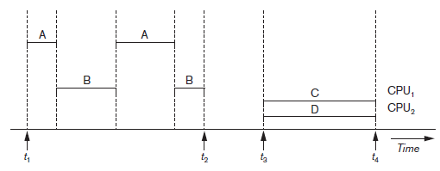
Introduction to Transaction Processing (cont’d.)
Interleaved processing
Parallel processing
  Processes C and D in figure below
Figure 20.1 Interleaved processing versus parallel processing of concurrent transactions

Slide 7
Transactions
Transaction: an executing program
  Forms logical unit of database processing
Begin and end transaction statements
  Specify transaction boundaries
Read-only transaction
Read-write transaction

Slide 8
Database Items
Database represented as collection of named data items
Size of a data item called its granularity
Data item
  Record
  Disk block
  Attribute value of a record
Transaction processing concepts independent of item granularity

Slide 9
Read and Write Operations
read_item(X)
  Reads a database item named X into a program variable named X
  Process includes finding the address of the disk block, and copying to and from a memory buffer
write_item(X)
  Writes the value of program variable X into the database item named X
  Process includes finding the address of the disk block, copying to and from a memory buffer, and storing the updated disk block back to disk

Slide 10
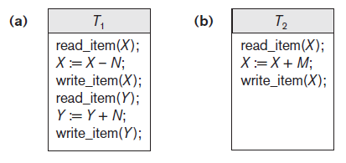
Read and Write Operations (cont’d.)
Read set of a transaction
  Set of all items read
Write set of a transaction
  Set of all items written
Figure 20.2 Two sample transactions (a) Transaction T1 (b) Transaction T2

Slide 11
DBMS Buffers
DBMS will maintain several main memory data buffers in the database cache
When buffers are occupied, a buffer replacement policy is used to choose which buffer will be replaced
  Example policy: least recently used

Slide 12
Concurrency Control
Transactions submitted by various users may execute concurrently
  Access and update the same database items
  Some form of concurrency control is needed
The lost update problem
  Occurs when two transactions that access the same database items have operations interleaved
  Results in incorrect value of some database items

Slide 13
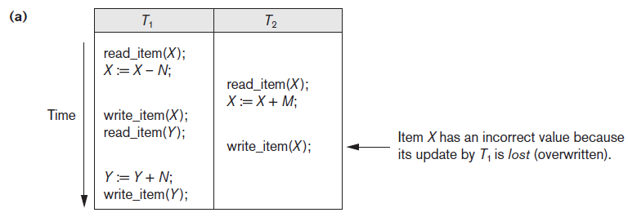
The Lost Update Problem
Figure 20.3 Some problems that occur when concurrent execution is uncontrolled (a) The lost update problem

Slide 14
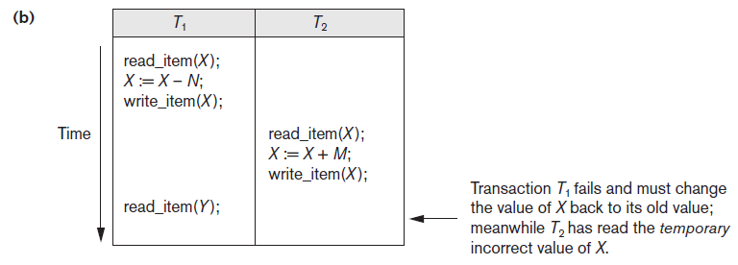
The Temporary Update Problem
Figure 20.3 (cont’d.) Some problems that occur when concurrent execution is uncontrolled (b) The temporary update problem

Slide 15
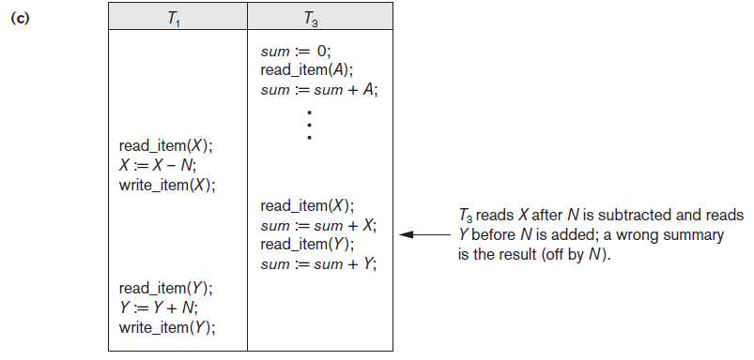
The Incorrect Summary Problem
Figure 20.3 (cont’d.) Some problems that occur when concurrent execution is uncontrolled (c) The incorrect summary problem

Slide 16
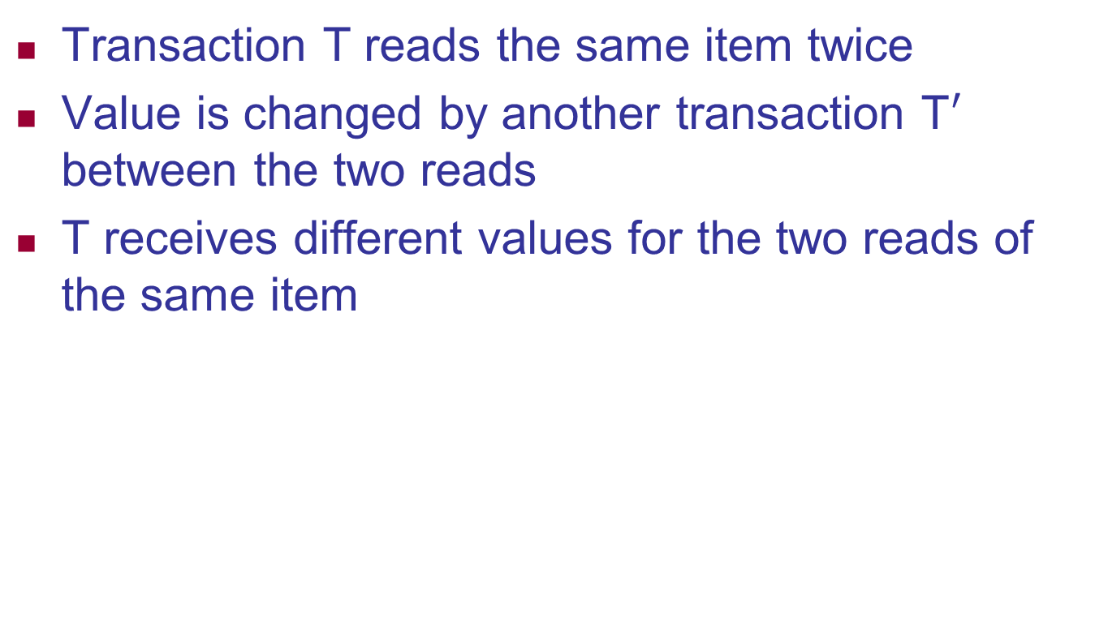
The Unrepeatable Read Problem
Transaction T reads the same item twice
Value is changed by another transaction T$′$ between the two reads
T receives different values for the two reads of the same item

Slide 17
Why Recovery is Needed
Committed transaction
  Effect recorded permanently in the database
Aborted transaction
  Does not affect the database
Types of transaction failures
  Computer failure (system crash)
  Transaction or system error
  Local errors or exception conditions detected by the transaction

Slide 18
Why Recovery is Needed (cont’d.)
Types of transaction failures (cont’d.)
  Concurrency control enforcement
  Disk failure
  Physical problems or catastrophes
System must keep sufficient information to recover quickly from the failure
  Disk failure or other catastrophes have long recovery times

Slide 19
20.2 Transaction and System Concepts
System must keep track of when each transaction starts, terminates, commits, and/or aborts
  BEGIN_TRANSACTION
  READ or WRITE
  END_TRANSACTION
  COMMIT_TRANSACTION
  ROLLBACK (or ABORT)

Slide 20
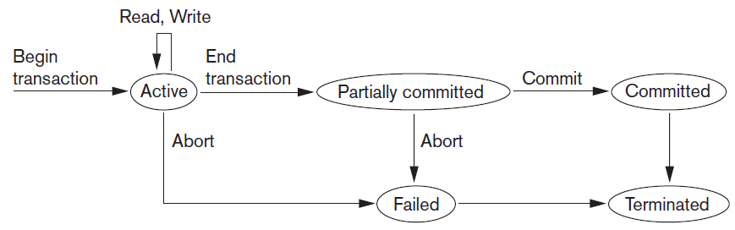
Transaction and System Concepts (cont’d.)
Figure 20.4 State transition diagram illustrating the states for transaction execution

Slide 21
The System Log
System log keeps track of transaction operations
Sequential, append-only file
Not affected by failure (except disk or catastrophic failure)
Log buffer
  Main memory buffer
  When full, appended to end of log file on disk
Log file is backed up periodically
Undo and redo operations based on log possible

Slide 22
Commit Point of a Transaction
Occurs when all operations that access the database have completed successfully
  And effect of operations recorded in the log
Transaction writes a commit record into the log
  If system failure occurs, can search for transactions with recorded start_transaction but no commit record
Force-writing the log buffer to disk
  Writing log buffer to disk before transaction reaches commit point

Slide 23
DBMS-Specific Buffer Replacement Policies
Page replacement policy
  Selects particular buffers to be replaced when all are full
Domain separation (DS) method
  Each domain handles one type of disk pages
    Index pages
    Data file pages
    Log file pages
  Number of available buffers for each domain is predetermined

Slide 24
DBMS-Specific Buffer Replacement Policies (cont’d.)
Hot set method
  Useful in queries that scan a set of pages repeatedly
  Does not replace the set in the buffers until processing is completed
The DBMIN method
  Predetermines the pattern of page references for each algorithm for a particular type of database operation
    Calculates locality set using query locality set model (QLSM)

Slide 25
20.3 Desirable Properties of Transactions
ACID properties
  Atomicity
    Transaction performed in its entirety or not at all
  Consistency preservation
    Takes database from one consistent state to another
  Isolation
    Not interfered with by other transactions
  Durability or permanency
    Changes must persist in the database

Slide 26
Desirable Properties of Transactions (cont’d.)
Levels of isolation
  Level 0 isolation does not overwrite the dirty reads of higher-level transactions
  Level 1 isolation has no lost updates
  Level 2 isolation has no lost updates and no dirty reads
  Level 3 (true) isolation has repeatable reads
    In addition to level 2 properties
  Snapshot isolation

Slide 27
20.4 Characterizing Schedules Based on Recoverability
Schedule or history
  Order of execution of operations from all transactions
  Operations from different transactions can be interleaved in the schedule
Total ordering of operations in a schedule
  For any two operations in the schedule, one must occur before the other

Slide 28
Characterizing Schedules Based on Recoverability (cont’d.)
Two conflicting operations in a schedule
  Operations belong to different transactions
  Operations access the same item X
  At least one of the operations is a write_item(X)
Two operations conflict if changing their order results in a different outcome
Read-write conflict
Write-write conflict

Slide 29
Characterizing Schedules Based on Recoverability (cont’d.)
Recoverable schedules
  Recovery is possible
Nonrecoverable schedules should not be permitted by the DBMS
No committed transaction ever needs to be rolled back
Cascading rollback may occur in some recoverable schedules
  Uncommitted transaction may need to be rolled back

Slide 30
Characterizing Schedules Based on Recoverability (cont’d.)
Cascadeless schedule
  Avoids cascading rollback
Strict schedule
  Transactions can neither read nor write an item X until the last transaction that wrote X has committed or aborted
  Simpler recovery process
    Restore the before image

Slide 31
20.5 Characterizing Schedules Based on Serializability
Serializable schedules
  Always considered to be correct when concurrent transactions are executing
  Places simultaneous transactions in series
    Transaction T₁ before T₂, or vice versa

Slide 32
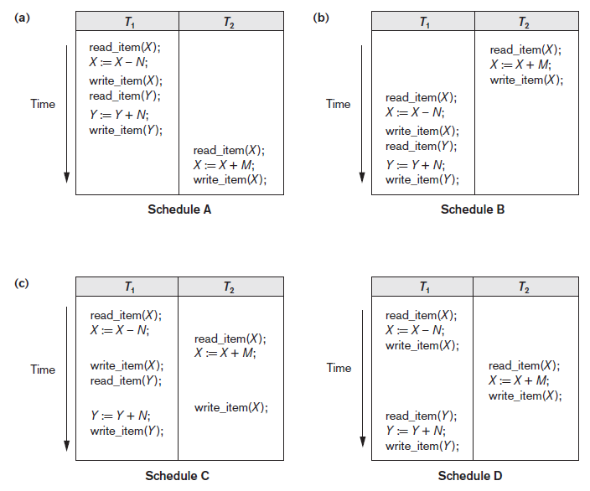
Figure 20.5 Examples of serial and nonserial schedules involving transactions T1 and T2 (a) Serial schedule A: T1 followed by T2 (b) Serial schedule B: T2 followed by T1 (c) Two nonserial schedules C and D with interleaving of operations

Slide 33
Characterizing Schedules Based on Serializability (cont’d.)
Problem with serial schedules
  Limit concurrency by prohibiting interleaving of operations
  Unacceptable in practice
  Solution: determine which schedules are equivalent to a serial schedule and allow those to occur
Serializable schedule of n transactions
  Equivalent to some serial schedule of same n transactions

Slide 34
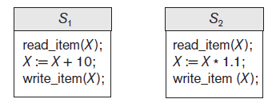
Characterizing Schedules Based on Serializability (cont’d.)
Result equivalent schedules
  Produce the same final state of the database
    May be accidental
  Cannot be used alone to define equivalence of schedules
Figure 20.6 Two schedules that are result equivalent for the initial value of X = 100 but are not result equivalent in general

Slide 35
Characterizing Schedules Based on Serializability (cont’d.)
Conflict equivalence
  Relative order of any two conflicting operations is the same in both schedules
Serializable schedules
  Schedule S is serializable if it is conflict equivalent to some serial schedule S’.

Slide 36
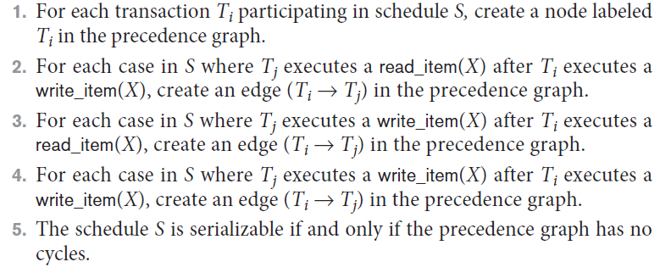
Characterizing Schedules Based on Serializability (cont’d.)
Testing for serializability of a schedule
Algorithm 20.1 Testing conflict serializability of a schedule S

Slide 37
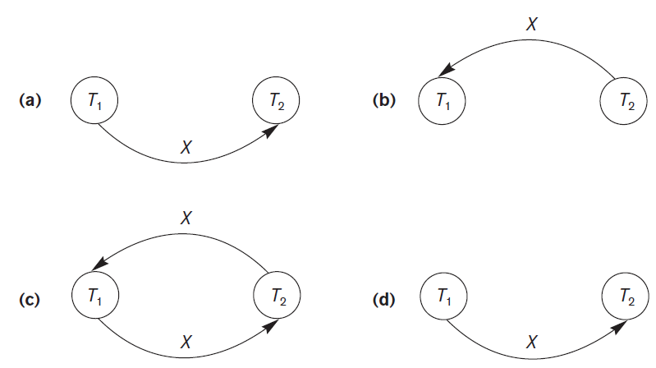
Characterizing Schedules Based on Serializability (cont’d.)
Figure 20.7 Constructing the precedence graphs for schedules A to D from Figure 20.5 to test for conflict serializability (a) Precedence graph for serial schedule A (b) Precedence graph for serial schedule B (c) Precedence graph for schedule C (not serializable) (d) Precedence graph for schedule D (serializable, equivalent to schedule A)

Slide 38
How Serializability is Used for Concurrency Control
Being serializable is different from being serial
Serializable schedule gives benefit of concurrent execution
  Without giving up any correctness
Difficult to test for serializability in practice
  Factors such as system load, time of transaction submission, and process priority affect ordering of operations
DBMS enforces protocols
  Set of rules to ensure serializability

Slide 39
View Equivalence and View Serializability
View equivalence of two schedules
  As long as each read operation of a transaction reads the result of the same write operation in both schedules, the write operations of each transaction must produce the same results
  Read operations said to see the same view in both schedules
View serializable schedule
  View equivalent to a serial schedule

Slide 40
View Equivalence and View Serializability (cont’d.)
Conflict serializability similar to view serializability if constrained write assumption (no blind writes) applies
Unconstrained write assumption
  Value written by an operation can be independent of its old value
Debit-credit transactions
  Less-stringent conditions than conflict serializability or view serializability

Slide 41
20.6 Transaction Support in SQL
No explicit Begin_Transaction statement
Every transaction must have an explicit end statement
  COMMIT
  ROLLBACK
Access mode is READ ONLY or READ WRITE
Diagnostic area size option
  Integer value indicating number of conditions held simultaneously in the diagnostic area

Slide 42
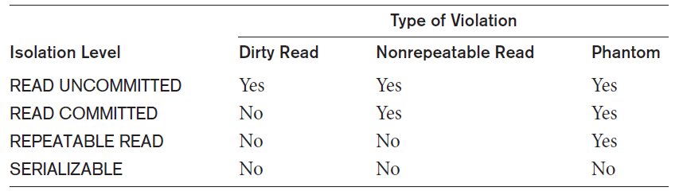
Transaction Support in SQL (cont’d.)
Isolation level option
  Dirty read
  Nonrepeatable read
  Phantoms
Table 20.1 Possible violations based on isolation levels as defined in SQL

Slide 43
Transaction Support in SQL (cont’d.)
Snapshot isolation
  Used in some commercial DBMSs
  Transaction sees data items that it reads based on the committed values of the items in the database snapshot when transaction starts
  Ensures phantom record problem will not occur

Slide 44
20.7 Summary
Single and multiuser database transactions
Uncontrolled execution of concurrent transactions
System log
Failure recovery
Committed transaction
Schedule (history) defines execution sequence
  Schedule recoverability
  Schedule equivalence
Serializability of schedules

