Slide 1
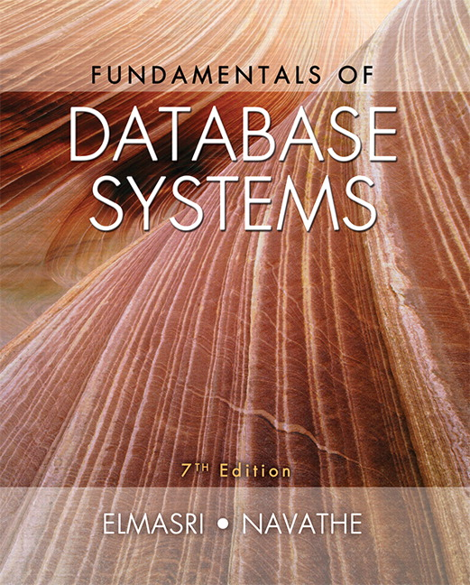

Slide 2
CHAPTER 19
Query Optimization

Slide 3
Introduction
Query optimization
  Conducted by a query optimizer in a DBMS
  Goal: select best available strategy for executing query
    Based on information available
Most RDBMSs use a tree as the internal representation of a query

Slide 4
19.1 Query Trees and Heuristics for Query Optimization
Step 1: scanner and parser generate initial query representation
Step 2: representation is optimized according to heuristic rules
Step 3: query execution plan is developed
  Execute groups of operations based on access paths available and files involved

Slide 5
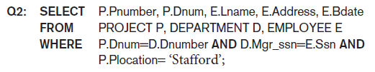
Query Trees and Heuristics for Query Optimization (cont’d.)
Example heuristic rule
  Apply SELECT and PROJECT before JOIN
    Reduces size of files to be joined
Query tree
  Represents relational algebra expression
Query graph
  Represents relational calculus expression
Example for Q2 on next slide

Slide 6
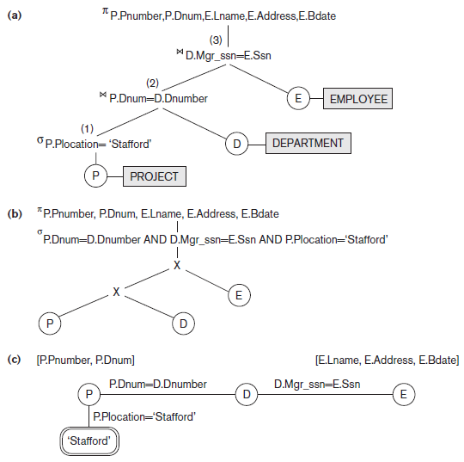
Query Trees and Query Graph Corresponding to Q2
Figure 19.1 Two query trees for the query Q2. (a) Query tree corresponding to the relational algebra expression for Q2. (b) Initial (canonical) query tree for SQL query Q2. (c) Query graph for Q2.

Slide 7
Query Trees and Heuristics for Query Optimization (cont’d.)
Query tree represents a specific order of operations for executing a query
  Preferred to query graph for this reason
Query graph
  Relation nodes displayed as single circles
  Constants represented by constant nodes
    Double circles or ovals
  Selection or join conditions represented as edges
  Attributes to be retrieved displayed in square brackets

Slide 8
Heuristic Optimization of Query Trees
Many different query trees can be used to represent the query and get the same results
Figure 19.1b shows initial tree for Q2
  Very inefficient - will never be executed
  Optimizer will transform into equivalent final query tree

Slide 9
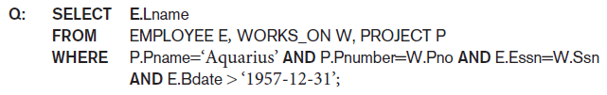
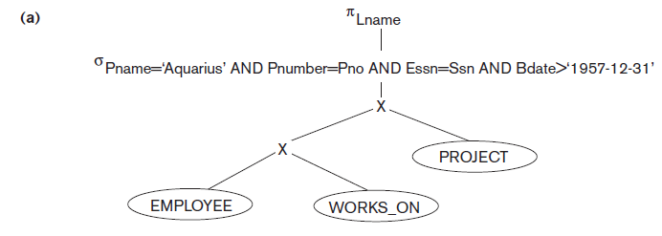
Query Transformation Example
Figure 19.2 Steps in converting a query tree during heuristic optimization. (a) Initial (canonical) query tree for SQL query Q.

Slide 10
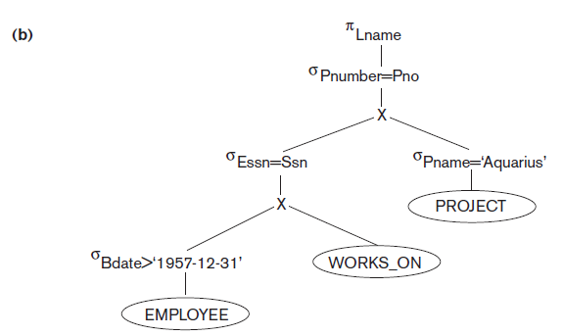
Query Transformation Example (cont’d.)
Figure 19.2 Steps in converting a query tree during heuristic optimization
(b) Moving SELECT operations down the query tree.

Slide 11
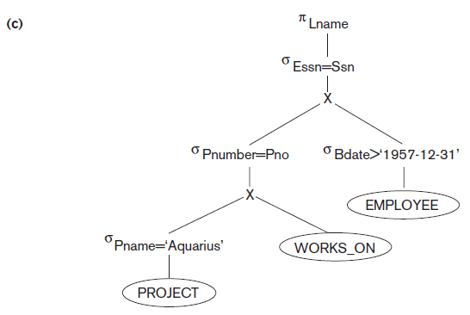
Query Transformation Example (cont’d.)
Figure 19.2 Steps in converting a query tree during heuristic optimization
(c) Applying the more restrictive SELECT operation first.

Slide 12
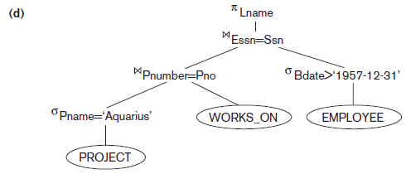
Query Transformation Example (cont’d.)
Figure 19.2 Steps in converting a query tree during heuristic optimization
(d) Replacing CARTESIAN PRODUCT and SELECT with JOIN operations.

Slide 13
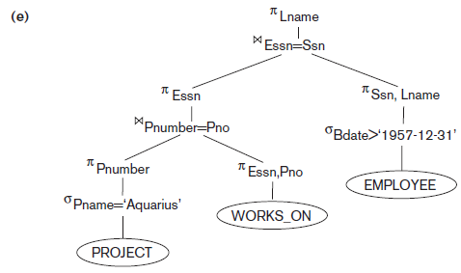
Query Transformation Example (cont’d.)
Figure 19.2 Steps in converting a query tree during heuristic optimization
(e) Moving PROJECT operations down the query tree.

Slide 14
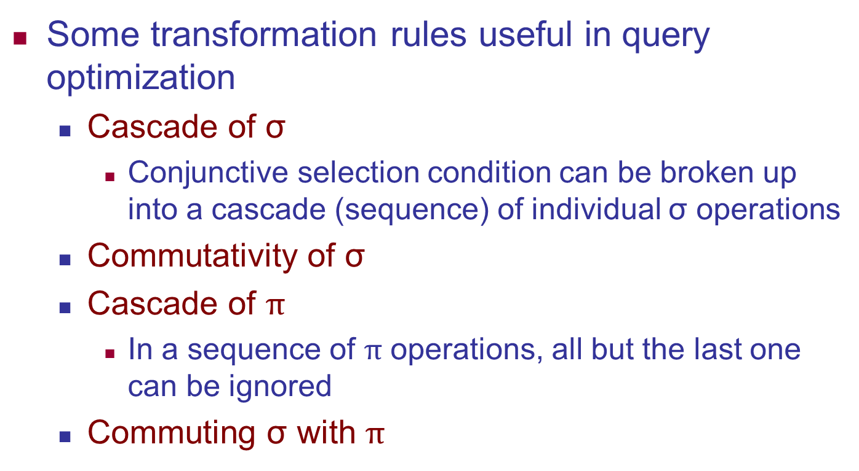
General Transformation Rules for Rational Algebra Equations

Slide 15
Summary of Heuristics for Algebraic Optimization
Apply first the operations that reduce the size of intermediate results
  Perform SELECT and PROJECT operations as early as possible to reduce the number of tuples and attributes
  The SELECT and JOIN operations that are most restrictive should be executed before other similar operations

Slide 16
19.2 Choice of Query Execution Plans
Materialized evaluation
  Result of an operation stored as temporary relation
Pipelined evaluation
  Operation results forwarded directly to the next operation in the query sequence

Slide 17
Nested Subquery Optimization
Unnesting
  Process of removing the nested query and converting the inner and outer query into one block
Queries involving a nested subquery connected by IN or ANY connector can always be converted into a single block query
Alternate technique
  Creating temporary result tables from subqueries and using them in joins

Slide 18
Subquery (View) Merging Transformation
Inline view
  FROM clause subquery
View merging operation
  Merges the tables in the view with the tables from the outer query block
  Views containing select-project-join operations are considered simple views
    Can always be subjected to this type of view-merging

Slide 19
Subquery (View) Merging Transformation (cont’d.)
Group-By view-merging
  Delaying the Group By operation after performing joins may reduce the data subjected to grouping in case the joins have low join selectivity
  Alternately, performing Group By early may reduce the amount of data subjected to subsequent joins
  Optimizer determines whether to merge GROUP-BY views based on estimated costs

Slide 20
Materialized Views
View defined in database as a query
  Materialized view stores results of that query
    May be stored temporarily or permanently
Optimization technique
  Using materialized views to avoid some of the computation involved in the query
  Easier to read it when needed than recompute from scratch

Slide 21
Incremental View Maintenance
Update view incrementally by accounting for changes that occurred since last update
  Join
  Selection
  Projection
  Intersection
  Aggregation

Slide 22
19.3 Use of Selectives in Cost-Based Optimization
Query optimizer estimates and compares costs of query execution using different strategies
  Chooses lowest cost estimate strategy
  Process suited to compiled queries
Interpreted queries
  Entire process occurs at runtime
  Cost estimate may slow down response time

Slide 23
Use of Selectives in Cost-Based Optimization (cont’d.)
Cost-based query optimization approach
  For a given query subexpression, multiple equivalence rules may apply
  Quantitative measure for evaluating alternatives
    Cost metric includes space and time requirements
  Design appropriate search strategies by keeping cheapest alternatives and pruning costlier alternatives
  Scope of query optimization is a query block
    Global query optimization involves multiple query blocks

Slide 24
Use of Selectives in Cost-Based Optimization (cont’d.)
Cost components for query execution
  Access cost to secondary storage
  Disk storage cost
  Computation cost
  Memory usage cost
  Communication cost

Slide 25
Catalog Information Used in Cost Functions
Information stored in DBMS catalog and used by optimizer
  File size
  Organization
  Number of levels of each multilevel index
  Number of distinct values of an attribute
  Attribute selectivity
    Allows calculation of selection cardinality
      Average number of records that satisfy equality selection condition on that attribute

Slide 26
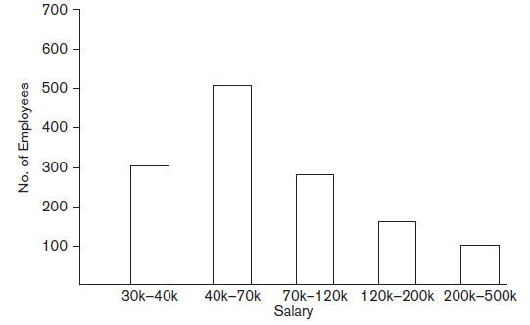
Histograms
Tables or data structures that record information about the distribution of data
RDBMS stores histograms for most important attributes
Figure 19.4 Histogram of salary in the relation EMPLOYEE

Slide 27
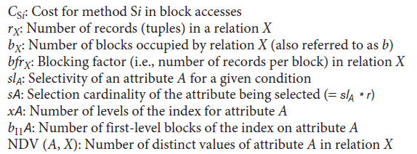
19.4 Cost Functions for SELECT Operation
Notation used in cost formulas

Slide 28
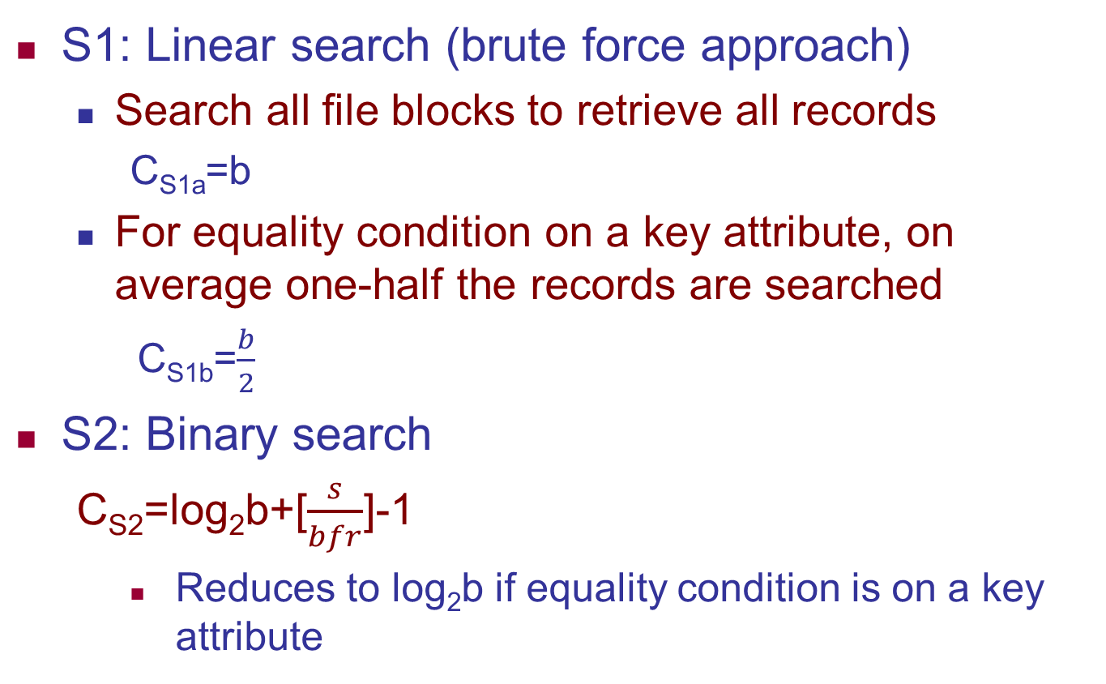
Cost Function for SELECT Operation (cont’d.)
S1: Linear search (brute force approach)
  Search all file blocks to retrieve all records
    C_{S1a}=b
  For equality condition on a key attribute, on average one-half the records are searched
    C_{S1b}=$\frac{b}{2}$
S2: Binary search
  C_{S2}=log₂b+[$\frac{s}{bfr}$]-1
    Reduces to log₂b if equality condition is on a key attribute

Slide 29
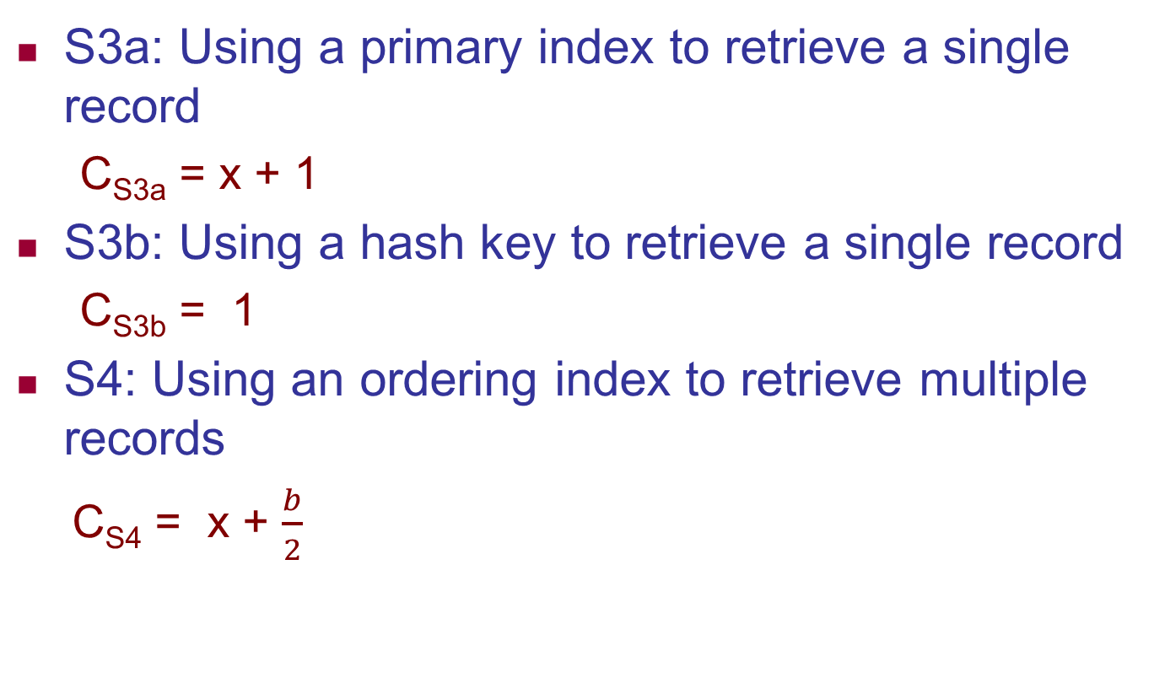
Cost Function for SELECT Operation (cont’d.)
S3a: Using a primary index to retrieve a single record
  C_{S3a} = x + 1
S3b: Using a hash key to retrieve a single record
  C_{S3b} = 1
S4: Using an ordering index to retrieve multiple records
  C_{S4} = x + $\frac{b}{2}$

Slide 30
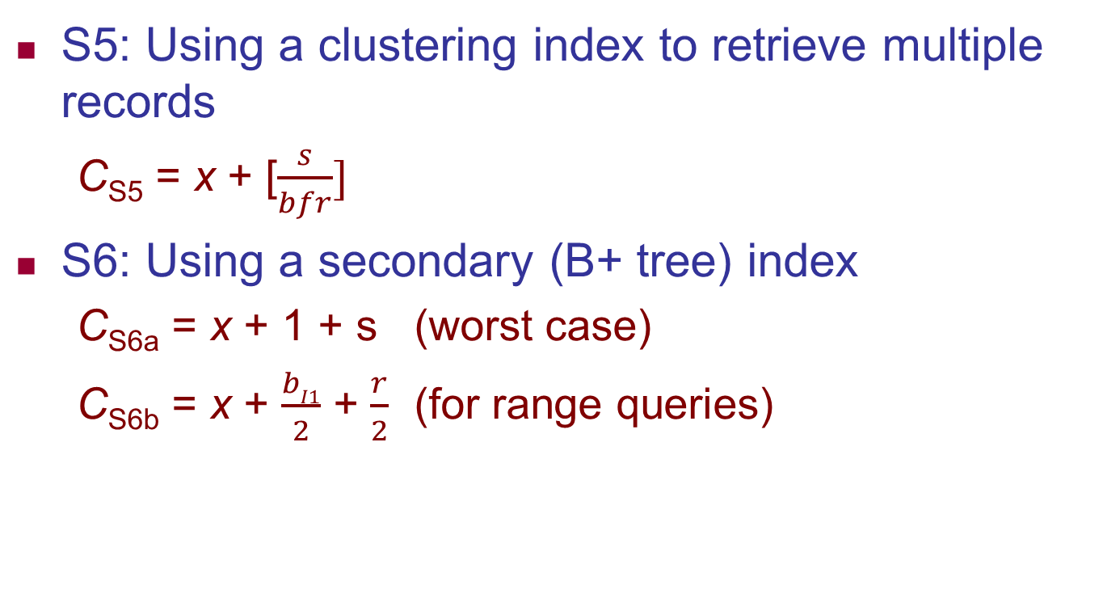
Cost Functions for SELECT Operation (cont’d.)

Slide 31
Cost Functions for SELECT Operation (cont’d.)
Dynamic programming
  Cost-based optimization approach
  Subproblems are solved only once
  Applies when a problem has subproblems that themselves have subproblems

Slide 32

19.5 Cost Functions for the JOIN Operation
Cost functions involve estimate of file size that results from the JOIN operation
Join selectivity
  Ratio of the size of resulting file to size of the CARTESIAN PRODUCT file
  Simple formula for join selectivity
Join cardinality

Slide 33

Cost Functions for the JOIN Operation (cont’d.)
J1: Nested-loop join
  For three memory buffer blocks:
  For n_{B} memory buffer blocks:
J2: Index-based nested-loop join
  For a secondary index with selection cardinality S_{B} for join attribute B of S:

Slide 34


Cost Functions for the JOIN Operation (cont’d.)
J3: Sort-merge join
  For files already sorted on the join attributes
  Cost of sorting must be added if sorting needed
J4: Partition-hash join

Slide 35




Cost Functions for the JOIN Operation (cont’d.)
Join selectivity and cardinality for semi-join
  Unnesting query above leads to semi-join
Join selectivity
Join cardinality

Slide 36
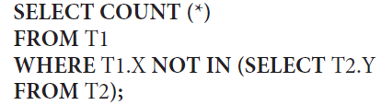


Cost Functions for the JOIN Operation (cont’d.)
Join selectivity and cardinality for anti-join
  Unnesting query above leads to anti-join
Join selectivity
Join cardinality

Slide 37
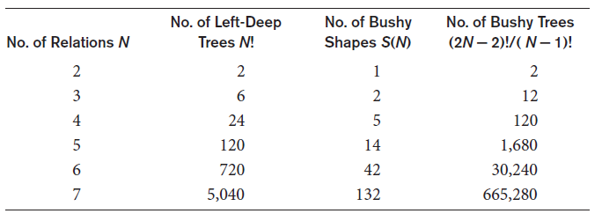
Cost Functions for the JOIN Operation (cont’d.)
Multirelation queries and JOIN ordering choices
  Left-deep join tree
  Right-deep join tree
  Bushy join tree
Table 19.1 Number of permutations of left-deep and bushy join trees of n relations

Slide 38
Cost Functions for the JOIN Operation (cont’d.)
Physical optimization involves execution decision at the physical level
  Cost-based physical optimization
    Top-down approach
    Bottom-up approach
Certain physical level heuristics make cost optimizations unnecessary
  Example: for selections, use index scans whenever possible

Slide 39
Cost Functions for the JOIN Operation (cont’d.)
Left-deep trees generally preferred
  Work well for common algorithms for join
  Able to generate fully pipelined plans
Characteristics of dynamic programming algorithm
  Optimal solution structure is developed
  Value of the optimal solution is recursively defined
  Optimal solution is computed and its value developed in a bottom-up fashion

Slide 40
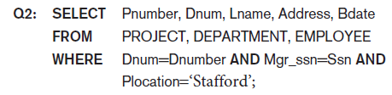
19.6 Example to Illustrate Cost-Based
Query Optimization
Example: Consider Q2 below and query tree from Figure 19.1(a) on slide 6
Information about the relations shown in Figure 19.6 (next slide)

Slide 41
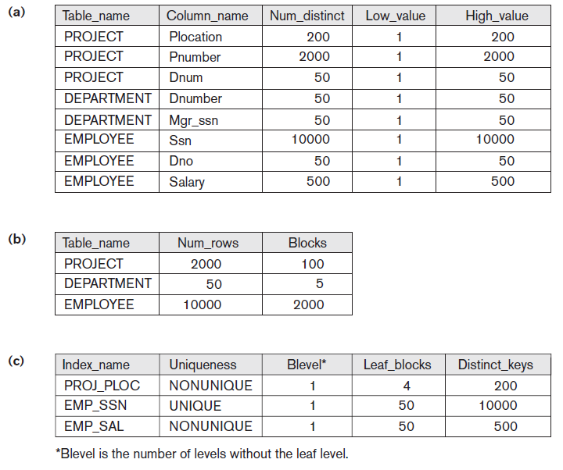
Figure 19.6 Sample statistical information for relations in Q2.
(a) Column information (b) Table information (c) Index information

Slide 42
Example to Illustrate Cost-Based
Query Optimization (cont’d.)
Assume optimizer considers only left-deep trees
Evaluate potential join orders
  PROJECT DEPARTMENT EMPLOYEE
  DEPARTMENT PROJECT EMPLOYEE
  DEPARTMENT EMPLOYEE PROJECT
  EMPLOYEE DEPARTMENT PROJECT

Slide 43
19.7 Additional Issues Related to Query Optimization
Displaying the system’s query execution plan
  Oracle syntax
    EXPLAIN PLAN FOR <SQL query>
  IBM DB2 syntax
    EXPLAIN PLAN SELECTION [additional options] FOR <SQL-query>
  SQL server syntax
    SET SHOWPLAN_TEXT ON or SET SHOWPLAN_XML ON or SET SHOWPLAN_ALL ON

Slide 44
Additional Issues Related to Query Optimization (cont’d.)
Size estimation of other operations
  Projection
  Set operations
  Aggregation
  Outer join
Plan caching
  Plan stored by query optimizer for later use by same queries with different parameters
Top k-results optimization
  Limits strategy generation

Slide 45
19.8 An Example of Query Optimization in Data Warehouses
Star transformation optimization
  Goal: access a reduced set of data from the fact table and avoid using a full table scan on it
  Classic star transformation
  Bitmap index star transformation
Joining back

Slide 46
19.9 Overview of Query Optimization in Oracle
Physical optimizer is cost-based
Scope is a single query block
Calculates cost based on object statistics, estimated resource use and memory needed
Global query optimizer
  Integrates logical transformation and physical optimization phases to generate optimal plan for entire query tree
Adaptive optimization
  Feedback loop used to improve on previous decisions

Slide 47
Overview of Query Optimization in Oracle (cont’d.)
Array processing
Hints
  Specified by application developer
  Embedded in text of SQL statement
  Types: access path, join order, join method, enabling or disabling a transformation
Outlines used to preserve execution plans
SQL plan management

Slide 48
19.10 Semantic Query Optimization
Uses constraints specified on the database schema
Goal: modify one query into another that is more efficient to execute

Slide 49
19.11 Summary
Query trees
Heuristic approaches used to improve efficiency of query execution
Reorganization of query trees
Pipelining and materialized evaluation
Cost-based optimization approach
Oracle query optimizer
Semantic query optimization

