Slide 1
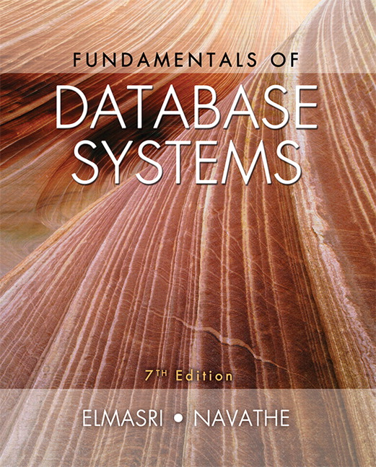

Slide 2
CHAPTER 18
Strategies for Query Processing

Slide 3
Introduction
DBMS techniques to process a query
  Scanner identifies query tokens
  Parser checks the query syntax
  Validation checks all attribute and relation names
  Query tree (or query graph) created
  Execution strategy or query plan devised
Query optimization
  Planning a good execution strategy

Slide 4
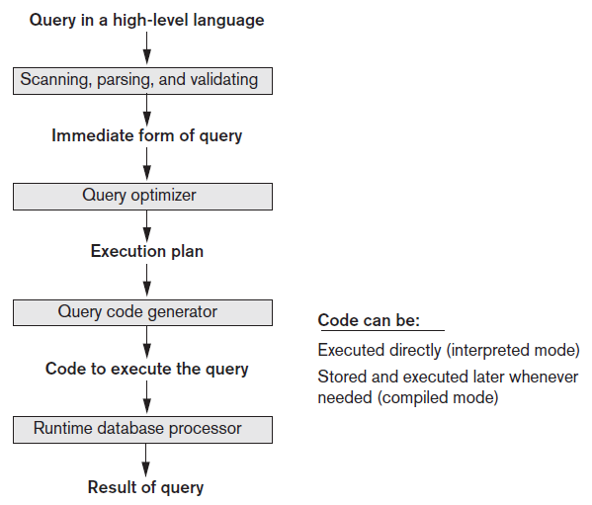
Query Processing
Figure 18.1 Typical steps when processing a high-level query

Slide 5
18.1 Translating SQL Queries into Relational Algebra and Other Operators
SQL
  Query language used in most RDBMSs
Query decomposed into query blocks
  Basic units that can be translated into the algebraic operators
  Contains single SELECT-FROM-WHERE expression
    May contain GROUP BY and HAVING clauses

Slide 6



Translating SQL Queries (cont’d.)
Example:
  Inner block
  Outer block

Slide 7


Translating SQL Queries (cont’d.)
Example (cont’d.)
  Inner block translated into:
  Outer block translated into:
Query optimizer chooses execution plan for each query block

Slide 8
Additional Operators Semi-Join and Anti-Join
Semi-join
  Generally used for unnesting EXISTS, IN, and ANY subqueries
  Syntax: T1.X S = T2.Y
    T1 is the left table and T2 is the right table of the semi-join
  A row of T1 is returned as soon as T1.X finds a match with any value of T2.Y without searching for further matches

Slide 9
Additional Operators Semi-Join and Anti-Join (cont’d.)
Anti-join
  Used for unnesting NOT EXISTS, NOT IN, and ALL subqueries
  Syntax: T1.x A = T2.y
    T1 is the left table and T2 is the right table of the anti-join
  A row of T1 is rejected as soon as T1.x finds a match with any value of T2.y
  A row of T1 is returned only if T1.x does not match with any value of T2.y

Slide 10
18.2 Algorithms for External Sorting
Sorting is an often-used algorithm in query processing
External sorting
  Algorithms suitable for large files that do not fit entirely in main memory
  Sort-merge strategy based on sorting smaller subfiles (runs) and merging the sorted runs
  Requires buffer space in main memory
    DBMS cache

Slide 11
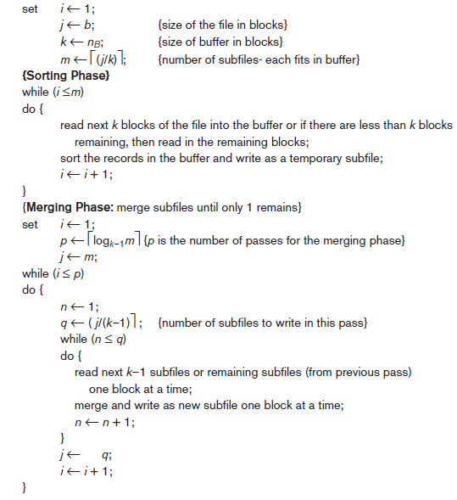
Figure 18.2 Outline of the sort-merge algorithm for external sorting

Slide 12
Algorithms for External Sorting (cont’d.)
Degree of merging
  Number of sorted subfiles that can be merged in each merge step
Performance of the sort-merge algorithm
  Number of disk block reads and writes before sorting is completed

Slide 13
18.3 Algorithms for SELECT Operation
SELECT operation
  Search operation to locate records in a disk file that satisfy a certain condition
  File scan or index scan (if search involves an index)
Search methods for simple selection
  S1: Linear search (brute force algorithm)
  S2: Binary search
  S3a: Using a primary index
  S3b: Using a hash key

Slide 14
Algorithms for SELECT Operation (cont’d.)
Search methods for simple selection (cont’d.)
  S4: Using a primary index to retrieve multiple records
  S5: Using a clustering index to retrieve multiple records
  S6: Using a secondary (B+ -tree) index on an equality comparison
  S7a: Using a bitmap index
  S7b: Using a functional index

Slide 15
Algorithms for SELECT Operation (cont’d.)
Search methods for conjunctive (logical AND) selection
  Using an individual index
  Using a composite index
  Intersection of record pointers
Disjunctive (logical OR) selection
  Harder to process and optimize

Slide 16
Algorithms for SELECT Operation (cont’d.)
Selectivity
  Ratio of the number of records (tuples) that satisfy the condition to the total number of records (tuples) in the file
  Number between zero (no records satisfy condition) and one (all records satisfy condition)
Query optimizer receives input from system catalog to estimate selectivity

Slide 17
18.4 Implementing the JOIN Operation
JOIN operation
  One of the most time consuming in query processing
  EQUIJOIN (NATURAL JOIN)
  Two-way or multiway joins
Methods for implementing joins
  J1: Nested-loop join (nested-block join)
  J2: Index-based nested-loop join
  J3: Sort-merge join
  J4: Partition-hash join

Slide 18
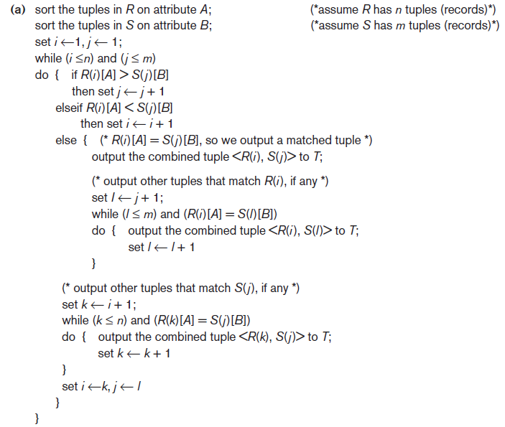

Implementing the JOIN Operation (cont’d.)
Figure 18.3 Implementing JOIN, PROJECT, UNION, INTERSECTION, and SET DIFFERENCE by using sort-merge, where R has n tuples and S has m tuples. (a) Implementing the operation

Slide 19
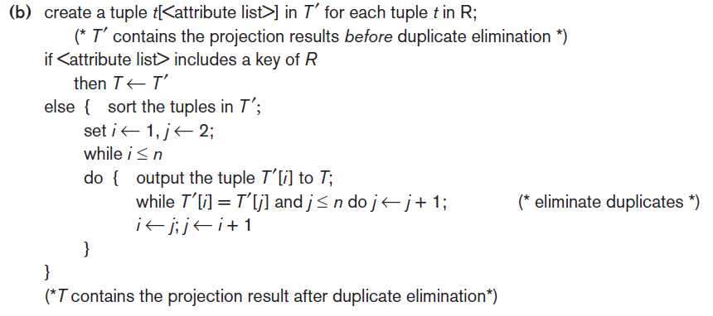

Implementing the JOIN Operation (cont’d.)
Figure 18.3 (cont’d.) Implementing JOIN, PROJECT, UNION, INTERSECTION, and SET DIFFERENCE by using sort-merge, where R has n tuples and S has m tuples. (b) Implementing the operation

Slide 20
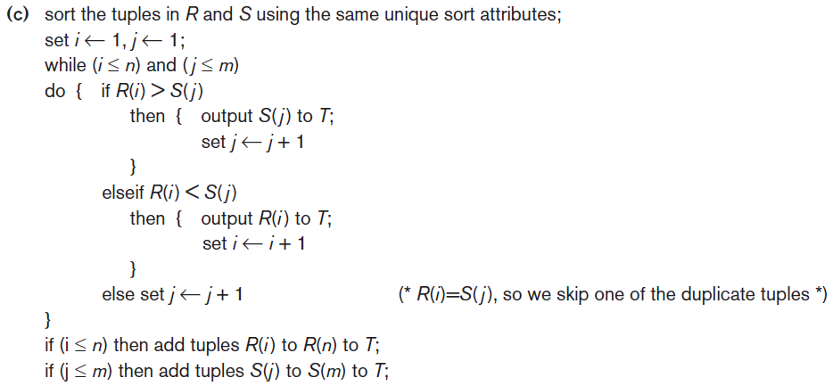
Implementing the JOIN Operation (cont’d.)
Figure 18.3 (cont’d.) Implementing JOIN, PROJECT, UNION, INTERSECTION, and SET DIFFERENCE by using sort-merge, where R has n tuples and S has m tuples. (c) Implementing the operation

Slide 21
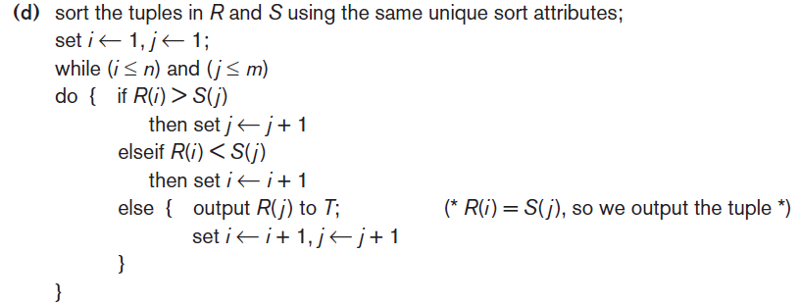
Implementing the JOIN Operation (cont’d.)
Figure 18.3 (cont’d.) Implementing JOIN, PROJECT, UNION, INTERSECTION, and SET DIFFERENCE by using sort-merge, where R has n tuples and S has m tuples. (d) Implementing the operation

Slide 22
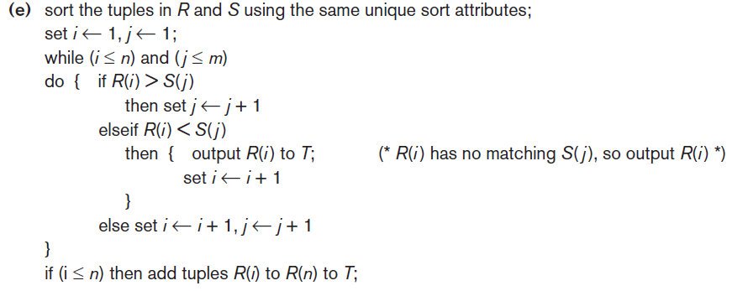
Implementing the JOIN Operation (cont’d.)
Figure 18.3 (cont’d.) Implementing JOIN, PROJECT, UNION, INTERSECTION, and SET DIFFERENCE by using sort-merge, where R has n tuples and S has m tuples. (e) Implementing the operation

Slide 23
Implementing the JOIN Operation (cont’d.)
Available buffer space has important effect on some JOIN algorithms
Nested-loop approach
  Read as many blocks as possible at a time into memory from the file whose records are used for the outer loop
  Advantageous to use the file with fewer blocks as the outer-loop file

Slide 24
Implementing the JOIN Operation (cont’d.)
Join selection factor
  Fraction of records in one file that will be joined with records in another file
  Depends on the particular equijoin condition with another file
  Affects join performance
Partition-hash join
  Each file is partitioned into M partitions using the same partitioning hash function on the join attributes
  Each pair of corresponding partitions is joined

Slide 25
Implementing the JOIN Operation (cont’d.)
Hybrid hash-join
  Variation of partition hash-join
  Joining phase for one of the partitions is included in the partition
  Goal: join as many records during the partitioning phase to save cost of storing records on disk and then rereading during the joining phase

Slide 26
18.5 Algorithms for PROJECT and Set Operations
PROJECT operation
  After projecting R on only the columns in the list of attributes, any duplicates are removed by treating the result strictly as a set of tuples
Default for SQL queries
  No elimination of duplicates from the query result
    Duplicates eliminated only if the keyword DISTINCT is included

Slide 27
Algorithms for PROJECT and Set Operations (cont’d.)
Set operations
  UNION
  INTERSECTION
  SET DIFFERENCE
  CARTESIAN PRODUCT
Set operations sometimes expensive to implement
  Sort-merge technique
  Hashing

Slide 28

Algorithms for PROJECT and Set Operations (cont’d.)
Use of anti-join for SET DIFFERENCE
  EXCEPT or MINUS in SQL
  Example: Find which departments have no employees
  becomes

Slide 29

18.6 Implementing Aggregate Operations and Different Types of JOINs
Aggregate operators
  MIN, MAX, COUNT, AVERAGE, SUM
  Can be computed by a table scan or using an appropriate index
Example:
  If an (ascending) B+ -tree index on Salary exists:
    Optimizer can use the Salary index to search for the largest Salary value
    Follow the rightmost pointer in each index node from the root to the rightmost leaf

Slide 30
Implementing Aggregate Operations and Different Types of JOINs (cont’d.)
AVERAGE or SUM
  Index can be used if it is a dense index
  Computation applied to the values in the index
  Nondense index can be used if actual number of records associated with each index value is stored in each index entry
COUNT
  Number of values can be computed from the index

Slide 31
Implementing Aggregate Operations and Different Types of JOINs (cont’d.)
Standard JOIN (called INNER JOIN in SQL)
Variations of joins
  Outer join
    Left, right, and full
    Example:
  Semi-Join
  Anti-Join
  Non-Equi-Join

Slide 32
18.7 Combining Operations Using Pipelining
SQL query translated into relational algebra expression
  Sequence of relational operations
Materialized evaluation
  Creating, storing, and passing temporary results
General query goal: minimize the number of temporary files
Pipelining or stream-based processing
  Combines several operations into one
  Avoids writing temporary files

Slide 33
Combining Operations Using Pipelining (cont’d.)
Pipelined evaluation benefits
  Avoiding cost and time delay associated with writing intermediate results to disk
  Being able to start generating results as quickly as possible
Iterator
  Operation implemented in such a way that it outputs one tuple at a time
  Many iterators may be active at one time

Slide 34
Combining Operations Using Pipelining (cont’d.)
Iterator interface methods
  Open()
  Get_Next()
  Close()
Some physical operators may not lend themselves to the iterator interface concept
  Pipelining not supported
Iterator concept can also be applied to access methods

Slide 35
18.8 Parallel Algorithms for Query Processing
Parallel database architecture approaches
  Shared-memory architecture
    Multiple processors can access common main memory region
  Shared-disk architecture
    Every processor has its own memory
    Machines have access to all disks
  Shared-nothing architecture
    Each processor has own memory and disk storage
    Most commonly used in parallel database systems

Slide 36
Parallel Algorithms for Query Processing (cont’d.)
Linear speed-up
  Linear reduction in time taken for operations
Linear scale-up
  Constant sustained performance by increasing the number of processors and disks

Slide 37
Parallel Algorithms for Query Processing (cont’d.)
Operator-level parallelism
  Horizontal partitioning
    Round-robin partitioning
    Range partitioning
    Hash partitioning
Sorting
  If data has been range-partitioned on an attribute:
    Each partition can be sorted separately in parallel
    Results concatenated
  Reduces sorting time

Slide 38
Parallel Algorithms for Query Processing (cont’d.)
Selection
  If condition is an equality condition on an attribute used for range partitioning:
    Perform selection only on partition to which the value belongs
Projection without duplicate elimination
  Perform operation in parallel as data is read
Duplicate elimination
  Sort tuples and discard duplicates

Slide 39
Parallel Algorithms for Query Processing (cont’d.)
Parallel joins divide the join into n smaller joins
  Perform smaller joins in parallel on n processors
  Take a union of the result
Parallel join techniques
  Equality-based partitioned join
  Inequality join with partitioning and replication
  Parallel partitioned hash join

Slide 40
Parallel Algorithms for Query Processing (cont’d.)
Aggregation
  Achieved by partitioning on the grouping attribute and then computing the aggregate function locally at each processor
Set operations
  If argument relations are partitioned using the same hash function, they can be done in parallel on each processor

Slide 41
Parallel Algorithms for Query Processing (cont’d.)
Intraquery parallelism
  Approaches
    Use parallel algorithm for each operation, with appropriate partitioning of the data input to that operation
    Execute independent operations in parallel
Interquery parallelism
  Execution of multiple queries in parallel
  Goal: scale up
  Difficult to achieve on shared-disk or shared-nothing architectures

Slide 42
18.9 Summary
SQL queries translated into relational algebra
External sorting
Selection algorithms
Join operations
Combining operations to create pipelined execution
Parallel database system architectures

