Slide 1
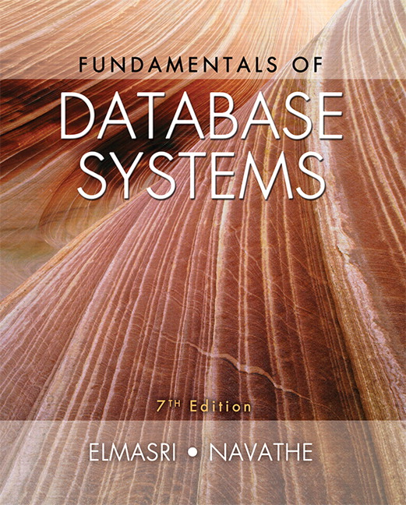

Slide 2
CHAPTER 13
XML: Extensible Markup Language

Slide 3
Introduction
Databases function as data sources for Web applications
  HTML
    Used in static Web pages
  XML, JSON
    Self-describing documents
    Dynamic Web pages
Chapter focus: XML data model and languages

Slide 4
13.1 Structured, Semistructured, and Unstructured Data
Structured data
  Stored in relational database
Semistructured data
  Not all data has identical structure
  Schema information mixed in
    Self-describing
  Directed graph model
Unstructured data
  Limited data type indication
  Example: Web pages in HTML

Slide 5
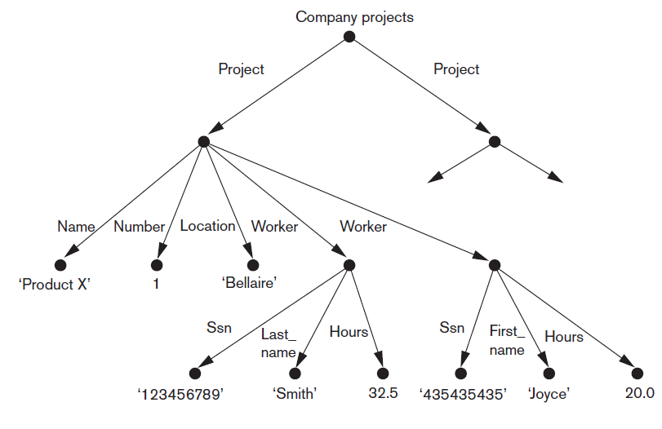
Directed Graph Model for Semistructured Data
Figure 13.1 Representing semistructured data as a graph

Slide 6
Structured, Semistructured, and Unstructured Data (cont’d.)
HTML uses predefined tags
  Document header
    Script functions, formatting styles
  Body
  Table tags
  Attributes
  Large number of predefined tags
XHTML
  Extends tags for different applications

Slide 7
13.2 XML Hierarchical (Tree) Data Model
Basic object: XML document
  Element
    Simple
    Complex
    Schema document defines element names
  Attribute
Document types
  Data-centric
  Document-centric
  Hybrid

Slide 8
13.3 XML Documents, DTD, and XML Schema
Conditions for well-formed XML documents
  Begins with XML declaration
  Syntactically correct
  Valid
    Must follow a particular schema

Slide 9
XML Documents, DTD, and XML Schema (cont’d.)
Notation for specifying elements
  elementname* indicates optional multivalued (repeating) element
  elementname+ indicates required multivalued (repeating) element
  elementname? indicates optional single-valued (non-repeating) element
  elementname indicates required single-valued (non-repeating) element

Slide 10
XML Documents, DTD, and XML Schema (cont’d.)
Notation for specifying elements (cont’d.)
  Type specified by parentheses following the element name
  !ATTLIST used to specify attributes within the element
  Parentheses can be nested when specifying elements
  Bar symbol (e₁|e₂) indicates either e₁ or e₂ can appear in the document

Slide 11
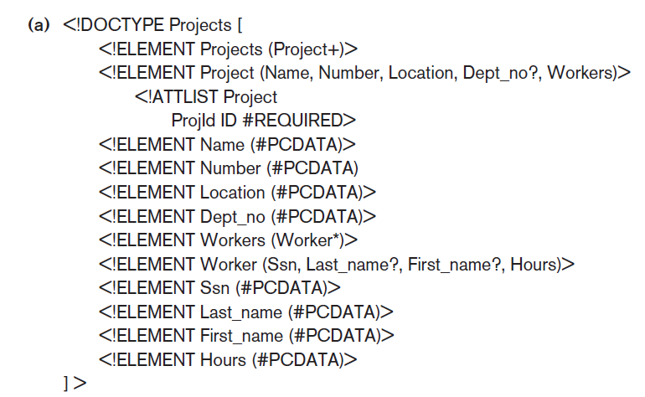
XML Documents, DTD, and XML Schema (cont’d.)
Figure 13.4(a) An XML DTD file called ‘Projects’

Slide 12
XML Schema
XML schema language
  Specifies document structure
  Same syntax rules as XML documents
  Elements, attributes, keys, references, and identifiers
  Example: Figure 13.5 in the text

Slide 13
XML Schema (cont’d.)
XML namespace
  Defines set of commands that can be used
Annotations, documentation, and language used
Elements and types
  Root element
  First-level elements
  Specifying element type and min and max occurrences

Slide 14
XML Schema (cont’d.)
Keys
  Constraints that correspond to relational database
  Primary key
  Foreign key
Complex elements
  xsd:complexType
Composite (compound) attributes

Slide 15
13.4 Storing and Extracting XML Documents from Databases
Use file system or DBMS to store documents as text
Use DBMS to store document contents as data elements
Design specialized system to store XML data
Create or publish custom XML documents from preexisting relational databases
  This approach explored further in 13.6

Slide 16
13.5 XML Languages
Query language standards
  XPath
  XQuery
Specifying XPath expressions in XML
  Returns sequence of items satisfying certain pattern
    Values, elements, or attributes
  Qualifier conditions
  Separators
    Single slash / or double slash //

Slide 17
XPath (cont’d.)
Example
  For COMPANY.XML document stored at location www.company.com/info.XML
  doc(www.company.com/infor.XML)/company returns company root node and all descendant nodes

Slide 18
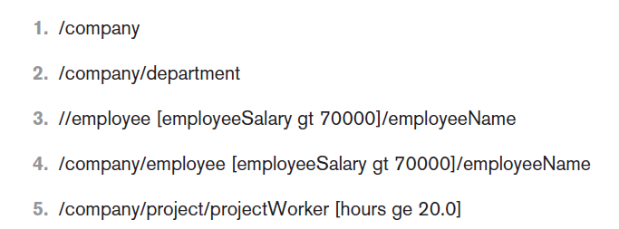
XPath (cont’d.)
Figure 13.6 Some examples of XPath expressions on XML documents that follow the XML schema file company in Figure13.5.

Slide 19
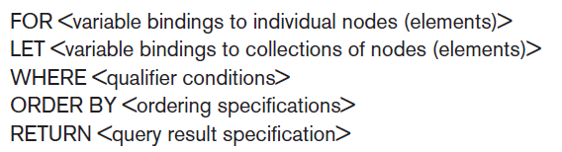
XQuery: Specifying Queries in XML
FLWOR expression
Variables preceded with $
For assigns variable to a range
Where specifies additional conditions
Order by specifies order of result elements
Return specifies elements for retrieval

Slide 20
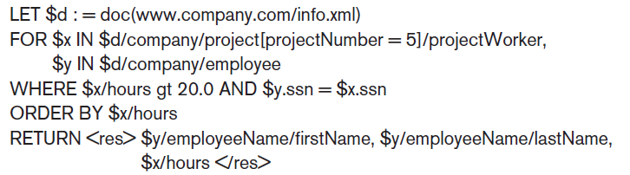
XQuery: Specifying Queries in XML
Example

Slide 21
Other Languages and Protocols Related to XML
Extensible Stylesheet Language (XSL)
Extensible Stylesheet Language for Transformations (XSLT)
Web Services Description Language (WSDL)
Simple Object Access Protocol (SOAP)
Resource Description Framework (RDF)

Slide 22
13.6 Extracting XML Documents from Relational Databases
XML uses hierarchical (tree) model
Common database model is flat relational database
Conceptually represent using ER schema
University example (follows)
  Choices for root: course, student, section

Slide 23
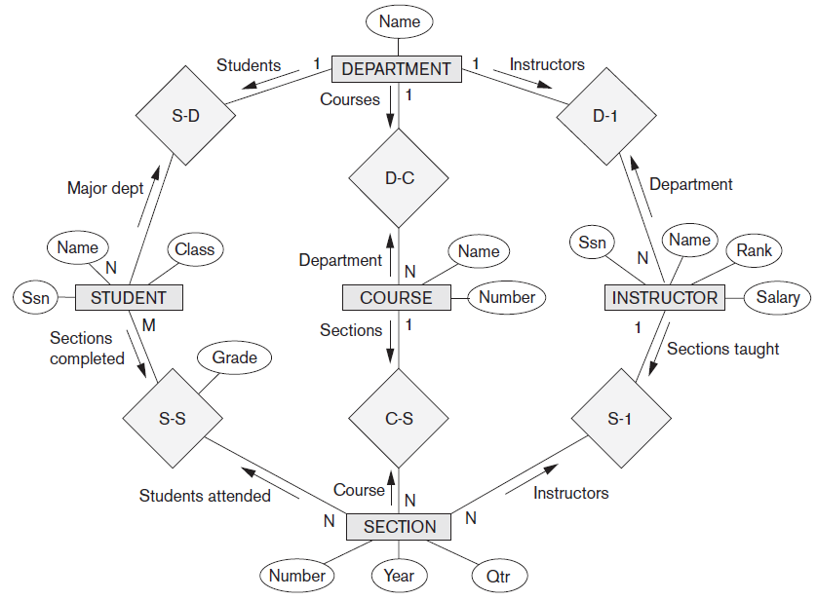
University Example
Figure 13.8 An ER schema diagram for a simplified UNIVERSITY database

Slide 24
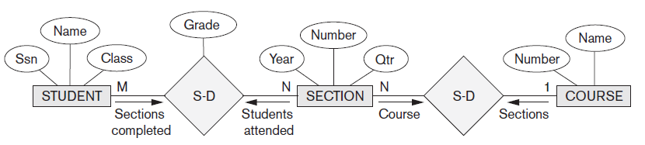
University Example (cont’d.)
Figure 13.9 Subset of the UNIVERSITY database schema needed for XML document extraction

Slide 25
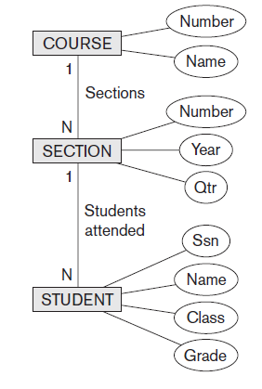
University Example (cont’d.)
Figure 13.10 Hierarchical (tree) view with ‘COURSE’ as the root

Slide 26
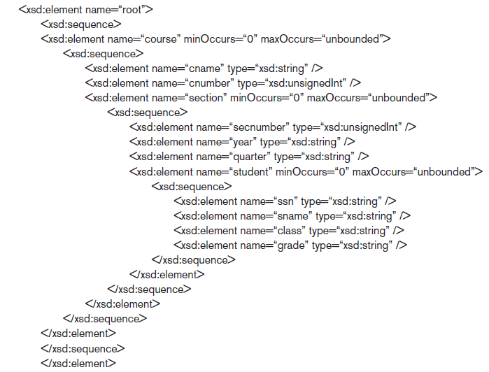
University Example (cont’d.)
Figure 13.11 XML schema with ‘COURSE’ as the root

Slide 27
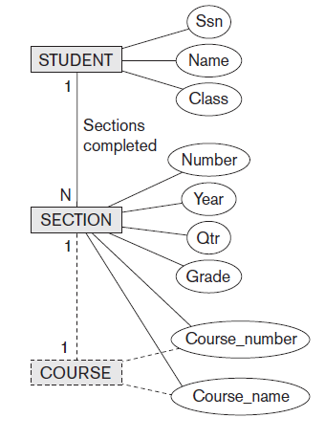
University Example (cont’d.)
Figure 13.12 Hierarchical (tree) view with ‘STUDENT’ as the root

Slide 28
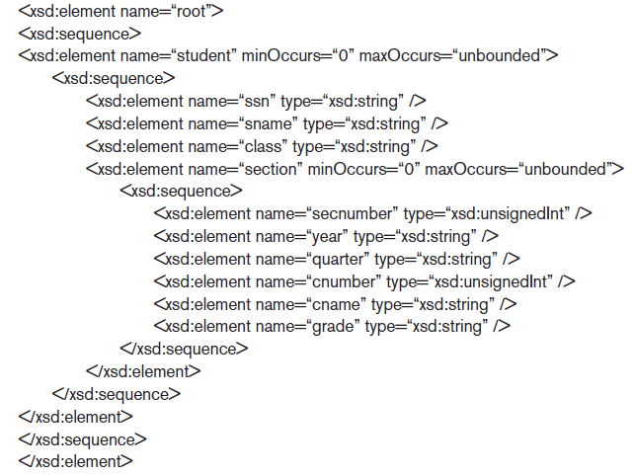
University Example (cont’d.)
Figure 13.13 XML schema document with ‘STUDENT’ as the root

Slide 29
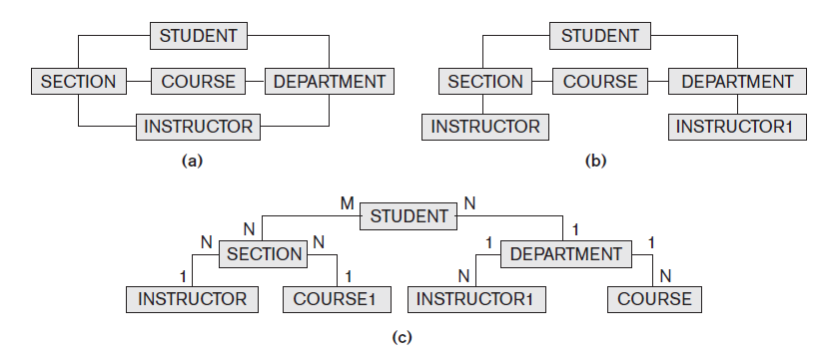
Breaking Cycles to Convert Graphs into Trees

Slide 30
Other Steps for Extracting XML Documents from Databases
Create SQL query to extract desired information
Execute the query
Restructure from flat to tree structure
Customize query to select single or multiple objects into the document

Slide 31
13.7 XML/SQL: SQL Functions for Creating XML Data
XMLELEMENT
  Specifies tag (element) name that will appear in XML result
XMLFOREST
  Specifies multiple element names
XMLAGG
  Aggregate several elements
XMLROOT
  Selected elements formatted as XML document with single root element

Slide 32


XML/SQL: SQL Functions for Creating XML Data (cont’d.)
XMLATTRIBUTES
  Creates attributes for the elements of the XML result
Example: create XML element containing the EMPLOYEE lastname for the employee with SSN 123456789
  Result:

Slide 33
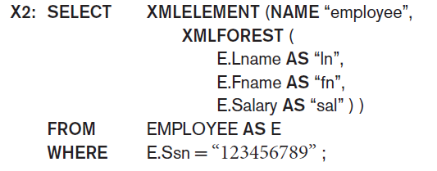
Employee Example (Query 2)
To retrieve multiple columns for a single row:
Result:

Slide 34
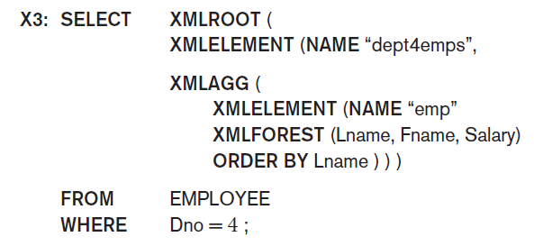
Employee Example (Query 3)
To create XML document with last name, first name, and salary of employees from Dept. 4:

Slide 35
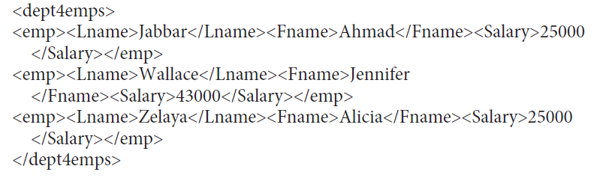
Employee Example (Query 3 cont’d.)
Result:

Slide 36
13.8 Summary
Structured, semistructured, and unstructured data
Hierarchical data model of XML standard
Languages for specifying structure
  XML DTD and XML schema
Approaches for storing XML documents
XPath and XQuery languages
Mapping issues
SQL/XML allows formatting query results as XML data

