Slide 1
Computer Security: Principles and Practice
Chapter 24: Wireless Network Security
EECS710: Information Security
Professor Hossein Saiedian
Fall 2014
Notes:
Lecture slides prepared by Dr Lawrie Brown (UNSW@ADFA) for “Computer Security: Principles and Practice”, 1/e, by William Stallings and Lawrie Brown, Chapter 1 “Overview”.

Slide 2
Wireless Security Overview
Concerns for wireless security are similar to those found in a wired environment
Security requirements are the same:
Confidentiality, integrity, availability, authenticity, accountability
Most significant source of risk is the underlying communications medium
Notes:
The concerns for wireless security, in terms of threats, and countermeasures, are
similar to those found in a wired environment, such as an Ethernet LAN or a wired
wide-area network. The security requirements are the same in both environments:
confidentiality, integrity, availability, authenticity, and accountability. However,
some of the security threats are exacerbated in a wireless environment and some are
unique to the wireless environment. The most significant source of risk in wireless
networks is the underlying communications medium. In addition, there have
traditionally been security risks in wireless protocols that have only been addressed
in relatively recent generations of these protocols.

Slide 3
Wireless Network Modes
The 802.11 wireless networks operate in two basic modes:
Infrastructure mode
Ad-hoc mode
Infrastructure mode
Each wireless client connects directly to a central device called Access Point (AP)
No direct connection between wireless clients
AP acts as a wireless hub that performs the connections and handles them between wireless clients

Slide 4
Wireless Network Modes
Ad-hoc mode:
Each wireless client connects directly with each other
No central device managing the connections
Rapid deployment of a temporal network where no infrastructures exist (advantage in case of disaster…)
Each node must maintain its proper authentication list

Slide 5
Key Factors Contributing to Risks
Channel: broadcast communication (more susceptible to eavesdropping and jamming)
Mobility: additional risks (later)
Resources: advanced OS (iPhone, Android), but limited resources (memory, processing)
Accessibility: Certain devices may be left unattended

Slide 6
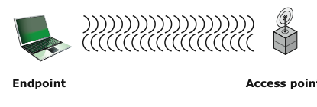
Wireless Networking Components (Facilitating points of attack)
Wireless client: WIFI-enabled laptop/tablet, cell phone, Bluetooth device, …
Access point: Cell towers, WIFI hotspots, wireless routers
Transmission medium: carries signals
Notes:
In simple terms, the wireless environment consists of three components that
provide point of attack ( Figure 24.1 ). The wireless client can be a cell phone, a
Wi-Fi enabled laptop or tablet, a wireless sensor, a Bluetooth device, and so on.
The wireless access point provides a connection to the network or service. Examples
of access points are cell towers, Wi-Fi hot spots, and wireless access points to wired
local or wide-area networks. The transmission medium, which carries the radio
waves for data transfer, is also a source of vulnerability.

Slide 7
Wireless Network Threats
Accidental association
Malicious association
Ad hoc networks
Nontraditional networks
Identity theft (MAC spoofing)
Man-in-the middle attacks
Denial of service (DoS)
Network injection
No central
point
of control
Bluetooth,
PDAs (spoofing
and eavesdropping)
Bogus reconfiguration
cmds to routers/switches
and degrade performance
Notes:
[CHOI08] lists the following security threats to wireless networks:
• Accidental association: Company wireless LANs or wireless access points to
wired LANs in close proximity (e.g., in the same or neighboring buildings) may
create overlapping transmission ranges. A user intending to connect to one
LAN may unintentionally lock on to a wireless access point from a neighboring
network. Although the security breach is accidental, it nevertheless exposes
resources of one LAN to the accidental user.
• Malicious association: In this situation, a wireless device is configured to
appear to be a legitimate access point, enabling the operator to steal passwords
from legitimate users and then penetrate a wired network through a legitimate
wireless access point.
• Ad hoc networks: These are peer-to-peer networks between wireless
computers with no access point between them. Such networks can pose a
security threat due to a lack of a central point of control.
• Nontraditional networks: Nontraditional networks and links, such as personal
network Bluetooth devices, barcode readers, and handheld PDAs pose a
security risk both in terms of eavesdropping and spoofing.
• Identity theft (MAC spoofing): This occurs when an attacker is able to
eavesdrop on network traffic and identify the MAC address of a computer
with network privileges.
• Man-in-the middle attacks: This type of attack is described in Chapter 21 in
the context of the Diffie-Hellman key exchange protocol. In a broader sense,
this attack involves persuading a user and an access point to believe that they
are talking to each other when in fact the communication is going through an
intermediate attacking device. Wireless networks are particularly vulnerable
to such attacks.
• Denial of service (DoS): This type of attack was discussed in detail in
Chapter 7 . In the context of a wireless network, a DoS attack occurs when an
attacker continually bombards a wireless access point or some other accessible
wireless port with various protocol messages designed to consume
system resources. The wireless environment lends itself to this type of attack,
because it is so easy for the attacker to direct multiple wireless messages at
the target.
• Network injection: A network injection attack targets wireless access points
that are exposed to non-filtered network traffic, such as routing protocol
messages or network management messages. An example of such an attack is
one in which bogus reconfiguration commands are used to affect routers and
switches to degrade network performance.

Slide 8
Wireless Security Measures
Signal hiding
Turn off SSID name broadcasting
Cryptic names
Reduce signal strengths (place away from windows and external walls
Directional antennas
Encryption (standard)

Slide 9
Securing Wireless Networks
Use encryption
Use and enable anti-virus, anti-spyware, firewall
Turn off SSID broadcasting
Change default identifier on router
Change router’s preset password
Apply MAC-filtering

Slide 10
SSID – Service Set Identification
Identifies a particular wireless network
A client must set the same SSID as the one in that particular AP Point to join the network
Without SSID, the client won’t be able to select and join a wireless network
Hiding SSID is not a security measure because the wireless network in this case is not invisible
It can be defeated by intruders by sniffing it from any probe signal containing it.

Slide 11
SSID
A way for vendors to make more money
It is easy to find the ID for a “hidden” network because the beacon broadcasting cannot be turned off
Simply use a utility to show all the current networks:
inSSIDer
NetStumbler
Kismet

Slide 12
Mobile Device Security Challenges
No more tight control over computing devices
Growing use of mobile (endpoint) devices
Cloud-based applications readily available (Box, Dropbox, Skype, …)
De-perimeterization: static network perimeter is gone
External business requirements (guests, third-party contractors, …)
Bring Your Own Device (BYOD)
The above results in threats (next page)

Slide 13
Mobile Device Security Threats
Lack of physical security control
Use of untrusted mobile devices
Use of untrusted networks
Use of apps created by unknown parties
Interaction with other systems (e.g., cloud-based data sync)
Use of untrusted contents

Slide 14
Mobile Device Security Strategy
Device security (next slide)
Traffic security (e.g., SSL, VPNs)
Barrier security (e.g., firewalls, IDS/IPS)

Slide 15
Mobile Device Security
Configure (enable) auto-lock
Configure/enable SSL
Enable password/PIN protection
Configure (disable/discourage) auto-completion (for passwords)
Enable remove wipe
Up-to-date OS/software
Install anti-virus software
Encrypt sensitive data on mobile devices
Prohibit installation of third-party apps
Policy development followed by training

Slide 16
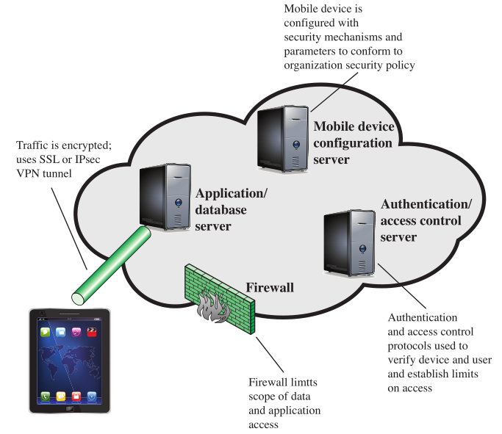
Mobile Device Security Elements
Configure based
on policy
Encrypt
Authenticate/
access control

Slide 17
IEEE 802.11 Wireless LAN
IEEE 802: a committee responsible for LANs
IEEE 802.11: responsible for developing wireless protocols
Many standards
The Wi-Fi alliance: became popular with 802.11b
Wi-Fi Protected Access (WPA, WPA2)

Slide 18
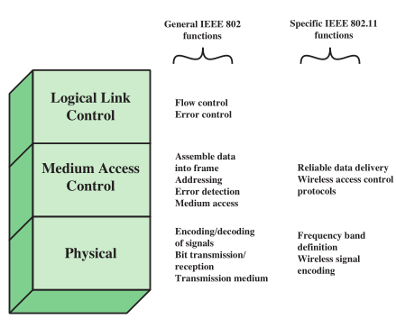
IEEE 802.11 Protocol Stack
Physical layer (encode/decode signals)
MAC layer: assembles MAC frame, disassembles frames and performs address recognition
LLC: keeps track of frame transmission

Slide 19
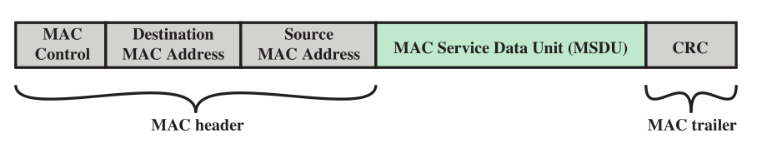
A MAC Frame (MPUD)
MAC protocol data unit (MPUD)

Slide 20
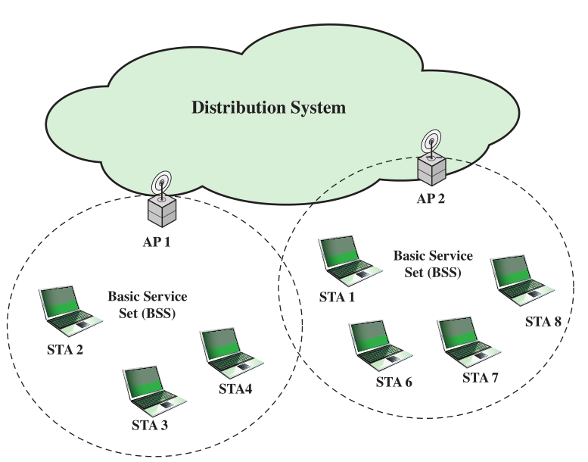
IEEE 802.11 Extended Service Set
BSS: the smallest building block
BSSs connected via APs
Aps functions as bridges
ESS: two or more BSSs

Slide 21
IEEE 802.11# Wireless Security
Wired Equivalent Privacy (WEP)
Wi-Fi Protected Access (WPA)
WPA2
Robust Security network (RSN)

Slide 22
WEP - Wired Equivalent Privacy
The original native security mechanism for WLAN
provide security through a 802.11 network
Used to protect wireless communication from eavesdropping (confidentiality)
Prevent unauthorized access to a wireless network (access control)
Prevent tampering with transmitted messages
Provide users with the equivalent level of privacy inbuilt in wireless networks.

Slide 23
How WEP works
IV
original unencrypted packet
checksum
RC4
key
IV
encrypted packet

Slide 24
WEP Flaws and Vulnerabilities
Weak keys:
It allows an attacker to discover the default key being used by the Access Point and client stations
This enables an attacker to decrypt all messages being sent over the encrypted channel.
IV (initialization vector) reuse and small size:
There are 2²⁴ different IVs
On a busy network, the IV will surely be reused, if the default key has not been changed and the original message can be retrieved relatively easily.

Slide 25

Attacks on WEP
WEP encrypted networks can be cracked in 10 minutes
Goal is to collect enough IVs to be able to crack the key
IV = Initialization Vector, plaintext appended to the key to avoid Repetition
Injecting packets generates IVs

Slide 26
Attacks on WEP
Backtrack 5 (Released 1st March 2012)
Tutorial is available
All required tools on a Linux bootable CD + laptop + wireless card

Slide 27
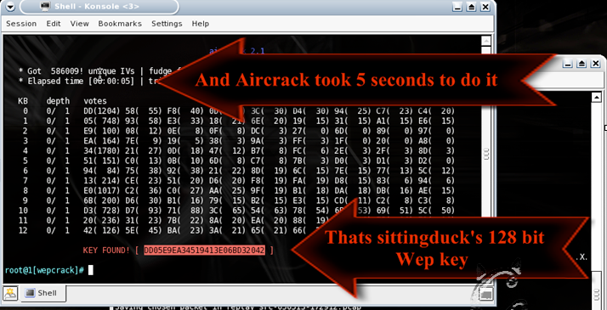
WEP Cracking Example

Slide 28
WPA - WI-FI Protected Access
New technique in 2002
Replacement of security flaws of WEP
Improved data encryption
Strong user authentication
Because of many attacks related to static key, WPA minimize shared secret key in accordance with the frame transmission
Use the RC4 algorithm in a proper way and provide fast transfer of the data before someone can decrypt the data.

Slide 29
WPA2 - WI-FI Protected Access 2
Based on the IEEE 802.i standard
2 versions: Personal & Enterprise
The primary enhancement over WPA is the use of the AES (Advanced Encryption Standard) algorithm
The encryption in WPA2 is done by utilizing either AES or TKIP
The Personal mode uses a PSK (Pre-shared key) & does not require a separate authentication of users
The enterprise mode requires the users to be separately authenticated by using the EAP protocol

Slide 30
WPA2
WPA2 has immunity against many types of hacker attacks
Man-in-the middle
Authentication forging
Replay
Key collision
Weak keys
Packet forging
Dictionary attacks

Slide 31
WEP vs WPA vs WPA2
 | WEP | WPA | WPA2
ENCRYPTION | RC4 | RC4 | AES
KEY ROTATION | NONE | Dynamic Session Keys | Dynamic Session Keys
KEY DISTRIBUTION | Manually typed into each device | Automatic distribution available | Automatic distribution available
AUTHENTICATION | Uses WEP key as Authentication | Can use 802.1x & EAP | Can use 802.1x & EAP

Slide 32
Procedures to Improve Wireless Security
Use wireless intrusion prevention system (WIPS)
Enable WPA-PSK
Use a good passphrase (https://grc.com/password)
Use WPA2 where possible
AES is more secure, use TKIP for better performance
Change your SSID every so often
Wireless network users should use or upgrade their network to the latest security standard released

Slide 33
Wireless Network Tools
MAC Spoofing
http://aspoof.sourceforge.net/
http://www.gorlani.com/publicprj/macmakeup/macmakeup.asp
http://www.klcconsulting.net/smac/
WEP Cracking tools
http://www.backtrack-linux.org/
http://www.remote-exploit.org/articles/backtrack/index.html
http://wepattack.sourceforge.net/
http://wepcrack.sourceforge.net/
Wireless Analysers
http://www.kismetwireless.net/
http://www.netstumbler.com/

Slide 34
Securing Wireless Transmission
Signal hiding (and SSID hiding)
Reduce signal strengths
Encryption: encrypt all wireless transmissions
Notes:
Following [CHOI08], we can group wireless security measures into those dealing
with wireless transmissions, wireless access points, and wireless networks (consisting
of wireless routers and endpoints).
The principal threats to wireless transmission
are eavesdropping, altering or inserting messages, and disruption. To deal with
eavesdropping, two types of countermeasures are appropriate:
• Signal-hiding techniques: Organizations can take a number of measures to
make it more difficult for an attacker to locate their wireless access points,
including turning off service set identifier (SSID) broadcasting by wireless
access points; assigning cryptic names to SSIDs; reducing signal strength to the
lowest level that still provides requisite coverage; and locating wireless access
points in the interior of the building, away from windows and exterior walls.
Greater security can be achieved by the use of directional antennas and of
signal-shielding techniques.
• Encryption: Encryption of all wireless transmission is effective against
eavesdropping to the extent that the encryption keys are secured.
The use of encryption and authentication protocols is the standard method of
countering attempts to alter or insert transmissions.
The methods discussed in Chapter 7 for dealing with denial of service apply
to wireless transmissions. Organizations can also reduce the risk of unintentional
DoS attacks. Site surveys can detect the existence of other devices using the same
frequency range, to help determine where to locate wireless access points. Signal
strengths can be adjusted and shielding used in an attempt to isolate a wireless
environment from competing nearby transmissions.

Slide 35
Securing Access Point
Disallow unauthorized access to the AP
Require authentication for any access including for devices wishing to attach themselves to the AP
Notes:
Following [CHOI08], we can group wireless security measures into those dealing
with wireless transmissions, wireless access points, and wireless networks (consisting
of wireless routers and endpoints).
The principal threats to wireless transmission
are eavesdropping, altering or inserting messages, and disruption. To deal with
eavesdropping, two types of countermeasures are appropriate:
• Signal-hiding techniques: Organizations can take a number of measures to
make it more difficult for an attacker to locate their wireless access points,
including turning off service set identifier (SSID) broadcasting by wireless
access points; assigning cryptic names to SSIDs; reducing signal strength to the
lowest level that still provides requisite coverage; and locating wireless access
points in the interior of the building, away from windows and exterior walls.
Greater security can be achieved by the use of directional antennas and of
signal-shielding techniques.
• Encryption: Encryption of all wireless transmission is effective against
eavesdropping to the extent that the encryption keys are secured.
The use of encryption and authentication protocols is the standard method of
countering attempts to alter or insert transmissions.
The methods discussed in Chapter 7 for dealing with denial of service apply
to wireless transmissions. Organizations can also reduce the risk of unintentional
DoS attacks. Site surveys can detect the existence of other devices using the same
frequency range, to help determine where to locate wireless access points. Signal
strengths can be adjusted and shielding used in an attempt to isolate a wireless
environment from competing nearby transmissions.

Slide 36
Securing Wireless Networks
use encryption
use anti-virus and anti-spyware software and a firewall
turn off identifier broadcasting
change the identifier on your router from the default
change your router’s pre-set password for administration
allow only specific computers to access your wireless network
Notes:
[CHOI08] recommends the following techniques
for wireless network security:
1. Use encryption. Wireless routers are typically equipped with built-in
encryption mechanisms for router-to-router traffic.
2. Use anti-virus and anti-spyware software, and a firewall. These facilities
should be enabled on all wireless network endpoints.
3. Turn off identifier broadcasting. Wireless routers are typically configured to
broadcast an identifying signal so that any device within range can learn of
the router’s existence. If a network is configured so that authorized devices
know the identity of routers, this capability can be disabled, so as to thwart
attackers.
4. Change the identifier on your router from the default. Again, this measure
thwarts attackers who will attempt to gain access to a wireless network using
default router identifiers.
5. Change your router’s pre-set password for administration. This is another
prudent step.
6. Allow only specific computers to access your wireless network. A router
can be configured to only communicate with approved MAC addresses.
Of course, MAC addresses can be spoofed, so this is just one element of a
security strategy.

Slide 37
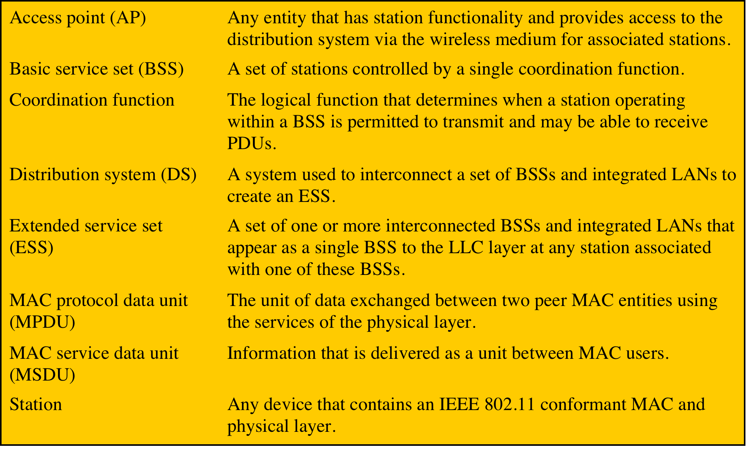
IEEE 802.11 Terminology
Notes:
IEEE 802 is a committee that has developed standards for a wide range of local area
networks (LANs). In 1990, the IEEE 802 Committee formed a new working group,
IEEE 802.11, with a charter to develop a protocol and transmission specifications
for wireless LANs (WLANs). Since that time, the demand for WLANs at different
frequencies and data rates has exploded. Keeping pace with this demand, the IEEE
802.11 working group has issued an ever-expanding list of standards. Table 24.1
briefly defines key terms used in the IEEE 802.11 standard.

Slide 38
Wireless Fidelity (Wi-Fi) Alliance
802.11b
first 802.11 standard to gain broad industry acceptance
Wireless Ethernet Compatibility Alliance (WECA)
industry consortium formed in 1999 to address the concern of products from different vendors successfully interoperating
later renamed the Wi-Fi Alliance
term used for certified 802.11b products is Wi-Fi
has been extended to 802.11g products
Wi-Fi Protected Access (WPA)
Wi-Fi Alliance certification procedures for IEEE802.11 security standards
WPA2 incorporates all of the features of the IEEE802.11i WLAN security specification
Notes:
The first 802.11 standard to gain broad industry acceptance was 802.11b. Although
802.11b products are all based on the same standard, there is always a concern
whether products from different vendors will successfully interoperate. To meet
this concern, the Wireless Ethernet Compatibility Alliance (WECA), an industry
consortium, was formed in 1999. This organization, subsequently renamed the
Wi-Fi (Wireless Fidelity) Alliance, created a test suite to certify interoperability
for 802.11b products. The term used for certified 802.11b products is Wi-Fi . Wi-Fi
certification has been extended to 802.11g products. The Wi-Fi Alliance has also
developed a certification process for 802.11a products, called Wi-Fi5 . The Wi-Fi
Alliance is concerned with a range of market areas for WLANs, including enterprise,
home, and hot spots.
More recently, the Wi-Fi Alliance has developed certification procedures for
IEEE 802.11 security standards, referred to as Wi-Fi Protected Access (WPA). The
most recent version of WPA, known as WPA2, incorporates all of the features of
the IEEE 802.11i WLAN security specification.

Slide 39
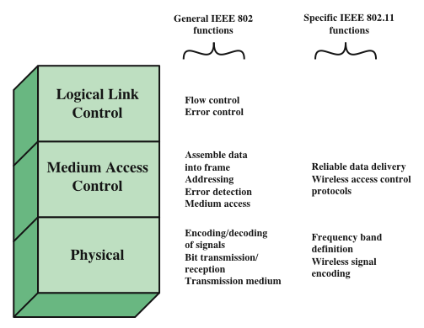
IEEE 802 Protocol Architecture
Notes:
Before proceeding, we need to briefly preview the IEEE 802 protocol architecture.
IEEE 802.11 standards are defined within the structure of a layered set
of protocols. This structure, used for all IEEE 802 standards, is illustrated in
Figure 24.2 .
The lowest layer of the IEEE 802 reference model is the
physical layer , which includes such functions as encoding/decoding of signals and
bit transmission/reception. In addition, the physical layer includes a specification of
the transmission medium. In the case of IEEE 802.11, the physical layer also defines
frequency bands and antenna characteristics.
All LANs consist of collections of devices that share
the network’s transmission capacity. Some means of controlling access to the
transmission medium is needed to provide an orderly and efficient use of that
capacity. This is the function of a medium access control (MAC) layer. The MAC
layer receives data from a higher-layer protocol, typically the logical link control
(LLC) layer, in the form of a block of data known as the MAC service data unit
(MSDU) . In general, the MAC layer performs the following functions:
• On transmission, assemble data into a frame, known as a MAC protocol data
unit (MPDU) with address and error-detection fields.
• On reception, disassemble frame, and perform address recognition and error
detection.
• Govern access to the LAN transmission medium.

Slide 40
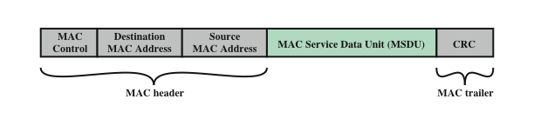
General IEEE 802 MPDU Format
Notes:
The exact format of the MPDU differs somewhat for the various MAC protocols
in use. In general, all of the MPDUs have a format similar to that of Figure 24.3 .
The fields of this frame are as follows:
• MAC Control: This field contains any protocol control information needed
for the functioning of the MAC protocol. For example, a priority level could
be indicated here.
• Destination MAC Address: The destination physical address on the LAN for
this MPDU.
• Source MAC Address: The source physical address on the LAN for this
MPDU.
• MAC Service Data Unit: The data from the next higher layer.
• CRC: The cyclic redundancy check field, also known as the Frame Check
Sequence (FCS) field. This is an error-detecting code, such as that which is
used in other data-link control protocols. The CRC is calculated based on the
bits in the entire MPDU. The sender calculates the CRC and adds it to the
frame. The receiver performs the same calculation on the incoming MPDU
and compares that calculation to the CRC field in that incoming MPDU. If the
two values don’t match, then one or more bits have been altered in transit.
The fields preceding the MSDU field are referred to as the MAC header , and
the field following the MSDU field is referred to as the MAC trailer . The header
and trailer contain control information that accompany the data field and that are
used by the MAC protocol.

Slide 41
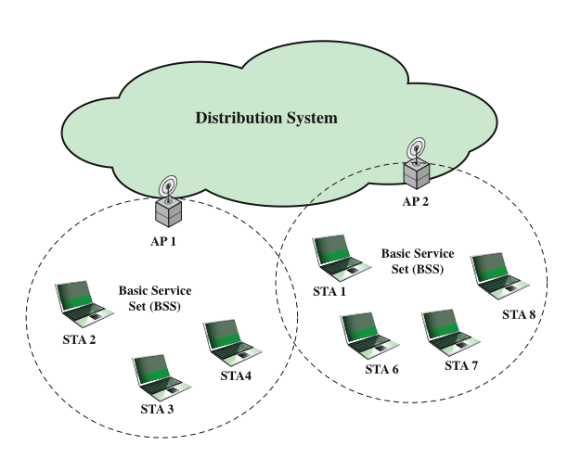
IEEE 802.11 Architecture: Extended Service Set
Notes:
Figure 24.4 illustrates the model developed by the 802.11 working group. The
smallest building block of a wireless LAN is a basic service set (BSS) , which consists
of wireless stations executing the same MAC protocol and competing for access to
the same shared wireless medium. A BSS may be isolated or it may connect to a
backbone distribution system (DS) through an access point (AP) . The AP functions
as a bridge and a relay point. In a BSS, client stations do not communicate directly
with one another. Rather, if one station in the BSS wants to communicate with
another station in the same BSS, the MAC frame is first sent from the originating
station to the AP and then from the AP to the destination station. Similarly, a MAC
frame from a station in the BSS to a remote station is sent from the local station to
the AP and then relayed by the AP over the DS on its way to the destination station.
The BSS generally corresponds to what is referred to as a cell in the literature. The
DS can be a switch, a wired network, or a wireless network.
When all the stations in the BSS are mobile stations that communicate directly
with one another (not using an AP) the BSS is called an independent BSS (IBSS) .
An IBSS is typically an ad hoc network. In an IBSS, the stations all communicate
directly, and no AP is involved.
A simple configuration is shown in Figure 24.4 , in which each station belongs
to a single BSS; that is, each station is within wireless range only of other stations
within the same BSS. It is also possible for two BSSs to overlap geographically,
so that a single station could participate in more than one BSS. Furthermore, the
association between a station and a BSS is dynamic. Stations may turn off, come
within range, and go out of range.
An extended service set (ESS) consists of two or more basic service sets
interconnected by a distribution system. The extended service set appears as a
single logical LAN to the LLC level.

Slide 42
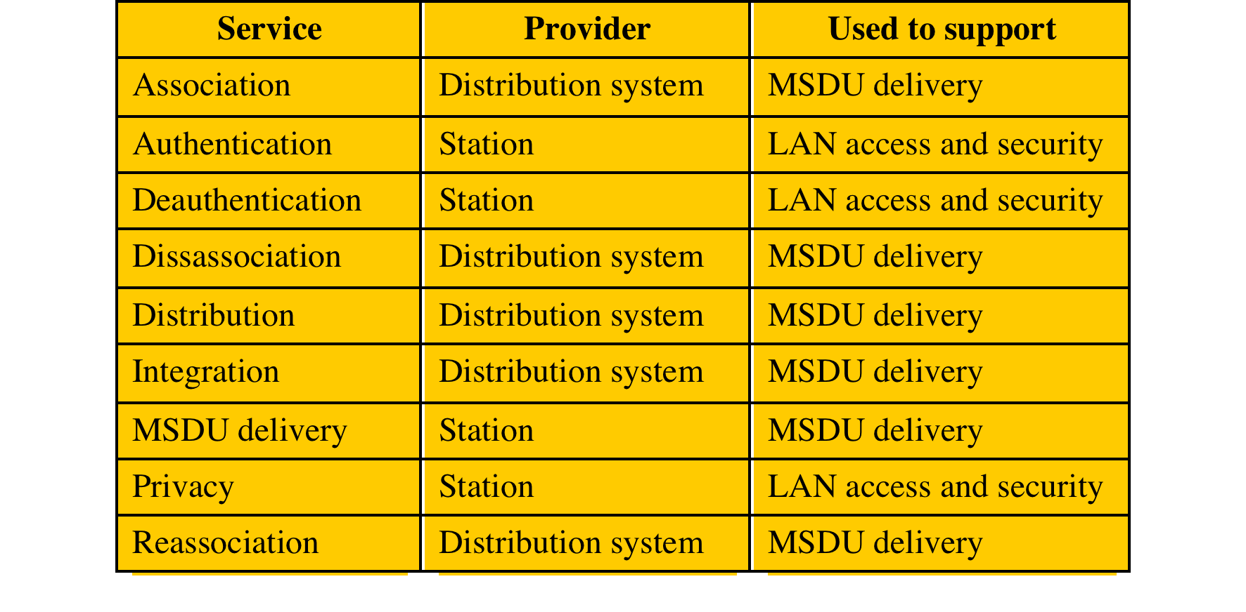
IEEE 802.11 Services
Service provider
may be a station
or DS; station
services are
implemented
in every 802.11
station
MAC Service Data Unit (MSDU)
Notes:
IEEE 802.11 defines nine services that need to be provided by the wireless LAN to
achieve functionality equivalent to that which is inherent to wired LANs. Table 24.2
lists the services and indicates two ways of categorizing them.
1. The service provider can be either the station or the DS. Station services
are implemented in every 802.11 station, including AP stations. Distribution
services are provided between BSSs; these services may be implemented in an
AP or in another special-purpose device attached to the distribution system.
2. Three of the services are used to control IEEE 802.11 LAN access and
confidentiality. Six of the services are used to support delivery of MSDUs
between stations. If the MSDU is too large to be transmitted in a single
MPDU, it may be fragmented and transmitted in a series of MPDUs.
Following the IEEE 802.11 document, we next discuss the services in an order
designed to clarify the operation of an IEEE 802.11 ESS network. MSDU delivery ,
which is the basic service, has already been mentioned. Services related to security
are introduced in Section 24.3 .

Slide 43
Distribution of Messages Within a DS
The two services involved with the distribution of messages within a DS are:
distribution
integration
distribution
the primary service used by stations to exchange MPDUs when the MPDUs must traverse the DS to get from a station in one BSS to a station in another BSS
integration
enables transfer of data between a statin on 802.11 LAN and wired station
Notes:
The two services involved with the
distribution of messages within a DS are distribution and integration. Distribution
is the primary service used by stations to exchange MPDUs when the MPDUs must
traverse the DS to get from a station in one BSS to a station in another BSS. For
example, suppose a frame is to be sent from station 2 (STA 2) to station 7 (STA 7)
in Figure 24.4 . The frame is sent from STA 2 to AP 1, which is the AP for this BSS.
The AP gives the frame to the DS, which has the job of directing the frame to the
AP associated with STA 7 in the target BSS. AP 2 receives the frame and forwards
it to STA 7. How the message is transported through the DS is beyond the scope of
the IEEE 802.11 standard.
If the two stations that are communicating are within the same BSS, then the
distribution service logically goes through the single AP of that BSS.
The integration service enables transfer of data between a station on an IEEE
802.11 LAN and a station on an integrated IEEE 802.x LAN. The term integrated
refers to a wired LAN that is physically connected to the DS and whose stations
may be logically connected to an IEEE 802.11 LAN via the integration service. The
integration service takes care of any address translation and media conversion logic
required for the exchange of data.

Slide 44
Association Services
association
establishes an initial association between a station and an AP
reassociation
enables an established association to be transferred from one AP to another, allowing a mobile station to move from one BSS to another
disassociation
a notification from either a station or an AP that an existing association is terminated
Notes:
To deliver a message within a DS, the distribution service needs to know where
the destination station is located. Specifically, the DS needs to know the identity of
the AP to which the message should be delivered in order for that message to reach
the destination station. To meet this requirement, a station must maintain an association
with the AP within its current BSS. Three services relate to this requirement:
• Association: Establishes an initial association between a station and an AP.
Before a station can transmit or receive frames on a wireless LAN, its identity
and address must be known. For this purpose, a station must establish an
association with an AP within a particular BSS. The AP can then communicate
this information to other APs within the ESS to facilitate routing and delivery
of addressed frames.
• Reassociation: Enables an established association to be transferred from one
AP to another, allowing a mobile station to move from one BSS to another.
• Disassociation: A notification from either a station or an AP that an existing
association is terminated. A station should give this notification before leaving
an ESS or shutting down. However, the MAC management facility protects
itself against stations that disappear without notification.

Slide 45
Association-Related Services
Transition types, based on mobility:
No transition
A station of this type is either stationary or moves only within the direct communication range of the communicating stations of a single BSS
BSS transition
Station movement from one BSS to another BSS within the same ESS; delivery of data to the station requires that the addressing capability be able to recognize the new location of the station
ESS transition
Station movement from a BSS in one ESS to a BSS within another ESS; maintenance of upper-layer connections supported by 802.11 cannot be guaranteed
Notes:
The primary purpose of the MAC layer is to
transfer MSDUs between MAC entities; this purpose is fulfilled by the distribution
service. For that service to function, it requires information about stations within
the ESS that is provided by the association-related services. Before the distribution
service can deliver data to or accept data from a station, that station must be
associated . Before looking at the concept of association, we need to describe the
concept of mobility. The standard defines three transition types, based on mobility:
• No transition: A station of this type is either stationary or moves only within
the direct communication range of the communicating stations of a single BSS.
• BSS transition: This is defined as a station movement from one BSS to
another BSS within the same ESS. In this case, delivery of data to the station
requires that the addressing capability be able to recognize the new location
of the station.
• ESS transition: This is defined as a station movement from a BSS in one ESS
to a BSS within another ESS. This case is supported only in the sense that
the station can move. Maintenance of upper-layer connections supported
by 802.11 cannot be guaranteed. In fact, disruption of service is likely to
occur.

Slide 46
Wireless LAN Security Protocols
Wired Equivalent Privacy (WEP) algorithm
802.11 privacy
Wi-Fi Protected Access (WPA)
Set of security mechanisms that eliminates most 802.11 security issues and was based on the current state of the 802.11i standard
Robust Security Network (RSN)
Final form of the 802.11i standard
Notes:
There are two characteristics of a wired LAN that are not inherent in a wireless
LAN.
1. In order to transmit over a wired LAN, a station must be physically connected
to the LAN. On the other hand, with a wireless LAN, any station within radio
range of the other devices on the LAN can transmit. In a sense, there is a
form of authentication with a wired LAN in that it requires some positive and
presumably observable action to connect a station to a wired LAN.
2. Similarly, in order to receive a transmission from a station that is part of a
wired LAN, the receiving station also must be attached to the wired LAN.
On the other hand, with a wireless LAN, any station within radio range can
receive. Thus, a wired LAN provides a degree of privacy, limiting reception of
data to stations connected to the LAN.
These differences between wired and wireless LANs suggest the increased
need for robust security services and mechanisms for wireless LANs. The
original 802.11 specification included a set of security features for privacy and
authentication that were quite weak. For privacy, 802.11 defined the Wired
Equivalent Privacy (WEP) algorithm. The privacy portion of the 802.11
standard contained major weaknesses. Subsequent to the development of WEP,
the 802.11i task group has developed a set of capabilities to address the WLAN
security issues. In order to accelerate the introduction of strong security into
WLANs, the Wi-Fi Alliance promulgated Wi-Fi Protected Access (WPA) as a
Wi-Fi standard. WPA is a set of security mechanisms that eliminates most 802.11
security issues and was based on the current state of the 802.11i standard. The
final form of the 802.11i standard is referred to as Robust Security Network
(RSN) . The Wi-Fi Alliance certifies vendors in compliance with the full 802.11i
specification under the WPA2 program.

Slide 47
IEEE 802.11i Services
Authentication: the exchange between a user and an authentication server (AS); temporary keys are generated
Access control: routes messages properly, facilitates key exchange
Privacy: MAC level data are encrypted
Security protocols that support the above services: next page

Slide 48
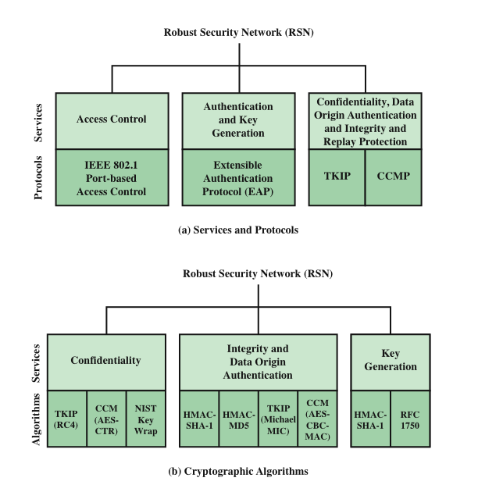
Elements of IEEE 802.11i
Notes:
The 802.11i RSN security specification defines the following services.
• Authentication: A protocol is used to define an exchange between a user and an
AS (authentication server) that provides mutual authentication and generates
temporary keys to be used between the client and the AP over the wireless link.
• Access control: This function enforces the use of the authentication function,
routes the messages properly, and facilitates key exchange. It can work with a
variety of authentication protocols.
• Privacy with message integrity: MAC-level data (e.g., an LLC PDU) are
encrypted along with a message integrity code that ensures that the data have
not been altered.
Figure 24.5a indicates the security protocols used to support these services,
while Figure 24.5b lists the cryptographic algorithms used for these services.

Slide 49
Phases of Operations: Possibilities
Two wireless STAs in the same BSS communicate via an AP
Two wireless STAs in the same ad hoc BSS communicating directly
Two wireless STAs in different BSS communicating via their Aps
A wireless less STA communicating with wired station via its AP

Slide 50
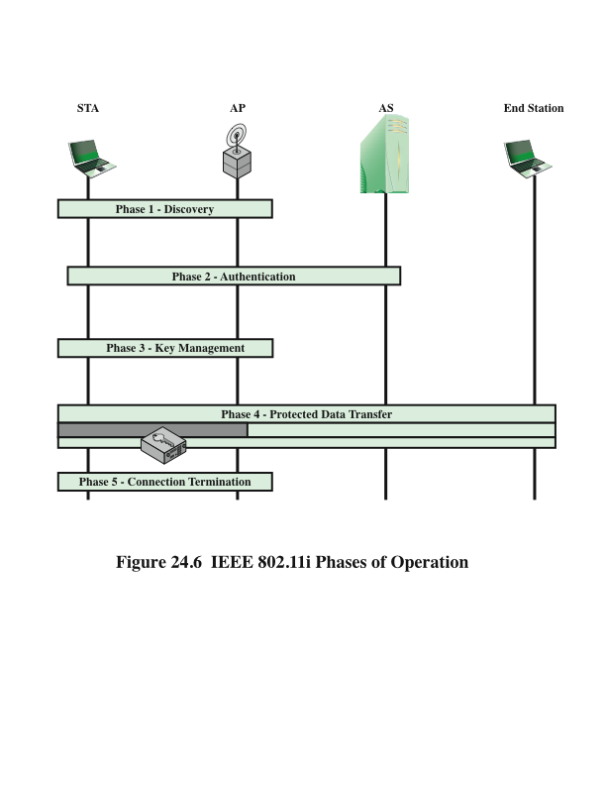
IEEE 802.11i Phases of Operation
Discovery: AP sends Beacon, Probe responses to advertise its 802.11 security policy
Authentication: STA and AS prove their identities
Key MGMT: cryptographic key are generated and saved in STA and SA
Protected data transfer
Connection termination
Notes:
The operation of an IEEE 802.11i RSN can be broken down into five distinct
phases. The exact nature of the phases will depend on the configuration and the end
points of the communication. Possibilities include (see Figure 24.4 ):
1. Two wireless stations in the same BSS communicating via the access point for
that BSS.
2. Two wireless stations (STAs) in the same ad hoc IBSS communicating directly
with each other.
3. Two wireless stations in different BSSs communicating via their respective
APs across a distribution system.
4. A wireless station communicating with an end station on a wired network via
its AP and the distribution system.
IEEE 802.11i security is concerned only with secure communication between
the STA and its AP. In case 1 in the preceding list, secure communication is assured
if each STA establishes secure communications with the AP. Case 2 is similar,
with the AP functionality residing in the STA. For case 3, security is not provided
across the distribution system at the level of IEEE 802.11, but only within each BSS.
End-to-end security (if required) must be provided at a higher layer. Similarly, in
case 4, security is only provided between the STA and its AP.
With these considerations in mind, Figure 24.6 depicts the five phases of
operation for an RSN and maps them to the network components involved. One
new component is the authentication server (AS). The rectangles indicate the
exchange of sequences of MPDUs. The five phases are defined as follows:
• Discovery: An AP uses messages called Beacons and Probe Responses to
advertise its IEEE 802.11i security policy. The STA uses these to identify an
AP for a WLAN with which it wishes to communicate. The STA associates
with the AP, which it uses to select the cipher suite and authentication
mechanism when the Beacons and Probe Responses present a choice.
• Authentication: During this phase, the STA and AS prove their identities to each
other. The AP blocks non-authentication traffic between the STA and AS until
the authentication transaction is successful. The AP does not participate in the
authentication transaction other than forwarding traffic between the STA and AS.
• Key generation and distribution: The AP and the STA perform several operations
that cause cryptographic keys to be generated and placed on the AP and
the STA. Frames are exchanged between the AP and STA only.
• Protected data transfer: Frames are exchanged between the STA and the end
station through the AP. As denoted by the shading and the encryption module
icon, secure data transfer occurs between the STA and the AP only; security is
not provided end-to-end.
• Connection termination: The AP and STA exchange frames. During this
phase, the secure connection is torn down and the connection is restored to
the original state.

Slide 51
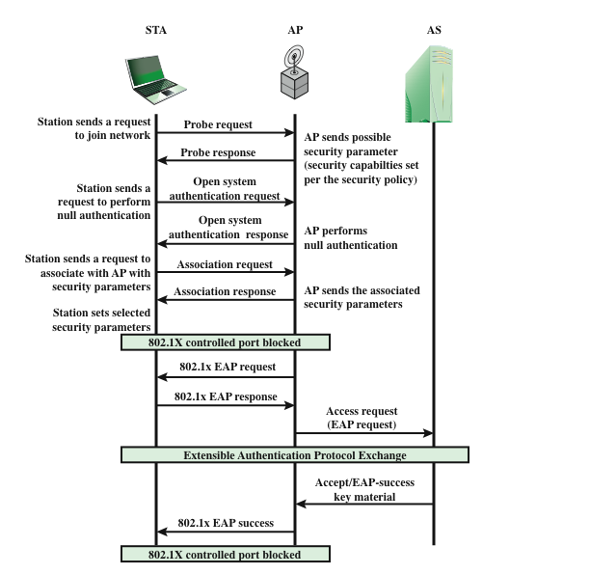
IEEE 802.11i Phases of Operation
Notes:
The operation of an IEEE 802.11i RSN can be broken down into five distinct
phases. The exact nature of the phases will depend on the configuration and the end
points of the communication. Possibilities include (see Figure 24.4 ):
1. Two wireless stations in the same BSS communicating via the access point for
that BSS.
2. Two wireless stations (STAs) in the same ad hoc IBSS communicating directly
with each other.
3. Two wireless stations in different BSSs communicating via their respective
APs across a distribution system.
4. A wireless station communicating with an end station on a wired network via
its AP and the distribution system.
IEEE 802.11i security is concerned only with secure communication between
the STA and its AP. In case 1 in the preceding list, secure communication is assured
if each STA establishes secure communications with the AP. Case 2 is similar,
with the AP functionality residing in the STA. For case 3, security is not provided
across the distribution system at the level of IEEE 802.11, but only within each BSS.
End-to-end security (if required) must be provided at a higher layer. Similarly, in
case 4, security is only provided between the STA and its AP.
With these considerations in mind, Figure 24.6 depicts the five phases of
operation for an RSN and maps them to the network components involved. One
new component is the authentication server (AS). The rectangles indicate the
exchange of sequences of MPDUs. The five phases are defined as follows:
• Discovery: An AP uses messages called Beacons and Probe Responses to
advertise its IEEE 802.11i security policy. The STA uses these to identify an
AP for a WLAN with which it wishes to communicate. The STA associates
with the AP, which it uses to select the cipher suite and authentication
mechanism when the Beacons and Probe Responses present a choice.
• Authentication: During this phase, the STA and AS prove their identities to each
other. The AP blocks non-authentication traffic between the STA and AS until
the authentication transaction is successful. The AP does not participate in the
authentication transaction other than forwarding traffic between the STA and AS.
• Key generation and distribution: The AP and the STA perform several operations
that cause cryptographic keys to be generated and placed on the AP and
the STA. Frames are exchanged between the AP and STA only.
• Protected data transfer: Frames are exchanged between the STA and the end
station through the AP. As denoted by the shading and the encryption module
icon, secure data transfer occurs between the STA and the AP only; security is
not provided end-to-end.
• Connection termination: The AP and STA exchange frames. During this
phase, the secure connection is torn down and the connection is restored to
the original state.

Slide 52
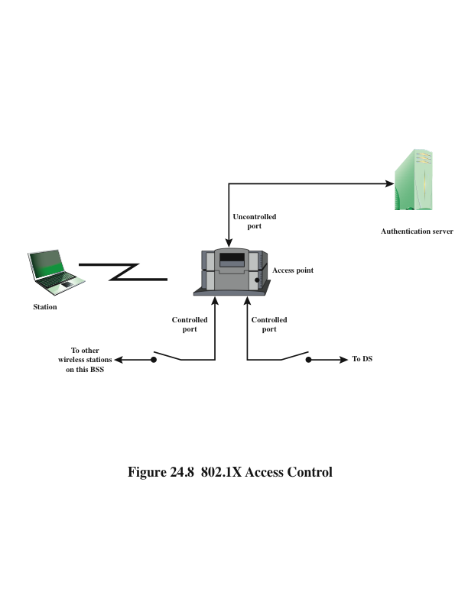
IEEE 802.1x Access Control (for Controlling Access)
Two physical ports; many logical ports mapped to the physical ports
Notes:
The operation of an IEEE 802.11i RSN can be broken down into five distinct
phases. The exact nature of the phases will depend on the configuration and the end
points of the communication. Possibilities include (see Figure 24.4 ):
1. Two wireless stations in the same BSS communicating via the access point for
that BSS.
2. Two wireless stations (STAs) in the same ad hoc IBSS communicating directly
with each other.
3. Two wireless stations in different BSSs communicating via their respective
APs across a distribution system.
4. A wireless station communicating with an end station on a wired network via
its AP and the distribution system.
IEEE 802.11i security is concerned only with secure communication between
the STA and its AP. In case 1 in the preceding list, secure communication is assured
if each STA establishes secure communications with the AP. Case 2 is similar,
with the AP functionality residing in the STA. For case 3, security is not provided
across the distribution system at the level of IEEE 802.11, but only within each BSS.
End-to-end security (if required) must be provided at a higher layer. Similarly, in
case 4, security is only provided between the STA and its AP.
With these considerations in mind, Figure 24.6 depicts the five phases of
operation for an RSN and maps them to the network components involved. One
new component is the authentication server (AS). The rectangles indicate the
exchange of sequences of MPDUs. The five phases are defined as follows:
• Discovery: An AP uses messages called Beacons and Probe Responses to
advertise its IEEE 802.11i security policy. The STA uses these to identify an
AP for a WLAN with which it wishes to communicate. The STA associates
with the AP, which it uses to select the cipher suite and authentication
mechanism when the Beacons and Probe Responses present a choice.
• Authentication: During this phase, the STA and AS prove their identities to each
other. The AP blocks non-authentication traffic between the STA and AS until
the authentication transaction is successful. The AP does not participate in the
authentication transaction other than forwarding traffic between the STA and AS.
• Key generation and distribution: The AP and the STA perform several operations
that cause cryptographic keys to be generated and placed on the AP and
the STA. Frames are exchanged between the AP and STA only.
• Protected data transfer: Frames are exchanged between the STA and the end
station through the AP. As denoted by the shading and the encryption module
icon, secure data transfer occurs between the STA and the AP only; security is
not provided end-to-end.
• Connection termination: The AP and STA exchange frames. During this
phase, the secure connection is torn down and the connection is restored to
the original state.

Slide 53
MPDU Exchange
authentication phase consists of three phases:
connect to AS
the STA sends a request to its AP that it has an association with for connection to the AS; the AP acknowledges this request and sends an access request to the AS
EAP (Extensible Authentication Protocol ) exchange
authenticates the STA and AS to each other
secure key delivery
once authentication is established, the AS generates a master session key and sends it to the STA
Notes:
The lower part of Figure 24.7 shows the MPDU exchange
dictated by IEEE 802.11 for the authentication phase. We can think of authentication
phase as consisting of the following three phases.
• Connect to AS: The STA sends a request to its AP (the one with which it has
an association) for connection to the AS. The AP acknowledges this request
and sends an access request to the AS.
• EAP exchange: This exchange authenticates the STA and AS to each other.
A number of alternative exchanges are possible, as explained subsequently.
• Secure key delivery: Once authentication is established, the AS generates
a master session key (MSK), also known as the Authentication,
Authorization, and Accounting (AAA) key, and sends it to the STA. As
explained subsequently, all the cryptographic keys needed by the STA for
secure communication with its AP are generated from this MSK. IEEE
802.11i does not prescribe a method for secure delivery of the MSK but
relies on EAP for this. Whatever method is used, it involves the transmission
of an MPDU containing an encrypted MSK from the AS, via the AP,
to the AS.

Slide 54
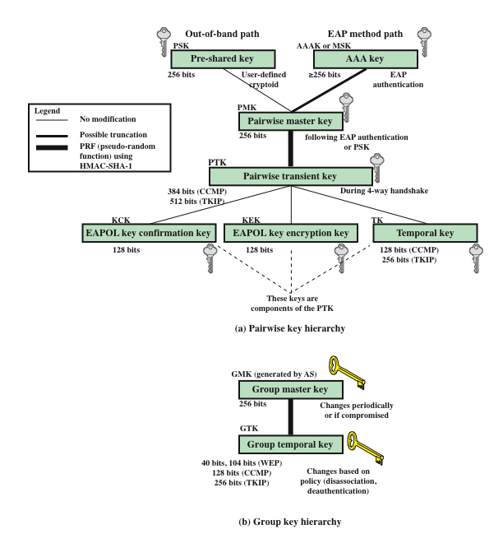
IEEE 802.11i Keys for Data Confidentiality and Integrity Protocols
EAP: Extensible Auth. Protocol
EAP over LAN: supports integrity and origin authentication
EAP Key Encryption Key: protects confidentiality
Temporal Key (TK): protects transmission
Notes:
The operation of an IEEE 802.11i RSN can be broken down into five distinct
phases. The exact nature of the phases will depend on the configuration and the end
points of the communication. Possibilities include (see Figure 24.4 ):
1. Two wireless stations in the same BSS communicating via the access point for
that BSS.
2. Two wireless stations (STAs) in the same ad hoc IBSS communicating directly
with each other.
3. Two wireless stations in different BSSs communicating via their respective
APs across a distribution system.
4. A wireless station communicating with an end station on a wired network via
its AP and the distribution system.
IEEE 802.11i security is concerned only with secure communication between
the STA and its AP. In case 1 in the preceding list, secure communication is assured
if each STA establishes secure communications with the AP. Case 2 is similar,
with the AP functionality residing in the STA. For case 3, security is not provided
across the distribution system at the level of IEEE 802.11, but only within each BSS.
End-to-end security (if required) must be provided at a higher layer. Similarly, in
case 4, security is only provided between the STA and its AP.
With these considerations in mind, Figure 24.6 depicts the five phases of
operation for an RSN and maps them to the network components involved. One
new component is the authentication server (AS). The rectangles indicate the
exchange of sequences of MPDUs. The five phases are defined as follows:
• Discovery: An AP uses messages called Beacons and Probe Responses to
advertise its IEEE 802.11i security policy. The STA uses these to identify an
AP for a WLAN with which it wishes to communicate. The STA associates
with the AP, which it uses to select the cipher suite and authentication
mechanism when the Beacons and Probe Responses present a choice.
• Authentication: During this phase, the STA and AS prove their identities to each
other. The AP blocks non-authentication traffic between the STA and AS until
the authentication transaction is successful. The AP does not participate in the
authentication transaction other than forwarding traffic between the STA and AS.
• Key generation and distribution: The AP and the STA perform several operations
that cause cryptographic keys to be generated and placed on the AP and
the STA. Frames are exchanged between the AP and STA only.
• Protected data transfer: Frames are exchanged between the STA and the end
station through the AP. As denoted by the shading and the encryption module
icon, secure data transfer occurs between the STA and the AP only; security is
not provided end-to-end.
• Connection termination: The AP and STA exchange frames. During this
phase, the secure connection is torn down and the connection is restored to
the original state.

Slide 55
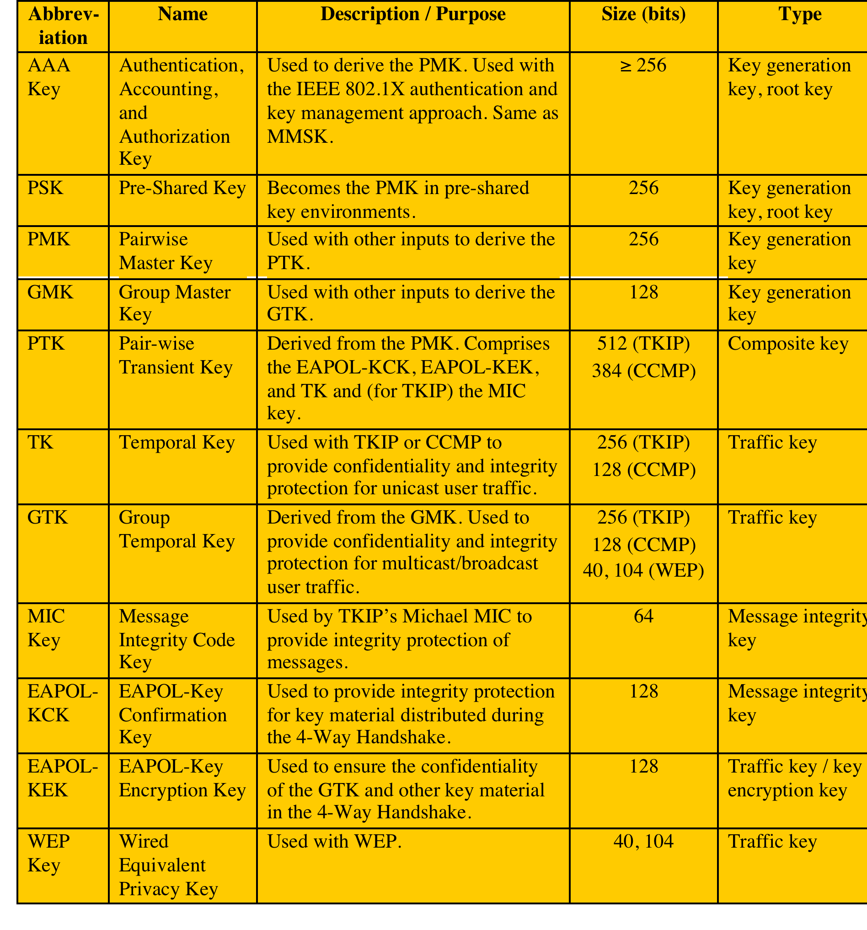
IEEE 802.11i Key Hierarchy (Key MGMT)
Notes:
The operation of an IEEE 802.11i RSN can be broken down into five distinct
phases. The exact nature of the phases will depend on the configuration and the end
points of the communication. Possibilities include (see Figure 24.4 ):
1. Two wireless stations in the same BSS communicating via the access point for
that BSS.
2. Two wireless stations (STAs) in the same ad hoc IBSS communicating directly
with each other.
3. Two wireless stations in different BSSs communicating via their respective
APs across a distribution system.
4. A wireless station communicating with an end station on a wired network via
its AP and the distribution system.
IEEE 802.11i security is concerned only with secure communication between
the STA and its AP. In case 1 in the preceding list, secure communication is assured
if each STA establishes secure communications with the AP. Case 2 is similar,
with the AP functionality residing in the STA. For case 3, security is not provided
across the distribution system at the level of IEEE 802.11, but only within each BSS.
End-to-end security (if required) must be provided at a higher layer. Similarly, in
case 4, security is only provided between the STA and its AP.
With these considerations in mind, Figure 24.6 depicts the five phases of
operation for an RSN and maps them to the network components involved. One
new component is the authentication server (AS). The rectangles indicate the
exchange of sequences of MPDUs. The five phases are defined as follows:
• Discovery: An AP uses messages called Beacons and Probe Responses to
advertise its IEEE 802.11i security policy. The STA uses these to identify an
AP for a WLAN with which it wishes to communicate. The STA associates
with the AP, which it uses to select the cipher suite and authentication
mechanism when the Beacons and Probe Responses present a choice.
• Authentication: During this phase, the STA and AS prove their identities to each
other. The AP blocks non-authentication traffic between the STA and AS until
the authentication transaction is successful. The AP does not participate in the
authentication transaction other than forwarding traffic between the STA and AS.
• Key generation and distribution: The AP and the STA perform several operations
that cause cryptographic keys to be generated and placed on the AP and
the STA. Frames are exchanged between the AP and STA only.
• Protected data transfer: Frames are exchanged between the STA and the end
station through the AP. As denoted by the shading and the encryption module
icon, secure data transfer occurs between the STA and the AP only; security is
not provided end-to-end.
• Connection termination: The AP and STA exchange frames. During this
phase, the secure connection is torn down and the connection is restored to
the original state.

Slide 56
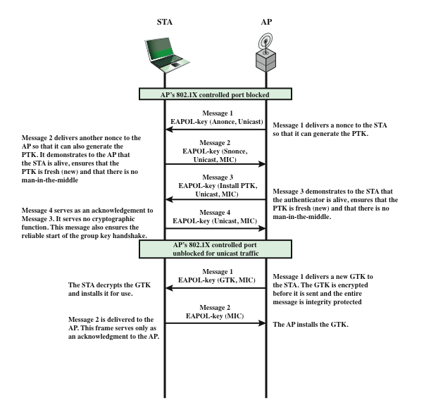
Phases of Operation: 4-way Handshake
Notes:
The upper part of Figure 24.10 shows the MPDU
exchange for distributing pairwise keys. This exchange is known as the 4-way
handshake . The STA and AP use this handshake to confirm the existence of
the PMK, verify the selection of the cipher suite, and derive a fresh PTK for the
following data session. The four parts of the exchange are as follows.
• AP → STA: Message includes the MAC address of the AP and a nonce (Anonce)
• STA → AP: The STA generates its own nonce (Snonce) and uses both nonces
and both MAC addresses, plus the PMK, to generate a PTK. The STA then
sends a message containing its MAC address and Snonce, enabling the AP to
generate the same PTK. This message includes a message integrity code (MIC) 2
using HMAC-MD5 or HMAC-SHA-1-128. The key used with the MIC is KCK.
• AP → STA: The AP is now able to generate the PTK. The AP then sends a
message to the STA, containing the same information as in the first message,
but this time including a MIC.
• STA → AP: This is merely an acknowledgement message, again protected
by a MIC.
For group key distribution, the AP generates a GTK
and distributes it to each STA in a multicast group. The two-message exchange with
each STA consists of the following:
• AP → STA: This message includes the GTK, encrypted either with RC4 or
with AES. The key used for encryption is KEK. A MIC value is appended.
• STA → AP: The STA acknowledges receipt of the GTK. This message
includes a MIC value.

Slide 57
Temporal Key Integrity Protocol (TKIP)
Designed to require only software changes to devices that are implemented WEP
Provides two services:
message integrity
adds a message integrity code to the 802.11 MAC frame after the data field
data confidentiality
provided by encrypting the MPDU
Notes:
IEEE 802.11i defines two schemes for protecting data transmitted in 802.11
MPDUs: the Temporal Key Integrity Protocol (TKIP) and the Counter Mode-CBC
MAC Protocol (CCMP).
TKIP is designed to require only software changes to devices that are
implemented with the older wireless LAN security approach called Wired
Equivalent Privacy (WEP). TKIP provides two services:
• Message integrity: TKIP adds a message integrity code to the 802.11 MAC
frame after the data field. The MIC is generated by an algorithm, called
Michael, that computes a 64-bit value using as input the source and destination
MAC address values and the data field, plus key material.
• Data confidentiality: Data confidentiality is provided by encrypting the
MPDU plus MIC value using RC4.
The 256-bit TK ( Figure 24.9 ) is employed as follows. Two 64-bit keys are
used with the Michael message digest algorithm to produce a message integrity
code. One key is used to protect STA-to-AP messages, and the other key is used to
protect AP-to-STA messages. The remaining 128 bits are truncated to generate the
RC4 key used to encrypt the transmitted data.
For additional protection, a monotonically increasing TKIP sequence counter
(TSC) is assigned to each frame. The TSC serves two purposes. First, the TSC is
included with each MPDU and is protected by the MIC to protect against replay attacks.
Second, the TSC is combined with the session TK to produce a dynamic encryption key
that changes with each transmitted MPDU, thus making cryptanalysis more difficult.

Slide 58
Summary
Wireless security overview
wireless network threats
wireless security measure
IEEE 802.11 wireless LAN overview
Wi-Fi alliance
IEEE 802 protocol architecture
IEEE 802.11 network components and architectural model
IEEE 802.11 services
Notes:
Chapter 24 summary.

