Slide 1
The Threat Environment
Attackers and Their Attacks
Primarily from Raymond R. Panko, Corporate Computer and Network Security, 2nd Edition, Prentice-Hall, 2010
Professor Hossein Saiedian
EECS710: Info Security and Assurance

Slide 2
Basic Security Terminology
Need an understanding of the threat environment
  Attackers
  Attacks
  Know your enemy
Security goals: CIA
  Confidentially: disallow sensitive data (in computer or while traveling) to be read by unauthorized people
  Integrity: disallow change or destruction of data
  Availability: people who are authorized to use data shout not be prevented from doing so

Slide 3
Security Compromises
When a threat succeeds in causing harm to a business
Compromise, breach, incident
Countermeasures: tools used to thwart the attacks
  AKA safeguards or controls
  Can be technical, human, mixture of two
The TJX case study

Slide 4
Countermeasure Types
Preventative: keeps attacks from happening (most controls)
Detective: indentify when a threat is attacking and when it is succeeding
Corrective: get the business back on track after a compromise

Slide 5
[Ex] Employee [Contractor] Threats
Very dangerous; employees
  Usually have extensive knowledge of the system
  Often have the credentials needed to access sensitive data
  Often know control mechanisms and how to avoid them
  Companies tend to thrust their employees
A study of financial services cybercrimes
  1996-2002
  87% of attacks committed by employees

Slide 6
Employee Sabotage
Disgruntled employees: Destruction of SW and/or HW
  Or for financial advantage (selling shares short before subsequent drop in price)
  [Case studies: Lloyd, UBS, LA]
Hacking: breaking into a system (using stolen credentials or other ploy)
  To steal or find embarrassing info

Slide 7
Side Note: Hacking
Intentionally accessing a computer resource without authorization or in excess of authorization
  Key issue: authorization
  Motivation is irrelevant (steal $1,000,000 or merely “testing security”)
Motivation: access to sensitive data, theft, thrill, validation of their skills, a sense of power

Slide 8
Employee Financial Theft or IP Theft
Reasons for accessing resources without authorization
  To find embarrassing info
  Criminal goals: financial theft
    Mis-appropriation of assets
    Theft of money [Case studies: Cisco accountants]/Sabathia]
  Criminal goals: theft of intellectual property (patents, trade secrets, copy righted items)
    IP is owned by its company and protected by law
    [Case study: paralegalemployee]

Slide 9
Employee Extortion
Perpetrator tries to obtain money or other goods by threatening to take actions that will threaten the employer’s IT resources/assets
  Logic bomb
  [Case study: Carpenter]

Slide 10
Computer/Internet Abuse
A particular employee sexual harassment case [Case study: Leung]
Abuse: activities that violate a company’s IT use or ethics policies
  Downloading (porn, illegal media/SW, malware, malicious tools)
    Downloading porn could lead to sexual harassment lawsuit against the company
  Non-Internet abuse: unauthorized access to private data [Case study: Obama’s phone records]

Slide 11
Data Loss
A damaging employee behavior
  Loss of laptops, USB drives with sensitive information, optical disks
  Ponemon survey: 630,000 laptop losses at airports every year

Slide 12
Other “Internet” Attacks
Contract workers: access credentials not deleted after contract
Can create risks identical to those created by the employees

Slide 13
Traditional External Attack[ers]
Malware [evil software] writers: virus, worms, Trojan horses, RATs, spam, …
Viruses: programs that attach themselves to legitimate programs
Initially: via floppy disks; now most are spread via emails or downloaded “free” software (or porn)

Slide 14
Traditional External Attack[ers]
Worms: full programs that do not attach themselves to other programs
[Cast study: Slammer]
Spread very similar to viruses but have far more aggressive spreading mode
  Jump from one computer to another without user’s intervention
  UCB researchers: a worst-case direct propagation worm could do $50 billion damage in the US
www.messagelabs.com keeps data on worms and viruses (1% of all emails contained V or W)

Slide 15
Traditional External Attack[ers]
Payloads: pieces of code that do damage or merely annoy the user
  Malicious payloads: potentials for extreme damage (e.g., delete files or install other malware]
Trojan horse: a program that hides itself by deleting a system file and taking on its name
  Look like legitimate system files
Remote Access Trojans [RAT]: attackers remotely access a computer to do pranks

Slide 16
Traditional External Attack[ers]
Spyware: a spectrum of Trojan horses programs that collect data and make it available to the attacker
  As cookies
  Keystroke loggers
  Password stealing software
  Data mining spyware (searchers the HD)
Rootkits: a software that takes over the “root” account and uses its privileges
Recall Sony’s extremely negative publicity, 2005

Slide 17
Traditional External Attack[ers]
Mobile code: downloaded items may contain executables in addition to text, images, and sound
  Examples: Microsoft Active X, Javascripts
  Often innocent, but if a computer has a vulnerability opened by the mobile code, hostile mobile code will exploit it

Slide 18
Traditional External Attack[ers]
SPAM: unsolicited email
  Annoying, fraudulent, advertise dangerous products, distribute viruses, worms, and THs
  According to MessageLabs: 73% of all emails are spam (March 2009)
Phishing: emails that appear to come from a bank or a legit firm
  Often direct the victim to an authentic-looking website
  Garner survey (2007): the US customers scammed out of $3.2 billion in 2007

Slide 19
Traditional External Attack[ers]
Hoaxes: make the victim feel unintelligent
  sulfnbk.exe hoax: asked users should delete sulfnbk.exe because it was a virus (users deleted their AOL access)
DoS attacks: make a server (or entire network) unavailable to legitimate users

Slide 20
Anatomy of a Hack
Reconnaissance probes
  Port scanning
Social engineering
  Shoulder surfing
DoS attacks

Slide 21
IP Address Scanning
IP address probes (e.g., in range 129.237….) are sent to learn about the live IP addresses before attacking
  Via ICMP [Internet Ctrl Msg Protocol], e.g., echo and echo-reply

Slide 22
Port Scanning
Once the attackers know the IP addresses of live hosts, it needs to know what programs (based on ports #) are running
  Ports 0-1023 are for well-known programs
  Example: port 80 is used by HTTP servers, 21 is used ftp, 22 is used by ssh, 23 by telnet
  Attacker sends port scanning probes

Slide 23
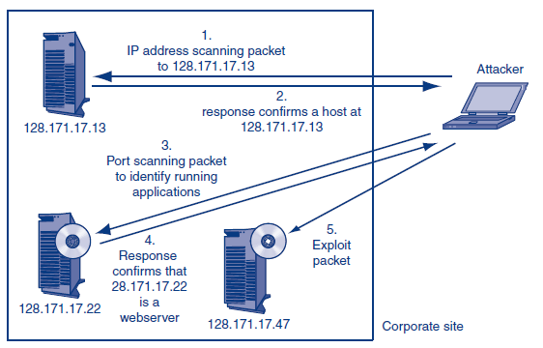
IP/Port Scanning

Slide 24
Spoofing
Each packet carries a source IP address
  Like a return address
Hackers do not want to publicize their IP address (to avoid reverse tracking)
Place a different IP address in the packet
What about replies to the ICMP packets?

Slide 25
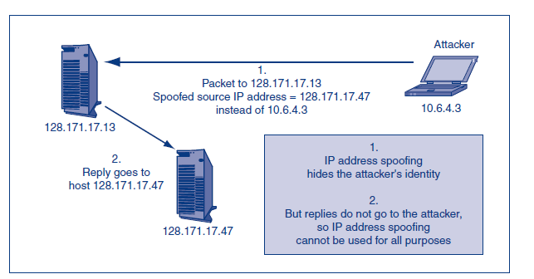
Spoofing Illustrated

Slide 26
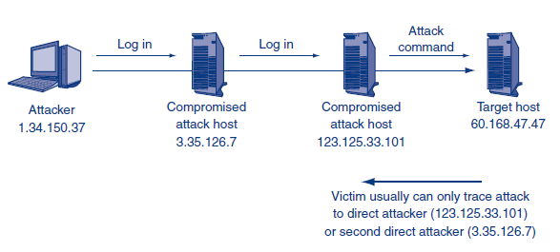
Spoofing Illustrated: Chain of Attack Computers

Slide 27
Social Engineering
A hacker calls a secretary claiming to be working with her/his boss and asks for sensitive info (e.g., password)
[Case studies: US Treasury, HP]
Piggybacking: following someone thru a secure door
Looking over should surfing
Pretexting: claiming to be a customer

Slide 28
DoS Attacks
Attempts to make a server (or network) unavailable to the users
  Attack on availability
  Flood hosts with attack packets (TCP SYN packets)
Distributed DoS attacks
  Attacker places bots on many Internet hosts
  Bots increase the attack rate
Code Red attack on the White House (2001)

Slide 29
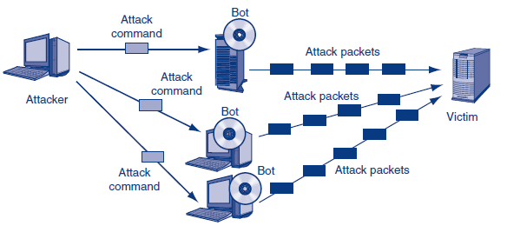
DDoS Illustrated

Slide 30
Attacker Skill Levels
Script kiddies
Career criminals
  FBI (2006): $67 billion costs to businesses a year
  [case study: Vasiliy]
International gangs (no prosecution)
  Black markets [case studies: Pae and CardCops]

Slide 31
Hackers’ Motivations
Fraud, theft, extortion [several case studies]
Stealing sensitive data about customers and employees
  Bank account, stock account
  Identify theft
Corporate identity theft [a couple case studies]
Competitor threats (commercial espionage)
Cyberwar (by national governments)
Cyberterror

Slide 32
Conclusions
The threat environment
  Know the enemy
  Can be within; can be the very people (IT personnel) expected to protect the system
    Quis custodiet custodes?
Types of threats/attacks
Types of attackers

