Slide 1
Computer Security
Principles and Practices
Security Audit
IT Security Management & Risk Assessment
IT Security Controls, Plans & Procedures
Gregory (Greg) Maltby, PMP, BSCS
October 11, 2010
EECS 710
Notes:
Good Evening – my name is Greg Maltby.
Tonight I will be covering 3 major topics
Security Audit
IT Security Management & Risk Assessment
IT Security Controls, Plans & Procedures
To start I would like to preview a couple of slides we will see later in the presentation,
to show how these 3 topics closely relate to each other.

Slide 2
Technical Security Controls
Notes:
This slide is from page 541 of the text.
It depicts Technical Security Controls.
We will discuss this slide in more detail later, but right now I want to point out where:
Audit (point to audit is on the slide) fits in the scheme of Security Controls.
As you can see it is part of the Detection and Recovery Controls
and has a direct relationship with another Detection and Recovery Control -
Intrusion Detection and Containment.
You can also see that - Input to the Audit information comes from the -
Authentication (point to audit is on the slide)
Authorization and
Access Control enforcement processes.
Now I would like to show another slide from chapter 17, on page 540.

Slide 3
IT Security Management Controls and Implementa-tion
Notes:
This slide depicts IT Security Management Controls and Implementation steps.
The first three steps deal with IT Security Management and Risk Assessment –
(those steps are)
Step 1. Prioritize Actions (from Chp. 16 we will discuss) –
- Input: Risk Levels form the Risk Assessment report
- Output: Actions ranking from High to Low
Step 2. Evaluate Recommended Control Options
Feasibility
Effectiveness
- Input: Risk Assessment Report
- Output: List of possible controls
Step3. Conduct Cost-Benefit Analysis
So – hopefully you can start to see how these three high-level topics:
Security Audit,
IT Security Management & Risk Assessment and
IT Security Controls, Plans & Procedures
related to each other.

Slide 4
Computer Security
Principles and Practices
Security Audit
IT Security Management & Risk Assessment
IT Security Controls, Plans & Procedures

Slide 5
Security Audit
Security auditing architecture
Security audit trail
Implementing the logging function
Audit trail analysis
Example: an integrated approach
Notes:
Chp 15. Security Audit
Security auditing is a form of auditing that focuses on the security of an organization’s information system assets.
This function is a key element in computer security.
Security Auditing can:
Provide a level of assurance of the proper operation of the computer with respect to security
Generate data that can be used in the after-the-fact analysis of an attack
Provide a means of assessing inadequacies in the security service
Provide data that can be used to define “normal” behavior (and therefore to help identify abnormal behavior)
and
Maintain a record useful in computer forensics
The Auditing topics we will cover include ( read slide )

Slide 6
Security Auditing Architecture
Security Audit:
  An independent review and examination of a system's records and activities to determine the adequacy of system controls, ensure compliance with established security policy and procedures, detect breaches in security services, and recommend any changes that are indicated for countermeasures.
  The basic audit objective is to establish accountability for system entities that initiate or participate in security-relevant events and actions. Thus, means are needed to generate and record a security audit trail and to review and analyze the audit trail to discover and investigate attacks and security compromises.”
Notes:
Our first topic is Security Auditing Architecture
Definitions ( read slide )
Security Audit
Three Key Points:
– the audit is a review and an examination (which is what any audit is)
- looking for not only breaches in security, but whether the proper controls are in place
- use this information to make recommendations for changes to the security process

Slide 7
Security Auditing Architecture
Security Audit Trail:
  A chronological record of system activities that is sufficient to enable the reconstruction and examination of the sequence of environments and activities surrounding or leading to an operation, procedure, or event in a security-relevant transaction from inception to final results”
Notes:
The second topic is Security Auditing Trail.
Definitions ( read slide )
Security Audit Trail
Key Point:
- the capture of security related information

Slide 8
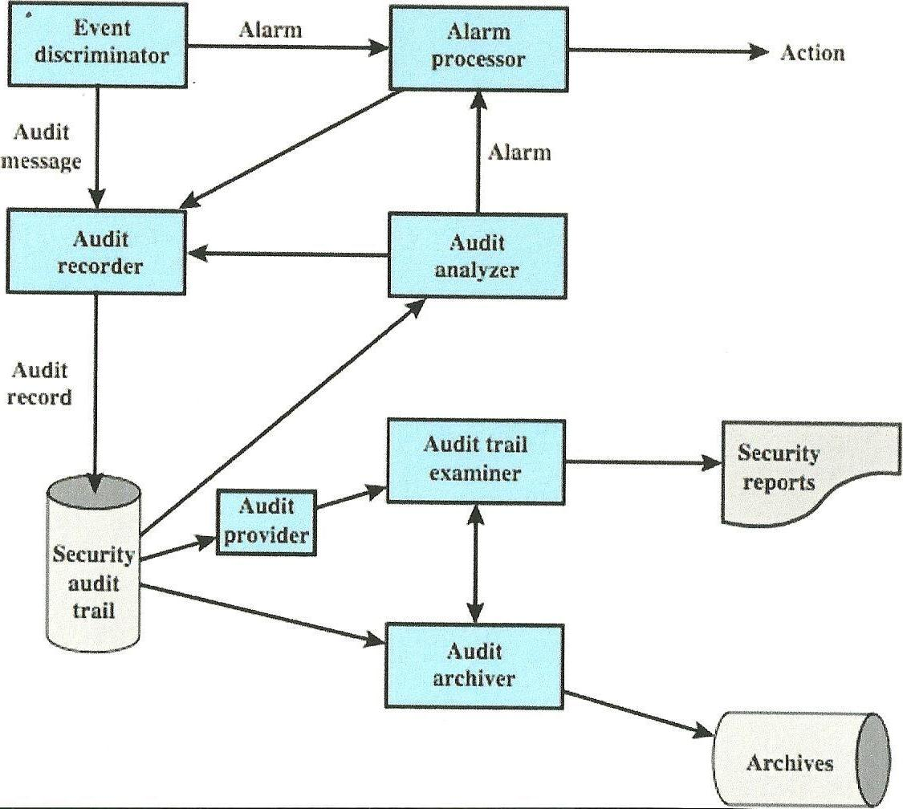
Security Audit and Alarms Model
Notes:
Encompassing these two topics, here we have an illustration of a Security Audit Model. It includes the following components ( read slide )
Event Discriminator: The logic embedded into the software of the system that monitors system activity and detects security-related events that it has been configured to detect.
Audit Recorder: For each detected event, the event discriminator transmits the information to an audit recorder. This can be in the form of a message or recording the event in a shared memory area.
Alarm Processor: Some events detected by the event discriminator are defined as alarm events. For each such event an alarm is issued to an alarm processor. The alarm processor takes some action based on the alarm.
Security Audit Trail: The Audit Recorder creates a formatted record of each event and stores it in the security audit trail.
Audit Analyzer: Interprets the security audit trail, and based on a pattern of activity, may define a new auditable event that is sent to the audit recorder and may generate an alarm.
Audit Archiver: Software module that periodically extracts records from the audit trail to create a permanent archive of auditable events. (Also called the Audit log.)
Archives: A permanent store of security-related events.
Audit Provider: An Application and/or user interface to the audit trail.
Audit Trail Examiner: An Application or user who examines the audit trail and audit archives for historical trends, computer forensic purposes, and other analysis.
Security Reports: The audit trail examiner can prepare human-readable security reports.

Slide 9
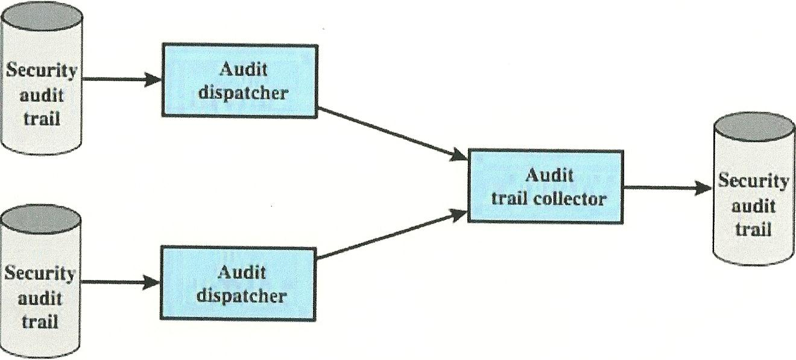
Distributed Audit Trail Model
Notes:
For a Distributed Audit Trail – two additional components are needed.
Audit Trail Collector: A module on a centralized system that collects audit trail records from other systems and creates a combined audit trail.
Audit Dispatcher: A module that transmits the audit trail records from its local system to the centralized audit trail collector.

Slide 10
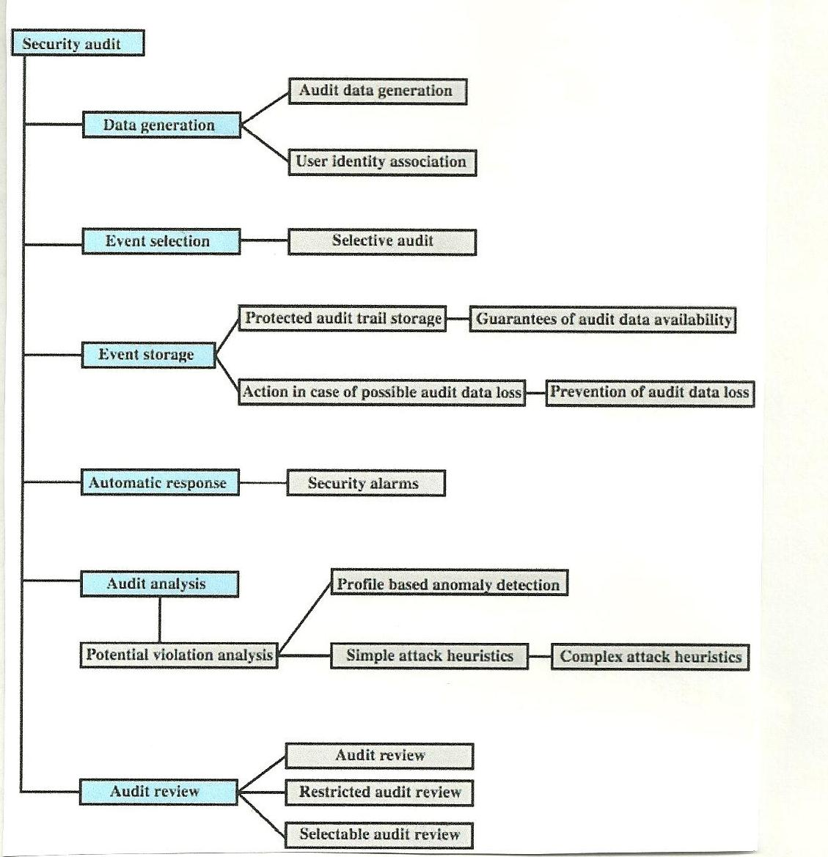
Security Auditing Functions
Notes:
In this slide we have another way of looking at the Security Auditing Functions. This view from the Common Criteria specification identifies 6 major areas: ( read slide )
Data Generation: Identifies the level of auditing, specifies the types of auditable events, and identifies the minimum set of audit-related information provided.
- (here we need to address a “Conflict” - between security and privacy.) A decision needs to made when to record the identity of the user associated with an action.
Event Selection: Inclusion or exclusion of events from the auditable set.
Allows the system to be configured at different levels of granularity to avoid the creation of unwieldy audit trails.
Event Storage: Creation and maintenance of the secure audit trail.
Automatic response: Defines reactions taken following detection of events that are indicative of a potential security violation.
Audit Analysis: Provided via automated mechanisms to analyze system activity and audit data in search of security violations.
This component identifies potential security violations, using anomaly detection and attack heuristics (i.e. an analysis is done to determine if a security violation has occurred).
Audit Review: Available to authorized users to assist in audit data review. This component may include the ability to perform searches, sort audit data and filter audit data.

Slide 11
Security Auditing Requirements – Event Definition
Event definition - must define what are auditable events
  Common Criteria suggests:
    introduction of objects within the security-related portion of the software into a subject’s address space
    deletion of objects
    distribution or revocation of access rights or capabilities
    changes to (subject or object) security attributes
    policy checks performed by the security software
    use of access rights to bypass a policy check
    use of identification and authentication functions
    security-related actions taken by an operator/user
    import or export of data from or to removable media
Notes:
Security Auditing Architecture consists of several requirements:
The first of these is Event Detection.
The Security Administrator must define the set of events that are subject to audit.
( read slide – starting with Common Criteria… )

Slide 12
Additional Security Auditing Requirements
Event detection: hooks created in the application & monitoring software to capture activity
Event recording: secure storage resistant to tampering or deletion.
Event and audit trail analysis: software, tools, and interfaces
Security of the auditing function
Minimal effect / impact on functionality
Notes:
Additional Security Auditing requirements are:
( read bullet points)

Slide 13
Security Audit – Implementation Guidelines
Agree on audit requirements with management
Scope of the checks should be agreed and controlled
Checks limited to read-only access to software & data
Other access only for isolated copies of system files, then erased or given appropriate protection
Resources for performing the checks should be explicitly identified and made available
Identify / agreed on special or additional requirements
All access should be monitored & logged, produce a reference trail
Document procedures, requirements, responsibilities
Person(s) doing audit independent of activities
Notes:
The last component of the Security Auditing Architecture is the implementation of the Auditing and analysis functions.
The ISO standard Code of Practice for Information Security Management (ISO17799) provides the following guidelines:
( read slide )

Slide 14
Security Audit Trail – What to collect
Issue of amount of data generated
  tradeoff quantity vs. efficiency
Data items captured may include:
  events related to the use of auditing software
  events related to (the use of) system security mechanisms
  events from IDS and firewall systems
  system management / operation events
  operating system access (e.g. system calls)
  access to selected applications
  remote access
Notes:
Now let’s take a brief look at our second topic, the Security Audit Trail in more detail.
One of the first issues to address regarding the Security Audit trail , is what to collect.
One factor to consider here is the amount of data generated.
So a tradeoff between quantity and efficiency must be made; that is - the more data collected and analyzed - the greater the performance penalty on the system.
Data items to consider capturing include:
( read sub-bullets of second bullet item )

Slide 15
Security Audit Trail – What to collect
Auditable items suggested in X.816 (Table 15.2)
  events related to a specific connection
  events related to the use of security services
  events related to management operations or notifications
  Auditable events (some examples)
    Deny access
    Authenticate
    Object: Creation, Deletion or Modification
Notes:
The textbook includes a couple of “suggested lists” of auditable items.
On page 482, Table 15.2, captures the suggestion from X.816.
Items suggested include ( read slide )
Another suggested list of auditable items is on page 483, Table 15.3, from
ISO 17700.
Items suggest include:
Authorized access
All privileged operations
Unauthorized access, attempts
System alerts or failures
Changes to, or attempts to change, system security settings and controls.

Slide 16
Implementing (Audit Trail) Logging
The foundation of a security auditing facility is the initial capture of the audit data.
Software must include hooks (capture points) that trigger data collection and storage of data as preselected events occur.
Operating system / application dependent
  system-level logging can use existing means
Notes:
(read slide)

Slide 17
Implementing the Logging Function
Useful to categorize audit trails
  system-level audit trails
  application-level audit trail
  user-Level audit trail
  physical access control (equipment)
Notes:
Our next high-level topic is Implementing the Logging Function.
We will briefly discuss four general types of audit trails:
System-Level Audit Trails
Application-Level Audit Trail
User-Level Audit Trail
Physical Access Control (equipment)

Slide 18
Auto Trail Category : System-Level
System-level audit trails:
  are generally used to monitor and optimize system performance
  can also serve a security audit function
  captures logins, device use, O/S functions, e.g.
    Jan 27 17:18:38 host1 login: ROOT LOGIN console
    Jan 27 17:19:37 host1 reboot: rebooted by root
    Jan 28 09:47:35 host1 shutdown: reboot by user1
Notes:
System-level audit trails are generally used to monitor and optimize system performance but can serve a security audit function as well.
Examples of the types of information captured for security audit trails includes:
Account login events
Directory Service access
Device (or object) usage
Access Policy Changes
Operating System functions
This slide shows examples of a root login access, a reboot and a shutdown of the system.

Slide 19
System Level : Windows Event Log
Each event is an entity that describes some interesting occurrence
  each event record contains:
    numeric id, set of attributes, optional user data
  presented as XML or binary data
Have three types of event logs:
  System event log – applications running under system service accounts and drivers
  Application event log - user-level applications
  Security event log - Windows Local Security Authority
Notes:
( read slide )
Attributes of event
- task
- opcode
- level
- version
- keywords

Slide 20
Windows Event Log Example
Event Type: Success Audit
Event Source: Security
Event Category: (1)
Event ID: 517
Date: 3/6/2006
Time: 2:56:40 PM
User: NT AUTHORITY\SYSTEM
Computer: KENT
Description: The audit log was cleared
Primary User Name: SYSTEM Primary Domain: NT AUTHORITY
Primary Logon ID: (0x0,0x3F7) Client User Name: userk
Client Domain: KENT Client Logon ID: (0x0,0x28BFD)
Notes:
( read slide )

Slide 21
Windows Event Categories
Account logon events
Account management
Directory service access
Logon events
Object access
Policy changes
Privilege use
Process tracking
System events
Notes:
( read slide )
Account logon events - User authentication activity from the perspective of the system that validated the attempt (e.g. authenticated granted, account mapped for logon).
Large numbers of failures may indicate scanning activity or brute force attacks.
Account management – Administrative activity related to the creation, management, and deletion of individual accounts and user groups (e. g. User account creation, change password attempt).
Directory service access – User-Level access to any Active Directory object that has a System Access Control List defined.
Logon events – User authentication activity, either to a local machine or over a network, from the system that originated the activity (e.g. successful user logon, logon failure, bad password).
Object access –User-Level access to file system and registry objects that have System Access Control Lists defined. Provides a relatively easy way to track read access, as well as changes to sensitive files (e.g. object open, object deleted).
Policy changes – Administrative changes to the access policies, audit configuration, and other system-level settings (e.g. user right assigned, audit policy changed).
Privilege use – If enabled, all instances of users exercising their access to particular system functions are recorded (e.g. creating objects, backing up the system).
Process tracking – Generates detailed audit information when processes start and finish (e.g. Process was created, process exited, auditable data was protected).
System events – Records information on events that affect the availability and integrity of the system (e.g. system is starting, Windows is shutting down, audit log cleared).

Slide 22
Auto Trail Category : Application-Level
To detect security violations within an application
To detect flaws in application's system interaction
Record appropriate security related details, e.g.
  Apr 911:20:22 host1 AA06370: from=<user2@host2>, size=3355, class=0
  Apr 911:20:23 host1 AA06370: to=<user1@host1>, delay=00:00:02, stat=Sent
  Apr 911:59:51 host1 AA06436: from=<user4@host3>, size=1424, class=0
  Apr 911:59:52 host1 AA06436: to=<user1@host1>, delay=00:00:02, stat=Sent
Notes:
Application-Level logging
Application logging is needed to capture or detect
security violations within an application or
to detect flaws in application's system interaction
Log record examples here include the size of a record being sent and the delay times.

Slide 23
Logging at Application Level
Privileged applications present security issues
  audit data may not be captured by system or user-level audit logs
  a large percentage of reported vulnerabilities
  e.g. failure to adequately check input data or application logic errors
Need to capture detailed behavior
Applications can be written to create audit data
If not done, consider two approaches to auditing:
  interposable libraries
  dynamic binary rewriting
Notes:
Application-Level logging
Applications present security problems that may not be captured by System-Level (or User-Level) logging.
A large percentage of reported vulnerabilities are related to application security violations (this is easy to understand - that’s were the data relationships are).
Examples include failure to adequately check input data or application logic errors.
( read 2nd bullet on)

Slide 24
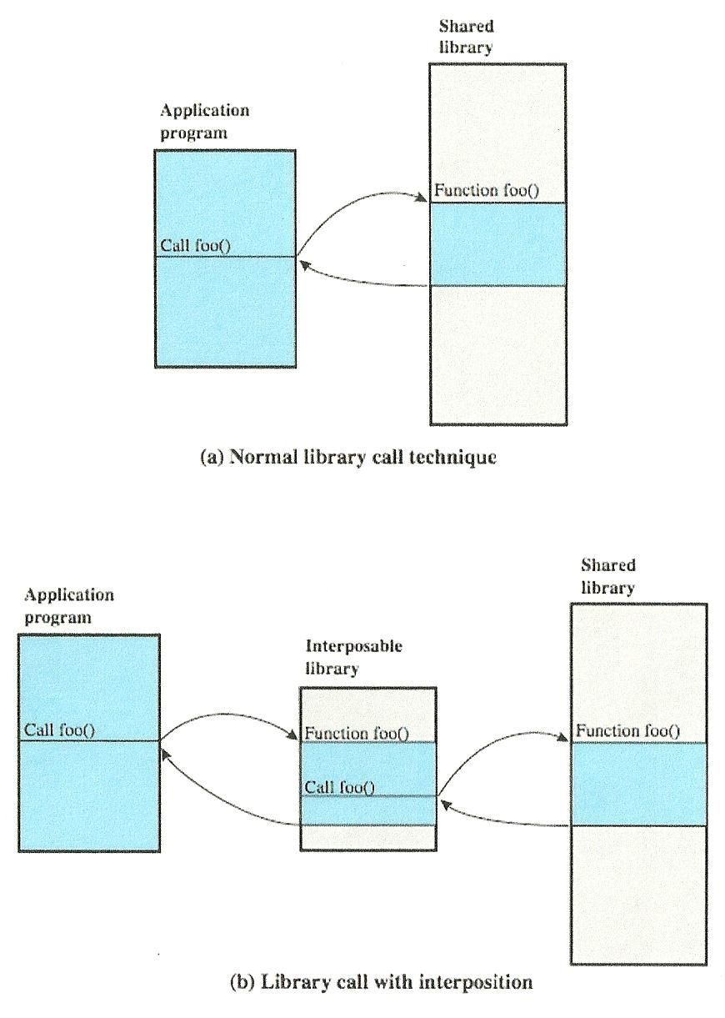
Interposable Libraries
Notes:
A technique that provides for application-level auditing by creating new procedures that intercept calls to shared library functions in order to instrument the logging activity.
(Top) Normal Mode of Operation when a program invokes a routine in dynamically linked shared libraries. At load time, the reference to routing “foo” in the program is resolved to the virtual memory address of the start of the “foo” in the shared library.
(Bottom) With library interpolation, a special interposable library is constructed so that at load time, the program links to the interposable library instead of the shared library.
For each function in the shared library for which auditing is to be invoked, the interposable library contains a function with the same name.
If the desired function is not contained in the interposed library, the loader continues its search in the shared library and links directly with the target function.
The interposed module can perform any auditing-related function, such as recording the fact of the call, the parameters passed and returned, etc..
Typically the interposed module will call the actual shared function so that the application’s behavior is not altered.
This technique allows the interception of certain function calls and the storage of state between such calls without requiring the recompilation of the calling program or shared objects.

Slide 25
Auto Trail Category : User-Level
Trace activity of individual users over time
  documents user’s actions
  can be used as input to an analysis program that attempts to define normal versus anomalous behavior
May capture
  user interactions with system (e.g.)
    commands issued
    identification and authentication attempts
    files and resources accessed.
    may also log use of applications
Notes:
User-Level logging can be used to trace an individual user’s activity to document their actions.
It can also be used as input to determine normal vs. abnormal behavior.
User-Level logging may capture user interactions with the system (e.g.):
commands issued
identification and authentication attempts
files and resources accessed.
may also log use of applications
QUESTION:
If a user denies performing an action, user-level audit trail provides documentation or evidence for what type of Deception Threat?
ANSWER: [ Repudiation ]

Slide 26
Auto Trail Category : Physical Access
Generated by physical access control (equipment)
  e.g. card-key systems, alarm systems
Sent to central host for analysis / storage
Can log
  date/time/location/user of access attempt
  both invalid and valid access attempts
  attempts to change access privileges
  may send violation messages to personnel
Notes:
Physical Access logging is…
( Read slide )
Last bullet point:
In order not to desensitize a guard or monitor, all access should not be sent to a screen. Only exceptions, such as failed access attempts, should be highlighted to those monitoring access.

Slide 27
Protecting Audit Trail Data: 3 alternatives
Read/write file on host
  easy to implement, least resource use, fast access
  vulnerable to attack by intruder
Write-once device (e.g. CD/DVD-ROM)
  more secure but less convenient
  need media supply and have delayed access
Write-only device (e.g. printer)
  paper-trail but impractical for analysis
Must protect both integrity and confidentiality
  using encryption, digital signatures, access controls
Notes:
The audit trail can be implemented in several ways:
( read slide)
(last bullet point)
? – Why is integrity important?
[An intruder may attempt to remove evidence of the intrusion by altering the audit trail. ]
? – Why is confidentially important?
[ Audit trail my capture sensitive information.]

Slide 28
Audit Trail Analysis
Analysis programs/procedures vary widely
  cf. NIST SP 800-92 offers some useful advice on this topic
Security Admin must understand context of log entries
  relevant info may reside in same / other logs, or non log sources (e.g. configuration management entries)
  possibility for unreliable entries (e.g. “false positives”)
Audit file formats contain a mix of plain text / codes
  hence must decipher manually / automatically
To gain an understanding of log data - regularly review log entries
Notes:
Our next high-level topic is Audit Trail Analysis.
( read slide )

Slide 29
Audit Analysis – Develop an Understanding of
Organizations policies regarding acceptable use
Security software (used)
  security-related events that can be detected
  general detection profile of each program
Operating Systems and major applications used
Characteristics of common attack techniques
  esp. how the use of these techniques might be recorded on each system
Software needed to perform analysis
  Log viewers, log reduction scripts, database query tools
Notes:
To perform Audit Analysis you must Develop an understanding of
( read slide )

Slide 30
Types of Audit Trail Analysis
Audit trails can be used in multiple ways
This depends in part on when analysis is done
Possibilities include:
  audit trail review after an event
    triggered by event to diagnose cause & remediate
  periodic review of audit trail data
    review bulk data to identify problems & behavior
  real-time audit analysis
    as part of an intrusion detection function
Notes:
Types of Audit Trail Analysis
( read slide)

Slide 31
Audit Review
Audit review capability provides administrator with information from selected audit records
  actions of one or more users (e.g. identification)
  actions on a specific object or resource
  all or a specified set of audited exceptions
  actions on a specific system / security attribute
May be filtered by time / source / frequency
Used to provide system activity baseline
To gauge level of security related activity
Notes:
Audit Review - types of “things” to look for.
( read slide )

Slide 32
Approaches to Data Analysis
Basic alerting
  indicate interesting type of event has occurred
Baselining
  define normal vs. unusual events / patterns
  compare with new data to detect changes
Windowing
  detection of events within a given set of parameters
Correlation
  seek relationships among events
Notes:
Approaches to Data Analysis – this slide identifies some of the major approaches to data analysis – in no way all inclusive, just a few examples.
ON 2nd bullet –
Types of baselining – anomaly detection and threshold detection
Windowing – within a given time period or outside a given time period – e.g. baselining the time of day each user logs in and flagging logins that fall outside that range.

Slide 33
Integrated Approaches
Large volume of audit data means manual analysis and manual baselining is impractical
Need a Security Information and Event Management (SIEM) system
  a centralized logging and analysis package
  agentless or agent-based
  normalizes a variety of log formats
  analyzes combined data
  correlates events among the log entries
  identifies and prioritizes significant events
  can initiate responses
Notes:
Our last high-level topic in this Chapter is a brief discussion on the idea of an Integrated Approach to Security Auditing
Given the large volume of audit data, manual analysis and manual baselining is not a practical approach.
An organization should consider the use of a Security Information and Event Management system (SIEM).
These systems a designed to :
be a centralized logging and analysis package
be agentless or agent-based
Agentless: the SIEM server receives data from the individual log generating hosts without needing to have special software installed on those hosts.
Agent-based: an agent program is installed on the log generating host to perform event filtering and aggregation of data.
normalizes a variety of log formats
be able to analyze combined data
correlate events among the log entries
identify and prioritize significant events
initiate responses

Slide 34
SIEM Example: Cisco MARS
Example of SIEM product
Supports a wide variety of systems
Agentless with central dedicated server
Wide array of analysis packages
An effective GUI
Server collects, parses, normalizes, correlates and assesses events to then check for false positives, vulnerabilities, and profiling
Notes:
One example of a SIEM mentioned in the test is MARS (developed by Cisco)
Features of MARS:
Supports a wide variety of systems
Agentless with central dedicated server
Wide array of analysis packages
An effective GUI
Server collects, parses, normalizes, correlates and assesses events to then check for false positives, vulnerabilities, and profiling

Slide 35
Security Audit : Summary
Introduced need for security auditing
Audit model, functions, requirements
Security audit trails
  system Level
  application Level
  user Level
Implementing logging – “What to collect”
Audit trail analysis
Integrated SIEM products

Slide 36
Computer Security
Principles and Practices
Security Audit
IT Security Management & Risk Assessment
IT Security Controls, Plans & Procedures

Slide 37
IT Security Management & Risk Assessment
IT Security Management
Organizational context and Security Policy
Security Risk Assessment
Detailed Security Risk Analysis

Slide 38
IT Risk Assessment Overview
Security requirements means asking
  What assets do we need to protect?
  How are those assets threatened?
  What can we do to counter those threats?
IT security management answers these
  determining security objectives & creating a risk profile
  perform security risk assessment of assets
  select, implement, monitor controls
  iterate process
Notes:
( last sub-bullet expanded )
The whole process must be iterated, and the plans and procedures kept up-to-date, because of the rapid rate of change in both the technology and the risk environment.

Slide 39
IT Security Management
IT Security Management: a process used to achieve and maintain appropriate levels of confidentiality, integrity, availability, accountability, authenticity and reliability.
Notes:
Our 1st high-level topic, IT Security Management is defined as…

Slide 40
IT Security Management Functions
Determining organizational IT security objectives, strategies and policies
Determining organizational IT security requirements
Identifying and analyzing security threats to IT assets
Identifying and analyzing risks
Notes:
IT Security Management Functions
( read slide ) 1st of 2 slides

Slide 41
IT Security Management Functions (2)
Specifying appropriate safeguards
Monitoring the implementation and operation of safeguards (providing cost effective protection)
Developing and implementing a security awareness program
Detecting and reacting to incidents
Notes:
IT Security Management Functions (continued)
( read slide )

Slide 42
Overview of IT Security Manange-ment
Notes:
IT Security Management needs to be a key part of an organization’s overall management plan.
The IT Security Risk assessment process should be incorporated into the wider risk assessment of all the organizations assets and business processes.
This should be a circular / iterative process.
Input to Risk Analysis options – IT Security policy and Organizational aspects
Risk Analysis options
Security Risk Analysis
Baseline
Informal
Formal
Combined
Selection of Controls
Development of Security Plan and Procedures
Become input to the Implementation Plan
Implement Controls
Security Awareness & Training
Become input to the “Follow-up”
Maintenance
Security Compliance
Change Management
Incident Handling

Slide 43
Plan – Do – Check - Act Process Model
Notes:
Repeating – IT Security Management needs to be an iterative process
Plan – establish security policy, objectives, processes and procedures relevant to managing risk and improving information security to deliver results in accordance with an organization’s overall policies and objectives.
Do – implement and operate the security policy, controls, processes and procedures.
Check – assess and measure process performance against security policy, objectives and practical experience and report the results to management for review.
Act – take corrective and preventive actions, based on the results of the internal security audit and management review.

Slide 44
Organizational Context and
Security Policy
First examine organization’s IT security:
  objectives - wanted IT security outcomes
  strategies - how to meet objectives
  policies - identify what needs to be done
Maintained and updated regularly
  using periodic security reviews
  reflect changing technical / risk environments
Examine role of IT systems in organization
Notes:
Our next high-level topic is Organizational Context and Security Policy
The initial step in the IT security management process comprises an examination of the organization’s IT Security objectives, strategies, and policies, in the context of the organization’s general risk profile.
Objectives – need to address individual rights, legal requirements, and standards imposed on the organization, in support of the overall organizational objectives.
Organizational security strategies identify how these objectives can be met.
Policies identify what needs to be done
The process needs to be maintained and updated regularly
using periodic security reviews
The process should reflect changing technical / risk environments
Examine role of IT systems in organization.
The policy should provide a clear overview of how an organization’s IT infrastructure supports its overall business objectives and what security requirements must be provided in order to do this most effectively.
It is critical that the IT Security policy has full approval and buy-in by senior management (this is implied…has the budget to implement / maintain process).

Slide 45
Security Policy Topics
Needs to address:
scope and purpose of the policy
the relationship of the security objectives to legal & regulatory obligations & business objectives
IT security requirements
assignment of responsibilities
risk management approach
security awareness and training
Notes:
(Security Policy Topics)
The IT Security Policy needs to address:
scope and purpose of the policy
the relationship of the security objectives to
legal & regulatory obligations and
business objectives
IT security requirements
assignment of responsibilities
risk management approach
security awareness and training

Slide 46
Security Policy Topics (2)
Need to address (cont)
general personnel issues
any legal sanctions that may be imposed on staff
integration of security into systems development
information classification scheme
contingency and business continuity planning
incident detection and handling processes
how when policy reviewed, and change control to it
Notes:
(Security Policy Topics continued)
general personnel issues
any legal sanctions that may be imposed on staff
integration of security into systems development
information classification scheme
contingency and business continuity planning
incident detection and handling processes
how when policy reviewed, and change control to it

Slide 47
IT Security Needs Management Support
IT security policy must be supported by senior management
Need IT security officer
  to provide consistent overall supervision
  liaison with senior management
  coordinate the Security Response Team efforts
  manage process (including security awareness)
Large organizations needs IT security officers on major projects / teams
Notes:
As mentioned before it is critical to the success of the IT Security Policy to have Senior Management support.
An IT Security Officer (or Executive) is needed:
to provide consistent overall supervision
liaison with senior management (preferably a peer relationship)
coordinate the Security Response Team efforts
manage process (including security awareness)
Security Officers on major projects
- Role is to develop and maintain security policies for their systems,
develop and implement security plans relating to these systems,
handle the day-to-day monitoring of the implementation of these plans

Slide 48
Security Risk Assessment
Critical component of process
  else may have vulnerabilities or waste money
Ideally examine every asset versus risk
  not feasible in practice
Choose one of possible alternatives based on organization’s resources and risk profile
  baseline
  informal
  detailed (formal)
  combined
Notes:
The third high-level topic of this chapter is Security Risk Assessment.
Security Risk Assessment should be viewed as a critical component of the Security process, without and assessment, there is a chance that resources will not be deployed where they will be the most effective.
- some risks may not be addressed or
- some safeguards may be deployed without sufficient justification – wasting time and money.
Ideally every organizational asset should be examined – but – this is not practical.
Four approaches to identifying and mitigating risks:
baseline
informal
detailed (formal)
combined
We will take a look at each of these in more detail in the next few slides.

Slide 49
Risk Assessment – Baseline Approach
Use “industry best practice ”
  easy, cheap, can be replicated
  but gives no special consideration to org
  may give too much or too little security
Implement safeguards against most common threats
Baseline recommendations and checklist documents available from various bodies
(usually) Only suitable for small organizations
Notes:
Baseline approach to risk assessment aims to implement a basic general level of security controls.
( read slide )
Advantages:
- doesn’t require the expenditure of additional resources in conducting a more formal risk assessment
- the same measures can be replicated over a range of systems
Disadvantages:
- no special consideration is given to variations in the organization’s risk exposure
- a chance that the baseline level may be set either
- too high, leading to expensive or restrictive security measure that may not be needed
- too low, resulting in insufficient security and leaving the organization vulnerable
GOAL – is to implement generally agreed safeguards to provide protection against the most common threats

Slide 50
Risk Assessment – Informal Approach
Conduct informal, practical risk analysis on organization’s IT systems
Exploits knowledge and expertise of analyst
Fairly quick and cheap
Does address some organization’s specific issues
Some risks may be incorrectly assessed
Skewed by analysts views, varies over time
Suitable for small to medium sized organizations
Notes:
The informal approach involves conducting some form of informal, practical or realistic, risk analysis for the organization’s IT System
This analysis does not involve the use of a formal, structured process, but rather exploits the knowledge and expertise of the individuals, performing the analysis.
Advantages:
- individuals performing the analysis require no additional skills
- fairly quick and cheap
- judgments can be made about specific vulnerabilities and risks
- more accurate and targeted controls may be used (compared to baseline)
Disadvantages:
- a chance that some risks may not be considered appropriately
- results may be skewed by the views and prejudices of the individuals performing the analysis
- may result in insufficient justification for suggested controls – which may bring the justification of the whole process into question
- may be inconsistent results over time as a result of differing expertise in those conducting the analysis

Slide 51
Risk Assessment – Detailed Approach
Most comprehensive approach
Assessment uses a formal structured process
  with a number of stages
  identify likelihood of risk and consequences
  analysis provides confidence controls appropriate
Costly and slow, requires expert analysts
May be a legal requirement to use
Suitable for large organizations with IT systems critical to their business objectives
Notes:
The third and most comprehensive approach is to conduct a detailed risk assessment of the organization’s IT systems.
Involves a number of stages
- identification of assets
- identification of threats and vulnerabilities to those assets
- determination of the likelihood of the risk occurring
- identification of the consequences to the organization should risk occur
- therefore identifies the risk the org is exposed to
Advantages:
- provides the most detailed examination of the security risks of an organization’s IT system
- produces strong justification for expenditure on controls proposed
- provides the best information for continuing to manage the security of these systems
Disadvantages:
- significant cost in time, resources, and expertise needed to perform the analysis
- the time taken to perform the analysis, may result in delays in providing suitable levels of protection for some systems
Note: The use of a formal, detailed risk analysis is often a legal requirement for some government organizations and businesses providing services to them.

Slide 52
Risk Assessment – Combined Approach
Combines elements of other approaches
  initial (suitable) baseline on all systems
  informal analysis to identify critical risks
  formal assessment on these systems
  iterated and extended over time
Better use of time and money resources
Better security earlier, evolves over time
May miss some risks early
Recommended alternative for most organizations
Notes:
The last approach combines elements of the baseline, informal and detailed risk analysis approaches.
Aim is to provide reasonable levels of protection as quickly as possible, and then to examine and adjust the protection controls deployed on key systems over time.
Starts with (sub bullet pt. 1.- ..suitable… - read 4 sub-bullets )
The use of initial high-level analysis to determine where further resources need to be expended, may be easier to sell to management.
This approach can be a better use of time and money.
This approach results in the development of a strategic picture of the IT resources and where major risks are likely to occur.
Allowing for better security earlier and for a growth in security control over time.
Disadvantage:
- If the initial high-level analysis is inaccurate, then some systems for which a detailed risk analysis should be performed may remain vulnerable for some time.

Slide 53
Risk Assessment Methodology
Notes:
Risk Assessment Methodology (Fig. 16.3, pg.519) may want to find this page – we will be referring to it throughout the discussion of this chapter.
Step 1 –System Characterization
Input: Hardware, software, system interfaces, data and information, people
Output: System boundary, system functions, system and data criticality
Step 2 – Threat Identification
Input: History of system attack, data from CRETs and similar sources
Output: Threat Statement
Step 3 – Vulnerability Identification
Input: Reports from prior risk assessments, Security requirements, Security Tests results
Output: List of potential vulnerabilities
Step 4 – Control Analysis
Input: Current controls, planned controls
Output: List of current and planned controls
Step 5 – Likelihood determination
Input: Threat-source motivation, Threat capacity, Nature of vulnerability, Current controls
Output: Likelihood rating
Step 6 – Impact Analysis( Loss of : INTEGRITY, AVAILABILITY, CONFIDENTIALITY
Input Mission impact analysis, asset critically assessment, data criticality, data sensitivity
Output: Impact rating
Step 7 – Risk Determination
Input: Likelihood of threat exploitation, Magnitude of impact, Adequacy of controls
Output: Risks and associated risk levels
Step 8 – Control recommendations : Output: Recommended Controls
Step 9 – Results documentation : Output: Risk assessment report

Slide 54
Risk Assessment Context
Determine broad risk exposure of organization
  related to wider political / social environment
  identify legal and regulatory constraints
  provide baseline for organization’s risk exposure
Specify organization’s risk appetite
Set boundaries of risk assessment
  depend in part on the risk assessment approach used
Decide on risk assessment criteria used
Notes:
From the model on the last slide, Risk Assessment Context would be part of Step 1.
( read 1st and 2nd bullet points )
Risk appetite – is defined as the level of risk the organization views as acceptable.
( read 3rd bullet point )
Boundaries – may be a single system, a functional area (i.e. Product info) or the entire IT infrastructure
As part of the Risk assessment –
- identify stakeholders
- decide who will do the risk assessment
( read 4th bullet point )

Slide 55
Risk Assessment Asset Identification
Identify assets
  “anything which needs to be protected”
  of value to organization to meet its objectives
  tangible or intangible (assets)
  in practice try to identify significant assets
Draw on expertise of people in relevant areas of organization to identify key assets
  identify and interview such personnel
  see checklists in various standards
Notes:
Last component of Step 1 (of slide 53)
( Read slide )
The goal here is to identify all assets that contribute significantly to attaining the organization's objectives and whose compromise or loss would seriously impact on the organization’s operation.

Slide 56
Risk Related Terms
Asset: anything that has value to the organization.
Threat: a potential cause of an unwanted incident which may result in harm to a system or organization.
Vulnerability: a weakness in an asset or group of assets which can be exploited by a threat
Risk: the potential that a given threat will exploit vulnerabilities of an asset or group of assets to cause loss or damage to the assets.
Notes:
Definitions of some Risk Related Terms. Note these are not just relevant to Security Risks – universal to all types of risk.
( read slide )

Slide 57
Threat identification
To identify threats or risks to assets ask:
  1. Who or what could cause it harm?
  2. How could this occur?
Threats are anything that hinders or prevents an asset (providing appropriate levels of the key security services) from functioning properly:
  confidentiality, integrity, availability, accountability, authenticity and reliability
Assets may have multiple threats
Notes:
The next step (Step 2 in the process on slide 53) is to identify the threats or risks the assets are exposed to.
The goal of this stage is to identify potentially significant risks to the assets. This requires answering the two questions listed at the top of this slide
( read slide )

Slide 58
Threat Sources
Threats may be
  natural “acts of god”
  man-made and either accidental or deliberate
Should consider human attackers:
  motivation
  capability
  resources
  probability of attack
  Deterrence
Any previous history of attack on organization
Notes:
Threats can be natural (some times referred to ”Acts of God” or man-made.
They can be accidental or deliberate.
( read 2nd bullet point )
Motivation: Why would someone target this organization? How motivated are they?
Capability: What is their level of skill in exploiting the threat?
(To me, this is a “major” unknown.)
Another way to view this question – How could this occur.
Resource: How much time, money, and other resources could they deploy?
Probability of attack: How likely and how often would our assets be targeted?
Deterrence: What are the consequences to the attacker of being identified?
( read 3rd bullet point )

Slide 59
“Threat identification” - Sources
Depends on risk assessors experience
Uses variety of sources
  natural threat chance from insurance (industry) statistics
  lists of potential threats in standards, IT security surveys, information from government security agencies (e.g. CERT)
  needs to be tailored to organization’s environment
  consider any vulnerabilities in its IT systems
Notes:
( read slide )

Slide 60
Vulnerability Identification
Identify exploitable flaws or weaknesses in organization’s IT systems or processes
Determine applicability and significance of threat to organization
Need combination of threat and vulnerability to create a risk to an asset
(again) Can use lists of potential vulnerabilities in standards etc.
Notes:
The third step in the process on slide 53 is to identify the potential vulnerabilities.
This step also addresses the second “ Security requirements” question we asked at the beginning of this chapter.
“How are assets threatened” or asked in other ways – How could this occur?
or
What are the Capabilities of a potential hacker.
This involves identifying flaws or weaknesses in the organization’s IT system or processes.
( Read 2nd bullet point on )
The outcome of this step should be a list of threats and vulnerabilities, with brief descriptions of how and why they might occur.

Slide 61
Analyze Existing Controls and Risks
Specify likelihood of occurrence of each identified threat to an asset given existing controls
  management, operational, technical processes and procedures to reduce exposure of organization to some risks
Specify consequence should threat occur
Derive overall risk rating for each threat
  risk = probability threat occurs x cost to organization
Notes:
The fourth step in the process on slide 53 is to identify and analyze the current and planned controls.
Before the likelihood of a threat can be specified, any existing controls used by the organization to attempt to minimize threats need to be identified.
( read slide )

Slide 62
Analyze Risks (cont)
In practice, risks are very hard to determine exactly / estimate
Use qualitative not quantitative, ratings for each risk (probability, cost)
Goal : order / prioritize resulting risks, to help determine which risks to address first (i.e. which risks to focus resources on)
Notes:
( read slide)
Qualitative – see next slide

Slide 63
Determine Likelihood (table 16.2, pg. 525)
Rating | Likelihood Description | Expanded Definition
1 | Rare | May occur only in exceptional circumstances and may deemed as “unlucky” or very unlikely.
2 | Unlikely | Could occur at some time but not expected given current controls, circumstances, and recent events.
3 | Possible | Might occur at some time, but just as likely as not. It may be difficult to control its occurrence due to external influences.
4 | Likely | Will probably occur in some circumstance and one should not be surprised if it occurred.
5 | Almost Certain | Is expected to occur in most circumstances and certainly sooner or later.
Notes:
Having identified existing controls, the likelihood that each identified threat could occur and cause harm to some asset needs to be specified.
This is the fifth step in the process on slide 53, - to determine the likelihood of the threat to occur.
The likelihood is typically described qualitatively.
( read slide )
There will likely be some uncertainty and debate over exactly which rating is more appropriate.
The goal of this process is to provide guidance to management as to which risk exist, and provide enough information to help them decide how to respond.
The risk analyst takes the descriptive asset and threat / vulnerability details form the previous steps in the process, and taking into consideration the overall risk environment and existing controls (of the organization), decides the appropriate rating.
This estimation relates the likelihood of the specified threat exploiting one or more vulnerabilities to an asset (or group of assets) which would result in harm to the organization.
Authors of the text suggests a rating of “likely” or higher should be assigned to a threat that has occurred before.

Slide 64
Risk Consequences (Table 16.3, pg. 526)
Rating | Consequence
1 | Insignificant | Generally a result of a minor security breach in a single area. Impact is likely to last less than several days and requires only minor expenditure to rectify
2 | Minor | Result of a security breach in one or two areas. Impact is likely to last less than a week, but can be dealt with at the segment or project level without management intervention. Can generally be rectified within project or team resources.
3 | Moderate | Limited systemic (and possibly ongoing) security breaches. Impact is likely to last up to 2 weeks and generally requires management intervention. Will have ongoing compliance costs to overcome
4 | Major | Ongoing systemic security breach. Impact will likely last 4-8 week sand require significant management intervention and resources to overcome, and compliance costs are expected to be substantial. Loss of business or organizational outcomes is possible, but not expected, especially if this is a once
5 | Catastrophic | Major systemic security breach. Impact will last for 3 months or more and senior management will be required to intervene for the duration of the event to overcome shortcomings. Compliance costs are expected to be very substantial. Substantial public or political debate about, and loss of confidence in, the organization is likely. Possible criminal or disciplinary action is likely
6 | Doomsday | Multiple instances of major systemic security breaches. Impact duration cannot be determined and senior management will be required to place the company under voluntary administration or other form of major restructuring. Criminal proceedings against senior management is expected, and substantial loss of business and failure to meet organizational objectives is unavoidable
Notes:
The sixth step in the process on slide 53 is to perform an Impact Analysis.
After identifying the likelihood of a threat to occur, the analyst must then specify the consequences of a specific threat occurring.
The author makes a note here that this is
“distinct from, and not related to, the likelihood of the threat occurring. Rather, consequence specification indicates the impact on the organization should the particular threat in question actually occur.
Even if a threat is regarded as rare or unlikely, if the organization would suffer severe consequences should it occur, then it clearly poses a risk to the organization.”
A qualitative descriptive value should be used.
( read slide )
This determination should be based upon the judgment of the asset’s owner and / or the organization’s management, rather than the opinion of the risk analyst.

Slide 65
Risk Level Determination
 | Consequences
Likelihood | Doomsday | Catastrophic | Major | Moderate | Minor | Insignificant
Almost Certain | E | E | E | E | H | H
Likely | E | E | E | H | H | M
Possible | E | E | E | H | M | L
Unlikely | E | E | H | M | L | L
Rare | E | H | H | M | L | L
Notes:
Once the likelihood and consequences of each specific threat have been identified, a final level of risk can be assigned.
This is the seventh step in the process on slide 53 is to make a Risk Level Determination,
or identify or assign a final level of risk.
This is typically determined using a table that maps the “Likelihood” values to a “Consequence” value to determine the “Risk Level”.
( read slide )

Slide 66
Risk Level Meaning
Risk Level | Description
Extreme (E) | Will require detailed research and management planning at an executive/director level. Ongoing planning and monitoring will be required with regular reviews. Substantial adjustment of controls to manage the risk are expected, with costs possibly exceeding original forecasts.
High (H) | Requires management attention, but management and planning can be left to senior project or team leaders. Ongoing planning and monitoring with regular reviews are likely, though adjustment of controls are likely to be met from within existing resources.
Medium (M) | Can be managed by existing specific monitoring and response procedures. Management by employees is suitable with appropriate monitoring and reviews.
Low (L) | Can be managed through routine procedures.
Notes:
This table provides a description of the Risk Level assignments.
( read slide )

Slide 67
Risk Register
Asset | Threat / Vulnerability | Existing Controls | Likelihood | Consequence | Level of Risk | Risk Priority
Internet router | Outside hacker attack | Admin password only | Possible | Moderate | High | 1
Destruction of data center | Accidental fire or flood | None (no disaster recovery plan) | Unlikely | Major | High | 2
Notes:
The results of the risk analysis process should be documented in Risk Register.
This should include a summary table such as seen in this slide.
This would be supported by details of how the various items were determined, including the rationale, justification, and supporting evidence used.
The aim of this documentation is to provide senior management with the information needed to make appropriate decisions on how best to manage the identified risks.
(It also provides evidence that a formal “Risk Assessment” was done.)

Slide 68
Risk Treatment Alternatives
Risk acceptance
Risk avoidance
Risk transferal
Reduce the consequence
Reduce likelihood
Notes:
Once the details of potentially significant risks are determined, management needs to decide whether it needs to take action in response to the risk assessment.
There are five broad alternatives available to management for treating identified risks:
Risk Acceptance: Choosing to accept a risk level greater than normal for business reasons.
- excessive costs or time needed to treat the risk
- management must accept the responsibility for the consequences to the organization should the risk occur.
Risk Avoidance: Not proceeding with the activity or system that creates this risk.
Risk Transferal: Sharing responsibility for the risk with a third party.
- typically achieved by taking out insurance against the risk occurring or entering into a partnership or a joint venture to share the risk
Reduce the Consequence: By modifying the structure or use of the assets at risk to reduce the impact on the organization should the risk occur. This could be achieved by implementing controls to enable the organization to quickly recover should the risk occur.
e.g. implementing an off-site backup process, or developing a disaster recovery plan
Reduce Likelihood: By implementing suitable controls to lower the chance of the vulnerability being exploited.
e.g. These could include technical or administrative controls – firewalls or access tokens
Such controls aim to improve the security of the asset, making it harder for an attack to succeed by reducing the vulnerability of the asset.

Slide 69
Risk Register Exercise

Slide 70
IT Security Management & Risk Assessment : Summary
Need to perform risk assessment as part of IT security management process
Relevant security standards
Presented risk assessment alternatives
Detailed risk assessment process involves:
  context including asset identification
  identify threats, vulnerabilities, risks
  analyze and evaluate risks

Slide 71
Computer Security
Principles and Practices
Security Audit
IT Security Management & Risk Assessment
IT Security Controls, Plans & Procedures

Slide 72
IT Security Controls, Plans & Procedures
IT Security management implementation
Security controls or safeguards
IT security plan
Implementation of controls
Implementation follow-up
Notes:
We will cover the high-level topics are:
IT Security Management Implementation – this is the focus of all of Chapter 17
Security Controls or Safeguards
IT Security Plan
Implementation of Controls
Implementation Follow-up

Slide 73
IT Security Management Controls and Implementa-tion
Notes:
Step 1. Prioritize Actions
- Input: Risk Levels form the Risk Assessment report
- Output: Actions ranking from High to Low
Step 2. Evaluate Recommended Control Options
Feasibility
Effectiveness
- Input: Risk Assessment Report
- Output: List of possible controls
Step3. Conduct Cost-Benefit Analysis
- Output: Cost-Benefit Analysis
Step 4. Select Controls
- Output: Selected Controls
Step 5. Assign Responsibility
- Output: List of Responsible persons
Step 6. Develop Safeguard Implementation Plan – most of these item we covered in Chapter 16
( read slide )
Step 7. Implement Selected Controls
- Output: Residual Risks

Slide 74
Controls or Safeguards
Controls or Safeguards are
  practices, procedures or mechanisms which may protect against a threat, reduce a vulnerability, limit the impact of an unwanted incident, detect unwanted incidents and facilitate recovery
Notes:
Let’s begin our high-level topic of Security Controls or Safeguards with a definition.
[Definition for] Controls also called Safeguards
( read slide )

Slide 75
Controls or Safeguards: Classes
Management
  focus on security policies, planning guidelines, and standards that influence the selection of operational and technical controls to reduce the risk of loss and to protect the organization’s mission
  refer to issues that management needs to address
Technical
  involve the correct use of hardware and software security capabilities in systems
Notes:
Controls can be classified as belonging to one of the following classes:
Management Controls
Technical Controls
or Operational Controls
( read slide )

Slide 76
Controls or Safeguards: Classes
Operational
  address the correct implementation and use of security policies and standards, ensuring consistency in security operations and correcting identified operational deficiencies
  relate to mechanisms and procedures that are primarily implemented by people rather than systems

Slide 77
Additional Types of Controls
Supportive: pervasive, generic, underlying technical IT Security capabilities, used by many other controls
Preventative: focus on preventing security breaches from occurring by inhibiting attempts to violate security policies of exploit a vulnerability
Detection and Recovery: focus on the response to a security breach by warning of violations and provide means to restore the resulting lost computing resources
Notes:
Each of these control classes may include the following:
( read slide )

Slide 78
Technical Security Controls
Notes:
This slide shows Supportive, Preventive and Detection and Recovery Controls for the class of Technical Controls.
Identify some of the Preventative Controls:
Authentication
Authorization
Access Control enforcement
Identify some of the Detection and Recovery Controls:
Audit
Intrusion Detection and containment
State Restore
Identify some of the Supportive Controls:
Security Administration
Cryptographic key Management
System protections

Slide 79
NSIT Security Controls
Class
Management | Risk Assessment
Management | Planning
Management | System and Services Acquisition
Management | Certification, Accreditation,& Security Assessments
Technical | Identification and Authentication
Technical | Access Control
Technical | Audit and Accountability
Technical | System and Communication Protection
Notes:
List of controls are provided in a number of national and international standards.
Here is a list from NIST05 - Recommended Security Controls for Federal Information Systems, National Institute of Standards and Technology Special Publication 800-53, 2005-02. Available from http://csrc.nist.gov/publications/nistpubs/.
This has been updated / replaced by - Recommended Security Controls for Federal Information Systems, National Institute of Standards and Technology Special Publication 800-53, 2005-02.
A 29 page document – with Appendices it is 237 pages.
(read slide)
Management Controls ( 4)
Technical Controls (4)

Slide 80
NSIT Security Controls (cont)
Class
Operational | Personnel Security
Operational | Physical and Environmental Protection
Operational | Contingency Planning
Operational | Configuration Management
Operational | Maintenance
Operational | Systems and Information Integrity
Operational | Media Protection
Operational | Incident Response
Operational | Awareness and Training
Notes:
Operational Controls (9)
(read slide)
A description of these Controls can be found on pages 543 – 544.

Slide 81
Potential Adjustments to Controls
Technology
Common controls
Public access systems
Infrastructure controls
Scalability issues
Risk assessment
Notes:
All controls do not apply to all environments or organizations.
Adjustments my need to be considered…
Technology – Some controls are only applicable to specific technologies – i.e. they are only needed by the systems that include these technologies.
e.g. wireless technology, readers for access tokens
Common Controls – the entire organization may be managed centrally and (security controls) may not be the responsibility of the managers of a specific system.
Public Access Systems – for public access systems (public Web Server), some controls e.g. personnel security, identification and authentication may not apply
Infrastructure Controls – physical access or environment controls are only relevant to areas housing the computer equipment.
Scalability Issues – controls may vary in size and complexity. Disaster recovery plan for a large organization would be more complex than one for a small one.
Risk Assessment – controls may be adjusted according to the results of specific risk assessment of systems.

Slide 82
Residual Risk
Notes:
The results of a risk assessment identifies risks that should be addressed.
Implementing controls can reduce the likelihood of the risk occurring.
The reduction in level of risk that results from implementing a new or enhanced control results from the reduction in threat likelihood or consequence that the control provides. This results in a residual risk (reduced impact).
A residual risk is a portion of the risk that is left after a risk assessment has been conducted and a change is made to reduce the risk
This reduction in likelihood may result from:
- reducing the vulnerabilities (flaws, errors or weaknesses)
- reducing the capability and motivation of the threat source (adding a targeted control)
A reduction in consequence occurs by reducing the magnitude of the adverse impact of the threat.
? – What would be an example of a control that would reduce the impact of a risk?
Having a Disaster Recovery plan developed and tested can reduce the impact of the loss of a data center.(Shorten the time to recover – have alternative system up and running.

Slide 83
Cost-Benefit Analysis
Perform C-B A to identify appropriate controls
  greatest benefit given resources available
Qualitative or quantitative
Show cost justified by reduction in risk
Contrast impact of implementing it or not
Management chooses selection of controls
  considers if it reduces risk too much or not enough, is too costly or appropriate
Notes:
It is likely that an organization will not have the resources to implement all the recommended controls.
So management should conduct a Cost-Benefit Analysis to identify which controls are most appropriate and provide the greatest benefit.
( read slide -(bullet pts. 1 – 3 )
Quantitative Data: 'Hard’ data measurable (through a suitable measure such as dollars, degrees, inches, millimeters) and it is or should be verifiable.
Qualitative data: 'Soft' data that approximates but does not measure the attributes, characteristics, properties, etc., of a thing or phenomenon
Qualitative data describes whereas quantitative data defines
The Cost-Benefit Analysis should include details of the impact of:
implementing the new or enhanced control
not implementing it
and the estimated cost of implementation.

Slide 84
IT Security Plan
Provides details of
  what will be done
  what resources are needed
  who is responsible
Goal is to detail the actions needed to improve the identified deficiencies in the organization’s risk profile in a timely manner.
Notes:
We will now take a look at our next high-level topic – the IT Security Plan.
Having identified and selected a range of possible controls to implement, an IT Security Plan should then be created.
(read slide)

Slide 85
IT Security Plan (2)
IT Security Plan should include
  risks (asset/threat/vulnerability combinations)
  recommended controls (from risk assessment)
  action priority for each risk
  selected controls (based on Cost-Benefit Analysis)
  required resources
  responsible personnel
  implementation dates (start and end dates)
  maintenance requirements
  other comments (as needed)
Notes:
(read slide)

Slide 86
IT Security Controls
– Implementation Plan Table
Risk (Asset / Threat) | Level of Risk | Recommended Controls | Priority | Selected Controls | Required Resources | Responsible Persons | Start – End Date | Other Comments
Hacker attack on Internet Router | High | - Disable external Telenet access - Set policy for strong admin passwords - Set backup strategy for router configuration files | High | - Install intrusion detection software | - 1 day of network admin time to install and test software - 2 days of training for network admin staff | Bob, Network Admin | 10/28 – 10/28 10/29- 10/30 | Look into replacing Telenet
Notes:
These details are summarized in an IT Security Controls Implementation Plan Table.
( read slide – columns / contents)
Note this document includes some of the same type of information we saw on our Risk Register.

Slide 87
Security Plan Implementation
IT security plan documents what needs to be done for each control
Identifies personnel to perform needed tasks
  implement new or enhanced controls
  system configuration changes, software upgrades or new system / software installation(s)
  development of new / extended procedures
Monitor implementation to ensure it done correctly (…test controls)
Notes:
The next phase of the IT security management process is to manage the implementation of the controls detailed in the IT security plan.
The Implementation of Controls is our next high-level topic.
This comprises the “do” stage of the cyclic implementation model discussed in slide 41.
The implementation phase consists of not only the direct implementation of the controls as detailed in the security plan, but also the associated training and general security awareness programs for the organization.
(read slide )

Slide 88
Security Training / Awareness
Personnel need training
  on details of design and implementation
  awareness of operational procedures
Also need general awareness for all
  all levels (personnel) in organization
  essential to meet security objectives
  aim to convince personnel that risks exist and breaches may have significant consequences
Notes:
Appropriate security training is an essential component in implementing controls.
( read slide )

Slide 89
Security Implementation Follow-Up
Security management is cyclic, should be repeated
Need to monitor implemented controls
Evaluate changes for security implications
  if not done, may increase chance of security breach
Follow-up includes
  maintenance of security controls
  security compliance checking
  change and configuration management
  incident handling
Notes:
Out last high level topic is IT Security Management Implementation Follow-up
The IT security management process is or should be a cyclic process constantly repeated to respond to changes in the IT systems and the risk environment.
The various controls implemented should be monitored to ensure their continued effectiveness.
Any proposed changes to systems should be checked for security implications.
If this is not done, it may increase the chance of a security breach.
(read last bullet)

Slide 90
Maintenance of Implemented Controls
Need continued maintenance and monitoring of implemented controls to ensure continued correct functioning and appropriateness
Tasks include:
  periodic review of controls
  upgrade of controls to meet new requirements
  checking system changes to ensure they do not impact controls
  address new threats or vulnerabilities
Goal - ensure controls perform as intended
Notes:
The first aspect of IT Security Management Implementation Follow-up deals with the continued maintenance and monitoring of the implemented controls, to ensure they are serving the purpose they were intended to.
( read bullet pt. 2 – on ) Tasks include…

Slide 91
Security Compliance
Audit process to review security processes
To verify compliance with security plan
May use internal or external personnel
Usually based on checklists
  verify suitable policies and plans were created
  verify suitable selection of controls were chosen
  verify controls are maintained and used correctly
Process often as part of wider general audit
Notes:
Security Compliance checking is an audit process to review the organization’s security processes.
The goal is to verify compliance with the security plan.
( read bullet pt. 3 – on )

Slide 92
Change Control / Management
Change management is the process to review proposed changes to systems
  evaluate security and wider impact of changes
  part of general systems administration process
  management of bug / patch testing and installation
  may be informal or formal
Notes:
( read slide )

Slide 93
Configuration Management
Configuration management is keeping track of configuration and changes to each system
  information needed to help restore systems following a failure
  to know what patches or upgrades might be relevant to particular systems
  part of general systems administration process
Notes:
( read slide )

Slide 94
Incident Handling
Need procedures specifying how to respond to a security incident(s)
  an incident will most likely occur sometime
Response needs to reflect the range of consequences of an incident on the organization
  procedures identify a suitable response
Classify types of action to avoid panic
Notes:
The procedures used to respond to a security incident make-up the final aspect in the “follow-up” stage of IT Security Management.
( read slide ) First of 2 slides

Slide 95
Incident Handling (2)
Benefits of having incident response capability
  ability to respond systematically, taking appropriate action
  helps personnel recover quickly, minimizing loss
  captured information can be used
    to better prepare for future incidents
    to properly deal with legal issues that may arise
Notes:
( read slide )

Slide 96
Types of Security Incidents
Any action threatening classic security services
Unauthorized modification of info on a system
  corrupting information
  changing information without authorization
  unauthorized processing of information
Unauthorized access to a system
  unauthorized viewing by information
  bypassing access controls
  denying access to another user
Notes:
This slide should be something we all know (now – given previous course material).
(read slide)

Slide 97
Incident Response Lifecycle
Notes:
Managing security incidents involves procedures and controls that address:
Detecting potential security incidents
Identifying and responding to breaches in security
Documenting breaches in security for future reference
This slide illustrates this process.
The concept that information learned as a result of a security incident should be used to improve procedures and the risk profile in the future is indicated by the arrow from Post-incident activity to Preparation. (…hence a cycle)

Slide 98
Detecting Incidents
Reports from users or admin staff
  encourage such reporting
Detected by automated tools
  e.g. system integrity verification tools, log analysis tools, network and host intrusion detection systems, intrusion prevention systems
  updated to reflect new attacks or vulnerabilities
  have costs – justified by benefits gained
Security Admins must monitor vulnerability reports
Notes:
Security incidents may be detected by users or administration staff, who report a system malfunction or anomalous behavior.
- encourage such reporting
Or security incidents may be detected by automated tools, which analyze information gathered from the systems and connecting networks
( read second bullet pt. - sub pt. - e.g. )

Slide 99
Responding to Incidents
Need documented response procedures
  how to identify cause of the security incident
  describe action taken to recover from it
Procedures should
  identify typical categories of incidents and approach taken to respond
  identify management personnel responsible for making critical decisions and their contacts
  identify whether to report incident to police / CERT etc.
Notes:
Once a potential incident is detected, there must be documented procedures to respond to it.
Should include… ( read 1st bullet pt. – sub pt. – on)

Slide 100
Documenting Incidents
Need to identify vulnerability used
  record details for future reference
  (purpose) how to prevent it occurring in future
Consider impact on organization and it’s risk profile
  was this a one-time isolated occurrence
  should the risk profile be reevaluated and (possibly) changed
Notes:
Following the immediate response to an incident, there is a need to identify what vulnerability led to its occurrence and how this might be addressed to prevent the incident in the future.
( read 1st bullet pt. – sub pt. – on )

Slide 101
IT Security Controls, Plans & Procedures : Summary
Security controls also called safeguards
  management, operational, technical
  supportive, preventative, detection / recovery
IT security plan
Implementation of controls
  implement plan, training and awareness
Implementation follow-up
  maintenance, compliance, change / config management, incident handling

Slide 102
Real World / Industrial Strength
Security Plan

