Slide 1
SAR Algorithms
Notes:
For the few classes, we are going to look at some efficient ways to implement SAR processing. But before we do this, I want to draw your attention to some important details about why we can do this and the motivation for it.

Slide 2
Recap: What is SAR processing?
SAR processing algorithms model the scene as a set of discrete point targets that do not interact with each other (aka Born approximation)
  No multibounce
  The electric field at the target comes only from the incident wave and not from surrounding scatterers
  The target model is linear because the scattered response from point target P1 and point target P2 is modelled as the response from point target P1 by itself + response from point target P2 by itself
  We can apply the principle of superposition!!!
SAR processing is the application of a matched filter for each pixel in the image where the matched filter coefficients are the response from a single isolated point target
  We will assume noise is whitened (decorrelated)
Equivalently, we can say:
  SAR processing is a correlation filter between a single isolated point target response and the raw data
  SAR processing is an inner product between our model of a single isolated point target and the raw data
Notes:
SAR processing algorithms model the scene as a set of discrete point targets whose scattered EM fields do not interact with each other. This allows us to consider each pixel in the scene independently from the others. Note that this is an assumption since each target in the scene is influenced by all the other targets and to get the exactly correct solution all targets must be considered simultaneously. But it turns out that in many cases, the interaction or scattered fields are much smaller than the incident field so that we can get close to the correct answer with the simplified model. Why this model? Because we can treat the target scattering as linear and we can consider each target individually. In other words, we don’t have to search through all possible target combinations which quickly becomes an intractable problem even for less than ten target pixels and typical SAR images have millions of pixels.

Slide 3
Recap: What is SAR processing?
SAR processing algorithms model the scene as a set of discrete point targets that do not interact with each other (aka Born approximation)
  No multibounce
  The target’s electric field is only from the incident wave and not from surrounding scatterers
  The target model is linear because the scattered response from point target P1 and point target P2 is modelled as the response from point target P1 by itself + response from point target P2 by itself
  We can apply the principle of superposition!!!
SAR processing is the application of a matched filter for each pixel in the image where the matched filter coefficients are the single isolated point target response
  We will assume noise is whitened (decorrelated)
Equivalently, we can say:
  SAR processing is a correlation filter between a single isolated point target response and the raw data
  SAR processing is an inner product between our model of a single isolated point target and the raw data
Notes:
SAR processing is just the application of a matched filter.

Slide 4
Recap: What is SAR processing?
SAR processing algorithms model the scene as a set of discrete point targets that do not interact with each other (aka Born approximation)
  No multibounce
  The target’s electric field is only from the incident wave and not from surrounding scatterers
  The target model is linear because the scattered response from point target P1 and point target P2 is modelled as the response from point target P1 by itself + response from point target P2 by itself
  We can apply the principle of superposition!!!
SAR processing is the application of a matched filter for each pixel in the image where the matched filter coefficients are the single isolated point target response
  We will assume noise is whitened (decorrelated)
Equivalently, we can say:
  SAR processing is a correlation filter between a single isolated point target response and the raw data
  SAR processing is an inner product between our model of a single isolated point target and the raw data
Notes:
A matched filter is also known as a correlation filter. In this case: we correlate the raw data with a single point target response. From a linear algebra perspective we call this taking the inner product between the raw data and a single point target response.

Slide 5
Recap: What is SAR processing?
So… SAR processing is a matched filter and the filter is linear
If the filter was also space invariant we could apply it in the frequency domain
But: the filter is not space invariant. The point target’s shape changes depending on the range to the radar.
Notes:
So, SAR processing is a linear filter. It would be convenient if the filter was also space invariant. This would mean every target has the same response only translated based on its location. If that was the case, then we could use an FFT to implement the filter. However, as you know, the point target is not space invariant and depends on the range.

Slide 6
Why do we care that it is not space invariant?
Recall linear time invariant (LTIV) systems have complex exponentials as their Eigenfunctions. A change of basis of the input and output to complex exponentials means that a simple component-wise multiply is all that is needed to apply the filter. A change of basis to complex exponentials can be efficiently implemented using a Fast Fourier Transform (FFT) assuming data are uniformly sampled.
Without Fourier method, O(N²M²) operations are required instead of O(N*log₂(N) M*log₂(M)) where N and M are the dimensions of the image and are usually on the order of thousands of pixels each. The direct application of “slow” convolution could be more than 100x slower than “fast” or Fourier based convolution.
Good news: we can exploit the structure of the signal to transform (usually through interpolation) the data into a domain where the signal is space invariant! To do this, we require properly sampled raw data and image pixels.
Notes:
So why do we care? Recall from your signal processing class that linear time invariant systems can be modelled by convolution and that convolution (which is slow) in one Fourier domain is equivalent to component-wise multiplication (which is fast) in the opposite Fourier domain. Since SAR processing is a two dimensional filter, the speed up from using Fourier methods is very large. Each of the algorithms that we look at will exploit the structure of the data collection geometry to interpolate the data into a domain which is space invariant.

Slide 7
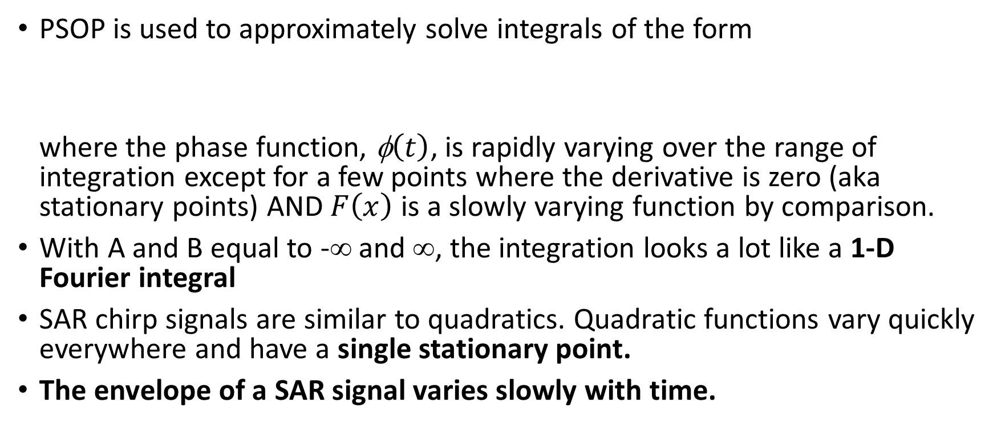
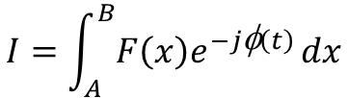
Principle of Stationary Phase (PSOP)
PSOP is used to approximately solve integrals of the form
where the phase function, $\text{}\left(t\right)$, is rapidly varying over the range of integration except for a few points where the derivative is zero (aka stationary points) AND $F\left(x\right)$ is a slowly varying function by comparison.
With A and B equal to -∞ and ∞, the integration looks a lot like a 1-D Fourier integral
SAR chirp signals are similar to quadratics. Quadratic functions vary quickly everywhere and have a single stationary point.
The envelope of a SAR signal varies slowly with time.
$$I=\int_{A}^{B}{F\left(x\right)e^{−j\text{φ}\left(t\right)}}dx$$
Notes:
To understand how to exploit the structure in the SAR signal to do Fourier domain processing, we need mathematical models in each Fourier domain.
To avoid complicated derivations that require numerical methods, we use a technique called the principle of stationary phase to evaluate the Fourier transforms to get an approximate solution.
The PSOP is used to evaluate integrals of this form. Note that this looks very similar to a 1-D Fourier integral with A and B replaced with –inf and +inf and with the complex Fourier exponential 2 pi f t embedded inside the phase function phi of t.
The requirement is that the phase function varies rapidly over the range of integration except at the stationary points and that the envelope is slowly varying relative to the phase function. SAR signals have these properties:
The phase function is quadratic in range and is hyperbolic in azimuth: i.e. they vary rapidly everywhere except at the stationary point.
Also, the envelope of the SAR signal changes slowly relative to the phase function.
For SAR signals, the accuracy of the PSOP scales with the time bandwidth product. The general rule of thumb is that accuracy is not good enough below a time bandwidth product of 100. Since most SAR signals have range and azimuth TBP much larger than this, the PSOP is a good solution for our purposes.

Slide 8
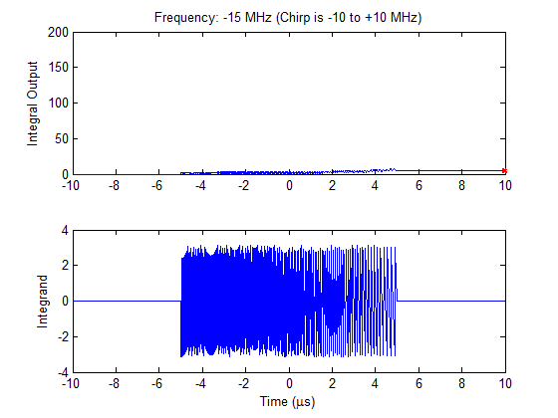
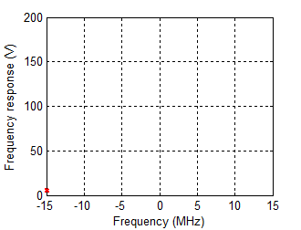
Notes:
To illustrate the principle of stationary phase, we show here the Fourier transform of a 20 MHz chirp.
The integrand is shown in the bottom panel for each frequency shown in the title.
The accumulation of the integrand is shown in the top left panel for each frequency where the red star on the right shows the total integration.
The top right panel shows the frequency response at each frequency (this corresponds to the red star on the left).
Note how the integral output is dominated by the contribution at the stationary point of the phase in the lower panel. The stationary point is where the phase function is slowly varying.
The idea behind the principle of stationary phase is to approximate the phase function at the stationary point with a Taylor expansion and ignore contribution elsewhere.

Slide 9






Remember:
must include your original phase function being integrated AND the Fourier term:
Write out envelope and phase function
Determine derivative of phase function.
Solve for the stationary point, t_{s}, in terms of f. This is the first messy part…
Determine second derivative of phase function. IGNORED IN OUR DERIVATIONS!
Plug t(f) into (4) wherever the stationary point occurs.
Simplify! This is the second messy part…
Process is the same for inverse Fourier transform except replace eqns above with:
$$\text{}\left(t\right)$$
$$−2πft$$
$$t_{s}\left(f\right)=…$$
$$\text{}\left(f\right)$$
$$2πft$$
$$f_{s}\left(t\right)=…$$
Notes:
With this method, we replace the phase function with a Taylor series approximation expanded around the stationary point as shown in (3). We then note that we can replace the envelope with a constant evaluated at the stationary point because it is effectively constant around the stationary point where effectively all of the integration output comes from. In other words, even though the envelope changes for other values of “x” away from the stationary point x_s, the value of the envelope does not matter because the integration is equal to zero over that range. The Taylor series approximation and constant envelope are inserted into (1) and we end up with an integrand that has a closed form solution which is given in (4). The critical steps are 1) Write out your envelope function and phase function (make sure your phase function includes the 2*pi*f*t term from the Fourier complex exponential).
2) Find the first derivative and solve for the integrand variable at the stationary point.
3) Plug this into (4). Equation is messy at this point, so simplify!
Derivation from: my.ece.ucsb.edu/York/Bobsclass/201C/Handouts/StationaryPhase.pdf

Slide 10

Good online SAR Resource
https://saredu.dlr.de/unit

Slide 11
Satellite and Low Squint Airborne SAR Algorithms
Lower squint (often <4-5 deg)
Narrow azimuth bandwidth (usually 0.5 deg to 10 deg azimuth beamwidth)
Range Doppler Algorithm
  Used by the Canadian Space Agency to process RADARSAT-1 and RADARSAT-2 satellite SAR data
Chirp Scaling Algorithm
  Used by the European Space Agency and the German Aerospace Center (DLR) to process TerraSAR-X satellite SAR data
These two algorithms (RDA and CSA) are very similar with the primary difference being how range cell migration correction is done.
  RDA works with any waveform, CSA requires the use of a chirp waveform

Slide 12
Satellite and Low Squint Airborne SAR Algorithms
The SAR filter is azimuth-space-invariant but it is range-variant
The primary structure exploited by these two algorithms is that the 2-D energy from the point target lies along a 1-D contour. This energy will be interpolated or scaled/shifted to lie on a 1-D line that does not cross range bins. By converting the range varying dimension to lie on a single range bin, convolution will no longer be required in the range dimension.
Notes:
Include animation showing this 1-D contour concept.

Slide 13
Range Doppler Algorithm (RDA) STEP 1
Pulse compression is a LTIV filter. It is straight forward to implement in the Fourier domain.
  Range FFT on raw data to transform to range-frequency / azimuth-space domain
  Apply range-domain matched filter for pulse compression
Do not take the IFFT in the range dimension when finished.

Slide 14
Range Doppler Algorithm (RDA) STEP 2
Azimuth FFT
  Transform to range-frequency / Doppler domain
2D Fourier Domain (3 targets)
Raw Data (single target)

Slide 15
Range Doppler Algorithm (RDA): STEP 3
Blurring occurs during the Doppler Fourier transform so that the point target “contour” is broadened. This affect is worse for large squint angles.
This blurring can be approximated by a frequency chirp in the range domain… so to correct we need to do pulse compression again.
This process is called Secondary Range Compression
  For an approximate solution, this second range compression can be applied during the regular pulse compression… this is suboptimal because the Fourier transform to the Doppler domain blurs the correction so it is better to apply in the range-Doppler domain.

Slide 16
Range Doppler Algorithm (RDA): STEP 3
Range Space Domain (i.e. Raw Data)
Range Doppler Domain
(note the blurring)

Slide 17
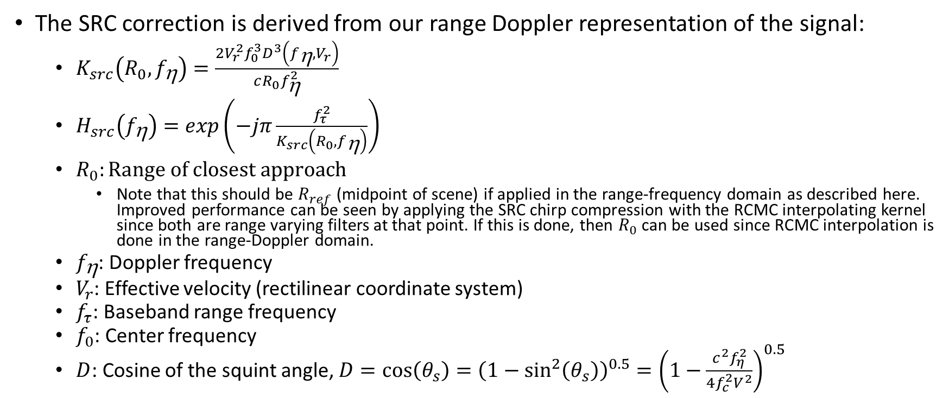
Range Doppler Algorithm (RDA): STEP 3
The SRC correction is derived from our range Doppler representation of the signal:
  $K_{src}\left(R_{0},f_{\text{h}}\right)=\frac{2V_{r}^{2}f_{0}^{3}D^{3}\left(f_{\text{h}},V_{r}\right)}{cR_{0}f_{\text{h}}^{2}}$
  $H_{src}\left(f_{\text{h}}\right)=exp\left(−jπ\frac{f_{τ}^{2}}{K_{src}\left(R_{0},f_{\text{h}}\right)}\right)$
  $R_{0}:Range of closest approach$
    Note that this should be $R_{ref}$ (midpoint of scene) if applied in the range-frequency domain as described here. Improved performance can be seen by applying the SRC chirp compression with the RCMC interpolating kernel since both are range varying filters at that point. If this is done, then $R_{0}$ can be used since RCMC interpolation is done in the range-Doppler domain.
  $f_{\text{h}}$: Doppler frequency
  $V_{r}$: Effective velocity (rectilinear coordinate system)
  $f_{τ}$: Baseband range frequency
  $f_{0}$: Center frequency
  $D$: Cosine of the squint angle, $D=\cos\left(θ_{s}\right)={\left(1−\sin^{2}\left(θ_{s}\right)\right)}^{0.5}={\left(1−\frac{c^{2}f_{η}^{2}}{4f_{c}^{2}V^{2}}\right)}^{0.5}$

Slide 18
Range Doppler Algorithm (RDA): STEP 3
Range Doppler Domain
(After Secondary Range Compression)
Range Doppler Domain
(note the blurring)

Slide 19
Range Doppler Algorithm (RDA): STEP 4
Range IFFT
  Transform to range / Doppler domain

Slide 20
Range Doppler Algorithm (RDA): STEP 5
Range Cell Migration Correction (RCMC) in Doppler domain
  SAR processing is a 2-D filter, but the energy is focused along a single hyperbolic contour.
    Contour is range dependent
  The idea is to flatten the contour using a process called RCMC
Example point target response:
RCMC easy to apply for a single
point target.

Slide 21
Range Doppler Algorithm (RDA): STEP 5
Example of two point targets at the same range and next to each other. Envelope is about the same for both but the phases are offset (think of two tones and what you see is the beat frequency… double side band suppressed carrier).
Could apply RCMC for this case as well.

Slide 22
Range Doppler Algorithm (RDA): STEP 5
Example of two point targets far apart from each other… RCMC not possible because each target needs a different correction.

Slide 23
Range Doppler Algorithm (RDA): STEP 5
Example of two point targets far apart from each other:

Slide 24
Range Doppler Algorithm (RDA): STEP 5
RCMC cannot be applied in the range-space domain because RCMC is dependent on the relative along-track position rather than the absolute along-track position.
Hmmm… we know that the range cell migration is a function of incidence angle (i.e. Doppler).
RCMC can be applied in the range-Doppler domain because RCMC depends on the absolute Doppler.
Every target at the same range has the same envelope in the range-Doppler domain!!!

Slide 25
Range Doppler Algorithm (RDA): STEP 5
Single Target
Both Targets… envelope has not changed, but interference pattern has.

Slide 26
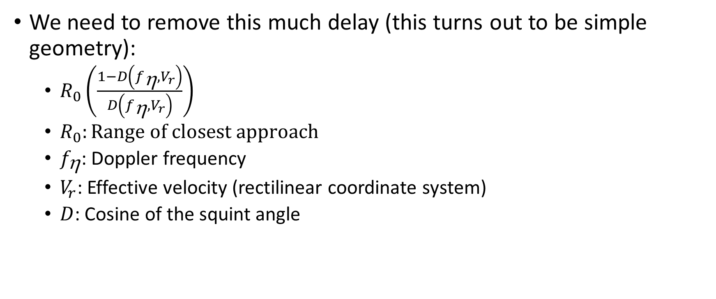
Range Doppler Algorithm (RDA): STEP 5
We need to remove this much delay (this turns out to be simple geometry):
  $R_{0}\left(\frac{1−D\left(f_{\text{h}},V_{r}\right)}{D\left(f_{\text{h}},V_{r}\right)}\right)$
  $R_{0}:Range of closest approach$
  $f_{\text{h}}$: Doppler frequency
  $V_{r}$: Effective velocity (rectilinear coordinate system)
  $D$: Cosine of the squint angle

Slide 27
Range Doppler Algorithm (RDA): STEP 5
Use the truncated and windowed sinc interpolation method to do the time shift. Example of 3 deg squint:

Slide 28
Range Doppler Algorithm (RDA): STEP 5
Use the truncated and windowed sinc interpolation method to do the time shift. Example of 10 deg squint:

Slide 29
Range Doppler Algorithm (RDA): STEP 6
All targets have been interpolated so that they occupy a single range bin in the range-Doppler domain.
Originally the problem was that the range cell migration changed as a function of range → This prevented a simple application of Fourier methods since the response was space-variant.
Now it is no longer a 2-D filter so the space variance does not matter and we only need to apply a 1-D azimuth filter.

Slide 30
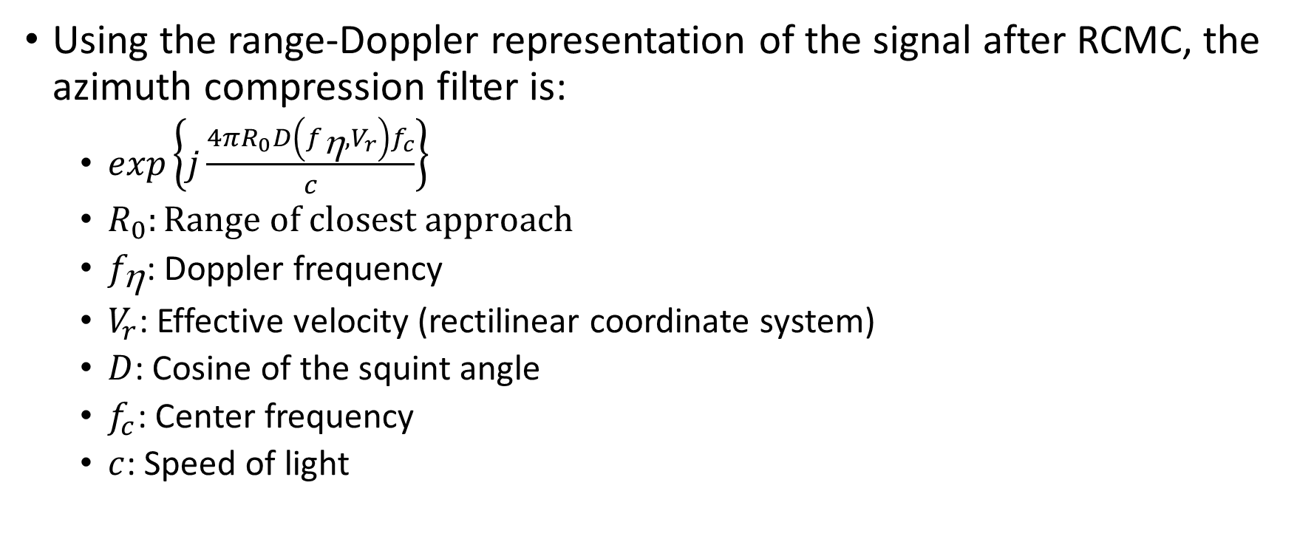
Range Doppler Algorithm (RDA): STEP 6
Using the range-Doppler representation of the signal after RCMC, the azimuth compression filter is:
  $exp\left\{j\frac{4πR_{0}D\left(f_{\text{h}},V_{r}\right)f_{c}}{c}\right\}$
  $R_{0}:Range of closest approach$
  $f_{\text{h}}$: Doppler frequency
  $V_{r}$: Effective velocity (rectilinear coordinate system)
  $D$: Cosine of the squint angle
  $f_{c}$: Center frequency
  $c$: Speed of light
Notes:
Note this azimuth filter is based strictly on the geometry (i.e. you can prove it using the Fourier analysis but the answer is a hyperbola and relates directly to the geometry).

Slide 31
Range Doppler Algorithm (RDA): STEP 7
Azimuth IFFT
  Transform into range / azimuth-space domain

Slide 32
Range Doppler Algorithm (RDA): STEP 7
Example (side note: range dependent Doppler centroid correction and relative range cell migration correction when there is squint).
No squint: Position is perfect
3 deg squint: range is correct, but azimuth is off by one pixel

Slide 33
Range Doppler Algorithm (RDA): STEP 7
10 deg squint (RCMC not perfect)
Azimuth correction ends with smeared range bins

Slide 34
Chirp Scaling Algorithm (CSA)
The problem with RDA is that the RCMC interpolation is slow and requires SRC.
Chirp scaling does the same thing as RDA, but does the RCMC with chirp scaling which also makes the blurring from the Doppler Fourier transform smaller.
  Greater efficiency + range/azimuth decoupling built into range compression (analogous to range Doppler algorithms secondary range compression)

Slide 35
Chirp Scaling Algorithm (CSA): Step 1
Azimuth FFT
  Transform to range / Doppler domain

Slide 36
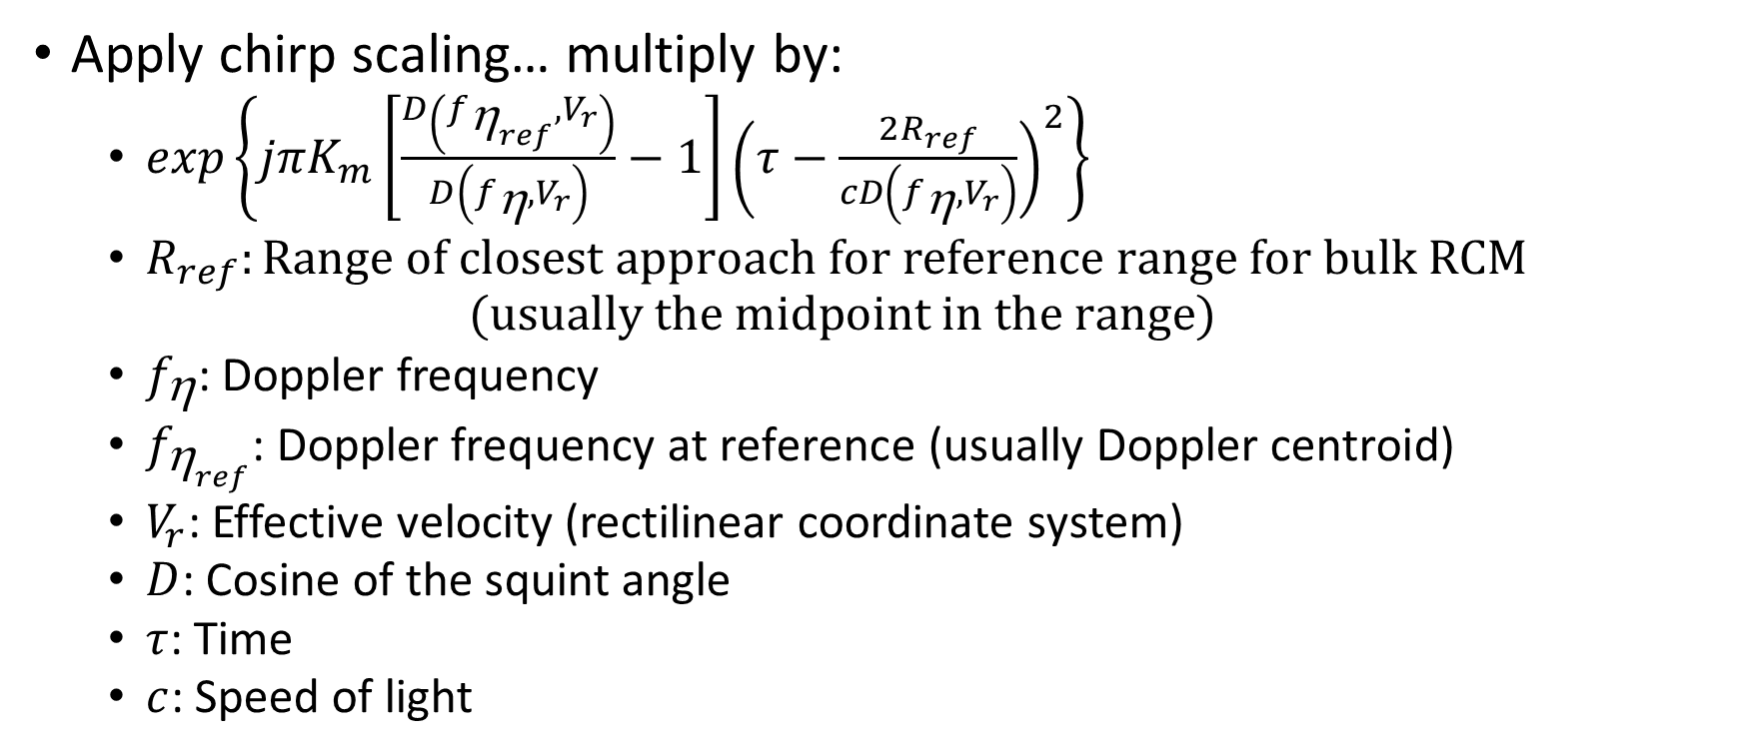
Chirp Scaling Algorithm (CSA): Step 2
Apply chirp scaling… multiply by:
  $exp\left\{jπK_{m}\left[\frac{D\left(f_{{\text{h}}_{ref}},V_{r}\right)}{D\left(f_{\text{h}},V_{r}\right)}−1\right]{\left(τ−\frac{2R_{ref}}{cD\left(f_{\text{h}},V_{r}\right)}\right)}^{2}\right\}$
  $R_{ref}:Range of closest approach for reference range for bulk RCM$
  $(usually the midpoint in the range)$
  $f_{\text{h}}$: Doppler frequency
  $f_{{\text{h}}_{ref}}\text{: }\text{Doppler} \text{frequency} \text{at} \text{reference}\text{ (}\text{usually} \text{Doppler} \text{centroid}\text{)}$
  $V_{r}$: Effective velocity (rectilinear coordinate system)
  $D$: Cosine of the squint angle
  $τ$: Time
  $c$: Speed of light

Slide 37
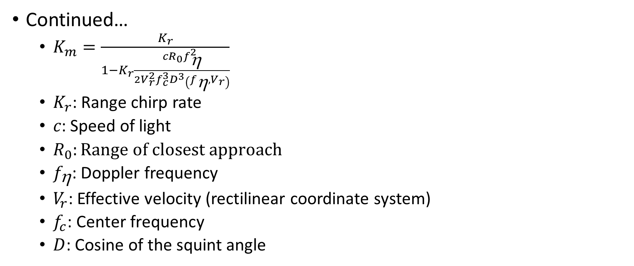
Chirp Scaling Algorithm (CSA): Step 2
Continued…
  $K_{m}=\frac{K_{r}}{1−K_{r}\frac{cR_{0}f_{\text{h}}^{2}}{2V_{r}^{2}f_{c}^{3}D^{3}\left(f_{\text{h}},V_{r}\right)}}$
  $K_{r}$: Range chirp rate
  $c\text{: }\text{Speed} \text{of} \text{light}$
  $R_{0}:Range of closest approach$
  $f_{\text{h}}$: Doppler frequency
  $V_{r}$: Effective velocity (rectilinear coordinate system)
  $f_{c}\text{: }\text{Center} \text{frequency}$
  $D$: Cosine of the squint angle

Slide 38
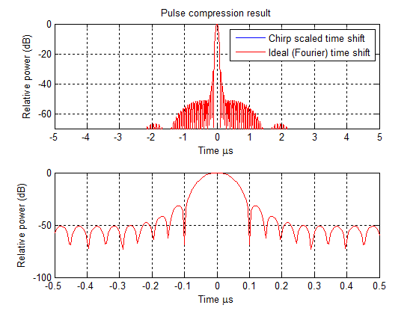
Notes:
Red line shows ideal (Fourier domain) time shift
Blue line shows chirp scaled time shift
20 MHz 10 us chirp: Animation shows from 0% to 10% of bandwidth chirp scaled

Slide 39
Chirp Scaling Algorithm (CSA): Step 3
Range FFT
  Transform to range-frequency / Doppler domain

Slide 40
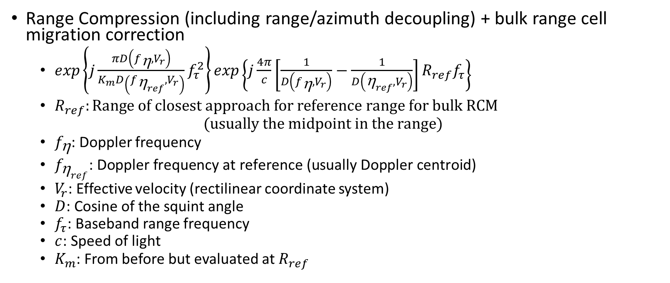
Chirp Scaling Algorithm (CSA): Step 4
Range Compression (including range/azimuth decoupling) + bulk range cell migration correction
  $exp\left\{j\frac{πD\left(f_{\text{h}},V_{r}\right)}{K_{m}D\left(f_{{\text{h}}_{ref}},V_{r}\right)}f_{τ}^{2}\right\}exp\left\{j\frac{4π}{c}\left[\frac{1}{D\left(f_{\text{h}},V_{r}\right)}−\frac{1}{D\left({\text{h}}_{ref},V_{r}\right)}\right]R_{ref}f_{τ}\right\}$
  $R_{ref}:Range of closest approach for reference range for bulk RCM$
  $(usually the midpoint in the range)$
  $f_{\text{h}}$: Doppler frequency
  $f_{{\text{h}}_{ref}}\text{: }\text{Doppler} \text{frequency} \text{at} \text{reference}\text{ (}\text{usually} \text{Doppler} \text{centroid}\text{)}$
  $V_{r}$: Effective velocity (rectilinear coordinate system)
  $D$: Cosine of the squint angle
  $f_{τ}$: Baseband range frequency
  $c$: Speed of light
  $K_{m}$: From before but evaluated at $R_{ref}$

Slide 41
Chirp Scaling Algorithm (CSA): Step 5
Range IFFT
  Transform to range / Doppler domain

Slide 42
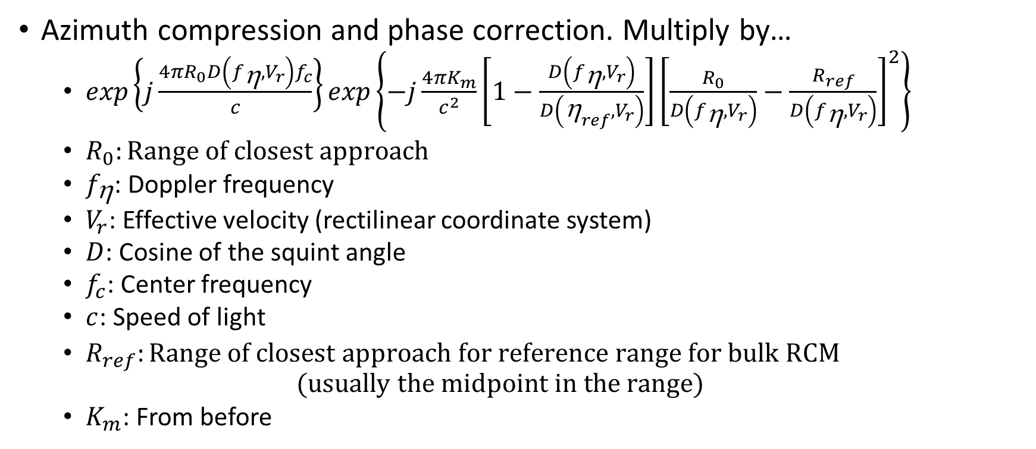
Chirp Scaling Algorithm (CSA): Step 6
Azimuth compression and phase correction. Multiply by…
  $exp\left\{j\frac{4πR_{0}D\left(f_{\text{h}},V_{r}\right)f_{c}}{c}\right\}exp\left\{−j\frac{4πK_{m}}{c^{2}}\left[1−\frac{D\left(f_{\text{h}},V_{r}\right)}{D\left({\text{h}}_{ref},V_{r}\right)}\right]{\left[\frac{R_{0}}{D\left(f_{\text{h}},V_{r}\right)}−\frac{R_{ref}}{D\left(f_{\text{h}},V_{r}\right)}\right]}^{2}\right\}$
  $R_{0}:Range of closest approach$
  $f_{\text{h}}$: Doppler frequency
  $V_{r}$: Effective velocity (rectilinear coordinate system)
  $D$: Cosine of the squint angle
  $f_{c}$: Center frequency
  $c$: Speed of light
  $R_{ref}:Range of closest approach for reference range for bulk RCM$
  $(usually the midpoint in the range)$
  $K_{m}$: From before

Slide 43
Chirp Scaling Algorithm (CSA): Step 7
Azimuth IFFT
  Transform to range / azimuth-space domain

Slide 44
Wide Aperture (Airborne and Ground based) Algorithms
f-k migration (AKA ω-k migration as in omega-wavenumber migration)
  Handles strip map mode data collection with very wide apertures
  Disadvantage is that time and space variant modifications are not handled well because processing is done in the f-k domain.
Time domain correlation (TDC): not covered
  Fast factorized TDC is a good and fast implementation of TDC which keeps most of the desirable properties of TDC
  Lars M.H. Ulander et al., Synthetic-Aperture Radar Processing Using Fast Factorized Back-Projection, Transactions on Aerospace and Electronic Systems, vol. 39, no. 3, July 2003.
Polar Format Algorithm (PFA) : not covered
  Armin W. Doerry, Synthetic Aperture Radar Processing with Tiered Subapertures, Sandia Report SAND94-1390, 1994.
    Very complete description of PFA
  Jack L. Walker, Range-Doppler Imaging of Rotating Objects, IEEE Transactions on Aerospace and Electronic Systems, vol. 16, no. 1, Jan 1980.
    Original reference.
Notes:
F-k migration is primarily used by very wide aperture . This is more common in ground penetrating systems where the azimuth beam pattern is often large and stripmap data is being collected.
For spotlight data, the PFA or polar format algorithm is typically used for very wide apertures since it is much more flexible than F-k migration. We won’t discuss this algorithm, but Doerry has produced a very nice explanation with all the details for this processing mode.

Slide 45
F-k migration
Exploding reflector model
  The linear target model is equivalent to the exploding reflector model
  Rather than the radar transmitting a pulse at time zero, each target is replaced by an isotropic source that radiates a pulse starting at time zero and the velocity of propagation is halved.
Notes:
See animation.

Slide 46
F-k migration: Step 1
Two-dimensional FFT
  Transform to range-frequency / wavenumber domain
    (Wavenumber has a one to one mapping with Doppler domain)

Slide 47
F-k migration: Step 2
Reference frequency multiply (RFM)
  Applies the 2-D filter for the reference range (i.e. determine the response from a point target at the reference range and then use that as a correlation/matched filter)
    This will apply both range and azimuth compression
  We know that this will perfectly focus the reference range, but slowly degrade away from that range because the filter needs to be space variant to perfectly focus the targets

Slide 48
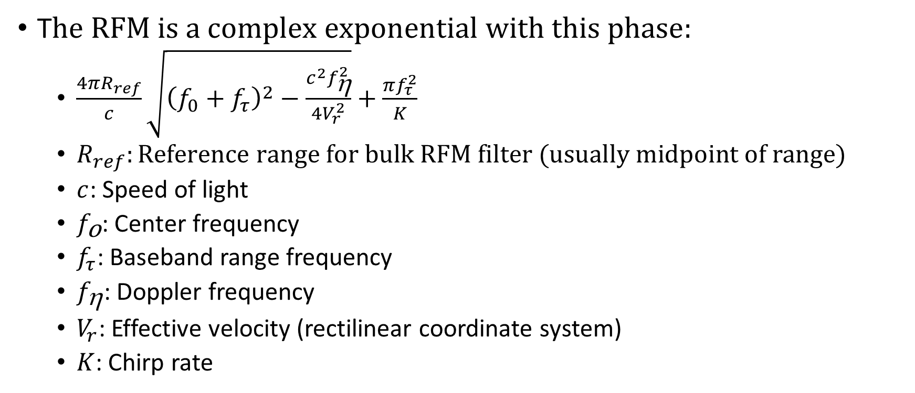
F-k migration: Step 2
T$he RFM is a complex exponential with this phase:$
  $\frac{4πR_{ref}}{c}\sqrt{{\left(f_{0}+f_{τ}\right)}^{2}−\frac{c^{2}f_{\text{h}}^{2}}{4V_{r}^{2}}}+\frac{πf_{τ}^{2}}{K}$
  $R_{ref}:Reference range for bulk RFM filter (usually midpoint of range)$
  $c$: Speed of light
  $f_{\text{o}}\text{: }\text{Center} \text{frequency}$
  $f_{τ}$: Baseband range frequency
  $f_{\text{h}}$: Doppler frequency
  $V_{r}$: Effective velocity (rectilinear coordinate system)
  $K$: Chirp rate

Slide 49
F-k migration: Step 2
Examples of reference range and away from reference range
Notes:
Note how the right image has a much wider impulse response width. The right image shows why the filter needs to be range dependent.

Slide 50
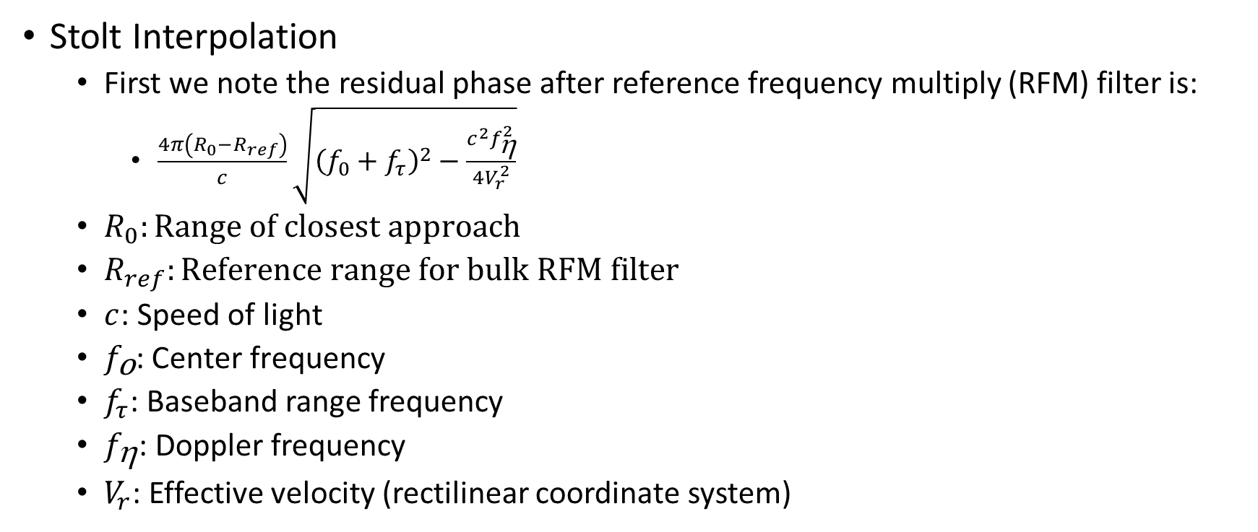
F-k migration: Step 3
Stolt Interpolation
  First we note the residual phase after reference frequency multiply (RFM) filter is:
    $\frac{4π\left(R_{0}−R_{ref}\right)}{c}\sqrt{{\left(f_{0}+f_{τ}\right)}^{2}−\frac{c^{2}f_{\text{h}}^{2}}{4V_{r}^{2}}}$
  $R_{0}:Range of closest approach$
  $R_{ref}:Reference range for bulk RFM filter$
  $c$: Speed of light
  $f_{\text{o}}\text{: }\text{Center} \text{frequency}$
  $f_{τ}$: Baseband range frequency
  $f_{\text{h}}$: Doppler frequency
  $V_{r}$: Effective velocity (rectilinear coordinate system)

Slide 51
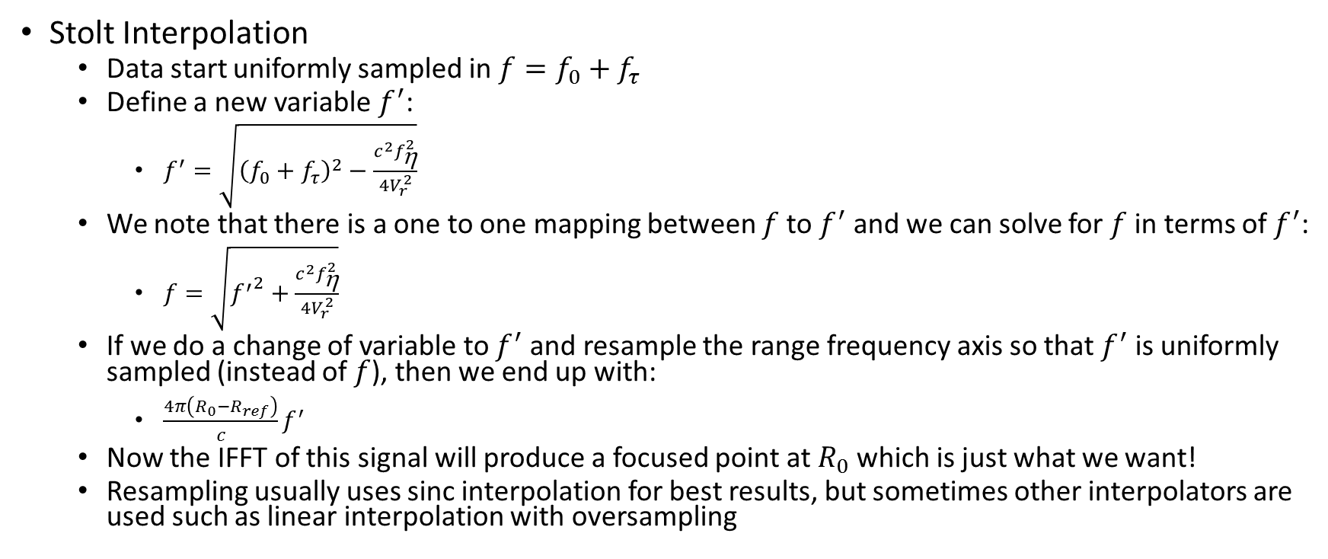
F-k migration: Step 3
Stolt Interpolation
  Data start uniformly sampled in $f=f_{0}+f_{τ}$
  Define a new variable $f^{′}$:
    $f^{′}=\sqrt{{\left(f_{0}+f_{τ}\right)}^{2}−\frac{c^{2}f_{\text{h}}^{2}}{4V_{r}^{2}}}$
  We note that there is a one to one mapping between $f$ to $f^{′}$ and we can solve for $f$ in terms of $f^{′}$:
    $f=\sqrt{{f^{′}}^{2}+\frac{c^{2}f_{\text{h}}^{2}}{4V_{r}^{2}}}$
  If we do a change of variable to $f^{′}$ and resample the range frequency axis so that $f^{′}$ is uniformly sampled (instead of $f$), then we end up with:
    $\frac{4π\left(R_{0}−R_{ref}\right)}{c}f^{′}$
  Now the IFFT of this signal will produce a focused point at $R_{0}$ which is just what we want!
  Resampling usually uses sinc interpolation for best results, but sometimes other interpolators are used such as linear interpolation with oversampling

Slide 52
F-k migration: Step 4
Two-dimensional IFFT
  Transform to range-space domain
  Before and after Stolt interpolation for target a long way from the reference range.

