Slide 1
Preliminary design review: Nixie tube clock
16 February 2015
Team A
Paul Plotkin (Team Lead), Amanda Parks, Sean Holloway, Cory Tindall

Slide 2
System design

Slide 3
system decomposition

Slide 4
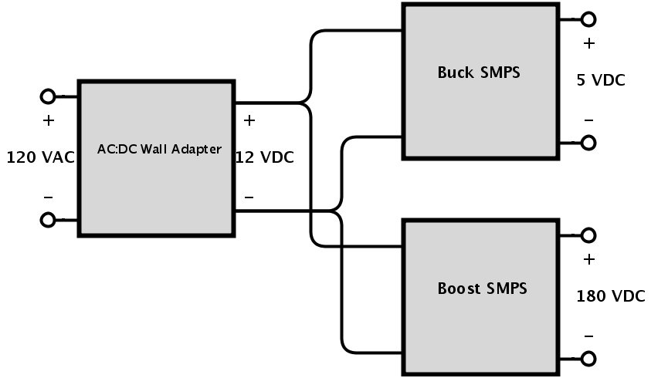
Power supply

Slide 5
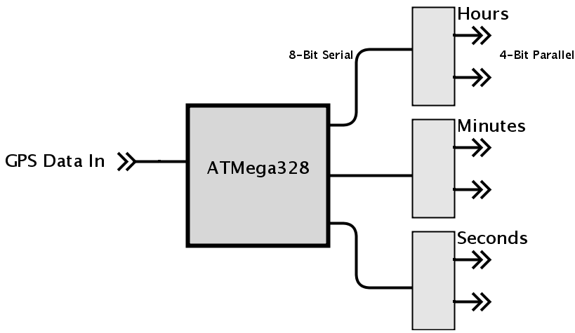
Low voltage (LV) board

Slide 6
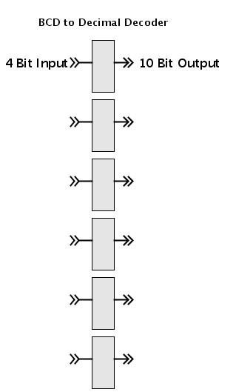
High voltage (HV) board

Slide 7
Testing & evaluation
LOW VOLTAGE
Supply
Stability
Heat dissipation
Microcontroller
Performance
Signal reception
Receivers
Position triangulation
Reception within enclosure
HIGH VOLTAGE
Supply
Waveform smoothness
Component ratings
Cold-Cathode Tube Interaction
Lifetime
Digit filament inspection
TTL Decoder Performance
LV to HV interface
Heat dissipation
ENCLOSURE
Safety
HV isolation
User input insolation
Grounding
Time Indicators
Lifetime

Slide 8
Project Management

Slide 9
Projected schedule
TASK | PROJECTED COMPLETION
LV TESTING | APRIL 18, 2015
HV TESTING | APRIL 18, 2015
HV SCHEMATIC & LAYOUT | APRIL 25, 2015
LV SCHEMATIC & LAYOUT | APRIL 25, 2015
ENCLOSURE DESIGN | APRIL 25, 2015
ENCLOSURE PRODUCTION | MAY 6, 2015

Slide 10
Organization & responsibility

Slide 11
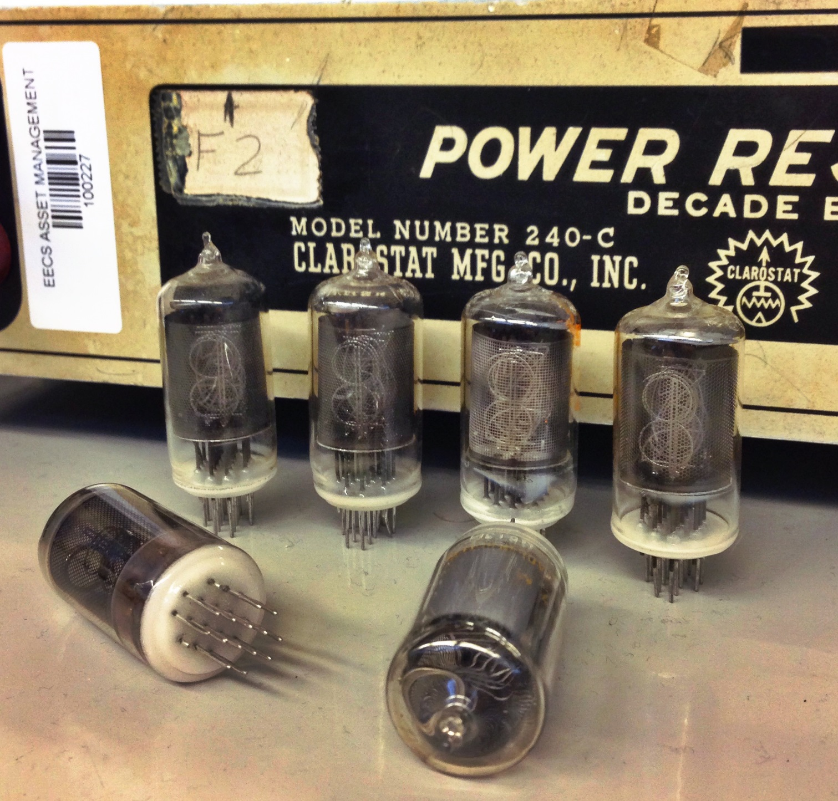
QUESTIONS?

