Slide 1


Computational Biomedical Science
PREF Outreach Program
Dr. Suzanne Shontz
Computer Science and Engineering
July 8, 2011

Slide 2
Today’s Agenda
You will learn:
about computational science and engineering and computational biomedical science
how computational tools can be used to improve treatment of two diseases:
deep vein thrombosis and hydrocephalus
other areas of engineering where they can be used.

Slide 3
Introduction to Computational Biomedical Science

Slide 4
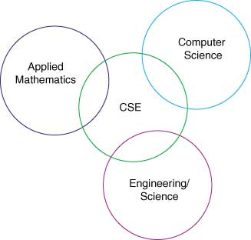
Computational Science and Engineering

Slide 5
What is Computational
Biomedical Science?
Computational science and engineering: The application of mathematical and computational techniques to a phenomenon in science or engineering.
Biomedical science: The application of the principles of the natural sciences to medicine.
Computational biomedical science: The application of mathematical and computational techniques to medicine.

Slide 6
Deep Vein Thrombosis

Slide 7
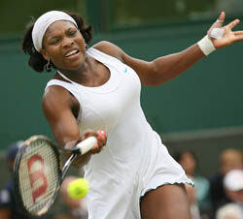
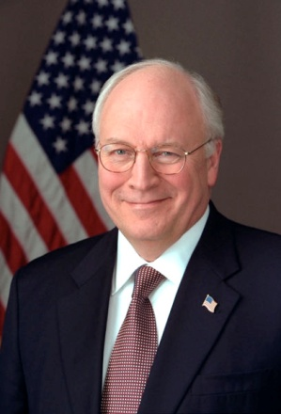

Famous People
What do these famous people have in common?
Serena Williams (US Tennis Star)
Dick Cheney (US Vice President)
David Bloom (US NBC Correspondent in Iraq)
http://wimbledon.open-tennis.com http://en.wikipedia.org/ sounddude.com
They all suffered from blood clots.

Slide 8
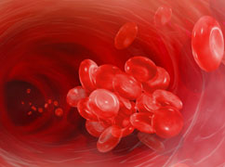
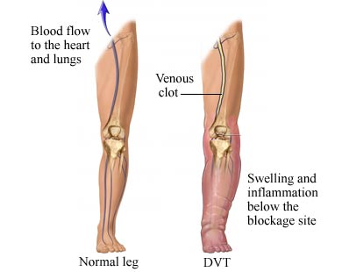
Deep Vein Thrombosis (DVT)
Formation of blood clot in deep vein (e.g., leg)
The leg can become swollen, hot, red, warm, and painful.
healthwithhope.com
Complication: The clot can
break free and travel into
the lungs.
How would this affect you?
Veinsveinsveins.com

Slide 9
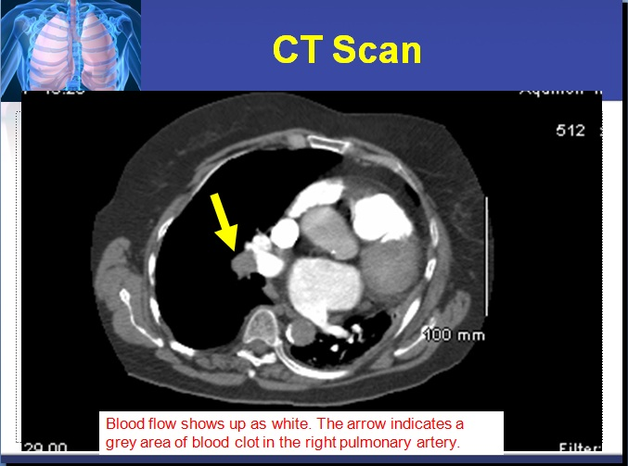
Detecting a Pulmonary Embolism
http://kierdoestri.blogspot.com/

Slide 10
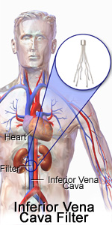
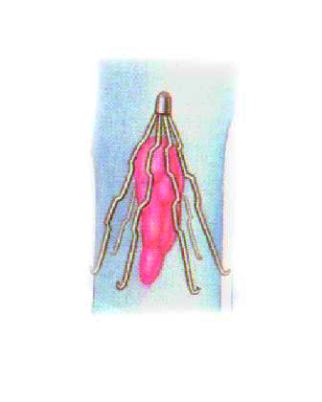
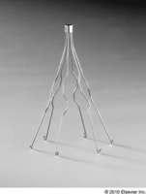
How do doctors treat blood clots?
Two treatment options:
Medicine (blood thinners)
Insertion of medical device to trap the
blood clots (IVC filters)
Greenfield Filter
(Boston Scientific)
Drugs.com
Members.tripod.com

Slide 11
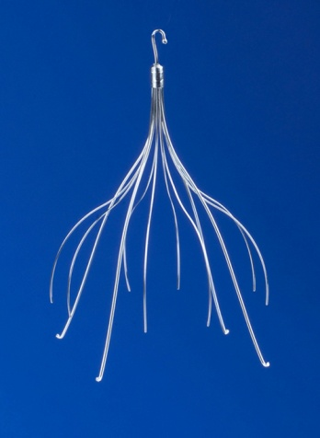
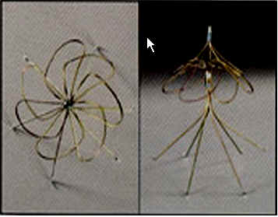
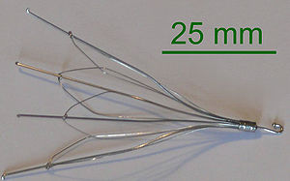
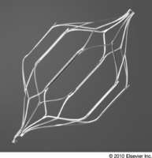
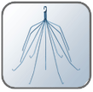
IVC Filters
There are many designs. Here are a few.
Celect filter
Cookmedical.com
Simon Nitinol Filter
lakeridgehealth.on.ca
Gunther Tulip Filter
En.wikipedia.org
Optease Filter
Cordis Corporation
G2 Express Filter
Bard PV

Slide 12
How can computational scientists help?
Computational scientists can run simulations and advise vascular surgeons on:
  selection of the appropriate IVC filter
  placement of the IVC filter.
These are patient-specific choices to make.
Why do you think the choice of IVC filter and its placement should depend upon the patient?

Slide 13
Simulation Ingredients
Patient medical data (CT scans) → model of patient veins and blood clots
Model of IVC filter (created via computer-aided design)
Equations for blood flow
Simulate the blood flow in the
vein with the IVC filter present

Slide 14
IVC Filter Simulations
The goal is to simulate (on the computer) the effect of placing a particular IVC filter in the vein of a given patient.
Repeat the simulation with different IVC filters and different placements of the IVC filters.
Choose the IVC filter and placement that is best for the patient.

Slide 15
Hydrocephalus

Slide 16
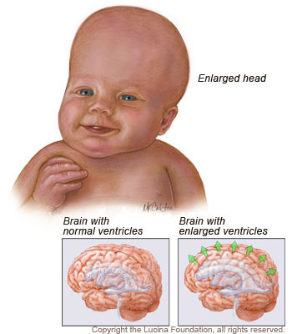
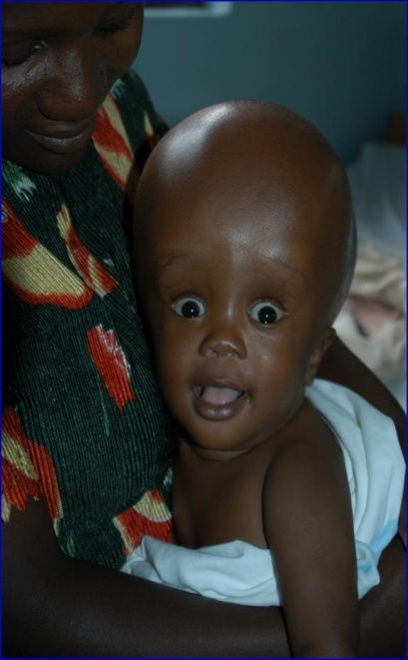
Hydrocephalus
What is hydrocephalus?
A build-up of excess cerebrospinal fluid in the head.
The ventricles in the brain enlarge.
LucinaFoundation.org
childrenshospitalblog.org

Slide 17
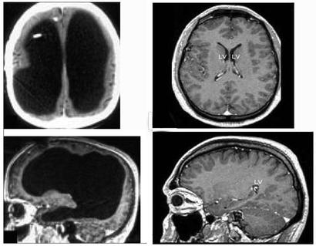
MRI Images of the Brain
Which column of images are for the normal brain?
Which column of images are for the hydrocephalic brain?
MentalHelp.net

Slide 18
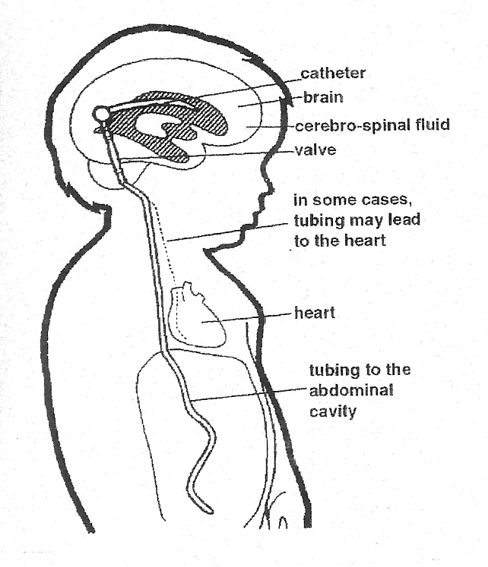
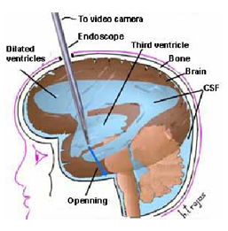
Treatment of Hydrocephalus
Nhfonline.org
http://imannooor.wordpress.com
Shunts: Remove excess fluid from the
brain and transport it to a re-adsorption site
Ventriculostomy: Surgical cut made
to create hole to drain fluid

Slide 19
How can computational scientists help?
Perform mathematical modeling of the brain and fluid growth.
Create computational models of the brain.
Perform simulations to determine how to control the settings on the shunts for optimal treatment of hydrocephalus.

Slide 20
Computational Tool:
Mesh Generation

Slide 21
Geometric Modeling via
Mesh Generation
Geometric models must be created for the IVC filter blood flow simulation and for the hydrocephalus simulation.
The models are created by the generation of meshes on the 3D objects.

Slide 22
What is a Mesh?
To simulate blood flow the vein with the IVC filter present, the vein and filter must be represented by a geometric model.
This model is represented as a mesh.
A mesh is a collection of vertices and elements with certain properties.

Slide 23
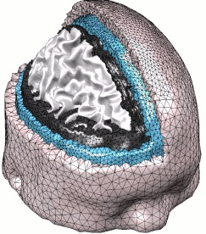
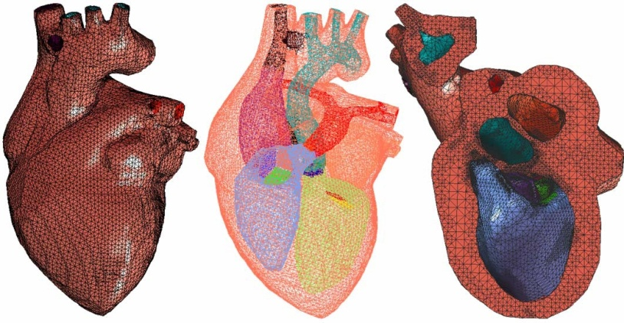
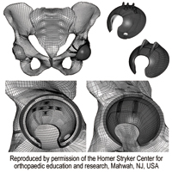
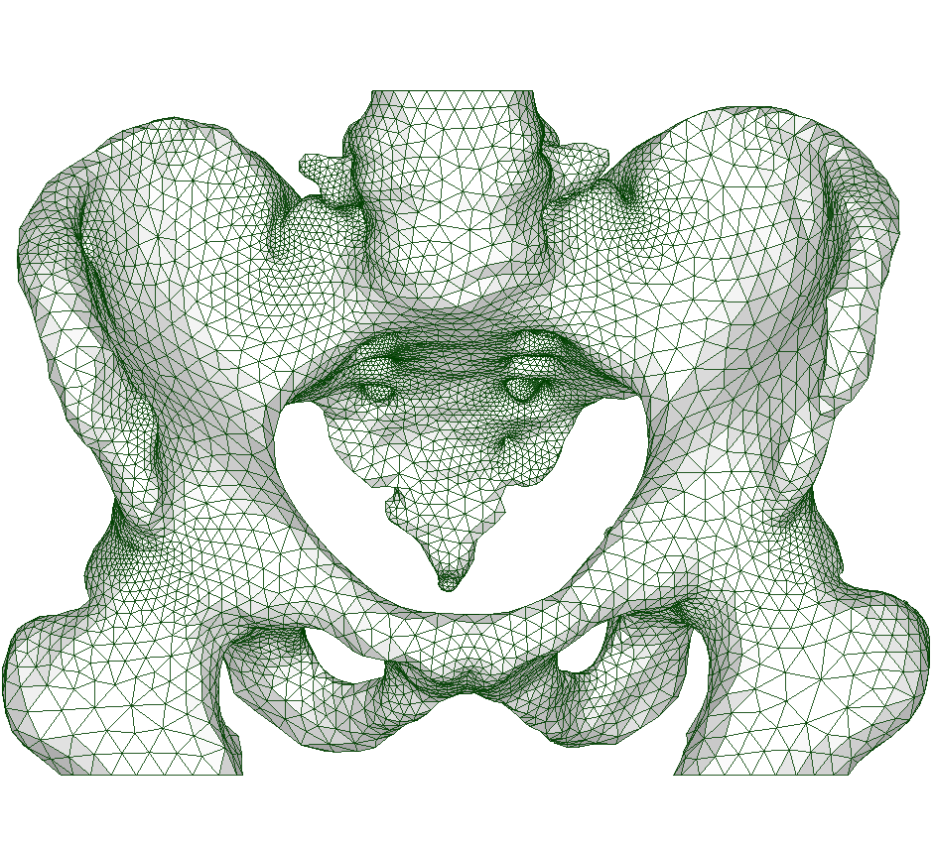
Examples of Meshes
Zhang et al.
nitrc.org
ETLab
at UAB

Slide 24
Dynamic Mesh Generation
For applications which move (e.g., insertion of an IVC filter into a deforming vein, the growing hydrocephalic brain) the mesh must be updated in response to the deformations.
This is necessary to keep the mesh a valid approximation of the geometry.

Slide 25
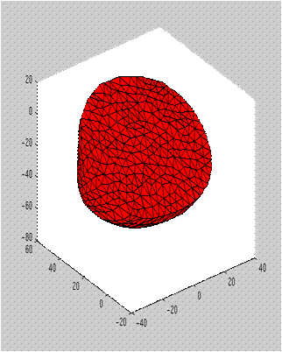
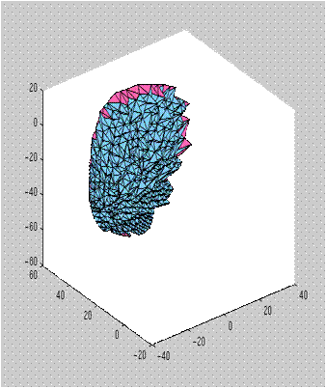
Beating Heart Simulation
Canine ventricles (surface mesh)
Canine ventricles (volume mesh)
Joint work with Stephen Vavasis, University of Waterloo

Slide 26
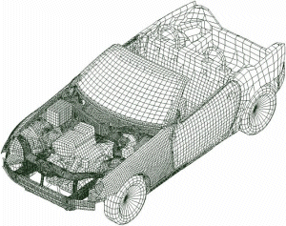
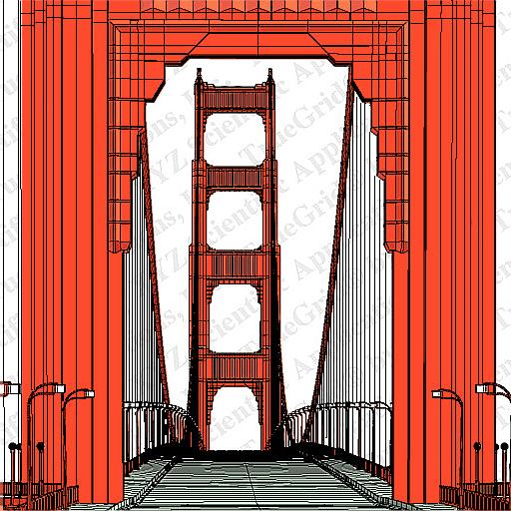
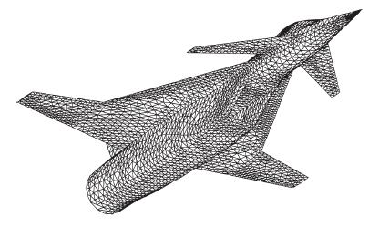
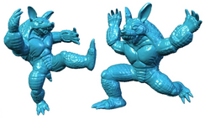
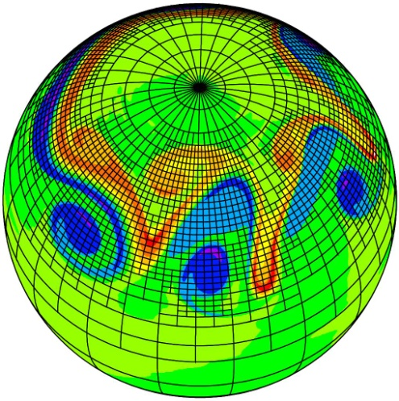
Some Non-Biomedical
Meshing Applications
anaxsoft.com
msc.commas.uni-stuttgart.de
Truegrid.com
http://visionair.ge.imati.cnr.it:8080/
St-Cyr, Jablonowski et al., MWR 2008)

Slide 27
Summary
There are many opportunities for computational scientists to aid doctors.
Mesh generation is an important tool for computational biomedical science.
Its use extends far beyond computational biomedical science to other areas of engineering and science.

Slide 28



IVC Filter Project Participants
Current Participants:
Suzanne Shontz (PI, CSE)
Shankar Prasad Sastry
Jibum Kim
Keefe Manning (Co-PI, BioE)
Michael Navitsky
Jason Nanna
Matthew Scanlon
Frank Lynch, M.D. (Co-PI, HMC)
Brent Craven (Co-PI, ARL)
Former Participants:
Michael Singer (LLNL)
Richard Medvitz (ARL)
Evan Ford (ARL)
Bryan Kraweic (ARL)
Thap Panitanarak (PSU)
Joseph Pearson (PSU)

Slide 29
Hydrocephalus Project Participants
Participants:
Suzanne Shontz (CSE)
Corina Drapaca (ESM)
Jeonghyung Park
Future collaborations are planned with:
Steven Schiff (ESM) and Qian Wang (Mech Eng).

