Slide 1


Computational Biomedical Science
Batmen Camp
Outreach Program
Dr. Suzanne Shontz
Department of Mathematics and Statistics
Department of Computer Science and Engineering
Center for Computational Sciences
Graduate Program in Computational Engineering
June 24, 2014

Slide 2
Today’s Agenda
You will learn:
about computational science and engineering and computational biomedical science;
how computational tools can be used to improve treatment of a disease:
deep vein thrombosis;
other areas of engineering where these tools can be used;
how to design an algorithm.

Slide 3
Introduction to Computational Biomedical Science

Slide 4
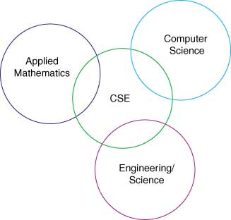
Computational Science and Engineering

Slide 5
What is Computational
Biomedical Science?
Computational science and engineering: The application of mathematical and computational techniques to simulate a phenomenon in science or engineering.
Biomedical science: The application of the principles of the natural sciences to medicine.
Computational biomedical science: The application of mathematical and computational techniques to medicine.

Slide 6
Deep Vein Thrombosis

Slide 7
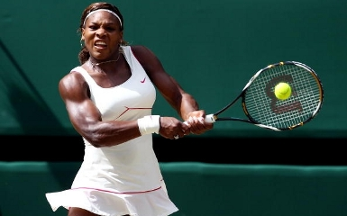
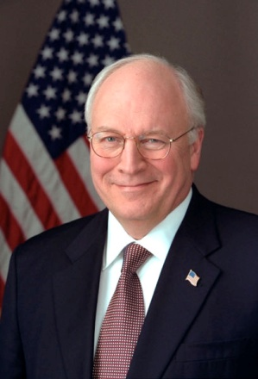
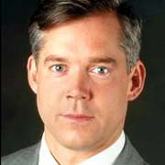
Famous People
What do these famous people have in common?
Serena Williams (US Tennis Star)
Dick Cheney (US Vice President)
David Bloom (US NBC Correspondent in Iraq)
They all suffered from blood clots.

Slide 8
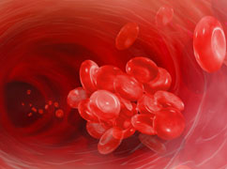
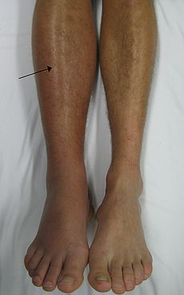
Deep Vein Thrombosis (DVT)
Formation of blood clot in deep vein (e.g., leg)
The leg can become swollen, hot, red, warm, and painful.
Complication: The clot can break free and travel into the lungs.
How would this affect you?

Slide 9
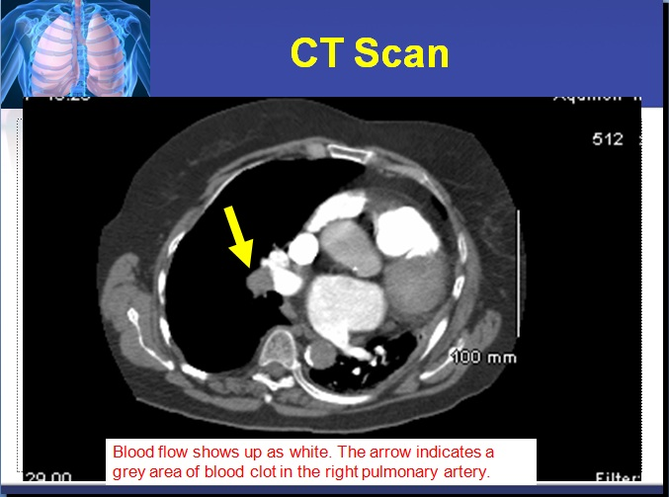
Detecting a Pulmonary Embolism

Slide 10
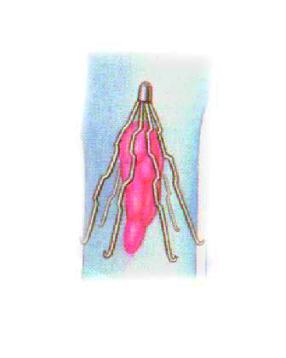
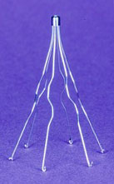
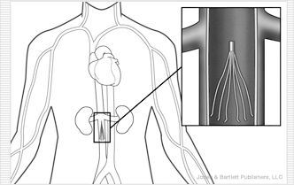
How do doctors treat blood clots?
Two main treatment options:
Medicine (blood thinners)
Insertion of medical device to trap the
blood clots (IVC filters)

Slide 11
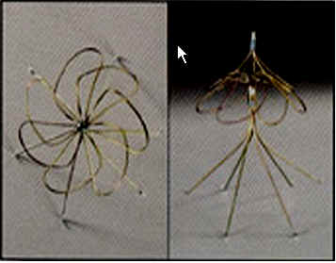
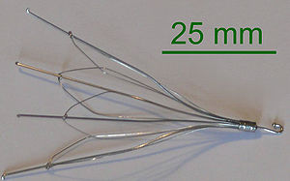
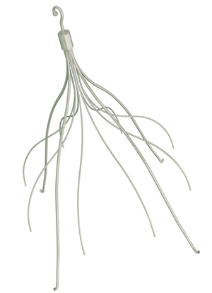
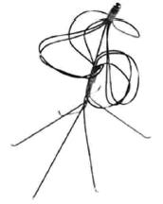
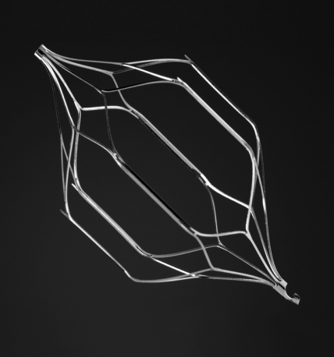
IVC Filters
There are many designs. Here are a few.

Slide 12
How does a doctor choose which
IVC filter to use?
Any thoughts?
The decision is typically based on:
which device(s) the doctor learned to implant in medical school/residency and
which device the doctor can obtain for the lowest price.

Slide 13
How can computational scientists help?
Computational scientists can run simulations and advise vascular surgeons on:
  selection of the appropriate IVC filter
  placement of the IVC filter.
Why do you think the choice of IVC filter and its placement should depend upon the patient?

Slide 14
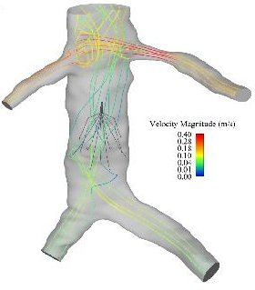
Simulation Ingredients
Patient medical data (CT scans) → model of patient veins and blood clots (requires image processing)
Model of IVC filter (created via computer-aided design)
Equations for blood flow
Simulate the blood flow in the
vein with the IVC filter present

Slide 15
IVC Filter Simulations
The goal is to simulate (on the computer) the effect of placing a particular IVC filter in the vein of a given patient.
Repeat the simulation with different IVC filters and different placements of the IVC filters.
Choose the IVC filter and placement that is best for the patient.

Slide 16
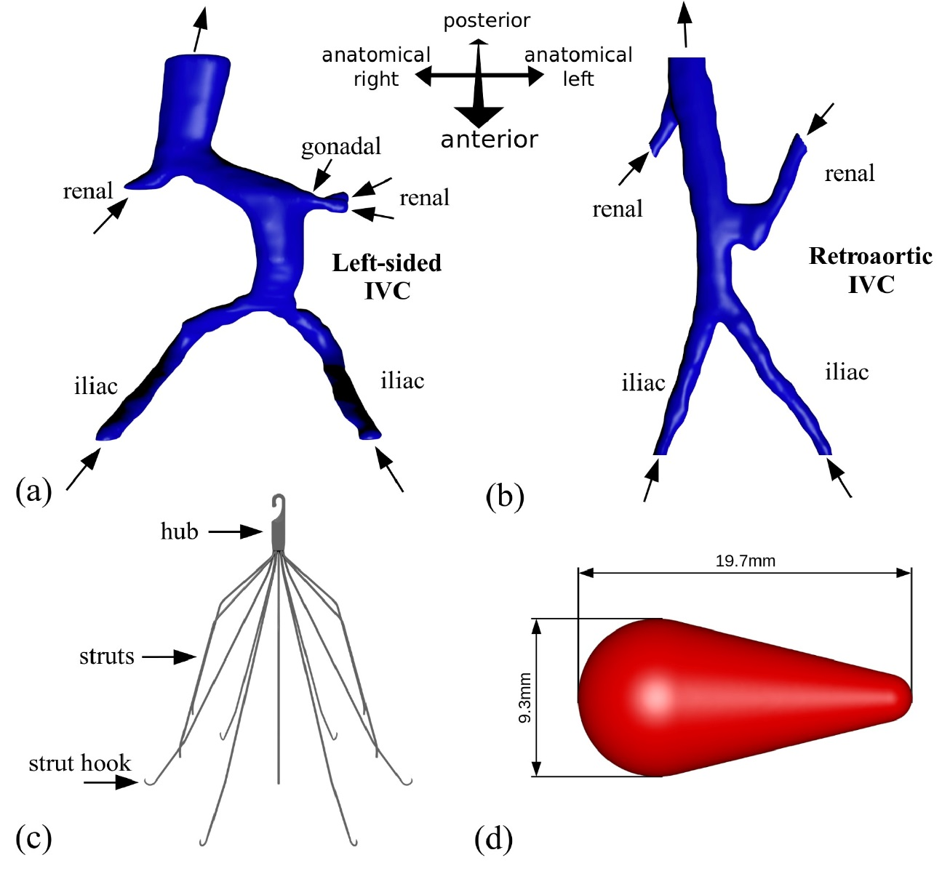
Sample Simulation – Geometric Models

Slide 17
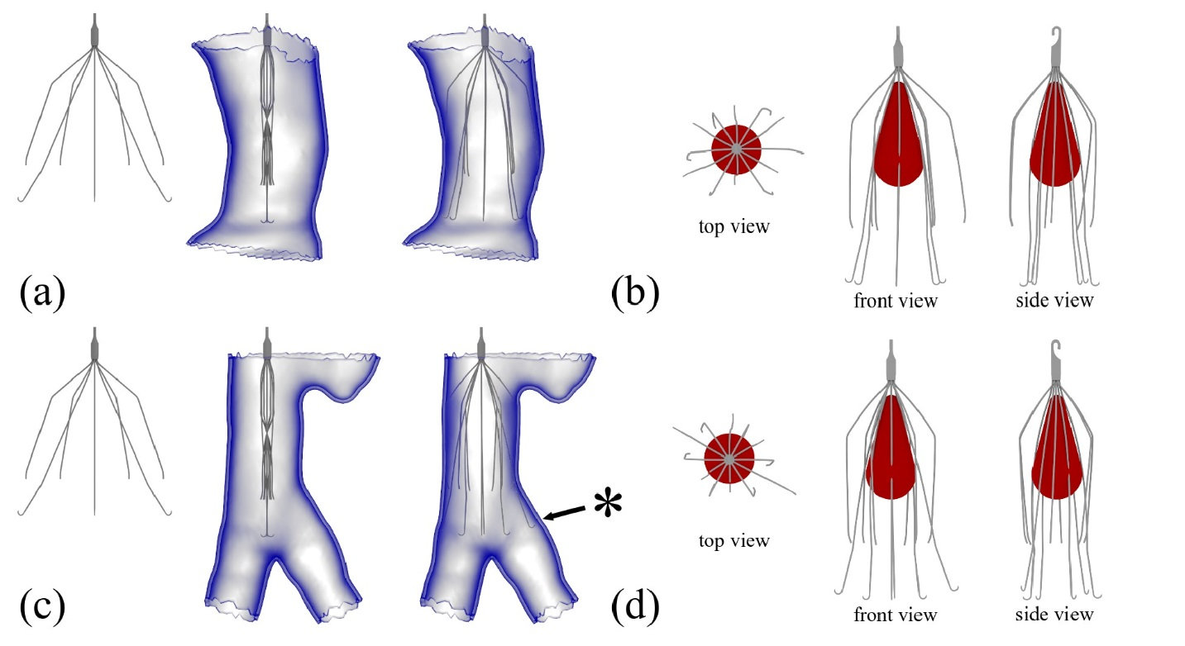
Sample Simulation – Geometric Models

Slide 18
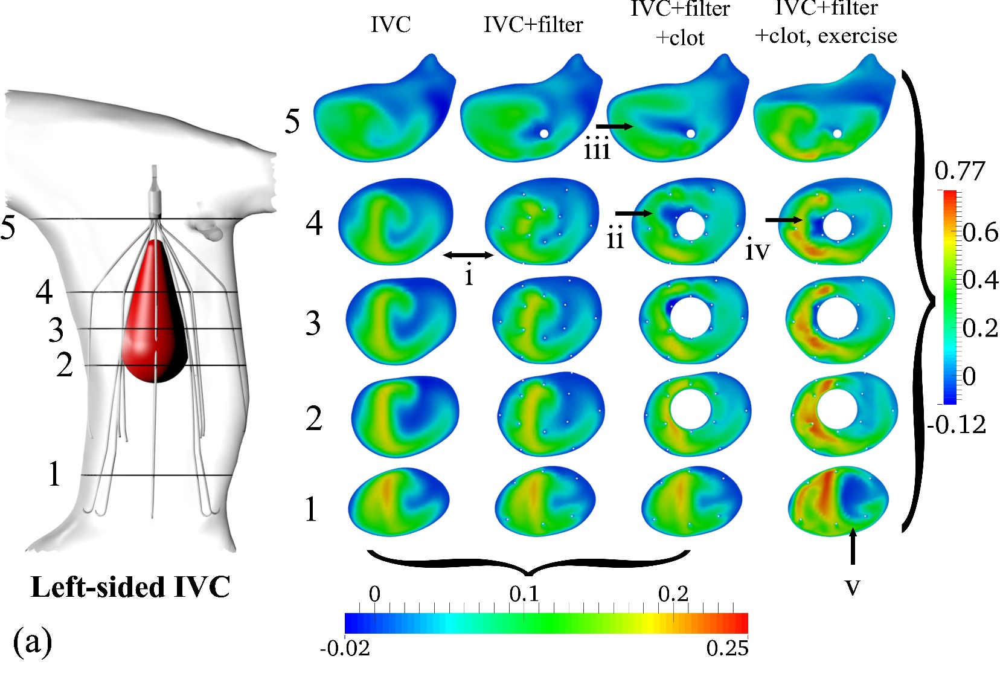
Sample Simulation – Blood Flow Results

Slide 19
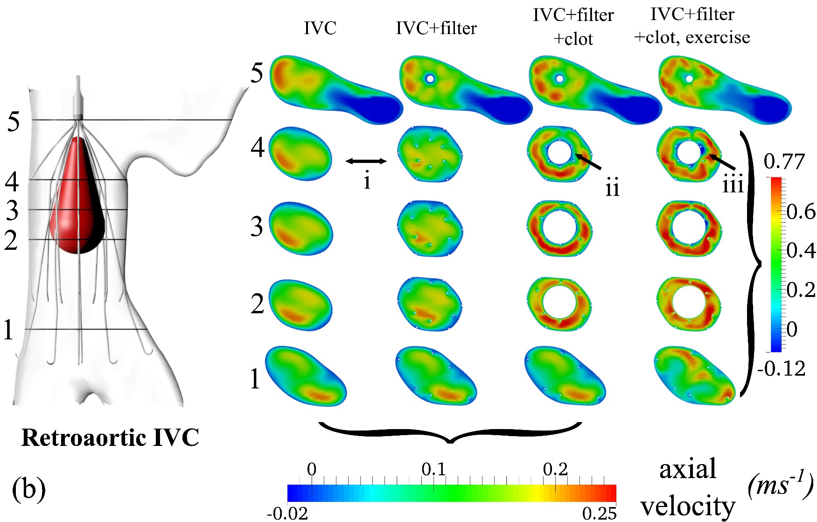
Sample Simulation – Blood Flow Results

Slide 20
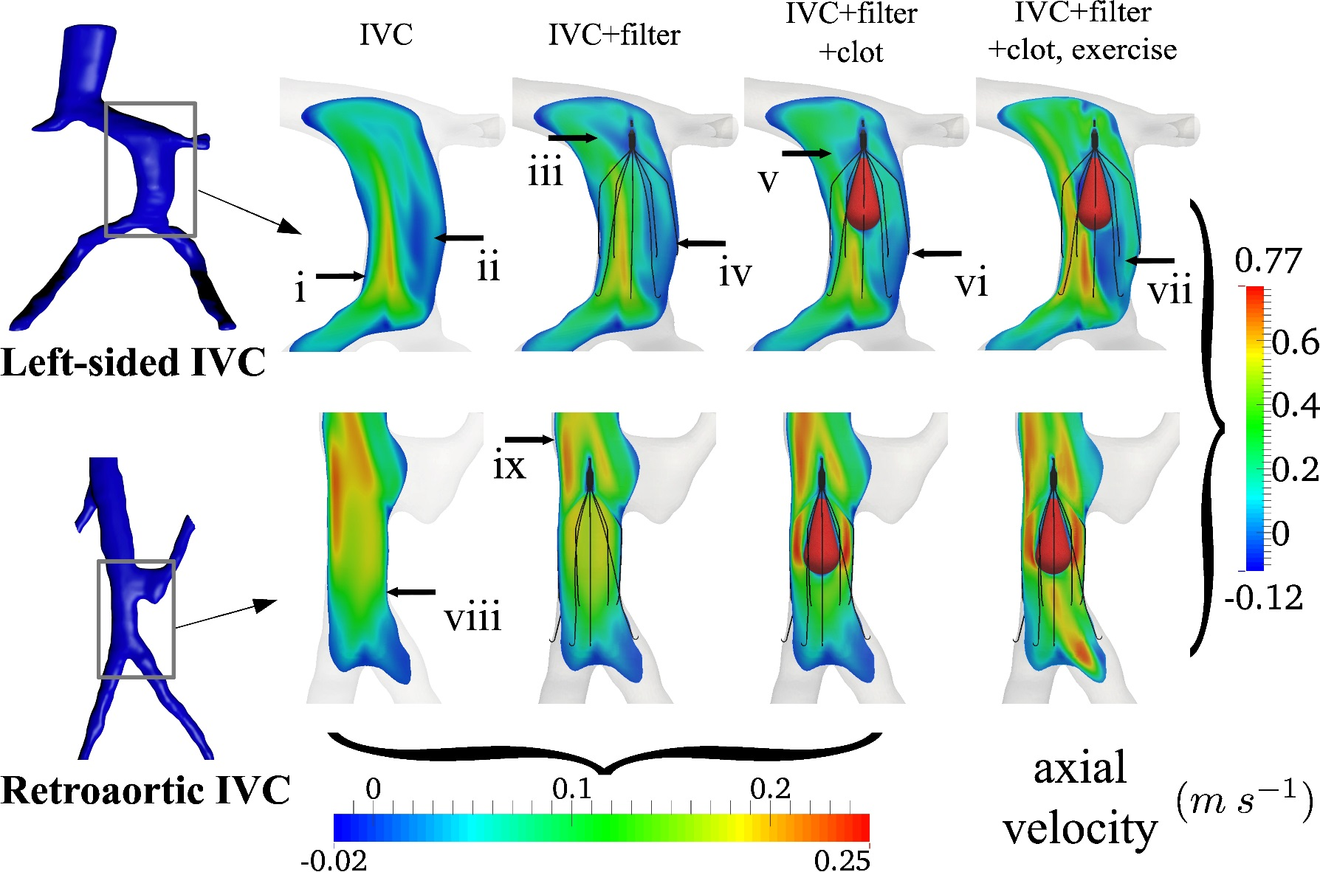
Sample Simulation – Blood Flow Results

Slide 21
Computational Tool:
Mesh Generation

Slide 22
Geometric Modeling via
Mesh Generation
Geometric models must be created for the IVC filter blood flow simulation.
The models are created by the generation of meshes on the 3D objects.

Slide 23
What is a Mesh?
To simulate blood flow the vein with the IVC filter present, for example, the vein and filter must be represented by a geometric model.
This model is represented as a mesh.
A mesh is a collection of vertices and elements with certain properties.

Slide 24
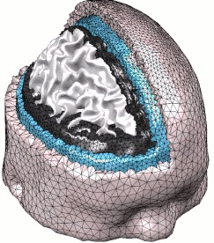
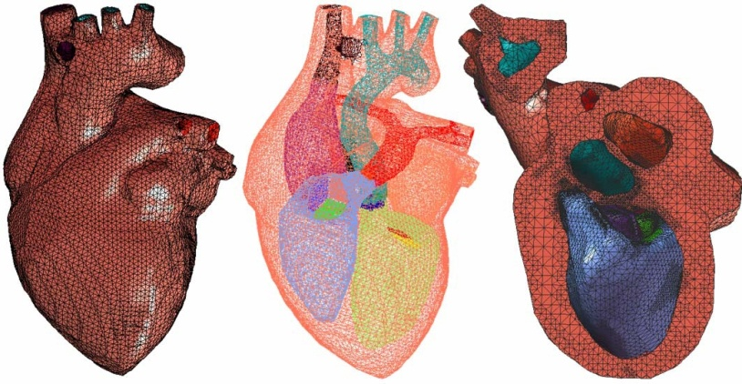
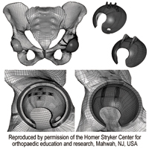
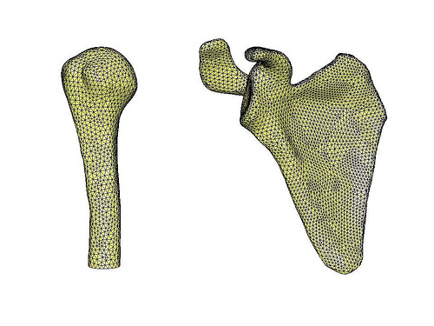
Examples of Meshes

Slide 25
How are Meshes Generated?
Computer software is used to generate meshes.
We will see one way in which meshes are generated, i.e., using the advancing front algorithm.

Slide 26
Slides from Steven Owen, 16th IMR Short Course
Advancing Front
C
A
B
Begin with boundary mesh - define as initial front
For each edge (face) on front, locate ideal node C based on front AB

Slide 27
Advancing Front
C
D
r
A
B
Determine if any other nodes on current front are within search radius r of ideal location C (Choose D instead of C)

Slide 28
Advancing Front
D
Book-Keeping: New front edges added and deleted from front as triangles are formed
Continue until no front edges remain on front

Slide 29
Advancing Front
Book-Keeping: New front edges added and deleted from front as triangles are formed
Continue until no front edges remain on front

Slide 30
Advancing Front
Book-Keeping: New front edges added and deleted from front as triangles are formed
Continue until no front edges remain on front

Slide 31
Advancing Front
Book-Keeping: New front edges added and deleted from front as triangles are formed
Continue until no front edges remain on front

Slide 32
Advancing Front
r
C
A
B
Where multiple choices are available, use best quality (closest shape to equilateral)
Reject any that would intersect existing front
Reject any inverted triangles (|AB X AC| > 0)
(Lohner,88;96)(Lo,91)

Slide 33
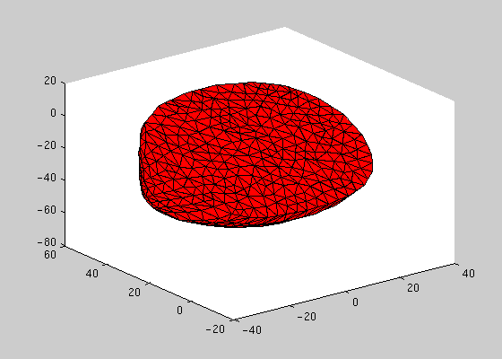
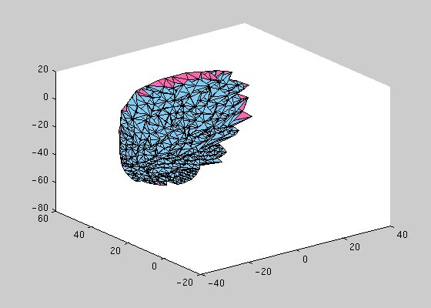
Beating Heart Simulation:
Dynamic Meshes
Canine ventricles (surface mesh)
Canine ventricles (volume mesh)
Joint work with Stephen Vavasis, University of Waterloo

Slide 34
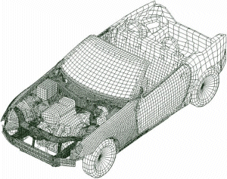
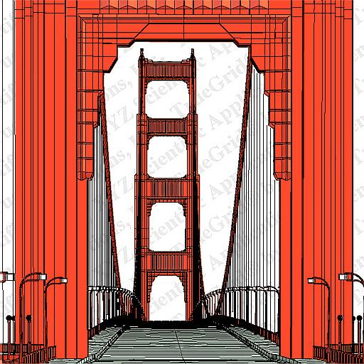
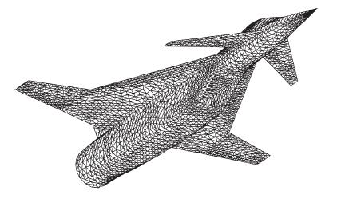
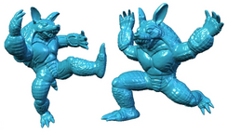
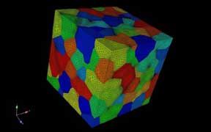
Some Non-Biomedical
Meshing Applications

Slide 35
Summary
There are many opportunities for computational scientists to aid doctors.
Mesh generation is an important tool for computational biomedical science.
Its use extends far beyond computational biomedical science to other areas of engineering and science.

Slide 36




IVC Filter Project Participants
Current/Recent Project Participants:
Suzanne Shontz (MSU Math/CSE/CCS/CME)
Shankar Prasad Sastry (PSU)
Jibum Kim (PSU)
Thap Panitanarak (PSU)
Brent Craven (PSU ARL)
Kenneth Aycock (PSU)
Rob Campbell (PSU ARL)
Keefe Manning (PSU BME/Surgery)
Experimental research students
Frank Lynch, M.D. (PSU HMC)

