Slide 1
A Parallel Linear Solver for Block Circulant Linear Systems with Applications to Acoustics
Suzanne Shontz, University of Kansas
Ken Czuprynski, University of Iowa
John Fahnline, Penn State
EECS 739: Scientific Parallel Computing
University of Kansas
January 21, 2016

Slide 2
MOTIVATION

Slide 3
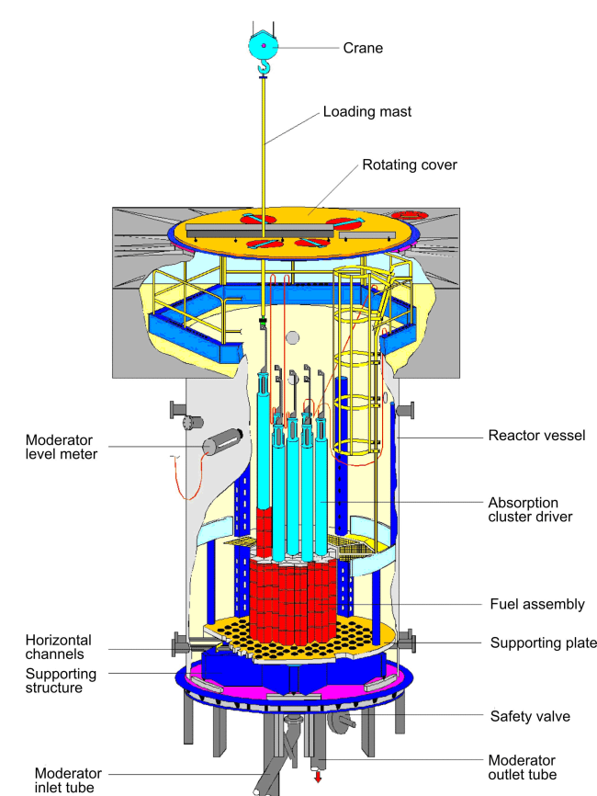
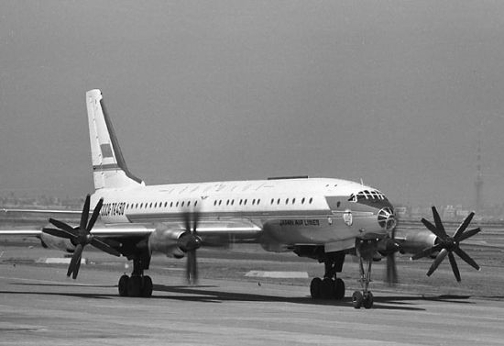
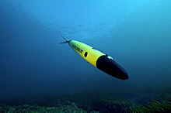
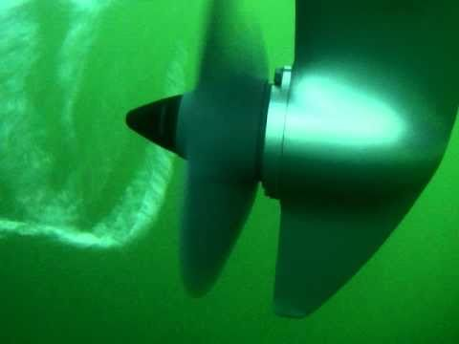
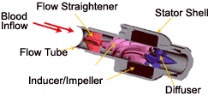
Application: Vibrating Structures Immersed in Fluids
Examples: Ships, UAVs, planes, blood pumps, reactors

Slide 4
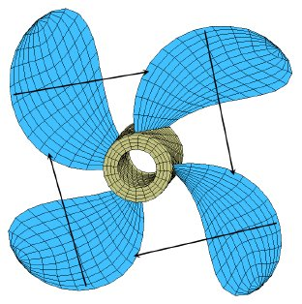
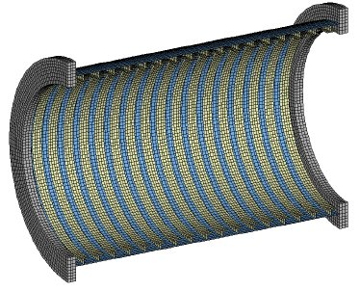
Examples of Rotationally Symmetric Boundary Surfaces
Real-world applications: propellers, wind turbines, etcetera

Slide 5
THE PROBLEM

Slide 6
The Problem
Goal: To compute the acoustic radiation for a vibrating structure immersed in a fluid.
Our focus: Structures with rotationally symmetric boundary surfaces
Image credit: Michael Lenz

Slide 7
Parallel Linear Solver for Acoustic Problems with
Rotationally Symmetric Boundary Surfaces
Context: Vibrating structure immersed in fluid. Acoustic analysis using boundary element method. Coupled to a finite element method for the structural analysis. We focus on the boundary element part of the calculation.
Goal: Solve block circulant linear systems to compute acoustic radiation of vibrating structure with rotationally symmetric boundary surface.
Approach: Parallel linear solver for distributed memory machines based on known inversion formula for block circulant matrices.

Slide 8
THE BOUNDARY ELEMENT METHOD (BEM)

Slide 9
Boundary Element Method
The boundary element method (BEM) is a numerical method for solving linear partial differential equations (PDEs).
In particular, the BEM is a solution method for solving boundary value problems (BVPs) formulated using a boundary integral formulation.
Discretization: Only of the surface (not of the volume). Reduces dimension of problem by one.
BEM: Used on exterior domain problems and when greater accuracy is required.
We employ the boundary element method to obtain the linear system of equations.

Slide 10
Comparison of the BEM with the Finite Element Method
Advantages of the BEM | Disadvantages of the BEM
Less data preparation time (due to surface only modeling) | Unfamiliar mathematics
High resolution of PDE solution (e.g., stress) | The interior must be modeled for nonlinear problems (but can often be restricted to a region of the domain)
Less computer time and storage (fewer nodes and elements) | Fully populated and unsymmetric solution matrix (as opposed to being sparse and symmetric)
Less unwanted information (most “interesting behavior” happens on the surface) | Poor for thin structures (shell) 3D analyses (large surface/volume ratio causes inaccuracies in calculations)

Slide 11
BLOCK CIRCULANT MATRICES VIA THE BOUNDARY ELEMENT METHOD

Slide 12
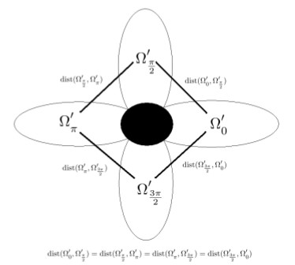
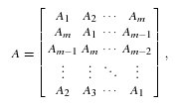
Discretization Using the BEM
rotationally
symmetric
boundary
surface
symmetry:
m = 4
block
circulant
matrix

Slide 13
Block Circulant Matrices
Properties of circulant matrices: Diagonalizable by Fourier matrix. Can use DFT and IDFT. Nice properties!
Related work (serial): algorithm derived from inversion formula
(Vescovo, 1997); derivation (Smyrlis and Karageorghis, 2006)
Related work (parallel): parallel block Toeplitz matrix solver (Alonso et al., 2005) (neglects potential concurrent calculations); parallel linear solver for axisymmetric case (Padiy and Neytcheva, 1997)

Slide 14
MATHEMATICAL FORMULATION OF LINEAR SYSTEM OF EQUATIONS

Slide 15
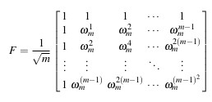
Notation: Fourier Matrix
The Fourier matrix is given by
where $ω$_{m} = $e^{i2π/m}$.
Note: The Fourier matrix is used in Fourier transforms.

Slide 16
Discrete Fourier Transform (DFT)
To compute the discrete Fourier transform (DFT) of a vector x, simply multiply F times x.
Example: m = 4
F*x = u

Slide 17
Inverse Discrete Fourier Transform (IDFT)
To compute the inverse of the discrete Fourier transform (IDFT) of a vector u, simply multiply
$\frac{1}{m}$ F* times u, where F* = Hermitian of F.
Continuing the example:
-
+
Divide by
m
+
-
F* times u = m*x

Slide 18
Fast Fourier Transform (FFT)
The Fourier transform of a vector (i.e., the DFT of a vector) of length 2m can be computed quickly by taking advantage of the following relationship between F_{m} and F_{2m}:
$F_{2m}= \left(\begin{matrix}I & D \\ I & −D\end{matrix}\right)\left(\begin{matrix}F_{m} & 0 \\ 0 & F_{m}\end{matrix}\right)$P,
where D is a diagonal matrix and P is a 2m by 2m permutation matrix.
Fast Fourier Transform (FFT): Requires two size m Fourier transforms plus two very simple matrix multiplications!

Slide 19
Key Equations
Let F = Fourier matrix, and let F_{b} denote the Kronecker product of F with I_{n}.
Then, the block DFT is given by:
To solve:
where

Slide 20
SERIAL ALGORITHM

Slide 21
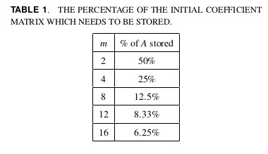
Block Circulant Matrix: Storage

Slide 22
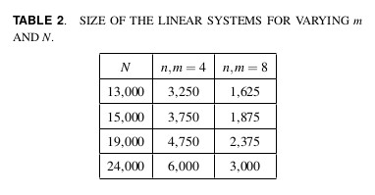
Block Circulant Matrix: Size of Linear Systems
Note: Solving a dense linear system is cubic in the size of the matrix.

Slide 23
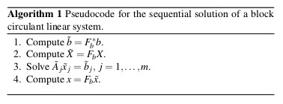
Sequential Algorithm
IDFT
DFT
Solution of m independent
linear systems
DFT

Slide 24
PARALLEL ALGORITHM

Slide 25
How to Parallelize the Algorithm?
Ideas?
Recall, we are interested in solving
where
m independent
linear systems
to solve!

Slide 26
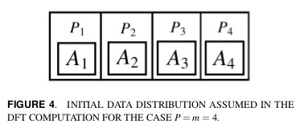
Block DFT Algorithm
A block DFT calculation is the basis for our parallel algorithm.
This demonstrates improved robustness (over use of the FFT) and allows for any boundary surface to be input.

Slide 27
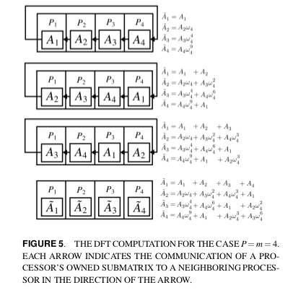
DFT Computation
This generalizes to the case when P > m.

Slide 28
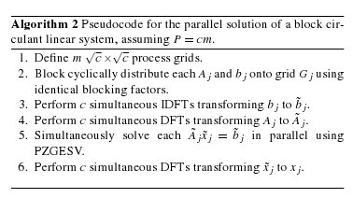
Parallel Algorithm
Asynchronous sends and receives.
Solve using SCALAPACK. Complexity: Cubic in n
The tradeoff of using overlapped communication and computation
is additional memory.

Slide 29
NUMERICAL EXPERIMENTS

Slide 30
Computer Architecture for Experiments
Cyberstar compute cluster at Penn State:
Run on two Intel Xeon X5550 quad-core processors
HyperThreading = disabled
Total: 8 physical cores running at 2.66 GHz
24 GB of RAM per node
Code:
Fortran 90 with MPI
ScaLAPACK library
Blocking and Communication:
Blocking factor of 50 for block cyclic distribution of A_{j} and b_{j} onto their respective processor grids.
DFT algorithm communications: blocks of size 4000
Asynchronous sends/receives

Slide 31
Metrics for Experiments
Runtime = wall clock time of parallel algorithm
= T_{p}
Speedup = how much faster is the parallel algorithm than the serial algorithm = S = T_{s}/T_{p}
Efficiency = E = S/P

Slide 32
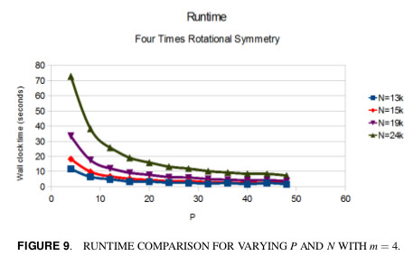
Experimental Results – 4 Processors
The runtime decreases as the number of processors increase
and as the problem size decreases.

Slide 33
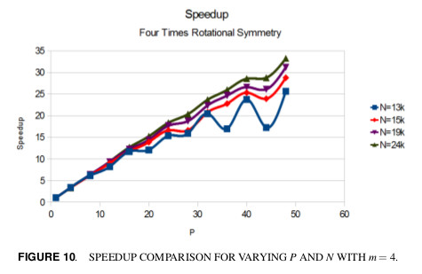
Oscillations are due to small variance in small runtime numbers.
They are smoothed out with increasing N.

Slide 34
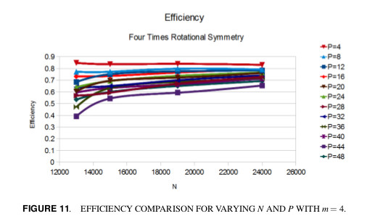
The efficiency increases for a decreased number of processors. It also increases with an increase in problem size.

Slide 35
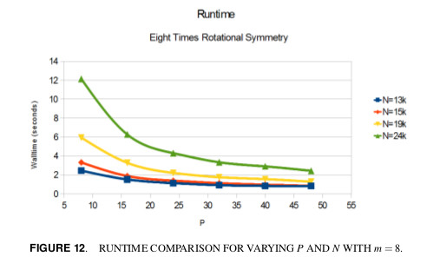
Experimental Results – 8 Processors
The runtime trend is the same as it is for m = 4.

Slide 36
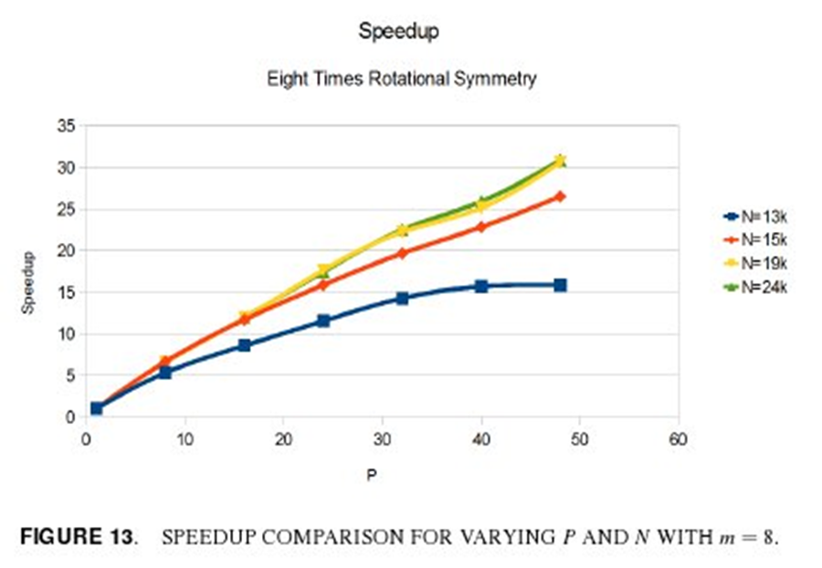
Experimental Results – 8 Processors
For small problems, the speedup levels off due to the ratio of computation versus communication in the linear system solve.
For larger problems, the speedup is nearly linear.

Slide 37
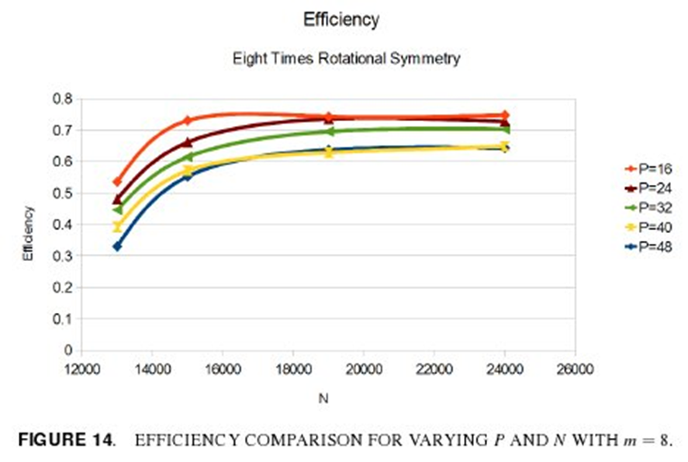
Experimental Results – 8 Processors
The efficiency is fairly good but not quite as high as it is for m = 4.
Based on increase in communications due to DFT algorithm and
size of linear system solve. Expect efficiency to remain high for
increased problem size.

Slide 38
CONCLUSIONS

Slide 39
Conclusions
We have proposed a parallel algorithm for solution of block circulant linear systems. Arise from acoustic radiation problems with rotationally symmetric boundary surfaces.
Based on block DFTs (more robust) and have embarrassingly parallel nature based on ScaLAPACK’s required data distributions.
Reduced memory requirement by exploiting block circulant structure.
Achieved near linear speedup for varying problem size, linear speedup for large N. Efficiency increases with problem size.
Can solve larger/higher frequency acoustic radiation problems.

Slide 40
Reference
K.D. Czuprynski*, J. Fahnline, and S.M. Shontz, Parallel boundary element solutions of block circulant linear systems for acoustic radiation problems with rotationally symmetric boundary surfaces, Proc. of the Internoise 2012/ASME NCAD Meeting, August 2012.

Slide 41
Acknowledgements
This work is based on the M.S. Thesis of Ken Czuprynski in addition to our Internoise 2012 paper.
Computing Infrastructure:
NSF grant OCI-0821527
Research Funding:
Penn State Applied research Laboratory’s Walker Assistantship Program (Czuprynski)
NSF Grant CNS-0720749 (Shontz)
NSF CAREER Award OCI-1054459 (Shontz)

