Slide 1
EECS 700: Computer Modeling, Simulation, and Visualization Dr. Shontz Chapter 3: Drawing with OpenGL

Slide 2
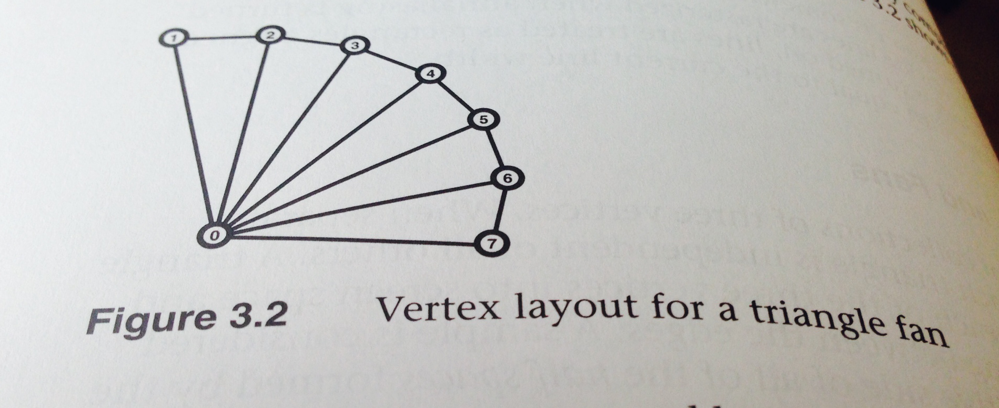
OpenGL Graphics Primitives
Points – use glPointSize().
Point Sprites –ignore these for now, as they are used with fragment/texture shaders
Lines, Strips, and Loops – use glLineWidth(). A closed sequence of lines is a line loop, whereas an open sequence of lines is a line strip.
Triangles, Strips, and Fans –

Slide 3
OpenGL Primitive Mode Tokens
Primitive Type | OpenGL Token
Points | GL_POINTS
Lines | GL_LINES
Line Strips | GL_LINE_STRIP
Line Loops | GL_LINE_LOOP
Independent Triangles | GL_TRIANGLES
Triangle Strips | GL_TRIANGLE_STRIP
Triangle Fans | GL_TRIANGLE_FAN

Slide 4
Rendering Polygons as Points, Outlines, or Solids
A polygon has two sides – front and back. By default, they are drawn filled.
To change how they are drawn, or to draw only outlines or vertices, use glPolygonMode(face,mode):
face = GL_FRONT_AND_BACK
mode = GL_POINT, GL_LINE, or GL_FILL (how polygon is drawn).
Convention: Polygons whose vertices appear in counterclockwise order are called front facing.
Call glFrontFace(mode) to swap front and back faces. Mode: GL_CCW (default) or GL_CW

Slide 5
Rendering Polygons as Points, Outlines, or Solids (cont.)
To avoid drawing certain polygons: use culling.
Example:
glEnable(GL_CULL_FACE);
glCullFace(mode), where mode = GL_FRONT, GL_BACK, or GL_FRONT_AND_BACK.
To disable culling:
glDisable(GL_CULL_FACE).

Slide 6
Data in OpenGL Buffers
Creating and allocating buffers: glGenBuffers(n, buffers). Yields array of buffer object names.
Next step: bind name to buffer binding target from table below.
Buffer Binding Target | Uses
GL_ARRAY_BUFFER | Binding point used to set vertex array data pointers using glVertexAttribPointer(). Will use most often.
GL_COPY_READ_BUFFER and GL_COPY_WRITE_BUFFER | Pair of binding points used to copy data between buffers without disturbing OpenGL state.
GL_DRAW_INDIRECT_BUFFER | Buffer target used to store parameters for indirect drawing commands
GL_ELEMENT_ARRAY_BUFFER | Buffers bound to this target contain vertex indices used by index draw commands
GL_PIXEL_BACK_BUFFER | Target for OpenGL commands that read data from image objects such as textures or framebuffer.

Slide 7
Data in OpenGL Buffers (cont.)
Binding Buffer Targets (continued) | Uses
GL_PIXEL_UNPACK_BUFFER | The opposite of the pixel pack buffer.
GL_TEXTURE_BUFFER | Buffers that are bound to texture objects so their data can be directly read inside shaders.
GL_TRANSFORM_FEEDBACK_BUFFER | Transformed vertices can be captured as they exist the vertex processing part of the pipeline (after the vertex or geometry shader) and some of their attributes written into buffer objects.
GL_UNIFORM_BUFFER | Binding target for uniform buffer objects.
To bind name: glBindBuffer(target, buffer); This creates a buffer object if this is the first time the name buffer has been bound.

Slide 8
Getting Data into and out of Buffers
The easiest way to get data into a buffer object is to load data into the buffer when it is allocated: glBufferData(target, size, data, usage);
This allocates size bytes of storage for buffer object bound to target. If data is non-NULL,
that space is initialized with contents of the memory addressed by data. usage is provided
to allow the application to indicate the intended usage.
Note: The buffer will resize itself based on the new data being stored (if called several times).
usage = GL_STATIC_DRAW, GL_DYNAMIC_COPY, etc. First part of token = STATIC, DYNAMIC, or STREAM. Second part of token = DRAW, READ, or COPY.
See Table 3.3 for more info on tokens. Pay particular attention to DYNAMIC vs. STREAM.
Use DRAW with vertex data, READ with pixel buffer objects and other buffers used to retrieve information from OpenGL. Use COPY with transform feedback buffers.

Slide 9
Initializing Part of a Buffer
Use glBufferSubData(target, offset, size, data), to initialize part of a buffer.
Can use a combination of glBufferData() and glBufferSubData() to allocate and initialize a buffer object and upload data into separate sections of it.
Example 3.1:
// Vertex positions
Static const GLfloat positions[] =
{
-1.0f, -1.0f, 0.0f, 1.0f,
1.0f, -1.0f, 0.0f, 1.0f,
1.0f, 1.0f, 0.0f, 1.0f,
-1.0f, 1.0f, 0.0f, 1.0f
};

Slide 10
Example 3.1 (continued)
// Vertex colors
static const GLfloat colors[] =
{
1.0f, 0.0f, 0.0f,
0.0f, 1.0f, 0.0f,
1.0f, 1.0f, 1.0f,
};
// Buffer object
GLuint buffer;
// Reserve a name for the buffer object.
glGenBuffers(1, &buffer);

Slide 11
Example 3.1 (continued)
// Bind it to the GL_ARRAY_BUFFER target.
glBindBuffer(GL_ARRAY_BUFFER, buffer);
// Allocate space for it (sizeof(positions) + sizeof(colors)).
glBufferData(GL_ARRAY_BUFFER,sizeof(positions) + sizeof(colors), NULL, GL_STATIC_DRAW);
// Put “positions” at offset zero in the buffer.
glBufferSubData(GL_ARRAY_BUFFER, 0, sizeof(positions), positions);
// Put “colors” at an offset in the buffer equal to the filled size of the buffer so far.
glBufferSubData(GL_ARRAY_BUFFER, sizeof(positions), sizeof(colors), colors);

Slide 12
Initializing Part of a Buffer (continued)
Use glClearBufferData() or glClearBufferSubData() to clear the buffer.
glClearBufferData(target, internalformat, format, type, data);
glClearBufferSubData(target, internalformat, offset, size, format, type, data);
Note: The data is first converted into the format specified by internalformat.
Then the data is used to fil the specified range of the buffer’s data store. In other words, you can initialize the data store of a buffer object this way.
Data can also be copied between buffer objects using glCopyBufferSubData().
glCopyBufferSubData(readtarget, writetarget, readoffset, writeoffset, size);

Slide 13
Accessing Contents of the Buffer
All of the functions covered in this section so far, i.e., glBufferData(), glBufferSubData(), and glGetBufferSubData() all cause OpenGL to make
a copy of your data.
Use glMapBuffer(target, access) to obtain access to memory owned by OpenGL.
Maps to the client’s address space the entire data store of the buffer object currently bound to target. Data can then be directly read/written relative to the returned pointer, depending on the access policy.
Access modes for glMapBuffer(): GL_READ_ONLY, GL_WRITE_ONLY, GL_READ_WRITE.
When finished: glUnmapBuffer(target);

Slide 14
Example 3.2: Initializing a Buffer with glMapBuffer()
GLuint buffer;
FILE * f;
size_t filesize;
// Open a file and find its size.
f = fopen(“data.dat”, “rb”);
fseek(f, 0, SEEK_END);
filesize = ftell(f);
fseek(f, 0, SEEK_SET);
// Create a buffer by generating a name and binding it to a buffer binding point. Note the
// binding means nothing in this example.
glGenBuffers(1, &buffer);
glBindBuffer(GL_COPY_WRITE_BUFFER, buffer);

Slide 15
Example 3.2 (continued)
// Allocate the data store for the buffer by passing NULL for the data parameter.
glBufferData(GL_COPY_WRITE_BUFFER, (GLsizei) filesize, NULL, GL_STATIC_DRAW);
// Map the buffer
void * data = glMapBuffer(GL_COPY_WRITE_BUFFER, GL_WRITE_ONLY);
// Read the file into the buffer
fread(data, 1, filesize, f);
// Unmap buffer since we’re done.
glUnmapBuffer(GL_COPY_WRITE_BUFFER);
// Close the file
fclose(f);

Slide 16
Asynchronous and Explicit Mapping
Use glMapBufferRange() to specify access more precisely:
glMapBufferRange(target, offset, length, access);
This maps all or part of a buffer object’s data store into the application’s address space.
Here access is a bitfield that must contain one or both of the GL_MAP_READ_BIT and the GL_MAP_WRITE_BIT and one or more of the following flags:
- GL_MAP_INVALIDATE_RANGE_BIT (data in specified range of the buffer may be discarded and considered invalid), GL_MAP_INVALIDATE_BUFFER_BIT (entire contents of buffer may be discarded and considered invalid), GL_MAP_FLUSH_EXPLICIT_BIT (determine which parts of the mapped range contain valid data; use wit GL_MAP_WRITE_BIT), GL_MAP_UNSYNCHRONIZED_BIT (if this bit is set, OpenGL will not attempt to synchronize buffer operations). See Table 3.5 for more information.

Slide 17
Asynchronous and Explicit Mapping
Flush a portion of the buffer:
glFlushMappedBufferRange(target, offset, length);
Indicates to OpenGL the range specified by offset and length in the mapped buffer bound to target has been modified and should be incorporated back into the buffer object’s data store.

Slide 18
Vertex Specification
At this point, we know how to put data in buffers and how to write a basic vertex shader.
Next up: Hooking the data up to the vertex shader.
VertexAttribPointer in Depth:
Recall glVertexAttribPointer(index, size, type, normalized, stride, pointer) specified where the data values for the vertex attribute with location index can be accessed.
Values of type for glVertexAttribPointer: GL_BYTE, GL_UNSIGNED_BYTE, GL_SHORT,…, GL_DOUBLE, etc. See Table 3.6 for more details.

Slide 19
Vertex Specification (continued)
Integer Vertex Attributes: Use glVertexAttribIPointer(index, size, type, stride, pointer).
Note the parameters are the same as they are for glVertexAttribPointer() with the exception of the omission of the normalize parameter which is not relevant here.
GL_BYTE, GL_SHORT, and etc. may be used for the type parameter.
Double-Precision Vertex Attributes: Use glVertexAttribLPointer(index, size, type, stride, pointer). Note that here “L” stands for long. The vertex attributes must be declared as 64-bit double precision floating-point types in the vertex shader.
Packed Data Formats for Vertex Attributes: BGRA-packing: W, X, Y, and Z.
RGBA-packing: W, Z, Y, and X.
Vertex data can only be specified in the W, X, Y, and Z format by using GL_INT_2_10_10_10_REV or GL_UNSIGNED_INT_3_20_20_20_REV tokens.

Slide 20
Vertex Specification (continued)
Enabling of vertex attribute arrays: Use glEnableVertexAttribArray() to enable vertex attribute arrays. If you forget to enable a vertex attribute array, the static vertex attribute will be used.
Static vertex attributes:
glVertexAttrib{1234}{fds}(index, values); // The static value is specified with index.
glVertexAttrib{1234}{fds}v(index, values); // Can specify up to four values for x, y, z, // and w parameters.
glVertexAttrib4{bsifd ub us ui}v(index, values);
All of these functions implicitly convert supplied parameters to floating-point before passing them to the vertex shader.

Slide 21
Vertex Specification (continued)
Related commands:
glVertexAttrib4Nub(index, x, y, z, w); // for use with single-precision glVertexAttrib4N{bsi ub us ui}v(index, v); // floating-point data
glVertexAttribI{1234}{I ui}(index, values); // for use with integer data
glVertexAttribI{123}{I ui}v(index, values);
glVertexAttribI4{bsi ub us ui}v(index, values);
glVertexAttribL{1234}(index, values); // for use with double-precision data
glVertexAttribL{1234}v(index, values);
Use 1.0 as default for w, 0.0 as default for y and z.

Slide 22
OpenGL Drawing Commands
Two categories of drawing commands: indexed and nonindexed draws.
Nonindexed draws: simply read vertex data sequentially.
Indexed draws: use array of indices stored in buffer object bound to the GL_ELEMENT_ARRAY_BUFFER binding used to indirectly index into the
enabled vertex arrays
Simplest nonindexed drawing: glDrawArrays(mode, first, count). Constructs a sequence of geometric primitives using array elements starting at first and ending at first + count – 1 of each enabled array. mode = GL_TRIANGLES, GL_LINE_LOOP, GL_LINES, or GL_POINTS.
Most basic indexed drawing: glDrawElements(mode, count, type, indices). Defines sequence of geometric primitives using count elements whose indices are stored in the buffer bound to GL_ELEMENT_ARRAY_BUFFER buffer binding point. mode = GL_TRIANGLES, GL_LINE_LOOP, GL_LINES, and GL_POINTS.

Slide 23
OpenGL Drawing Commands (continued)
glDrawElementsBaseVertex(mode, count, type, indices, basevertex) behaves identically to glDrawElements() except that the i^{th} element transferred by the corresponding draw command will be taken from element indices[i]+basevertex of each enabled attribute array.
Typical use: Animations.
glDrawRangeElements(mode, start, end, count, type, indices) is a restricted form of glDrawElements(). Guarantees that any index contained in the section of the element array buffer referenced by indices and count will fall within the range specified by start and end.
glDrawRangeElementsBaseVertex(mode, start, end, count, type, indices, basevertex). Values stored in the element array buffer will fall between start and end before basevertex is added.

Slide 24
OpenGL Drawing Commands (continued)
OpenGL drawing commands that do not start with draw:
1. glMultiDrawArrays(mode, first, count, primcount) – Draws multiple sets of geometric primitives with a single OpenGL function call. first and count are arrays of primcount parameters that would be valid for a call to glDrawArrays().
Equivalent code:
for (i = 0; i < primcount; i++){
glDrawArrays(mode, first[i], count[i]);}
2. glMultiDrawElements(mode, count, type, indices, primcount) – Draws multiple sets of geometric primitives with a single OpenGL function call.
Equivalent code:
for (i = 0; i < primcount; i++){
glDrawElements(mode, count[i], type, indices[i]);}

Slide 25
OpenGL Drawing Commands (continued)
3. glMultiDrawElementsBaseVertex(mode, count, type, indices, primcount, baseVertex) – Draws multiple sets of geometric primitives with a single OpenGL function call.
Equivalent code:
for (i = 0; i < primcount; i++)
{
glDrawElements(mode, count[i], type, indices[i], baseVertex[i]);
}

Slide 26
Example 3.5: Setting up for the Drawing Command
static const GLfloat vertex_positions[] = // Four vertices
{
-1.0f, -1.0f, 0.0f, 1.0f,
1.0f, -1.0f, 0.0f, 1.0f,
-1.0f, 1.0f, 0.0f, 1.0f,
-1.0f, -1.0f, 0.0f, 1.0f,
};
static const GLfloat vertex_colors[] = // Color for each vertex.
{
1.0f, 1.0f, 1.0f, 1.0f,
1.0f, 1.0f, 0.0f, 1.0f,
1.0f, 0.0f, 1.0f, 1.0f,
0.0f, 1.0f, 1.0f, 1.0f
};

Slide 27
Example 3.5 (continued)
// Three indices (to draw one triangle at a time):
static const GLushort vertex_indices[] =
{
0, 1, 2
};
// Set-up element array buffer
glGenBuffers(1, ebo);
glBindBuffer(GL_ELEMENT_ARRAY_BUFFER, ebo[0]);
glBufferData(GL_ELEMENT_ARRAY_BUFFER, sizeof(vertex_indices), vertex_indices, GL_STATIC_DRAW);
// Set-up vertex attributes
glGenVertexArrays(1, vao);
glBindVertexArray(vao[0]);

Slide 28
Example 3.5 (continued)
// Set-up vertex attributes (continued)
glGenBuffers(1, vbo);
glBindBuffer(GL_ARRAY_BUFFER, vbo[0]);
glBufferData(GL_ARRAY_BUFFER, sizeof(vertex_positions) + sizeof(vertex_colors), NULL, GL_STATIC_DRAW);
glBufferSubData(GL_ARRAY_BUFFER, 0, sizeof(vertex_positions), vertex_positions);
glBufferSubData(GL_ARRAY_BUFFER, sizeof(vertex_positions), sizeof(vertex_colors), vertex_colors);

Slide 29
Example 3.6: Drawing Commands Example
// DrawArrays
model_matrix = vmath::translation(-3.0f, 0.0f, -5.0f);
glUniformMatrix4fv(render_model_matrix_loc, 4, GL_FALSE, model_matrix);
glDrawArrays(GL_TRIANGLES, 0, 3);
// DrawElements
model_matrix = vmath::translation(-1.0f, 0.0f, -5.0f);
glUniformMatrix4fv(render_model_matrix_loc, 4, GL_FALSE, model_matrix);
glDrawElements(GL_TRIANGLES, 3, GL_UNSIGNED_SHORT, NULL);
// DrawElementsBaseVertex
model_matrix = vmath::translation(1.0f, 0.0f, -5.0f);
glUniformMatrix4fv(render_model_matrix_loc, 4, GL_FALSE, model_matrix);
glDrawElementsBaseVertex(GL_TRIANGLES, 3, GL_UNSIGNED_SHORT, NULL, 1);
This renders 3 similar traingles each rendered using a different drawing command.

Slide 30
Restarting Primitives
glPrimitiveRestartIndex(index) – Specifies the vertex array element index used to indicate a new primitive should be started during rendering.
Only watches for index specified by glPrimitiveReseartIndex() if glEnable(GL_PRIMITIVE_RESTART) is enabled. Disable it with glDisable(GL_PRIMITIVE_RESTART).
Example 3.7: Initializing data for a cube made of two triangle strips
// 8 corners of a cube, side length 2, centered at the origin
static const GLfloat cube_positions[] =
{
-1.0f, -1.0f, -1.0f, 1.0f,
-1.0f, -1.0f, 1.0f, 1.0f,
…
1.0f, 1.0f, 1.0f, 1.0f
};

Slide 31
Example 3.7 (continued)
// Color for each vertex:
static const GLfloat cube_colors[] =
{
1.0f, 1.0f, 1.0f, 1.0f,
…
0.5f, 0.5f, 0.5f, 1.0f
};
// Indices for the triangle strips
static const GLushort cube_indices[] =
{
0, 1, 2, 3, 6, 7, 4, 5, // first strip
0xFFFF, // restart index
2, 6, 0, 4, 1, 5, 3, 7 // second strip
};

Slide 32
Example 3.7 (continued)
// Set up the element array buffer
glGenBuffers(1, ebo);
glBindBuffer(GL_ELEMENT_ARRAY_BUFFER, ebo[0]);
glBufferData(GL_ELEMENT_ARRAY_BUFFER, sizeof(cube_indices), cube_indices, GL_STATIC_DRAW);
// Set up the vertex attributes
glGenVertexArrays(1, vao);
glBindVertexArray(vao[0]);
glGenBuffers(1, vbo);
glBindBuffer(GL_ARRAY_BUFFER, vbo[0]);
glBufferData(GL_ARRAY_BUFFER, sizeof(cube_positions) + sizeof(cube_colors), NULL,
GL_STATIC_DRAW);
glBufferSubData(GL_ARRAY_BUFFER, 0, sizeof(cube_positions), cube_positions);

Slide 33
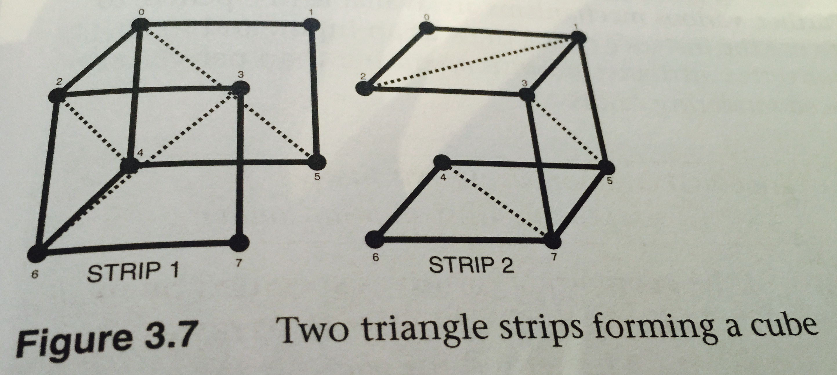
Example 3.7 (continued)
glBufferSubData(GL_ARRAY_BUFFER, sizeof(cube_positions), sizeof(cube_colors), cube_colors);
glVertexAttribPointer(0, 4, GL_FLOAT, GL_FALSE, 0, NULL);
glVertexAttribPointer(1, 4, GL_FLOAT, FL_FALSE, 0, (const Glvoid *) sizeof(cube_positions));
glEnableVertexAttribArray(0);
glEnableVertexAttribArray(1);

Slide 34
Example 3.8: Drawing a Cube Made from Two Triangle Strips Using Primitive Restart
// Set up needed for a glDrawElements call.
glBindVertexArray(vao[0]);
glBindBuffer(GL_ELEMENT_ARRAY_BUFFER, ebo[0]);
#if USE_PRIMITIVE_RESTART // When primitive restart is on, we can call one draw command
glEnable(GL_PRIMITIVE_RESTART);
glPrimitiveRestartIndex(0xFFFF);
glDrawElements(GL_TRIANGLE_STRIP, 17, GL_UNSIGNED_SHORT, NULL);
#else
// Without primitive restart, need to call two draw commands.
glDrawElements(GL_TRIANGLE_STRIP, 8, GL_UNSIGNED_SHORT, NULL);
glDrawElements(GL_TRIANGLE_STRIP, 8, GL_UNSIGNED_SHORT, (const GLvoid *) (9*sizeof(GLushort)));
#endif

