Slide 1
EECS 700: Computer Modeling, Simulation, and Visualization
Dr. Shontz
Chapter 2: Shader Fundamentals (continued)

Slide 2
Compiler Control – How Shaders are Compiled
#pragma optimize (on)
or
#pragma optimize (off)
Default: Optimization is enabled for shaders.
Can only be issued outside of function definition.

Slide 3
Global Shader-Compilation Option
Extension processing in shaders:
#extension extension_name : <directive>
where extension_name uses the same extension name returned by calling glGetString(GL_EXTENSIONS) or
#extension all : <directive>
affects the behavior of all extensions
Directives: require, enable, warn, disable (see Table 2.11)

Slide 4
Interface Blocks
Shader variables shared with application or between stages can be, and sometimes must be, organized into blocks of variables.
Examples:
Uniform variables: organize into uniform blocks
Input/output variables: organize into in/out blocks
Shader storage buffers: organize into buffer blocks
Uniform blocks:
uniform b { // uniform or in or out or buffer
vec4 v1; // list of variables
bool v2;
}; // access members as v1 and v2
uniform b { // uniform or in or out or buffer
vec4 v1; // list of variables
bool v2;
} name; // access members as name.v1 and name.v2

Slide 5
Specifying Uniform Blocks in Shaders
Declaring a uniform block:
uniform Matrices {
mat4 ModelView;
mat4 Projection;
mat4 Color;
};
Only transparent types can be within a uniform block. (Opaque types include samplers, images, and atomic counters.)
Uniform blocks must be declared at global scope.

Slide 6
Uniform Block Layout Control
Qualifiers are used to specify how to lay out the variables in a uniform block.
Layout qualifiers (see Table 2.12):
shared – share uniform block among multiple programs
packed – lay out uniform block to minimize memory use (typically disables sharing)
std140 – standard layout for uniform blocks or shader storage buffer blocks (see Appendix I)
std430 – standard layout for buffer blocks (see Appendix I)
row_major – store matrices in uniform block in row-major element ordering
column_major – store in column-major element ordering (default ordering)
Examples:
layout (shared, row_major) uniform;
layout (packed, column_major) uniform;

Slide 7
Accessing Uniform Blocks from Application
Find offsets of various uniform variables inside named uniform blocks in shaders by calling glGetUniformBlockIndex()
To initialize a buffer object to be associated with uniform block: bind a GL_UNIFORM_BUFFER target by calling glBindBuffer()
Determine how large to make buffer object to accommodate variables in named uniform block of shader by calling glGetActiveUniformBlockiv(). Request GL_UNIFORM_BLOCK_DATA_SIZE.
Associate buffer object with uniform block by calling glBindBufferRange() or glBindBufferBase()
Initialize or change values in block.
To explicitly control uniform block’s binding, call glUniformBlockBinding() before glLinkProgram().
If default layout used, call glGetUniformIndices() followed by glGetActiveUniformsiv(). The former will yield the index of a uniform variable. The latter will give the offset and size for that index.

Slide 8
Example 2.4: Initializing Uniform Variables in a Named Uniform Block
/* Vertex and fragment shaders that share a block of uniforms named Uniforms. */
const char* vShader = {
  “#version 330 core\n”
  “uniform Uniforms {“
  “ vec3 translation;”
  “ float scale;”
  “ vec4 rotation;”
  “ bool enabled;”
  “};”
  “in vec2 vPos;”
  “in vec3 vColor;”
  “out vec4 fColor;”

Slide 9
Example 2.4: Continued
  “void main()”
  “{“
  “ vec3 pos = vec3(vPos, 0.0);”
  “ float angle = radians(rotation[0]);”
  “ vec3 axis = normalize(rotation.yzw);”
  “ mat3 I = mat3(1.0);”
  “ mat3 S = mat3( 0, -axis.z, axis.y, “
  “ axis.z, 0, -axis.x, “
  “ -axis.y, axis.x, 0);”
  “ mat3 uuT = outerProduct(axis, axis);”
  “ mat3 rot = uuT + cos(angle)*(I-uuT) + sin(angle)*S;”
  “ pos *= scale;”
  “ pos *= rot;”
  “ fColor = vec4(scale, scale, scale, 1);”
  “ gl_Position= vec4(pos, 1);”
  “}”
  };

Slide 10
Example 2.4: Continued
  const char* fShader = {
  “#version 330 core\n”
  “uniform Uniforms {“
  “ vec3 translation;”
  “ float scale;”
  “ vec4 rotation;”
  “ bool enabled;”
  “};”
  “in vec4 fColor;”
  “out vec4 color;”
  “void main()”
  “{“
  “ color = fColor;”
  “}”
  };

Slide 11
Example 2.4: Continued
  /* Helper function to convert GLSL types to storage sizes */
  size_t
  TypeSize(Glenum type)
  {
  size_t size;
  #define CASE(Enum, Count, Type) \
  case Enum: size = Count*sizeof(Type); break
  switch(type) {
  CASE(GL_FLOAT, 1, GLfloat);
  …
  CASE(GL_INT_VEC2, 2, GLint);
  …
  CASE(GL_FLOAT_MAT4x3, 12, GLfloat);
  #undef CASE
  default:
  fprintf(stderr, “Unknown type: 0x%x\n”, type);
  exit(EXIT_FAILURE);
  break;
  }
  return size;
  }

Slide 12
Example 2.4: Continued
  void
  init()
  {
  GLuint program;
  glClearColor(1, 0, 0, 1);
  ShaderInfo shaders[] = {
  {GL_VERTEX_SHADER, vShader},
  {GL_FRAGMENT_SHADER, fShader},
  {GL_NONE, NULL}
  };
  program = LoadShaders(shaders);
  glUseProgram(program);
  /* Initialize uniform values in uniform block “Uniforms” */
  GLuint uboIndex;
  GLint uboSize;
  GLuint ubo;
  GLvoid *buffer;
  …

Slide 13
Example 2.4: Continued
  /* Find the uniform buffer index for “Uniforms”, and determine the block’s sizes */
  uboIndex = glGetUniformBlockIndex(program, “Uniforms”);
  glGetActiveUniformBlockiv(program, uboIndex, GL_UNIFORM_BLOCK_DATA_SIZE, &uboSize);
  buffer= malloc(uboSize);
  if (buffer == NULL) {
  fprintf(stderr, “Unable to allocate buffer\n”);
  exit(EXIT_FAILURE);
  }

Slide 14
Example 2.4: Continued
  else {
  enum {Translation, Scale, Rotation, Enabled, NumUniforms};
  /* Values to be stored in buffer object */
  GLfloat scale = 0.5;
  GLfloat translation[] = {0.1, 0.1, 0.0};
  GLfloat rotation[] = {90, 0.0, 0.0, 1.0};
  GLboolean enabled = GL_TRUE;
  /* Since we know the names of the uniforms in our block, make an
  ** array of those values */
  const char* names[NumUniforms] = {
  “translation”,
  “scale”,
  “rotation”,
  “enabled”
  };
  …

Slide 15
Example 2.4: Continued
  /* Query the necessary attributes to determine where in the buffer we
  ** should write the values */
  GLuint indices[NumUniforms];
  GLint size[NumUniforms];
  GLint offset[NumUniforms];
  GLint type[NumUniforms];
  glGetUniformIndices(program, NumUniforms, names, indices);
  glGetActiveUniformsiv(program, NumUniforms, indices,
  GL_UNIFORM_OFFFSET, offset);
  glGetActiveUniformsiv(program, NumUniforms, indices,
  GL_UNIFORM_SIZE, size);
  glGetActiveUniformsiv(program, NumUniforms, indices,
  GL_UNIFORM_TYPE, type);

Slide 16
Example 2.4: Continued
  /* Copy the uniform values into the buffer */
  memcpy(buffer + offset[Scale], &scale,
  size[Scale] * TypeSize(type[Scale]));
  memcpy(buffer + offset[Translation], &translation,
  size[Translation] * TypeSize(type[Translation]));
  memcpy(buffer + offset[Rotation], &rotation,
  size[Rotation] * TypeSize(type[Rotation]));
  memcpy(buffer + offset[Enabled], &enabled,
  size[Enabled] * TypeSize(type[Enabled]));
  /* Create the uniform buffer object, initialize its storage, and associate
  ** it with the shader program */
  glGenBuffers(1, &ubo);
  glBindBuffer(GL_UNIFORM_BUFFER, ubo);
  glBufferData(GL_UNIFORM_BUFFER, uboSize, buffer, GL_STATIC_RAW);
  glBindBufferBase(GL_UNIFORM_BUFFER, uboIndex, ubo);
  }
  …
  }

Slide 17
Buffer Blocks
GLSL buffer blocks operate similarly to uniform blocks.
Important differences:
Shaders can write to them and modify their contents as seen from other shader invocations or the application.
Size can be established just before rendering, rather than at compile or link time.
Example:
buffer BufferObject { // create a read-writeable buffer
int mode; // preamble members
vec4 points[]; // last member can be an unsized array
};
Memory qualifiers apply to buffer blocks.
Set-up shader storage buffer object similarly to how a uniform buffer was set-up. Now glBindBuffer() and glBufferData() take GL_SHADER_STORAGE_BUFFER as the target.

Slide 18
In/Out Blocks
Shader variables that output from one stage and input into the next stage can also be organized into interface blocks.
Example of vertex shader output:
out Lighting {
vec3 normal;
vec2 bumpCoord;
};
Example of fragment shader input:
in Lighting {
vec3 normal;
vec2 bumpCoord;
};

Slide 19
Compiling Shaders
The compiler and linker for GLSL shaders are part of the OpenGL API.
For each shader object:
1. Create a shader object.
2. Compile shader source into object.
3. Verify that shader compiled successfully.
To link multiple shader objects into a shader program:
1. Create shader program.
2. Attach appropriate shader objects to shader program.
3. Link shader program.
4. Verify shader link phase completed successfully.
5. Use shader for vertex or fragment processing.

Slide 20
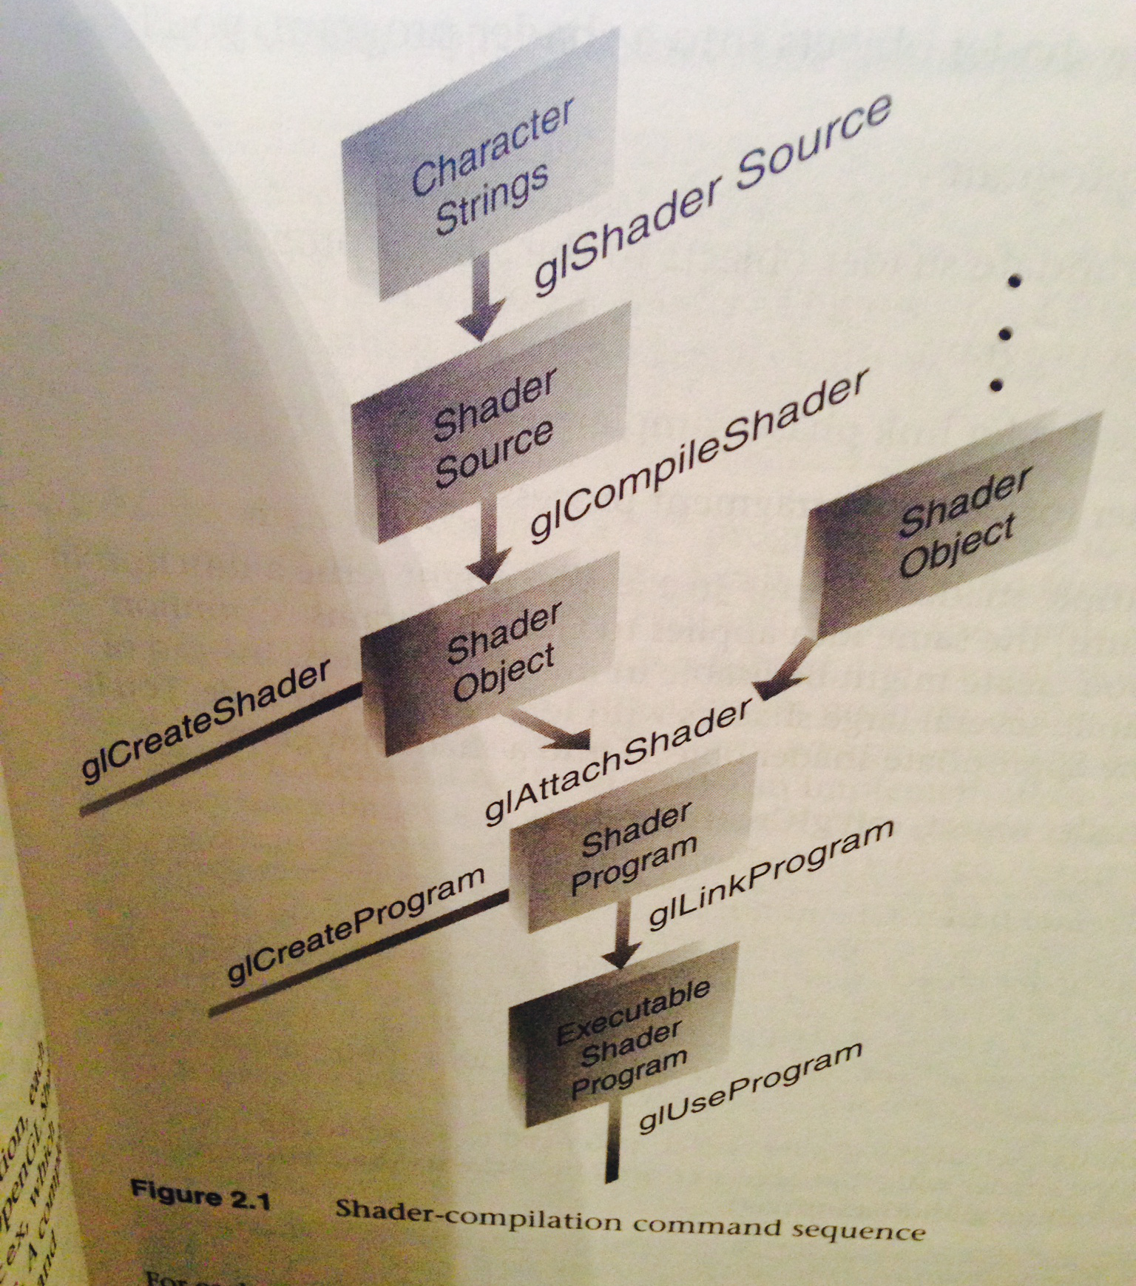
Shader-Compilation Command Sequence
2
3
5
1
6
4
7

